Slide 1

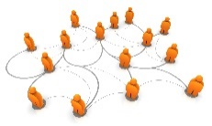
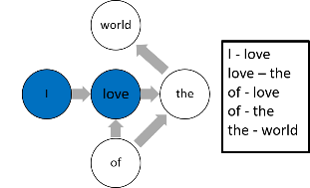
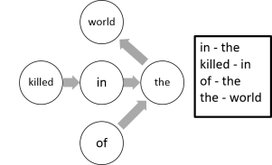
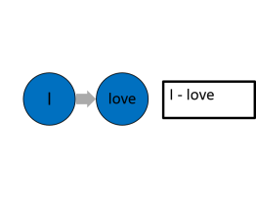
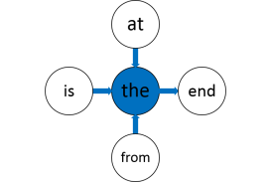
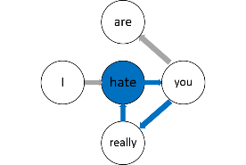

Tweets
News
Preprocessing
Tweets
emotion1
Tweets
emotion2
Tweets
Emotion n
Processed
tweets
Processed
news
Graph-Based
Connector and
Emotion Words
Extraction
…
Processed emotion sets
Graph Construction
…
News graph
Emotion 1
Vector Model
Emotion 2
Vector Model
Emotion n
Vector Model
Tweets graph
Graph Reduction
Models
Construction
Emotion graph
…
Node Centrality Analysis
Node Clustering
Analysis
Classifier
Connector words
Emotion words
List of patterns
Emotion Patterns Extraction

