Slide 1





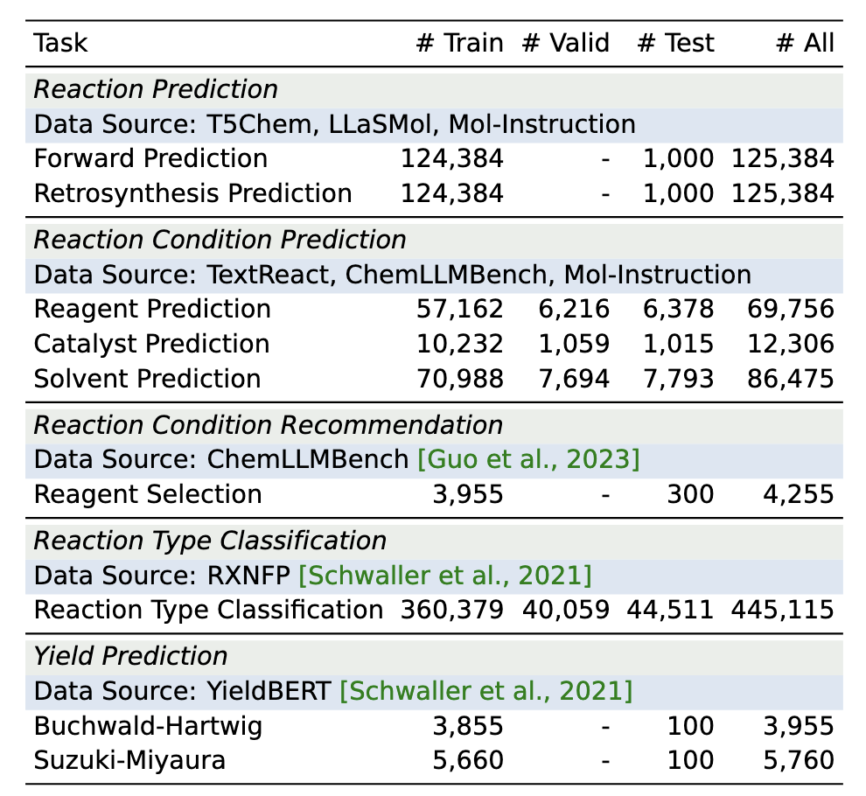
PRESTO: Progressive Pretraining Enhances Synthetic Chemistry Outcomes
He Cao♠, Yanjun Shao♠, Zhiyuan Liu, Zijing Liu, Xiangru Tang, Yuan Yao, Yu Li
♠ equal contribution
Motivation
Dataset for PRESTO Downstream Tasks
Experiments: Key Findings
Multimodal Large Language Models (MLLMs) in in biomolecular disciplines neglect multiple molecular graph interactions and lack clear downstream tasks to validate framework effectiveness.
The effectiveness of MLLMs is influenced by inconsistent pretraining strategies, underscoring the necessity for systematic evaluation to optimize performance in synthetic chemistry.
RESTO supports various synthetic chemistry tasks:
Reaction prediction
Forward reaction prediction
Retrosynthesis prediction
Reaction condition prediction
Reagent
Catalyst
Solvent
Reaction condition recommendation
Reaction type classification
Yield prediction
* Base v.s. Instruction-Tuned LLMs
* Pretrain Stage-2 Dataset Configuration
Progressive Pretraining Strategy: PRESTO
Bridges molecule-text modality gap
Enhances multi-graph understanding
Tailored for synthetic chemistry tasks
Addressing Data Leakage in Benchmarks
Base and instruction-tuned LLMs show similar capabilities
Interleaved data and name-conversion data is crucial for domain knowledge injection.
Issues: Data leakage in Mol-Instruction [Fang et al., 2023] benchmark
Overlapping (i.e., high scaffold similarities, avg ≈ 0.8) between train and test sets)
Consequences: Overestimated performance, limited generalizability
Our solution:
Non-overlapping, scaffold-based splits ⇝ more challenging test set
Unique test set reactions, molecular scaffold splitting (similarity threshold: 0.5-0.6)
Additional Findings
* Ablation on # Trainable Params
* SFT training dataset coverage and diversity
Stage1: Molecule-Text Alignment
Cultivates cross-modal alignment ability
Stage2: Domain Incremental Pretraining
Focuses on multi-graph understanding
Injects domain knowledge of synthetic chemistry
Interleaved text-molecule understanding
Molecule name/format conversion tasks
Experiments: Key Findings
* Scaling SFT Train Time
Updating LLMs is essential
full-finetune > PEFT to get better results on domain tasks
Balancing SFT training time optimizes downstream task performance
3-epoch is OK
Coverage and diversity of the SFT dataset are critical for better results
* Multi-stage Pretraining Strategy Ablations
* Molecular Token Granularity Ablations
Interleaved Dataset for Stage-2 Pretraining
Over 3 million detailed synthetic procedures from USPTO-Patent [Lowe, 2017]
Use BERN2 [Sung et al., 2022] to extract molecule entities
Molecule name conversions:
IUPAC [Favre and Powell, 2014] , chemical formulas [Hill,1900], and SMILES [Weininger, 1988]
Conclusions and Future Directions
PRESTO: A versatile framework for synthetic chemistry. Bridges modality gap and enhances LLM multi-graphs understanding. Potential to advance synthetic chemistry and drug discovery.
Future Work:
Expand to including 3D molecular representations.
Enhance dialogue capabilities. Develop larger domain-specific LLMs.
Progressive pretraining strategy enhances performance
Align modalities → Domain incremental pretrain → Downstream SFT
Molecular representation granularity matters

