Slide 1
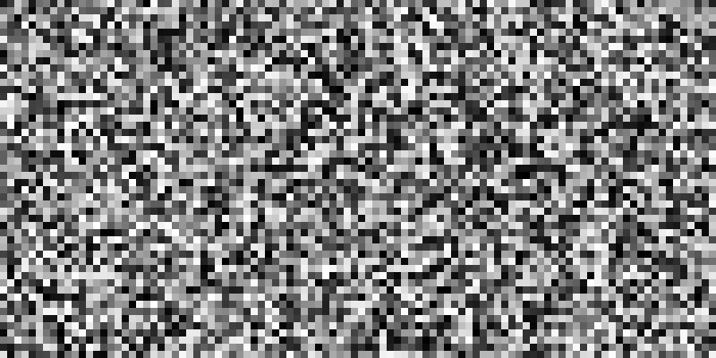
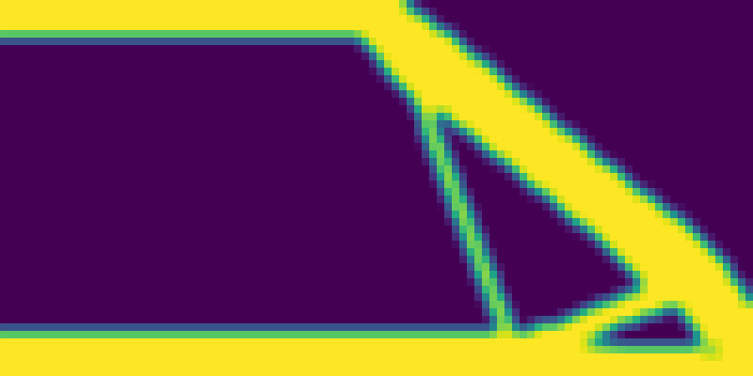
Generative AI for inverse design
GenAI
model
(black box)
random noise z (50x100)
+
conditions
vf=0.30 rmin=2.0 force@0.50
new beam design
(out-of-sample conditions)

