Slide 1
DCC 2026 PARIS · OPENING KEYNOTE
WORKSHOP OPENING
Benchmarking
Generative AI
for Engineering
Design.
Why shared, executable contracts are the missing infrastructure.
Matthew Keeler · Soheyl Massoudi · Mark Fuge
D-MAVT, ETH Zürich · EngiBench + EngiOpt
[HERO: Airbus A320 bionic partition OR EngiBench beams2d hero render]
Source: Autodesk + Airbus 2016 press image; OR engibench.docs/_static/img/problems/beams2d.png
Notes:
Open with the most striking visual you have — a real photo of a generatively-designed part that the audience can recognise as 'this is engineering, not a toy demo'. Don't read the title. Establish in one sentence: this workshop is about how to know whether new ML methods actually work for engineering design.

Slide 2
THE PROMISE
AI is already designing parts we manufacture and fly.
[PHOTO: Airbus A320 bionic partition installed in cabin]
[PHOTO: GE GEnx engine bracket in carbon-printed metal]
[SEM IMAGE: photonic metasurface unit cell array]
Source: Autodesk + Airbus 2016 press release (widely republished).
Source: GE Additive Bracket Challenge (2013), winning entry.
Source: Stanford Fan-group inverse design (e.g., Sell et al. 2017).
Airbus A320 bionic partition
GE Additive jet-engine bracket
Inverse-designed metasurface
45% lighter. Printed in titanium. Certified, flown.
84% mass reduction. Topology-optimized + 3D-printed.
Optical devices beyond hand-crafted baselines.
Why this matters
DCC 2026 workshop | EngiBench + EngiOpt
Notes:
Three real-world examples. Swap any of them for cases closer to the audience's domain if you have them. Point: generative methods aren't speculative for engineering — they make production parts. Pace: ~30s per example, name what changed materially (mass / cost / function).

Slide 3
A RENAISSANCE OF METHODS
Every few years, a new generative recipe.
And every paper claims a new state of the art.
GAN era
VAE era
Diffusion
LLMs + agents
[GAN era sample]
[VAE era sample]
[Diffusion sample]
[LLMs + agents sample]
See IMAGE_BRIEF.md
See IMAGE_BRIEF.md
See IMAGE_BRIEF.md
See IMAGE_BRIEF.md
2017
2019
2022
2024
cGANs for layouts & shapes.
Smooth latent design manifolds.
Score-based generative design.
Code-writing design pipelines.
The methods change quickly. The way we evaluate them barely changes at all.
Why this matters
DCC 2026 workshop | EngiBench + EngiOpt
Notes:
Pace this fast — ~10 seconds per era. The point is volume, not method detail. Every couple of years a new generative recipe arrives, all of them get applied to engineering, all of them claim SOTA. Land the kicker: methods change quickly, evaluation doesn't.

Slide 4
AN HONEST QUESTION
When a paper says
“we beat the SOTA on topology optimization”,
what actually changed?
Better model? · Easier conditions? · Weaker feasibility check? · Some mix of all three?
Today's literature does not give us a way to know.
Why this matters
DCC 2026 workshop | EngiBench + EngiOpt
Notes:
Pause after asking. Don't fill the silence. Most attendees will recognise the discomfort — they've all read a paper where they couldn't tell. Land softly: 'today's literature does not let us know.' This is the slide that sets up the entire workshop.

Slide 5
ML'S REPRODUCIBILITY CRISIS
We are not the first field to face this.
Mainstream ML had this exact problem a decade ago — and built the infrastructure to recover. We can copy the playbook.
2017 · THE CRISIS
2019–21 · THE RESPONSE
2026 · OUR TURN
≈30%
NeurIPS reproducibility checklist
Engineering design ML
is standing where ML
stood in 2017.
Every paper must document data, code, and compute.
Open code, weights, harnesses
of accepted ML papers couldn't be reproduced from the text alone.
Default expectation, not optional supplement.
Shared benchmarks become the unit of progress
Same problem. None of the infrastructure yet.
Pineau et al. 2019.
HuggingFace, Papers-with-Code, leaderboards.
Why we cannot tell
DCC 2026 workshop | EngiBench + EngiOpt
Notes:
Tell the story left-to-right. (1) ML had its own crisis around 2017 — a study found 30% of papers couldn't be reproduced from text alone. (2) The community responded with checklists, open code/weights, and shared benchmarks. (3) Engineering design ML is now in the 2017 spot. The point of this workshop is to skip the 'flounder for two years' phase and go straight to the playbook that worked.

Slide 6
ENGINEERING DESIGN IS HARDER
A design paper hides far more silent choices.
SIX KNOBS THAT FLIP CONCLUSIONS
Simulator
Which solver? Which mesh? Which tolerance?
Constraints
Manufacturability, disconnected-material, volfrac slack.
Conditions
Distribution of loads and scenarios.
Baselines
Random search vs. SIMP vs. CMA-ES.
Representation
Pixels, meshes, B-splines, Bézier curves.
Units & scaling
Compliance vs. stress vs. dB.
[ANNOTATED FIGURE: a Beams2D problem with callouts for solver, mesh, boundary conditions, volume fraction, baseline optimizer, units]
Source: render via engibench problem.render(beams2d) and annotate, or adapt Sigmund's 99-line code paper figures.
Why we cannot tell
DCC 2026 workshop | EngiBench + EngiOpt
Notes:
Walk the audience through the figure if you have a real one — point at each callout. The list on the right is the canonical taxonomy: any one of these can quietly flip a conclusion. Mention that vision papers hide at most a handful of choices; design papers hide all of these. Don't enumerate the whole list — pick two and move on.

Slide 7
A CONCRETE CASE
Same task name. Same headline number.
Two recent "Beams2D" papers both report MSE = 0.04. Are they comparable? Each row below is a setup choice that quietly changes the problem.
PAPER A — diffusion for topology
PAPER B — cVAE for inverse design
Reported MSE = 0.04
Reported MSE = 0.04
Material budget
fixed at 0.50
Material budget
sampled 0.30 – 0.55
problem setup — volume fraction
problem setup — volume fraction
Smoothing scale
1.5 px
≠
Smoothing scale
2.5 px
solver — filter radius
solver — filter radius
Validity check
soft penalty
Validity check
hard reject
scoring rule — feasibility
scoring rule — feasibility
Convergence
1e-3 (loose)
Convergence
1e-5 (tight)
solver — stopping tolerance
solver — stopping tolerance
Test scenarios
near training mean
Test scenarios
OOD corners
evaluation — condition split
evaluation — condition split
Different problem, same number.
Why we cannot tell
DCC 2026 workshop | EngiBench + EngiOpt
Notes:
Each row is a different category of setup choice. The bold label is what the choice does in plain language; the italic line below names the technical term. Walk through 2-3 rows: 'material budget' (how much material is allowed), 'validity check' (when a design is called invalid), 'test scenarios' (whether evaluation looks like training). Point: every paper picks values for ALL of these, usually without saying so.

Slide 8
THREE FAILURE MODES
Without a shared contract, three patterns recur.
These are the three patterns reviewers most often see when AI-for-design results cannot be reproduced or compared.
01
02
03
CHERRY-PICKED CONDITIONS
VISUAL-ONLY EVALUATION
ONE-NUMBER SCORES
Evaluated only where it's easy.
Looks good. Doesn't work.
A single scalar hides everything else.
Models tested only on conditions close to the training distribution. Numbers look strong on paper. Generalisation collapses on real scenarios.
Generated designs look convincing in a paper figure. Run them through the simulator and many violate constraints or under-perform a baseline.
Accuracy or MSE is reported alone. Feasibility, diversity, novelty, and warm-start value are not. Different choices among those flip the winner.
[OPTIONAL: scatter / t-SNE of train vs test conditions]
[OPTIONAL: design grid + a simulator-failure overlay]
[OPTIONAL: spider chart showing a model winning on objective only]
Why we cannot tell
DCC 2026 workshop | EngiBench + EngiOpt
Notes:
Three patterns reviewers flag most often. Big numeral, then the pull-quote — that's what the audience reads. Spend ~25 seconds per panel and give one real example you've seen for at least one of them. The grey italic line at the bottom of each panel is a hint for what evidence figure would strengthen this slide later; it's a presenter note, not for the audience.

Slide 9
SECTION 2 — LESSONS FROM OTHER FIELDS
What benchmarks have done elsewhere.
Vision, language, and biology have all been here. Three case studies, one recipe.
Notes:
Section break. Brief pause. The next 4 slides step back and look at how vision, language, and biology each solved their version of this problem.

Slide 10
LESSON 1 — IMAGENET
One frozen evaluation made breakthroughs unambiguous.
[STRIP: 10 representative ImageNet sample images]
Source: image-net.org/about (CC-BY); fall back to Wikipedia ImageNet example tiles.
ImageNet top-5 classification error
A shared task plus a shared evaluation made a decade of progress legible.
28.2
AlexNet (2012)
25.8
16.4
11.7
6.7
3.6
3
2.3
2010
2011
2012
2013
2014
2015
2016
2017
Shared task + shared evaluation = a decade of compounding progress.
Lessons from other fields
DCC 2026 workshop | EngiBench + EngiOpt
Notes:
Two beats: the chart and the kicker. The 2012 AlexNet jump landed unambiguously because the benchmark was unambiguous. Without ImageNet, the deep learning revolution would have taken much longer to be recognised as a revolution. Engineering design has no such yardstick.

Slide 11
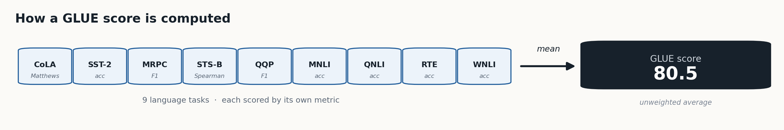
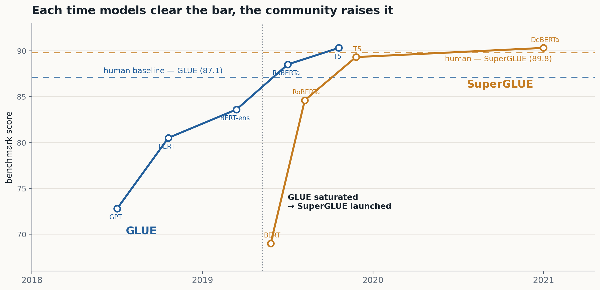
LESSON 2 — GLUE / SUPERGLUE
When one task saturates, a suite sustains the conversation.
Lessons from other fields
DCC 2026 workshop | EngiBench + EngiOpt
Notes:
Two visuals, no wall of text. Left-to-right band: a GLUE score is just the unweighted average of 9 language tasks, each with its own metric — one number hiding nine. Then the chart: in ~a year BERT-class models cleared GLUE's human baseline, so the community didn't declare victory — it launched the harder SuperGLUE, which was then climbed too. Engineering design ML is where NLP was when GLUE first launched: it needs the suite, not one beam problem.

Slide 12
LESSON 3 — CASP / ALPHAFOLD
A 25-year community benchmark made a breakthrough legible.
CASP — THE PROTOCOL
Held-out targets.
Blind submissions.
One shared score.
1994
2000
2010
2020
CASP14
[IMAGE: AlphaFold predicted structure overlaid on experimental, CASP14]
Without CASP, AlphaFold is a press release. With it, a verdict.
Source: DeepMind AlphaFold blog (2020); CASP14 results page (predictioncenter.org/casp14).
Lessons from other fields
DCC 2026 workshop | EngiBench + EngiOpt
Notes:
Land the protocol slowly: held-out targets, blind submissions, one shared score — for 25 years. That patience is what made AlphaFold credible to biologists overnight. Engineering design will need its own version of CASP for results to land the same way.

Slide 13
WHAT GOOD BENCHMARKS SHARE
Four ingredients turn a dataset into a benchmark.
The recipe is consistent across ImageNet, GLUE, CASP, OGB, MuJoCo.
FIXED INPUTS
STANDARD EVAL
OPEN ACCESS
COMMUNITY
Same data, same splits, no silent re-curating.
Scoring is code, not prose.
Low cost of entry.
Lives across years.
Engineering design ML has almost none of this — yet.
Lessons from other fields
DCC 2026 workshop | EngiBench + EngiOpt
Notes:
Don't enumerate the four like a list — they're the recipe. The kicker is what matters: every mature ML field has these four, engineering design has almost none. That's the gap this workshop is about.

Slide 14
SECTION 3 — WHAT OUR FIELD NEEDS
What engineering design ML still lacks.
The gap is not theory or talent. It is shared, executable infrastructure.
Notes:
Now the punchline. What does our field still lack, and what does that imply we should build?

Slide 15
FIVE MISSING PIECES
Engineering design ML lacks shared infrastructure.
Each can be rebuilt. No one should have to. That is the gap.
01
02
03
04
05
Standard problems
Shared simulators
Curated datasets
Multi-faceted metrics
Reproducible runners
A curated set of well-defined design tasks.
Installable, deterministic, citable.
Optimized designs + conditions + metadata, pre-split.
Feasibility, gap, diversity, novelty, warm-start.
One harness for training and evaluation.
What the field needs
DCC 2026 workshop | EngiBench + EngiOpt
Notes:
Read out the names quickly — 5 to 10 seconds total. Don't expand on each. The point is to make the gap visible, not exhaustive. The next two slides motivate why each one matters.

Slide 16
EVALUATION, PROPERLY SCOPED
Engineering quality has many axes. A single scalar will betray you.
Feasibility
Feasibility
Constraints actually satisfied.
Performance
Warm-start
Performance
Sim score vs. optimizer baseline.
Diversity
Modes covered, not collapsed.
Novelty
New designs, not paraphrases.
Warm-start
Does it help downstream search?
Novelty
Diversity
What the field needs
DCC 2026 workshop | EngiBench + EngiOpt
Notes:
If you have real spider data from your own runs, overlay it on this chart. The point: a model can win on one axis and lose on another. Pick the 2-3 axes that matter most to the audience's domain.

Slide 17
DATASETS ALONE DO NOT BENCHMARK
Releasing the dataset is necessary, but not enough.
Without the simulator and the scoring pipeline, you can display designs — you cannot score them.
DATASET ONLY
Dataset
Trained model
Generated design
Display only
DATASET + SIMULATOR + SCORING
Dataset
Trained model
Simulator + score
Portable verdict
What the field needs
DCC 2026 workshop | EngiBench + EngiOpt
Notes:
This is the core argument for EngiBench versus just-release-the-dataset. The top flow ends at 'display only' — papers can show designs but cannot tell you whether they are good. The bottom flow ends at 'portable verdict' — numbers travel between labs. Land this slowly.

Slide 18
WHY WE BUILT IT
Enter EngiBench.
A standardized framework for benchmarking generative AI in engineering design. Published at NeurIPS 2025.
Notes:
Brief transition. Pause for emphasis. From here on, the deck is concrete: what we built, what it gives you, and what you'll do with it in the next three hours.

Slide 19
THE DESIGN PATTERN
Each problem is a "paper in a can".
Eight ingredients, one Python interface, ready to compare across labs.
Design space
Optimize
Conditions
Simulate
engibench
Objectives
problem
Render
Constraints
Dataset
EngiBench
DCC 2026 workshop | EngiBench + EngiOpt
Notes:
The 'paper in a can' metaphor is the whole slide. Each satellite is a real Python attribute on a Problem object — when you say a name, say what it gives you. This is THE contract slide. Spend ~45 seconds.

Slide 20
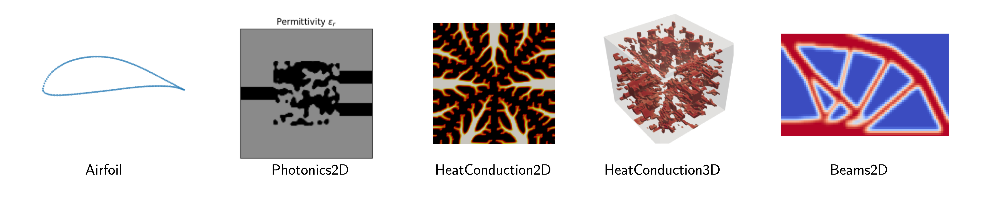
COVERAGE TODAY
Structural, thermal, aerodynamic, photonic, electronic.
Each comes with a dataset, a simulator, and a baseline optimizer.
EngiBench
DCC 2026 workshop | EngiBench + EngiOpt
Notes:
Don't enumerate every problem — name the domains and move on. The image is the point. Mention briefly that there's a contribution path for new problems and that the next notebook walks them through one.

Slide 21
THE CONTRACT, IN CODE
Design-problem questions become Python calls.
Same task contract
from engibench.utils.all_problems import BUILTIN_PROBLEMS
problem = BUILTIN_PROBLEMS['beams2d'](seed=7)
design = my_generator.sample(problem.conditions_keys)
ok = problem.check_constraints(design, conds)
score = problem.simulate(design, conds)
baseline = problem.optimize(starting=design, config=conds)
problem.render(design)
Every paper compares on the same problem.
Swap the model, not the task
Your generator is one cell. The rest is fixed.
Portable evidence
Your numbers match a reviewer's numbers.
EngiBench
DCC 2026 workshop | EngiBench + EngiOpt
Notes:
Don't read the code. Point at three lines (problem.check_constraints, problem.simulate, problem.optimize) and say what each gives you. The three callouts on the right are the takeaway claims — emphasise 'portable evidence': numbers match across laptops.

Slide 22
FROM MOTIVATION TO PRACTICE
Four notebooks. One contract.
Run them in order. Then we come back together to discuss what is missing.
NOTEBOOK 00
NOTEBOOK 01
NOTEBOOK 02
NOTEBOOK 03
Frame
Train
Evaluate
Extend
[SCREENSHOT: simple/00_*.ipynb output]
[SCREENSHOT: simple/01_*.ipynb output]
[SCREENSHOT: simple/02_*.ipynb output]
[SCREENSHOT: simple/03_*.ipynb output]
Source: capture from the notebook output cell
Source: capture from the notebook output cell
Source: capture from the notebook output cell
Source: capture from the notebook output cell
Inspect a benchmark contract end-to-end.
Fit a small conditional generator.
Score designs as engineering candidates.
Wrap your own problem behind the same API.
Then: what is missing, and where do we go next as a community?
Workshop path
DCC 2026 workshop | EngiBench + EngiOpt
Notes:
Quick orientation, ~45 seconds. Don't go deep — they'll see it themselves. Mention runtime fallbacks: if training is slow, the evaluation notebook auto-rebuilds artifacts. The kicker reminds the audience that the second half is a real discussion, not a tutorial.

Slide 23
DCC 2026 WORKSHOP · OPENING KEYNOTE
Benchmarks do not
slow research down.
They make it add up.
Up next → Notebook 00: Frame your design problem as a benchmark contract.
Notes:
Land the line. Long pause. Then redirect to Notebook 00 — physical transition (move from podium, change screens). Don't add more words here; the slide is the takeaway.

