Slide 1
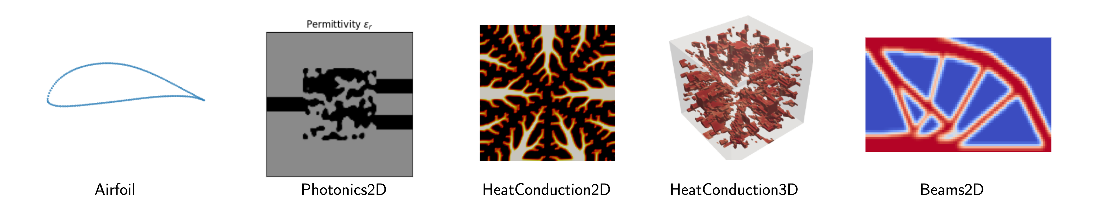

DCC 2026 Paris workshop
Benchmarking AI for Engineering Design
A hands-on path from design-problem framing to generated-design evaluation
Matthew Keeler, Soheyl Massoudi, Mark Fuge
Participant deck, simple notebook track

Slide 2
Why this workshop exists
Engineering design ML cannot become cumulative if every paper quietly changes the problem.
A model comparison is only meaningful when the design space, conditions, constraints, simulator, baseline, and metrics are visible enough for another lab to rerun.
01
Hidden setup choices
02
Plausible-looking failures
03
Hard-to-reuse results
Two methods may appear comparable while using different constraints, solvers, tolerances, or condition distributions.
Generated geometries can look convincing to the eye and still violate rules or lose after simulation.
If the task contract is implicit, another group cannot know whether they improved the method or changed the problem.
The workshop gives you a practical language for making these choices explicit.
Motivation
DCC 2026 workshop | EngiBench + EngiOpt

Slide 3
What you should leave believing
A benchmark is not just a leaderboard. It is a way to make design claims reproducible.
The red line of the workshop is simple: make the engineering task explicit, then use the same executable contract to train, evaluate, diagnose, and transfer ideas to your own domain.
1
Make the task explicit
Design space, conditions, objectives, constraints, simulator, and baseline live in one interface.
2
Diagnose model behavior
Evaluation tells you whether a generator is feasible, useful, diverse, and helpful for optimization.
3
Carry it back to your lab
The same pattern lets you sketch a benchmark for your own engineering domain.
By the end, you should be able to ask: what exactly was benchmarked, and can I reuse it?
Motivation
DCC 2026 workshop | EngiBench + EngiOpt

Slide 4
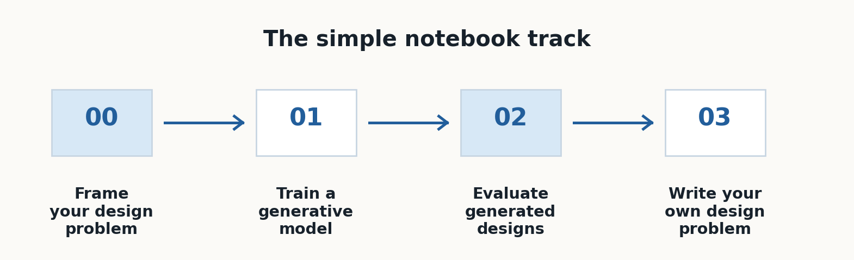
What you will do today
You will turn that motivation into four simple notebooks.
The simple notebook track is the main participant path.
Workshop path
DCC 2026 workshop | EngiBench + EngiOpt

Slide 5
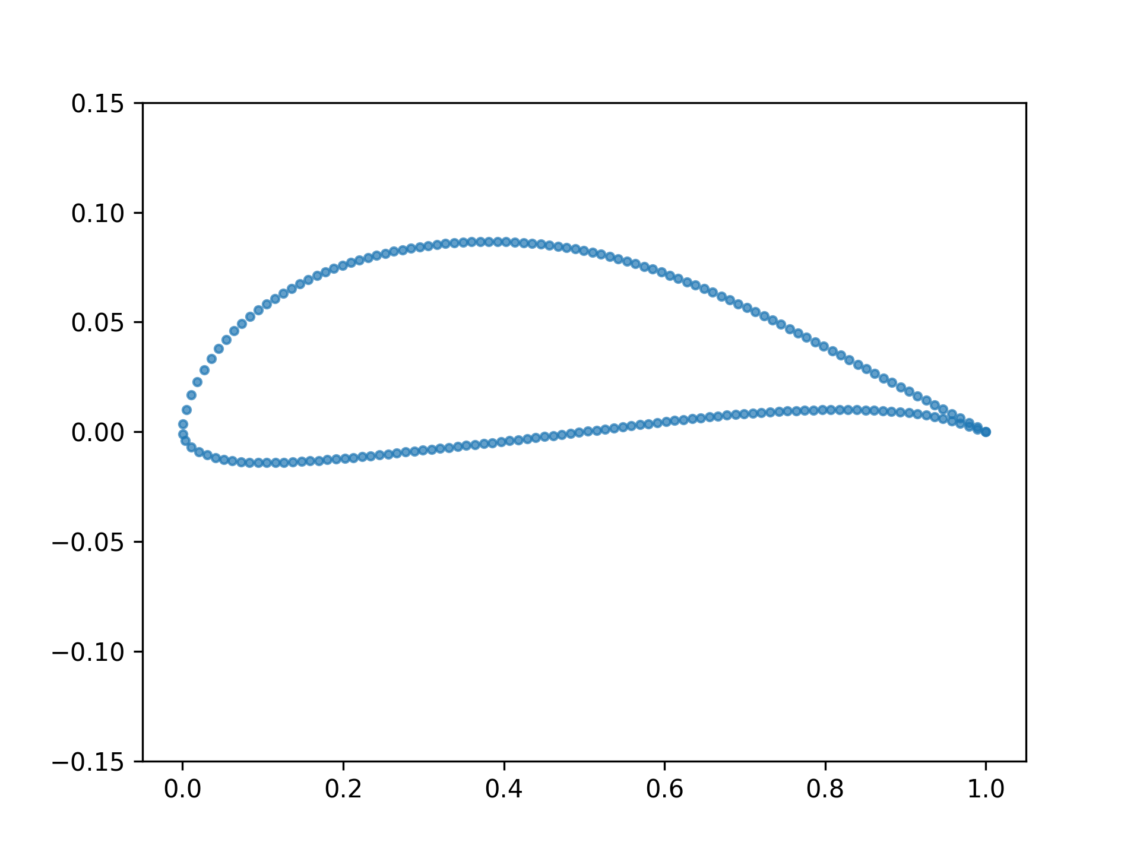
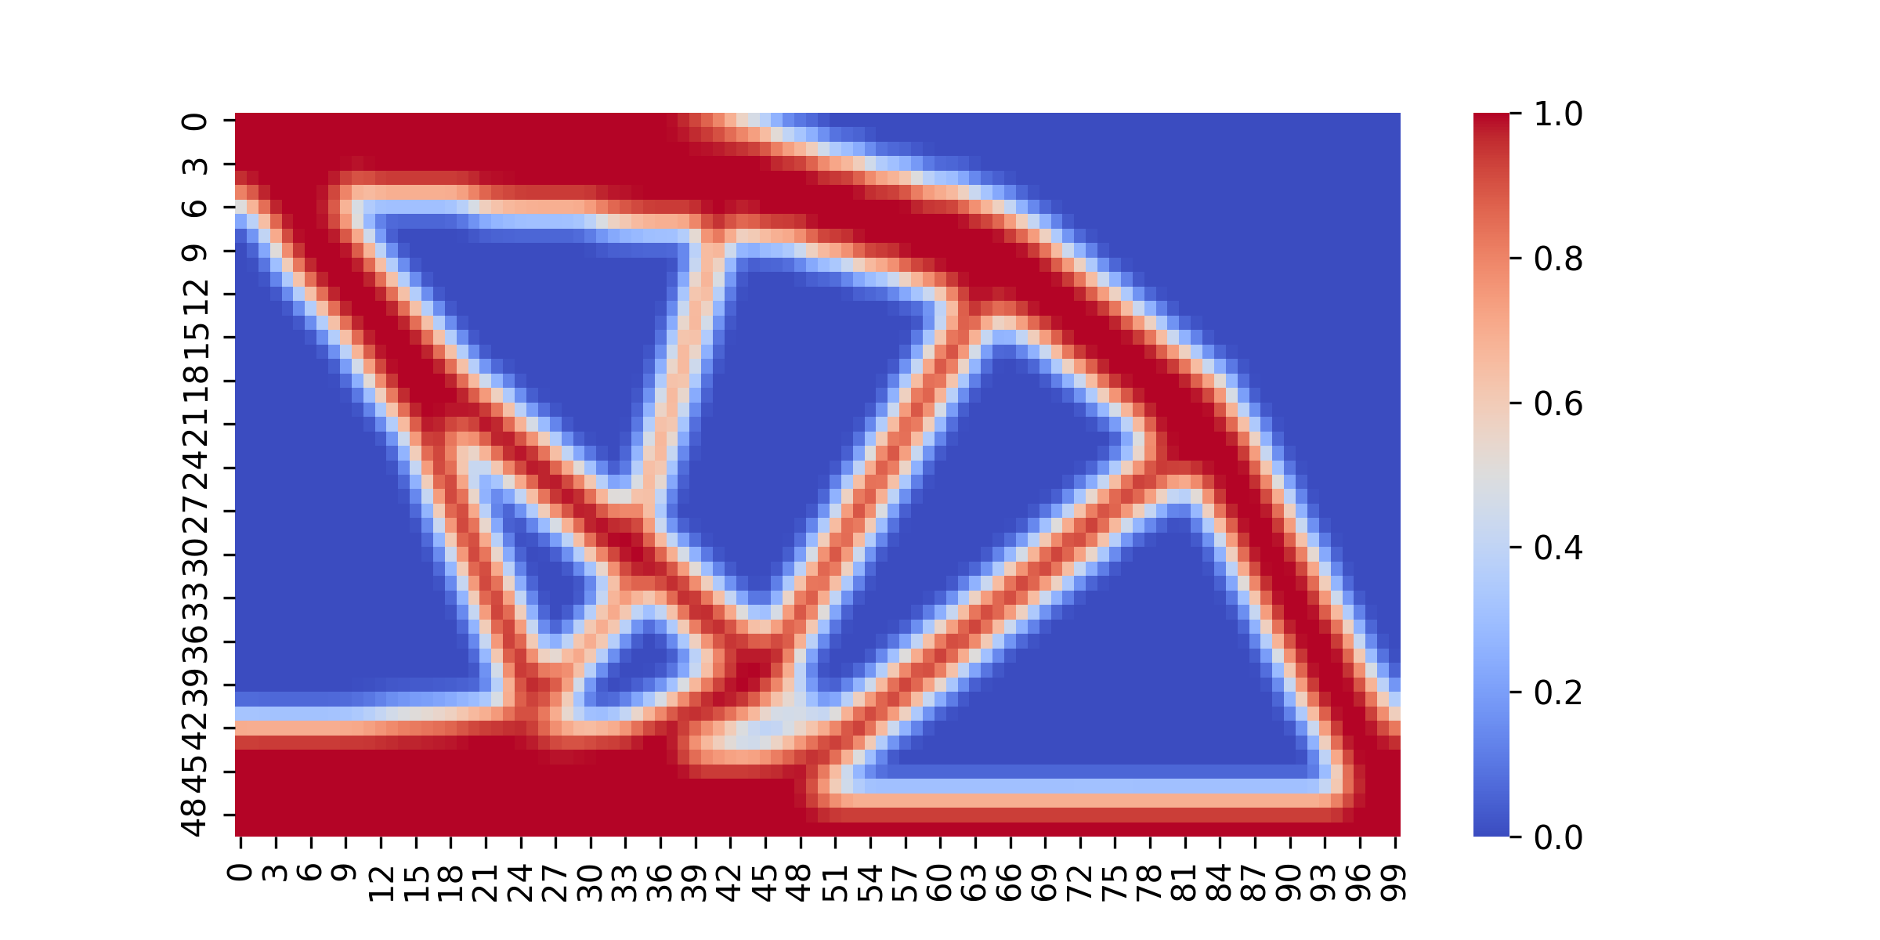
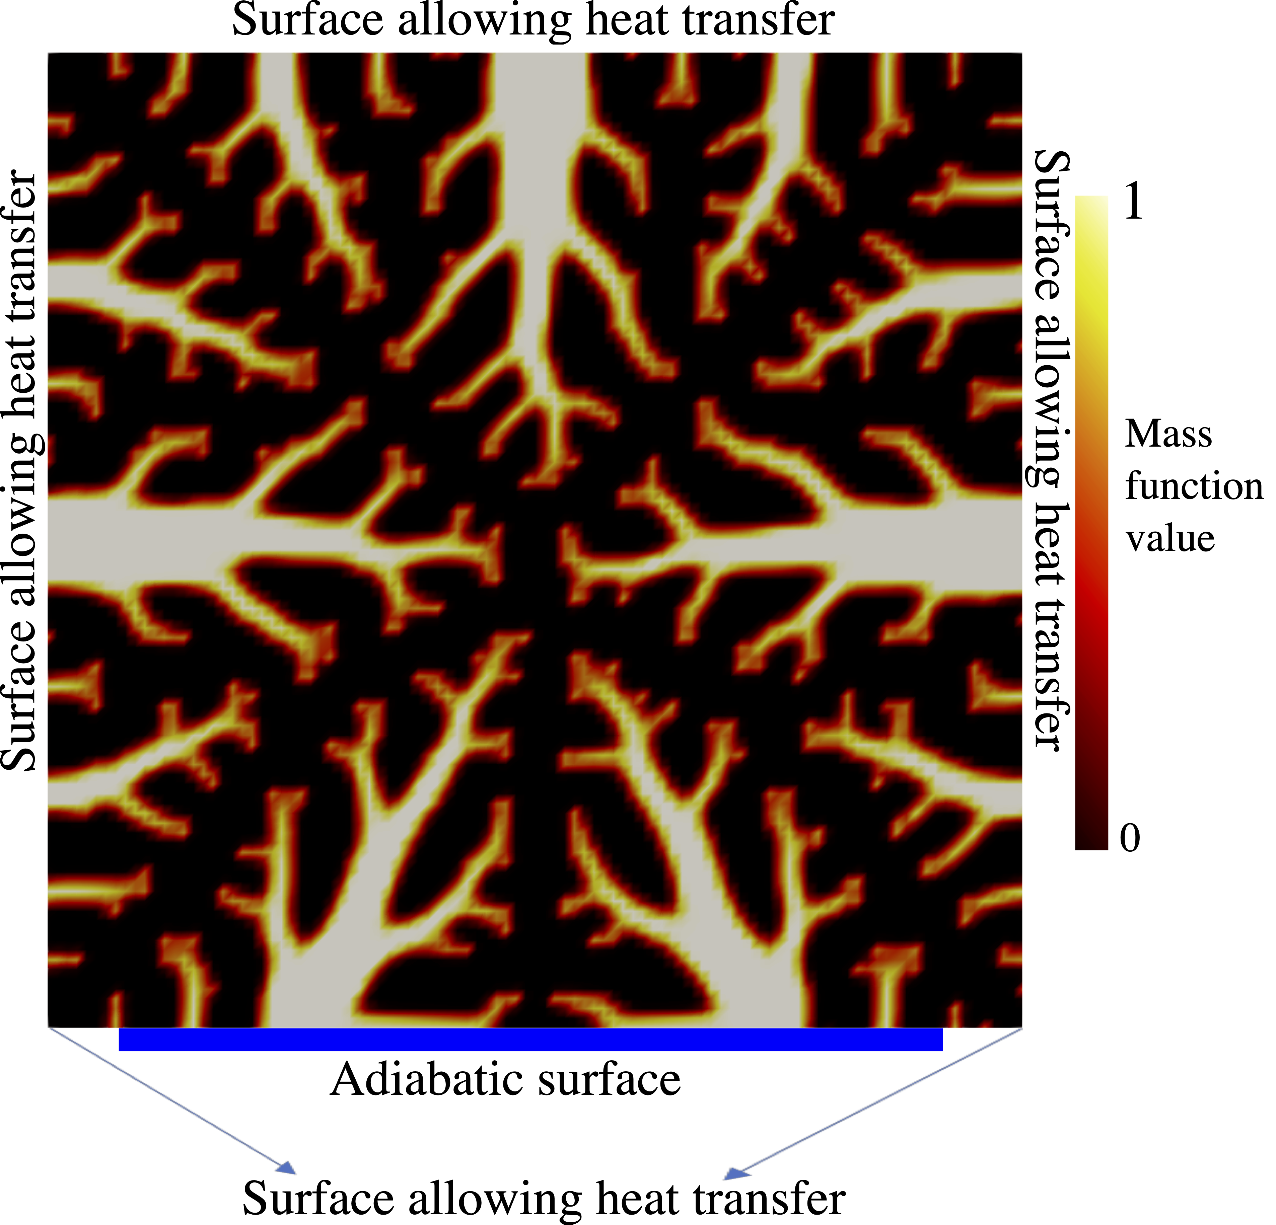
Why benchmark before modeling?
Before asking which AI method wins, make sure everyone is solving the same design problem.
Same-looking tasks
Same-looking designs
Same-looking scores
Different papers may change conditions, simulators, or constraints without making the change visible.
A generated design can look reasonable while breaking engineering rules.
A single objective value can hide feasibility, diversity, and usefulness for optimization.
Today, you will make those hidden choices explicit.
Why benchmark?
DCC 2026 workshop | EngiBench + EngiOpt

Slide 6
Benchmark mental model
A benchmark records the design task, not only the dataset.
design space
conditions
objective
constraints
dataset
render
simulate
optimize
If one of these pieces changes, the benchmark result may change too.
Benchmark mental model
DCC 2026 workshop | EngiBench + EngiOpt

Slide 7
Notebook 00
00_framing_your_design_problem.ipynb
Frame your design problem before touching a model.
You should leave with
problem object
dataset sample
rendered design
You will identify what is designed, what conditions change, what counts as better, and what makes a candidate invalid.
constraint check

Slide 8
Notebook 00 anchor
The first concrete task is Beams2D: place material so a loaded beam is stiff.
Design
a material density field
Conditions
volume fraction, load position, filter radius
Objective
minimize compliance
Validity
material and geometry rules
Notebook 00
DCC 2026 workshop | EngiBench + EngiOpt

Slide 9
What the API gives you
EngiBench turns design-problem questions into Python calls.
problem = BUILTIN_PROBLEMS['beams2d'](seed=7)
problem.design_space
problem.conditions_keys
problem.objectives
problem.dataset
problem.check_constraints(design, config)
problem.simulate(design, config)
problem.optimize(starting_point, config)
problem.render(design)
What can I design?
What scenarios matter?
What is better?
Is it valid?
What does it look like?
Notebook 00
DCC 2026 workshop | EngiBench + EngiOpt

Slide 10
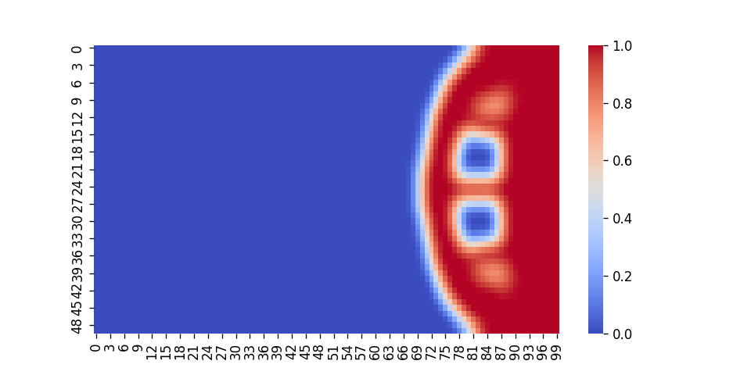
What to notice in Notebook 00
The same design can be inspected visually, checked for validity, simulated, and optimized.
Look
render a design
Check
find violated constraints
Score
run the simulator
Compare
call a classical baseline
Notebook 00
DCC 2026 workshop | EngiBench + EngiOpt

Slide 11
Notebook 01
01_training_a_generative_model.ipynb
Train a generative model against the optimizer's answers.
You should leave with
training loss
generated designs
baseline designs
This is intentionally lightweight: the point is to see the full workflow, not to win the benchmark in one notebook.
artifact bundle

Slide 12
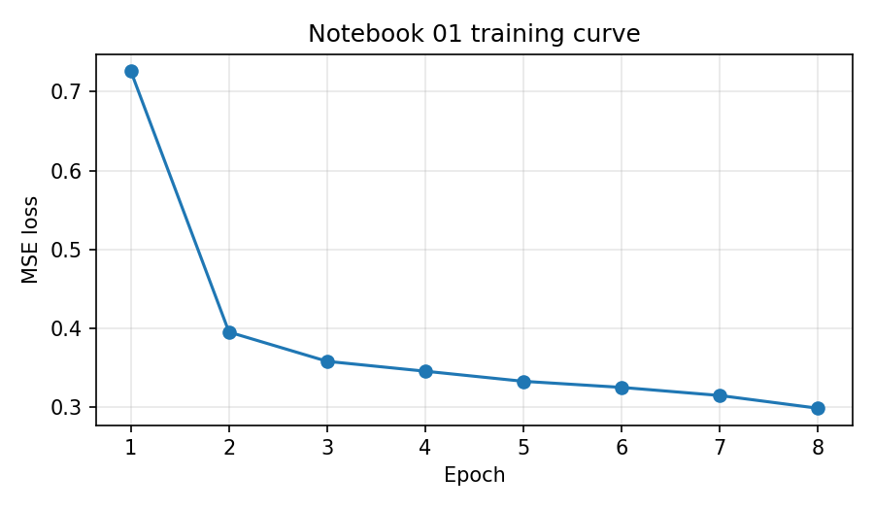
Notebook 01
Training loss is a learning signal, not an engineering verdict.
What the model sees
condition tensors plus optimized Beams2D designs
What the loss says
whether generated images resemble optimizer answers
What it does not say
whether the design obeys constraints or performs well
Notebook 01
DCC 2026 workshop | EngiBench + EngiOpt

Slide 13
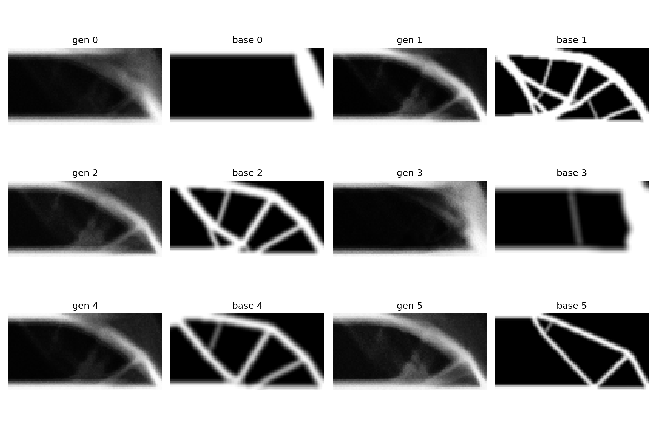
Generated vs baseline
Look at the designs, but do not stop at the eye test.
Notebook 02 will turn this visual comparison into engineering evidence.
Notebook 01
DCC 2026 workshop | EngiBench + EngiOpt

Slide 14
Notebook 02
02_evaluating_your_generated_designs.ipynb
Evaluate generated designs as engineering candidates.
You should leave with
feasibility rates
objective comparison
diversity proxy
You will check rules, run performance comparisons, measure diversity, and ask whether generation helps optimization.
warm-start curves

Slide 15
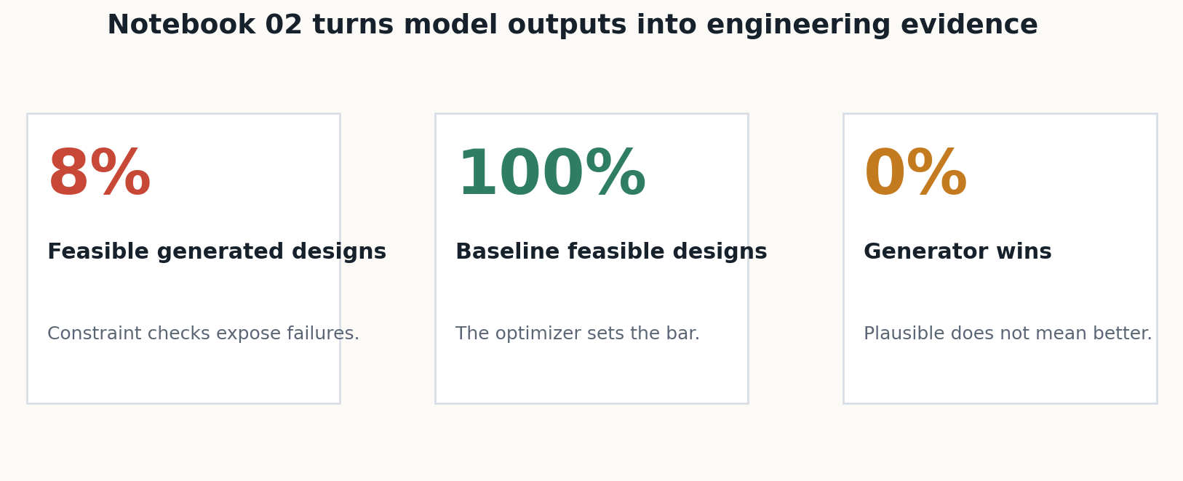
Notebook 02
A benchmark turns model outputs into evidence.
Notebook 02
DCC 2026 workshop | EngiBench + EngiOpt

Slide 16
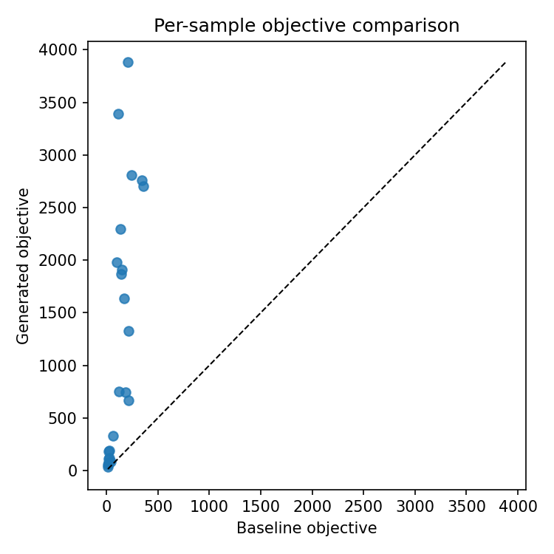
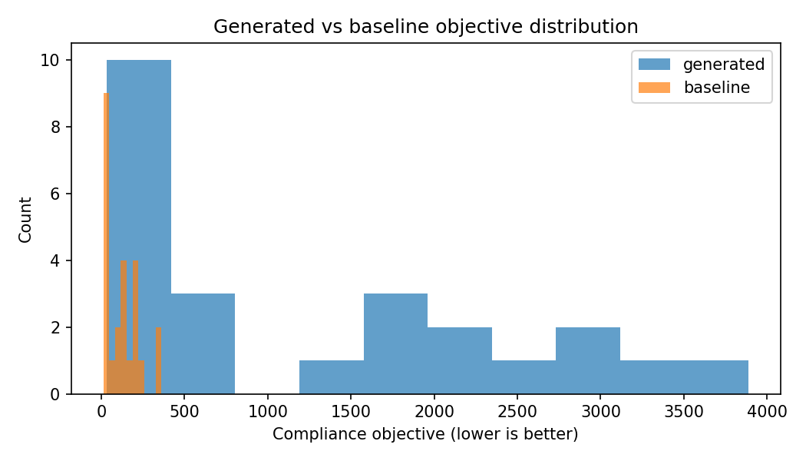
A useful failure mode
In the saved workshop run, visual plausibility did not imply feasibility or performance.
This is the point of the workshop: engineering validity is measured, not assumed.
Notebook 02
DCC 2026 workshop | EngiBench + EngiOpt

Slide 17
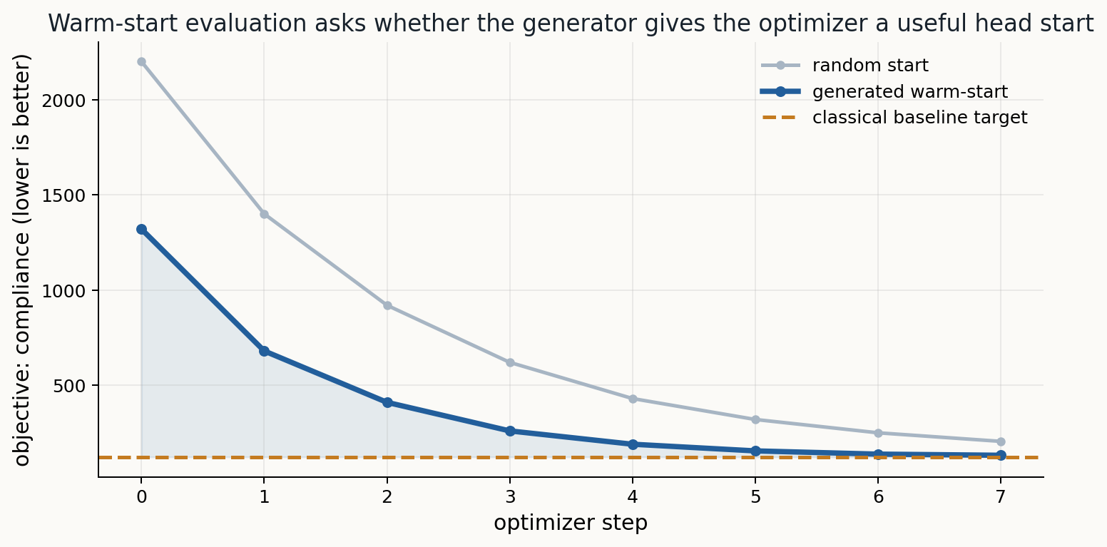
Warm-starting
A generator can still be useful if it gives the optimizer a better starting point.
Notebook 02
DCC 2026 workshop | EngiBench + EngiOpt

Slide 18
Discussion
Which metric would change the conclusion in your design domain?
Feasibility
Objective gap
Diversity
Novelty
Warm-start value
In your field, what would make a generated design scientifically convincing?
Discussion
DCC 2026 workshop | EngiBench + EngiOpt

Slide 19
Notebook 03
03_writing_your_own_problem.ipynb
Write your own design problem behind the same interface.
You should leave with
design space
conditions
objective
You will wrap a tiny physics problem, then use it exactly like Beams2D.
constraints
simulate
optimize
render

Slide 20
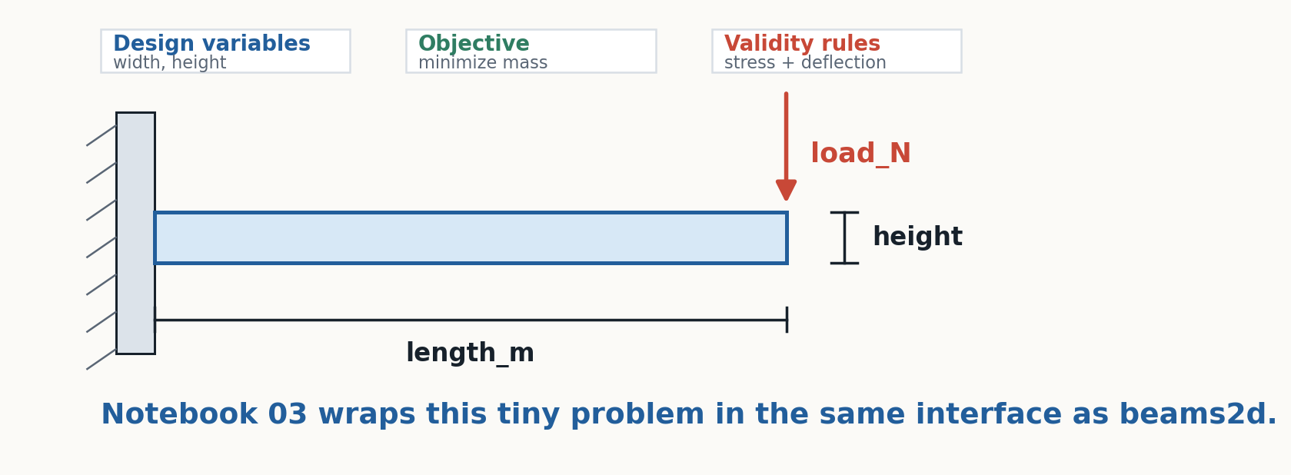
Notebook 03 anchor
The example problem is small on purpose: a cantilever beam with real engineering checks.
Notebook 03
DCC 2026 workshop | EngiBench + EngiOpt

Slide 21
Your implementation checklist
A reusable problem needs a small set of explicit promises.
design_space
simulate
What values may the design take?
How do we score a candidate?
conditions
optimize
What scenario must it work under?
What classical baseline should we compare with?
objectives
render
What should be minimized or maximized?
Can humans inspect the design?
check_constraints
When is a candidate invalid?
Notebook 03
DCC 2026 workshop | EngiBench + EngiOpt

Slide 22
Use this for your own research
Translate your domain into the benchmark contract.
1
What is the design representation?
2
What conditions vary between scenarios?
3
What objective would an engineer trust?
4
What makes a design invalid?
5
What baseline would be hard to beat?
6
What figure would reveal a bad design instantly?
Discussion
DCC 2026 workshop | EngiBench + EngiOpt

Slide 23
Workshop logistics
Use the simple notebooks; keep the solution notebooks as facilitator references.
Participant path
Facilitator reference
Use notebooks in workshops/dcc26/simple/
Use participant/ and solutions/ only when we need a completed version.
Workshop logistics
DCC 2026 workshop | EngiBench + EngiOpt

Slide 24
When Colab or local runtime is slow
The workshop still works if training or optimization takes longer than expected.
If setup is slow
stay in the notebook prose and inspect the already generated figures
If training is slow
use the saved artifact bundle and continue to evaluation
If optimization is slow
run fewer warm-start examples and focus on interpretation
If widgets fail
use the static galleries; the benchmark questions are the same
Workshop logistics
DCC 2026 workshop | EngiBench + EngiOpt

Slide 25
Resources during the workshop
Keep these links nearby while you work.
Simple notebooks
EngiOpt/workshops/dcc26/simple/
EngiBench docs
https://engibench.ethz.ch/
Code
IDEALLab/EngiBench and IDEALLab/EngiOpt
Paper
OpenReview: EngiBench, NeurIPS 2025 Datasets and Benchmarks
Workshop resources
DCC 2026 workshop | EngiBench + EngiOpt

Slide 26
Closing
Leave with a way to make your design problem executable, comparable, and reusable.
That is the contribution of EngiBench + EngiOpt: not another isolated demo, but an executable contract for engineering design research.
Frame
Build
Evaluate
Share
Matthew Keeler, Soheyl Massoudi, Mark Fuge
EngiBench + EngiOpt

