Slide 1
Cloud Computing
Cloud computing is the delivery of computing services—including servers, storage, databases, networking, software, analytics, and intelligence—over the Internet ("the cloud") to offer faster innovation, flexible resources, and economies of scale.
Cloud computing is a way to deliver computing as a service rather than a product. It is completely based on the Internet.
Cloud computing is the delivery of computing services over the internet.
Computing services include common IT infrastructure such as virtual machines, storage, databases, and networking.
Computing services also include things like Internet of Things (IoT), machine learning (ML), and artificial intelligence (AI).

Slide 2
Cloud Computing
Cloud Computing with an example -
Whenever you travel through a bus, you take a ticket for your destination and hold back to your seat till you reach your destination. Likewise, other passengers also take ticket and travel in the same bus with you. When your stop comes you get off the bus. Cloud computing is just like that bus, carrying data and information for different users and allows to use its service with minimal cost.
There are the following operations that we can do using cloud computing:
Developing new applications and services
Storage, back up, and recovery of data
Hosting blogs, websites and services
Delivery of software on demand
Analysis of data
Streaming videos and audios

Slide 3
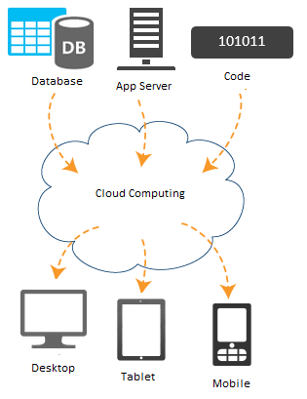
Cloud Computing

Slide 4
Why Cloud Computing?
Cloud computing has become essential in today's digital world for individuals, startups, and enterprises.
1. Cost Efficiency: No upfront hardware investment – pay only for what you use.
2. Scalability and Flexibility: Easily scale up or down based on your business needs.
3. Faster Time to Market: Develop, test, and deploy applications much faster using ready-to-use cloud platforms (like Azure App Services or AWS Elastic Beanstalk).
4. Anywhere, Anytime Access: Access services and data from any device with internet.
5. Improved Security and Compliance: Top cloud providers offer robust security controls, data encryption, firewalls, identity management, etc.
6. Automatic Updates and Maintenance: Cloud services are automatically updated with the latest features and security patches.
7. High Availability and Reliability: Built-in disaster recovery, data backup, and redundancy.

Slide 5
Cloud Computing Benefits
Benefit | Description
Cost Efficiency | Save money on hardware, maintenance, and staffing
Scalability | Instantly adjust resources to match demand
Mobility | Work from anywhere, anytime
Security | Enterprise-grade protection and compliance
Reliability | High uptime, disaster recovery, and backups
Speed | Rapid deployment and provisioning
Innovation | Access latest tools like AI, analytics, IoT
Sustainability | Eco-friendly shared infrastructure

Slide 6
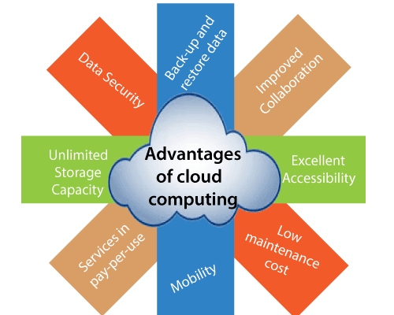
Advantages of Cloud Computing

Slide 7
CapEx vs OpEx in Cloud Computing
CapEx(capital expenditure) means spending funds on infrastructure purchases such as building a data center.
CapEx funding by its nature requires upfront capital for these large purchases, which limits many organizations from building data centers.
Capital expenditures are accounted for as payments for goods and services and recorded on the balance sheet.
Capital expenditures incur depreciation as assets age.
Examples of CapEx expenditure in the cloud:
Building/premises purchase
Physical data center equipment like servers and networking infrastructure
IT equipment for IT and office staff
Patents
Installing local software or in-house applications

Slide 8
CapEx vs OpEx in Cloud Computing
Operational Expenditure (OpEx): It is like a pay-as-you-go service.
You can deduct this expense in the same year you spend it. There is no up-front cost, as you pay for a service or product as you use it.
Examples of OpEx expenses in the cloud
Items that require a subscription fee, such as software licenses or cloud-based services such as SaaS, IaaS, PaaS, and DaaS
Property leasing, such as leasing IT infrastructure on Amazon Web Services (AWS) for a monthly fee
Ongoing web hosting
Annual IT infrastructure maintenance agreements
Software support

Slide 9
CapEx vs OpEx in Cloud Computing
Context | CapEx | OpEx
The upfront cost | Significant | None
Ongoing cost | Low | Based on usage
Tax Deduction | Over-time | Same year
Early Termination | No | Anytime
Maintenance | Significant | Low
Value over time | Lowers | No change

Slide 10
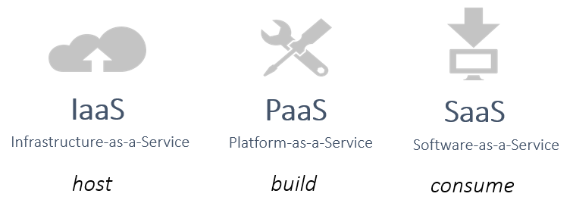
Cloud Service Models
Cloud computing offers services in different layers to meet various business and technical needs.
These are mainly categorized into three core service models:

Slide 11
Infrastructure-as-a-Service(Iaas)
Provides virtualized computing resources over the internet. You get the raw infrastructure — like servers, storage, and networking — on demand. Advantages
🔧 You manage
Applications
Data
Runtime
Middleware
🌐 Cloud provider manages:
Virtualization
Servers
Storage
Networking
💡 Examples:
Amazon EC2 (AWS)
Microsoft Azure Virtual Machines
Google Compute Engine
Use Cases:
Hosting websites or applications
Backup and recovery
high-performance computing

Slide 12
Platform-as-a-Service(Paas)
Provides a platform and environment to allow developers to build, test, and deploy applications without managing infrastructure.
🔧 You manage:
Applications
Data
🌐 Cloud provider manages:
Runtime
Middleware
OS
Servers
Storage
Networking
💡 Examples:
Google App Engine
Azure App Services
Heroku
Use Cases:
Application development & deployment
APIs and microservices
Database-backed web apps

Slide 13
Software-as-a-Service(Saas)
Fully functional software applications delivered over the internet. End users access it via browsers or apps without managing anything.
🔧 You manage:
Just your data (if allowed)
🌐 Cloud provider manages:
Everything (app, infrastructure, updates)
💡 Examples:
Google Workspace (Docs, Sheets, Gmail)
Microsoft 365 (Word, Excel, Teams)
Salesforce, Zoom, Dropbox
📦 Use Cases:
Email and communication
CRM, ERP, project management tools
Online collaboration

Slide 14
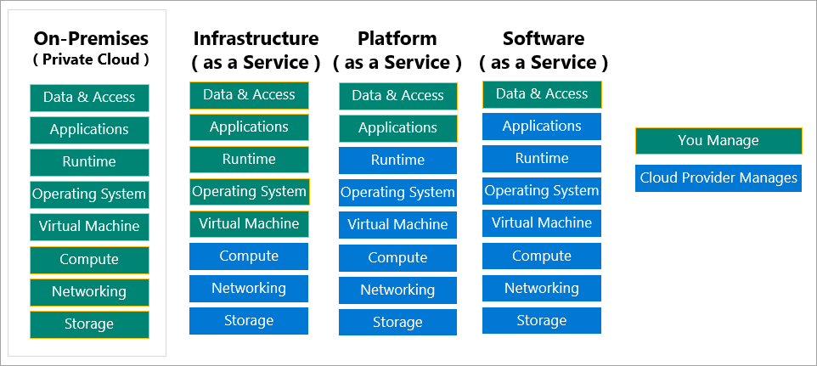
Cloud Service Models

Slide 15
Cloud Computing Service Models Comparisons
Feature | IaaS | PaaS | SaaS
Managed By | Mostly you | Shared (you + provider) | Fully by provider
Flexibility | High | Medium | Low
Control | Full infrastructure | App-level only | Limited to usage/data
Setup Time | Long | Medium | Instant
Users | System admins, DevOps | Developers | End users, business users

Slide 16
Other Evolving Service Models
Model | Description
FaaS (Function as a Service) | Serverless computing, runs functions on-demand (e.g., AWS Lambda)
BaaS (Backend as a Service) | Manages backend services like authentication, database, etc.
DaaS (Desktop as a Service) | Provides virtual desktops over the cloud

Slide 17
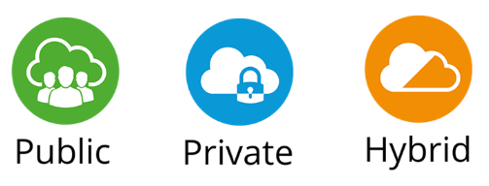
Cloud Deployment Models
Cloud deployment models define how cloud services are made available and who can access them.
They determine the ownership, control, and accessibility of the cloud infrastructure.
There are three primary deployment models
1. Public Cloud
2. Private Cloud
3. Hybrid Cloud

Slide 18
Public Cloud
The cloud infrastructure is owned and operated by a third-party provider, and services are delivered over the internet to the general public
Examples:
Amazon Web Services (AWS)
Microsoft Azure
Google Cloud Platform (GCP)
Key Features:
Shared environment (multi-tenant)
Highly scalable and cost-effective
No hardware management required by users
Use Cases:
Web hosting
Dev/Test environments
SaaS applications

Slide 19
Private Cloud
The cloud infrastructure is used exclusively by a single organization. It can be hosted on-premises or by a third-party vendor.
💡 Examples:
VMware vSphere
Microsoft Azure Stack
OpenStack Private Cloud
📌 Key Features:
Higher security and control
Custom infrastructure setup
Suitable for sensitive data or regulatory needs
🧰 Use Cases:
Financial institutions
Government agencies
Enterprises with strict compliance

Slide 20
Hybrid Cloud
A combination of public and private clouds, allowing data and applications to be shared between them.
💡 Examples:
Azure Hybrid Cloud
AWS Outposts
Google Anthos
📌 Key Features:
Flexibility and scalability of public cloud
Control and security of private cloud
🧰 Use Cases:
Cloud bursting (handle peak loads in public cloud)
Backup and recovery

Slide 21
Community Cloud(Optional)
A cloud infrastructure shared by several organizations with common concerns (e.g., security, compliance, jurisdiction).
💡 Examples:
Government organizations sharing cloud infrastructure
Healthcare providers sharing HIPAA-compliant cloud
📌 Key Features:
Shared responsibility and cost
Tailored to community-specific requirements
🧰 Use Cases:
Universities
Research organizations
Public sector partnerships

Slide 22
Cloud Deployment Models Comparison
Feature | Public Cloud | Private Cloud | Hybrid Cloud | Community Cloud
Ownership | Third-party | Single org | Both | Multiple orgs
Cost | Low (shared) | High (dedicated) | Medium | Shared among members
Security | Standard | High | Medium to High | Medium to High
Scalability | Very High | Limited | High | Moderate
Customizability | Low | High | Moderate | Moderate

Slide 23
Cloud Deployment Models Summery
Deployment Model | Best For
Public Cloud | Startups, small businesses, general-purpose apps
Private Cloud | Enterprises needing full control and security
Hybrid Cloud | Organizations needing flexibility and compliance
Community Cloud | Groups with shared goals and compliance needs

Slide 24
Overview of Cloud Service Providers
Cloud service providers (CSPs) offer platforms, infrastructure, and software over the internet, enabling individuals and organizations to build, deploy, and manage applications without maintaining physical servers.
Top Cloud Providers
1. Amazon Web Services (AWS)
2. Microsoft Azure
3. Google Cloud Platform (GCP)
4. IBM Cloud
5. Oracle Cloud Infrastructure (OCI)
6. Alibaba Cloud

Slide 25
Cloud Service Providers-Amazon Web Services (AWS)
Launched: 2006
Market Leader 🌍
🔧 Key Services:
Compute: EC2 (Elastic Compute Cloud)
Storage: S3 (Simple Storage Service), Glacier
Databases: RDS, DynamoDB
Serverless: Lambda
DevOps Tools: CodePipeline, CloudFormation
✅ Key Strengths:
Widest global infrastructure (100+ availability zones)
Richest service offerings (200+ services)
Strong in machine learning, analytics, and big data
Real Companies Using AWS:Netflix Airbnb NASA

Slide 26
Cloud Service Providers-Microsoft Azure
Launched: 2010
Enterprise Favorite 🏢
🔧 Key Services:
Compute: Azure Virtual Machines
App Services: Azure App Service, Functions
Databases: SQL Database, Cosmos DB
DevOps: Azure DevOps, Pipelines
AI/ML: Azure Cognitive Services
✅ Key Strengths:
Deep integration with Windows, Office 365, Active Directory
Hybrid capabilities (Azure Stack)
Strong compliance and enterprise support
Real Companies Using AWS: LinkedIn Adobe Mercedes-Benz

Slide 27
Cloud Service Providers-Google Cloud Platform (GCP)
Launched: 2008
Developer & Data-Centric 💡
🔧 Key Services:
Compute: Compute Engine, Kubernetes Engine (GKE)
Storage: Cloud Storage
Data & AI: BigQuery, Vertex AI, AutoML
DevOps: Cloud Build, Cloud Functions
✅ Key Strengths:
Industry-leading AI/ML and data analytics
Superior networking and container support
Tight integration with open-source tools
Real Companies Using AWS: Spotify PayPal YouTube

Slide 28
Cloud Service Providers-IBM Cloud
Focus: Hybrid cloud, AI, enterprise apps
🔧 Key Services:
Virtual Servers, Cloud Foundry, Watson AI
Integration with IBM software and mainframes
✅ Key Strengths:
AI with Watson
Focus on regulated industries

Slide 29
Cloud Service Providers-Oracle Cloud Infrastructure (OCI)
Focus: Databases and ERP solutions
🔧 Key Services:
Oracle Autonomous Database, Compute, Object Storage
✅ Strengths:
Strong in database performance
Integrated with Oracle ERP and business applications

Slide 30
Cloud Service Providers-Alibaba Cloud
Cloud Provider in China & Asia-Pacific
🔧 Key Services:
Elastic Compute Service, Object Storage Service (OSS)
✅ Strengths:
Scalable cloud for high-traffic platforms
Competitive pricing in Asia

Slide 31
Cloud Service Providers Comparison Table
Provider | Strengths | Best Use Cases
AWS | Most mature, widest services | Startups to enterprise, global apps
Azure | Enterprise & hybrid integration | Windows-based, enterprise workloads
GCP | Big data, analytics, AI | Data science, containerized apps
IBM Cloud | Hybrid, AI with Watson | Regulated industries, AI apps
Oracle | Database performance, business apps | ERP, DB-heavy apps
Alibaba | Cost-effective Asia-Pacific cloud | eCommerce, Asian business expansion

Slide 32
Cloud Service Providers Comparison Table
Cloud Provider | Notable Services | Real-World Use
AWS | EC2, S3, Lambda | Netflix, Airbnb
Azure | VMs, AD, DevOps | Adobe, Mercedes
GCP | BigQuery, Firebase | Spotify, YouTube
IBM Cloud | Watson AI, Blockchain | Volkswagen, Mayo Clinic
Oracle Cloud | Autonomous DB, ERP | Zoom, Toyota
Alibaba Cloud | ECS, OSS, MaxCompute | TikTok (China), AirAsia

