Slide 1
What is Logging?
Logging is the process of recording information about your application's execution — such as:
Errors
Warnings
Debug info
Startup configuration
HTTP requests/responses
Logging is an essential feature of an applications for detecting or investigating issues.

Slide 2
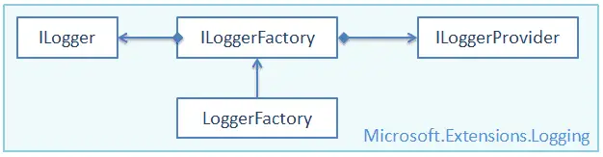
logging in ASP.Net Core
Logging is built in feature for Asp.net Core Applications.
Logging in ASP.NET Core is a built-in feature that helps you track the flow of execution, catch errors, debug issues, and audit system behavior.
You can write your logs to a file on a disk or a database, and send an error email.
ASP.Net Core provides support for a wide variety of logging providers; you can plug in your own logging frameworks like Log4Net, NLog, and Elmah.
Microsoft.Extensions.Logging includes the necessary classes and interfaces for logging.
ILogger
ILoggingFactory
LoggingFactory
ILoggingProvider

Slide 3
logging in ASP.Net Core
Logging is built in feature for Asp.net Core Applications.
Logging in ASP.NET Core is a built-in feature that helps you track the flow of execution, catch errors, debug issues, and audit system behavior.
Built-in Logging Providers in ASP.NET Core
ASP.NET Core supports multiple logging providers, including
Console – Output logs to the terminal/command window
Debug – Output logs to the Visual Studio Output window
EventSource / EventLog – For system-level logging
Azure App Insights
File logging (via 3rd-party libraries like Serilog, NLog, etc.)

Slide 4
Logging Providers
A logging provider displays or stores logs to a particular medium such as a console, a debugging event, an event log, a trace listener, and others. Microsoft provides various logging providers as NuGet packages.
Logging Provider's NuGet Package | Output Target
Microsoft.Extensions.Logging.Console | Console
Microsoft.Extensions.Logging.AzureAppServices | Azure App Services 'Diagnostics logs' and 'Log stream' features
Microsoft.Extensions.Logging.Debug | Debugger Monitor
Microsoft.Extensions.Logging.EventLog | Windows Event Log
Microsoft.Extensions.Logging.EventSource | EventSource/EventListener
Microsoft.Extensions.Logging.TraceSource | Trace Listener

Slide 5
Log Levels
Log levels indicate the importance or severity of log messages. Built-in log providers include extension methods to indicate log levels.
Log levels indicate the severity of the messages being logged.
ASP. Net Core defines six log levels: Trace, Warning, Debug, Information, Error, and Critical.
The following table lists log levels in .NET Core.
Log Level | Severity | Extension Method | Description
Trace | 0 | LogTrace() | Detailed debugging info
Debug | 1 | LogDebug() | Less detailed debugging info
Information | 2 | LogInformation() | Logs messages for the flow of the application.
Warning | 3 | LogWarning() | Potential issue
Error | 4 | LogError() | Unhandled exceptions
Critical | 5 | LogCritical() | System failure

Slide 6
Configure Logging in Program.cs (.NET 6/7/8)
var builder = WebApplication.CreateBuilder(args);
// Configure built-in logging
builder.Logging.ClearProviders();
builder.Logging.AddConsole();
builder.Logging.AddDebug();
var app = builder.Build();

Slide 7
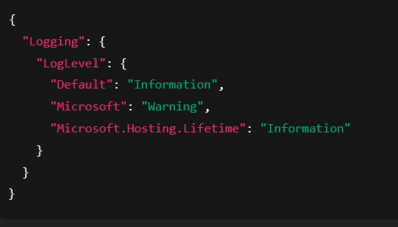
Configure Logging in Program.cs (.NET 6/7/8)
You can control logging levels via appsettings.json:
This config controls the minimum log level for different parts (namespaces) of your application.
ASP.NET Core uses a hierarchical logging system, so you can filter logs per namespace.

Slide 8
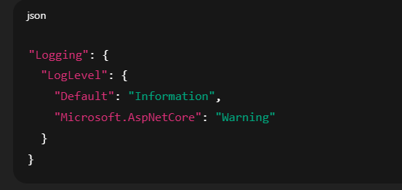
Configure Logging in Program.cs (.NET 6/7/8)
"Default": "Information"
This sets the default minimum log level for your whole application.
All logs with level Information, Warning, Error, Critical will be shown.
Debug and Trace messages will be ignored unless overridden.
✅ "Microsoft.AspNetCore": "Warning"
This overrides the log level only for logs coming from Microsoft.AspNetCore (framework logs).
It suppresses noisy logs like info/debug from ASP.NET Core internals (e.g., middleware, routing).
Only Warning, Error, and Critical logs from this namespace will be shown.

Slide 9
Using Third-party Loggers
For advanced scenarios like writing logs to a file, database, or Elasticsearch, use
Serilog
Nlog
log4net

