Slide 1
MicroServices Architecture
Microservice Architecture is a design approach where a large application is broken down into small, independent services (microservices), each responsible for a specific business capability.
Microservices architecture is an approach to create small services.
Microservices architecture decompose a big application into multiple small services. Each small service is a Microservice.
Each microservice running in their own space.
Microservices are independent services directly calling their own database.
Microservices are can communicate each other.
Microservice architecture in ASP.NET Core is a design pattern where a large application is broken down into smaller, loosely coupled, independently deployable services. Each microservice is responsible for a specific business function and can be developed, deployed, and scaled independently
All microservices in a project get deployed in production at their own pace, on-premise on the cloud, independently, living side by side.

Slide 2
Key Concepts of Microservices Architecture
Concept | Description
Service Independence | Each service has its own codebase and database (optional), and runs in its own process.
Single Responsibility | Each microservice does one thing well (like User Service, Order Service).
Communication | Services talk to each other using HTTP (REST) or Message Queues.
Database per service | Each service can have its own database (not shared).
Deployment | Services can be deployed and updated independently.
Technology agnostic | Though you're using ASP.NET Core, each service could technically be written in any language.

Slide 3
Key Characteristics of Microservices
Feature | Description
Decentralized Services | Each service handles a single responsibility and operates independently.
Technology Agnostic | Services can use different tech stacks (e.g., ASP.NET Core, Node.js).
Independent Deployment | Teams can build, test, and deploy services independently.
Fault Isolation | Failure in one service doesn't bring down the whole application.
Domain-Driven Design | Services are organized around business capabilities (e.g., Billing, Orders).
Scalability | Services can be scaled independently based on demand.

Slide 4
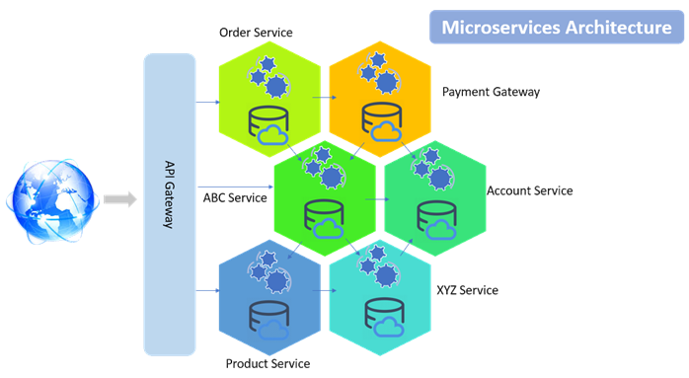
Microservice Architecture Diagram

Slide 5
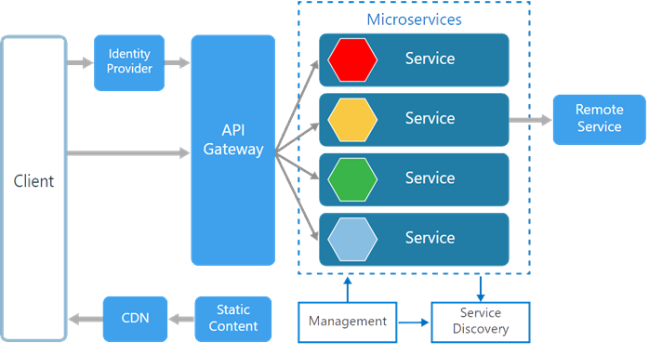
Microservice Architecture Diagram
There are various components in a microservices architecture apart from microservices themselves.

Slide 6
Microservice Components
Component | Purpose
Service | A standalone application/module with its own logic and database.
API Gateway | A single entry point for client requests. Handles routing, authentication, and aggregation.
Service Discovery | Registers and finds services dynamically (e.g., Consul, Eureka).
Database per Service | Each service has its own DB to avoid tight coupling.
Inter-Service Communication | REST APIs (synchronous) or message queues (asynchronous).
Centralized Logging/Monitoring | Use tools like ELK stack, Prometheus, Grafana.
Authentication & Authorization | Usually done with JWT and enforced at the gateway or individual services.

Slide 7
Advantages of Microservices Architecture
Microservices are smaller in size. So easier to develop, deploy, and debug.
Every Microservices can be written in different programming language, databases, and tools for each service.
Microservices are independent of each other, meaning that if one of the microservices goes down, there is little risk of the full application shutting down
Microservices can be scaled quickly and can be reused among different projects
Microservices work well with containers like Docker
Microservices are Support for continuous integration and delivery
Microservices can be deployed to different servers or even different datacentres.
Microservices can communicate each other

Slide 8
Challenges of Microservices Architecture
Complex deployment and orchestration
Complex distributed system
Data consistency issues
Distributed data management
Requires strong DevOps practices
Monitoring and logging across services
Requires robust monitoring, logging, tracing

Slide 9
Microservice Use Cases
E-commerce platform (Product, Order, Cart, Payment)
Banking systems (Accounts, Transactions, Loans, Notifications)
Online learning platforms (Users, Courses, Assessments, Payments)

Slide 10
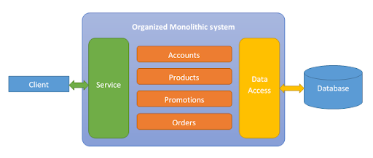
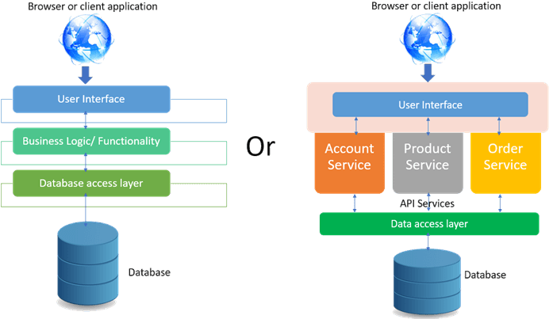
Monolithic Architecture
A monolithic architecture is a traditional software design pattern where the entire application is built as a single, tightly coupled unit. All modules — UI, business logic, and data access — are packaged and deployed together.
Architecture Diagram (Monolithic)

Slide 11
Key Characteristics Monolithic Architecture
Characteristic | Description
Single Codebase | All functionality resides in one codebase/project.
Tightly Coupled | All modules depend on each other; changes in one module may affect others.
Single Deployment Unit | The entire application is compiled and deployed as one unit.
Shared Database | Typically, all parts of the application use the same database.

Slide 12
Advantages of Monolithic Architecture
Advantage | Description
Simple to develop | Easier for small teams and beginners to build and test.
Easy deployment | One file or container to deploy.
Performance | Lower latency as function calls are local.
Less overhead | No inter-process communication or distributed transactions.

Slide 13
Disadvantages of Monolithic Architecture
Disadvantage | Description
Hard to scale | You must scale the entire app even if only one part (like reporting) needs more resources.
Low flexibility | Difficult to use different tech stacks per module.
Slower development | Changes in one area can break the entire app.
Difficult to maintain | As the codebase grows, it becomes hard to manage.
Long build/release cycles | A small change requires redeploying the whole app.

Slide 14
Monolithic vs Microservices Architecture
Aspect | Monolithic | Microservices
Deployment | Single unit | Independent services
Scalability | Entire app | Per service
Technology Stack | Usually one tech stack | Multiple allowed
Database | Shared | Isolated per service
Fault Isolation | Low | High
DevOps Complexity | Low | High

Slide 15
Tech Stack Summary Microservices Architecture
Layer/Function | Tech Used
Web API | ASP.NET Core Web API
API Gateway | Ocelot
Authentication | JWT, ASP.NET Core Identity
DB ORM | Entity Framework Core
Database | SQL Server
Inter-Service Comm | REST (HttpClient), gRPC (optional), or RabbitMQ (optional)
Containerization | Docker + Docker Compose
Documentation | Swagger/OpenAPI
CI/CD | GitHub Actions / Azure DevOps
Logging/Monitoring | Serilog, Seq, Grafana, Kibana

