Slide 1
What is Bootstrap?
Bootstrap is a popular open-source front-end framework used for designing responsive and mobile-first websites and web applications.
It provides a collection of HTML, CSS, and JavaScript components that help developers build user interfaces quickly and consistently.
Bootstrap 5 is the latest major version.

Slide 2
Key Features of Bootstrap
Responsive Grid System
Uses a 12-column grid layout to help design layouts that adapt to different screen sizes (mobile, tablet, desktop).
Pre-designed UI Components
Includes buttons, navbars, modals, forms, alerts, cards, and more, all styled consistently.
Customizable with Utility Classes
Offers many utility classes for margin, padding, colors, text alignment, and more, which reduce the need to write custom CSS.
JavaScript Plugins
Includes interactive elements like carousels, dropdowns, modals, and tooltips, powered by JavaScript (uses Popper.js and optionally jQuery in older versions).
Cross-browser Compatibility
Ensures components work consistently across different browsers.

Slide 3
Why Use Bootstrap
Speeds up development.
Reduces the need to write CSS from scratch.
Helps create mobile-friendly designs easily.

Slide 4
Bootstrap Grid System
The Bootstrap Grid System is a powerful layout system that allows you to design responsive page layouts using a flexible 12-column structure.
It's one of the core features of Bootstrap and is especially useful for creating designs that adapt to different screen sizes.
You can divide the container in rows and each row in columns with space multiple of the 12
12 columns per row: All Bootstrap rows are divided into 12 columns. You can mix and match columns as long as their total equals 12.
Rows and columns: The layout is structured using .container, .row, and .col-* classes.

Slide 5
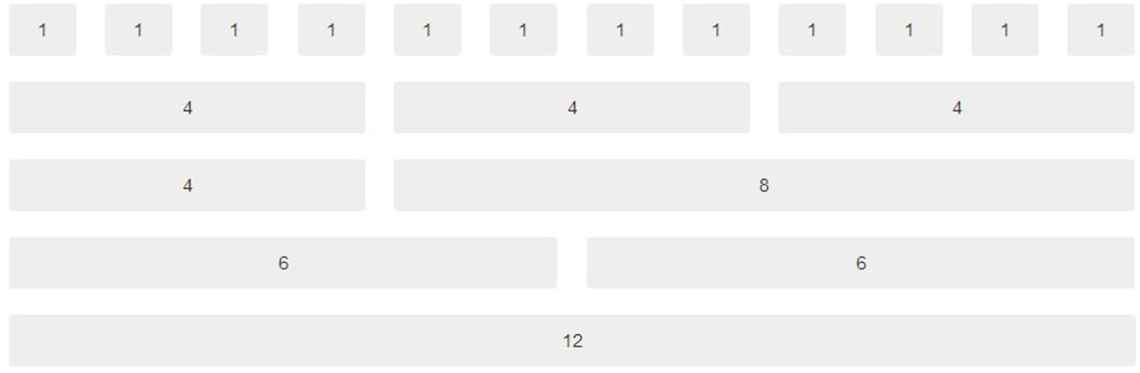
Bootstrap Grid System

Slide 6
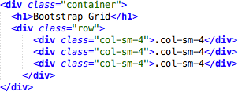
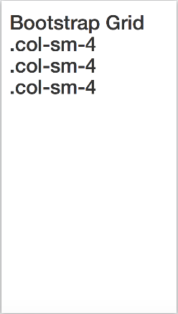
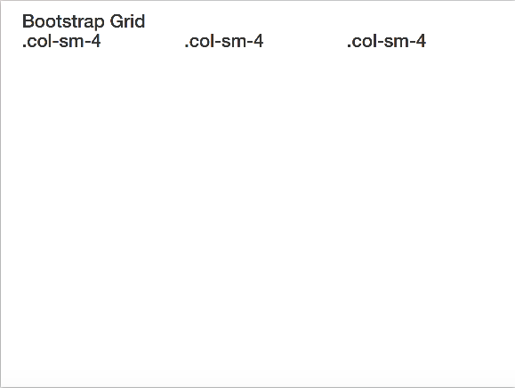
Bootstrap Grid System
In the bellow example, we divide the space inside the container in 1 row and this row in 3 columns with the same side. 4+4+4 = 12
You can use any combination that the sum be equal to 12.
small screens
big screens

Slide 7
✅ Basic Structure
<div class="container">
<div class="row">
<div class="col-6">Column 1 (6/12)</div>
<div class="col-6">Column 2 (6/12)</div>
</div>
</div>
This creates two columns each taking up 50% of the row.

Slide 8
🔄 Responsive Breakpoints
You can make columns responsive by using different breakpoints
Class Prefix | Screen Size | Example
.col- | Extra small (<576px) | col-12
.col-sm- | Small (≥576px) | col-sm-6
.col-md- | Medium (≥768px) | col-md-4
.col-lg- | Large (≥992px) | col-lg-3
.col-xl- | Extra large (≥1200px) | col-xl-2

Slide 9
Bootstrap components
Bootstrap offers a wide range of pre-built components that you can use to quickly build beautiful, interactive, and responsive UI elements without writing custom CSS or JavaScript.
overview of the most commonly used Bootstrap components
✅ 1. Alerts
Used for feedback messages, like success or error notifications.
✅ 2. Buttons
Easily styled buttons with contextual classes.
✅ 3. Cards
A flexible content container with options for headers, footers, images, and more.
✅ 4. Modals
Popup windows used for dialogs, forms, or notifications.

Slide 10
Bootstrap components
✅ 5. Navbar
Responsive navigation header for your site.
✅ 6. Carousel
Image slider component.
✅ 7. Accordion (Collapsible Panels)
Used for FAQs or collapsible content sections.
✅ 8. Badges
For notifications or counts.
✅ 9. Progress Bars
Show progress of a task.
✅ 10. Tabs / Pills
Switch between different content panes.

Slide 11
Bootstrap components
Bootstrap also includes
Toasts
Spinners
Pagination
Dropdowns
Forms
Tooltips
Popovers

