Slide 1
HTML
HTML stands for Hyper Text Markup Language.
HTML is a presentation Language to present data on webpage.
HTML is not case sensitive language.
HTML standards are provided by W3C[World Wide Web Consortium]
HTML is a error free language.
HTML is useful to develop static web pages.
HTML comes with predefined tags and entities.
Extension of HTML is .html or .htm

Slide 2
HTML Sturcture
<html>
<head>
<title>
Title of the webpage
</title>
</head>
<body>
--------
</body>
</html>
<head>
Declare JavaScript
Declare styles
Declare external styles files
Declare js files
Declare meta info
</head>
<Body>
To declare all predefined Tags
</Body>

Slide 3
HTML
Html comes with predefined tags and entities
The general format for a HTML tag is:
<tag_name>string of text</tag_name>
Heading Tags
h1,h2,h3,h4,h5,h6
<h1>Welcome to HTML</h1>
<p></p> for paragraphs
<span>EmpID</span>
Adding Images
<img src="peter.jpg" width="200" height="150" alt="My friend Peter">
The alt attribute is used to give the short description

Slide 4
Overview
Adding links
<a href="peter.html">Peter's page</a>
<a href=“home.html"><img src="logo.gif" alt="home page"></a>
Adding lists
a) unordered list.
<ul>
<li> the first list item</li>
<li> the second list item</li>
</ul>

Slide 5
Overview
b) ordered list.
<ol type=1> (type=1 or a or i)
<li> the first list item</li>
<li> the second list item</li>
</ol>
Note:<br> is use to line brakes

Slide 6
Tables
Tables are used for information as well as for layout.
<table border="1"> <tr><th>Year</th><th>Sales</th></tr> <tr><td>2000</td><td>$18M</td></tr> <tr><td>2001</td><td>$25M</td></tr> <tr><td>2002</td><td>$36M</td></tr>
</table>
<table border="1" cellpadding="10">
<table border="1" cellpadding="10" cellspacing="10">
<table border="1" cellpadding="10" width="80%">

Slide 7
Overview
Entities:
&nbsp; | Blank space
&copy; | ©
&reg; | ®
&#8482; | ™

Slide 8
Forms
The <form> tag in HTML is used to collect user input and submit it to a server or process it with JavaScript. It creates a form container where you can include various form controls like text fields, checkboxes, radio buttons, and buttons.
<form>
<input type=“text” name=“txtuser”>
<input type=“password” name=“txtpass”>
<input type=“submit” value=“Login”>
</form>

Slide 9
🎯 Main Purposes of <form>
Function | Description
Group Inputs | Wraps and organizes input fields (e.g., textboxes, checkboxes, selects) into a logical unit.
Handle User Input | Allows users to enter data (e.g., login, registration, search, contact info).
Submit Data | Sends collected data to a server or JavaScript handler when the form is submitted.
Validation | Supports HTML5 validation for required fields, patterns, ranges, etc.

Slide 10
⚙️ Key Attributes of <form>
Attribute | Purpose
action | URL where the form data should be sent.
method | HTTP method: GET (default) or POST.
enctype | Type of encoding (e.g., multipart/form-data for file uploads).
target | Specifies where to display the response (e.g., _self, _blank).
novalidate | Disables HTML5 form validation.
🔄 Form Submission Process
User fills out the form
User clicks submit
Browser validates input (if applicable)
Data is sent to the server (or handled via JavaScript)

Slide 11
Forms
Input Controls.
TextBox:
<input type=“text” name=“txtuser”>
Password:
<input type=“password” name=“txtpass”>
Button
<input type=“button” value=“clickme”>
<input type=“submit” value=“Login”>
<input type=“reset” value=“reset”>
Checkbox
<input type=“checkbox” value=“clickme”>
Radio
<input type=“Radio” value=“clickme”>

Slide 12
Forms
Combo Box(only one selection at a time)
<select name=“country”>
<option value="India"> India </option>
<option value="China"> China </option>
</select>
List Box(one/many selection allowetd)
<select name=“country” multiple=multiple>
<option value="India"> India </option>
<option value="China"> China </option>
</select>

Slide 13
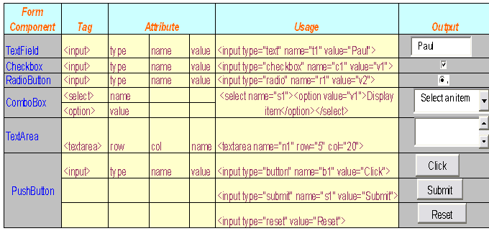

Slide 14
Html
Some other formatting tags
<b> </b> - makes the text bold
<i> </i> - makes the text italics
<p> </p> - creates a paragraph
<center> </center> -aligns the text center
<HR> - draws a horizontal line
<font> </font> - specifies type and size of font
face=“Times New Roma” size=29

