Slide 1
Ado.net Entity Framework Core
Entity Framework Core is a data access technology.
Entity Framework (EF) Core is a lightweight, extensible, open source and cross-platform version of the popular Entity Framework data access technology.
ADO.NET entity framework is an ORM (Object Relational Mapping) framework developed by Microsoft to automate database related activities for your application.
Entity Framework gives developers an automated mechanism for accessing & storing the data in the database.
The Microsoft ADO.NET Entity Framework enables developers to work with relational data as domain-specific objects, eliminating the need for most of the data access plumbing code that developers usually need to write.
Using the Entity Framework, developers issue queries using LINQ, then retrieve and manipulate data as strongly typed objects.
It is an enhancement to ADO.NET that gives developers an automated mechanism for accessing & storing the data in the database.
EF Core is intended to be used with .NET Core applications. However, it can also be used with standard .NET 4.5+ framework based applications.

Slide 2
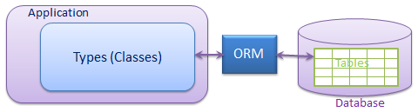
O/RM framework
ORM is a tool for storing data from domain objects to relational database like MS SQL Server in automated way without much programming.
O/RM includes three main parts: Domain class objects, Relational database objects and Mapping information on how domain objects maps to relational database objects (tables, views & stored procedures).
ORM helps us to keep our database design separate from our domain class design. This makes application maintainable and extendable
It also automates standard CRUD operation (Create, Read, Update & Delete) so developer doesn’t need to write it manually.
There are many ORM frameworks for .net in the market like DataObjects.Net, NHibernate, OpenAccess, SubSonic etc . ADO.NET Entity Framework is an open source ORM framework from Microsoft.

Slide 3
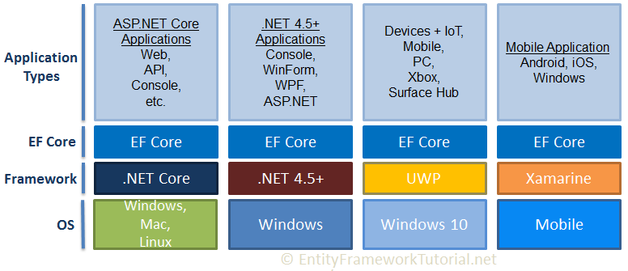
Entity Framework Core

Slide 4
EF Core Version History
EF Core Version | Release Date | Target Framework
EF Core 7.0 | Nov 2022 | .NET 6
EF Core 6.0 | Nov 2021 | .NET 6
EF Core 5.0 | Nov 2020 | .NET Standard 2.1
EF Core 3.0 | Sept 2019 | .NET Standard 2.1
EF Core 2.0 | August 2017 | .NET Standard 2.0
EF Core 1.0 | June 2016 | .NET Standard 2.1
EF Core Official Documentation: https://learn.microsoft.com/en-us/ef/core/
EF Core on GitHub: https://github.com/dotnet/efcore

Slide 5
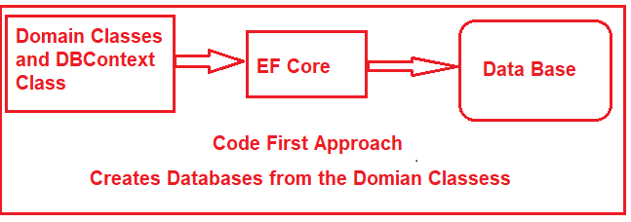
EF Core Development Approaches
EF Core supports two development approaches
1) Code-First
2) Database-First.
EF Core mainly targets the code-first approach and provides little support for the database-first approach because the visual designer or wizard for DB model is not supported as of EF Core.
EF Core Code First Approach:
In the code-first approach, EF Core API creates the database and tables using migration based on the conventions and configuration provided in your domain classes.

Slide 6
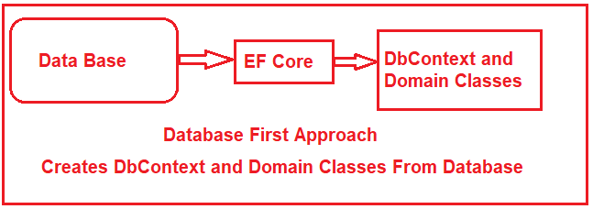
EF Core Development Approaches
EF Core Database First Approach:
In the database-first approach, EF Core API creates the domain and context classes based on your existing database using EF Core commands. This has limited support in EF Core as it does not support visual designer or wizard.

Slide 7
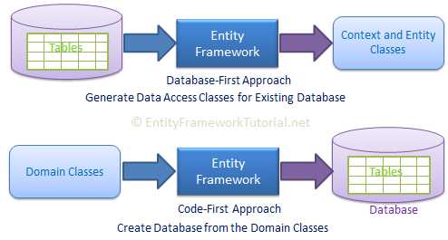
EF Core Development Approaches

Slide 8
EF Core vs EF 6
Entity Framework Core is the new and improved version of Entity Framework for .NET Core applications.
EF Core continues to support the following features and concepts, same as EF 6.
DbContext & DbSet
Data Model
Querying using Linq-to-Entities
Change Tracking
SaveChanges
Migrations

Slide 9
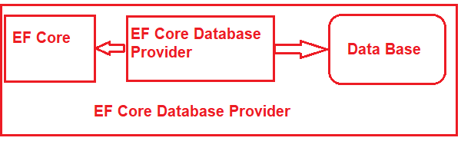
EF Core Database Providers
The EF Core supports both relational and non-relational databases and this is possible due to database providers.
Entity Framework Core uses a provider model to access many different databases. EF Core includes providers as NuGet packages which you need to install.
The database providers are available as NuGet packages. The Database Provider sits between the EF Core and the database it supports.
Database | NuGet Package
SQL Server | Microsoft.EntityFrameworkCore.SqlServer
MySQL | MySql.Data.EntityFrameworkCore
PostgreSQL | Npgsql.EntityFrameworkCore.PostgreSQL
SQLite | Microsoft.EntityFrameworkCore.SQLite
SQL Compact | EntityFrameworkCore.SqlServerCompact40
In-memory | Microsoft.EntityFrameworkCore.InMemory

Slide 10
Install Entity Framework Core
Entity Framework Core can be used with .NET Core or .NET 4.6 based applications.
EF Core is not a part of .NET Core and standard .NET framework. It is available as a NuGet package. You need to install NuGet packages for the following two things to use EF Core in your application:
EF Core DB provider
EF Core tools
PM> Install-Package Microsoft.EntityFrameworkCore.SqlServer
PM> Install-Package Microsoft.EntityFrameworkCore.Tools
Install-Package Microsoft.EntityFrameworkCore.SqlServer -Version 7.0.11
Install EF Core Using .NET CLI(Command Line)
dotnet add package Microsoft.EntityFrameworkCore.SqlServer --version 7.0.11

Slide 11
Entity Framework Core: DbContext
The DbContext class is an integral part of Entity Framework.
An instance of DbContext represents a session with the database which can be used to query and save instances of your entities to a database.
DbContext is a combination of the Unit Of Work and Repository patterns.
The Unit of Work and Repository patterns are architectural patterns commonly used in software development, particularly in applications that interact with databases. They help manage data access, maintain clean separation of concerns, and make the code easier to test and maintain.

Slide 12
Entity Framework Core: DbContext
DbContext in EF Core allows us to perform following tasks:
Manage database connection
Configure model & relationship
Querying database
Saving data to the database
Caching
Transaction management
To use DbContext in our application, we need to create the class that derives from DbContext
public class SchoolContext : DbContext
{
public DbSet<Student> Students { get; set; }
public DbSet<Course> Courses { get; set; } }
}
The DbSet<TEntity> type allows EF Core to query and save instances of the specified entity to the database.
LINQ queries against a DbSet<TEntity> will be translated into queries against the database.
EF Core API will create the Student and Grade table in the underlying SQL Server database where each property of these classes will be a column in the corresponding table.

Slide 13
Entity Framework Core: DbContext
DBSet and DbContext Methods
Method | Usage
Add | Adds a new entity to DbContext with Added state and starts tracking it. This new entity data will be inserted into the database when SaveChanges() is called.
Find | Finds an entity with the given primary key values.
Remove | Sets Deleted state to the specified entity which will delete the data when SaveChanges() is called.
SaveChanges | Execute INSERT, UPDATE or DELETE command to the database for the entities with Added, Modified or Deleted state.
Update | Attaches disconnected entity with Modified state and start tracking it. The data will be saved when SaveChagnes() is called.

Slide 14
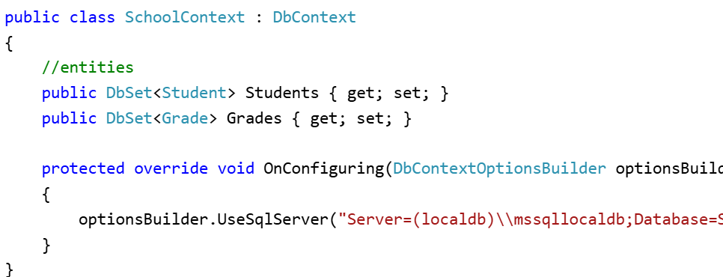
Configure Database Connection
In the above code, the optionsBuilder.UseSqlServer() is an extension method used to configure EF to use SQL Server as the database provider by specifying a database connection string.

Slide 15
CODE FIRST

Slide 16
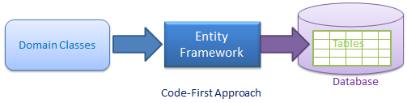
Code-First
Entity Framework introduced Code-First approach from Entity Framework 4.1. Code-First is mainly useful in Domain Driven Design. With the Code-First approach, you can focus on the domain design and start creating classes as per your domain requirement rather than design your database first and then create the classes which match your database design. Code-First APIs will create the database on the fly based on your entity classes and configuration.

Slide 17

Migrations in Entity Framework Core
Migration is a way to keep the database schema in sync with the EF Core model by preserving data.
EF Core API builds the EF Core model from the entity classes
EF Core migrations API will create or update the database schema based on the EF Core model. Whenever you change the domain classes, you need to run migration commands to keep the database schema up to date.
EF Core migrations are a set of commands which you can execute in Package Manager Console or PowerShell or in .NET Core CLI (Command Line Interface).
To use EF Core Migrations API, we need to install the NuGet package Microsoft.EntityFrameworkCore.Tools.
Adding a Migration
add-migration InitialSchoolDB
EF Core provides migrations commands to create, update, or remove tables and other DB objects based on the entities and configurations.

Slide 18
Migrations in Entity Framework Core
The Add-Migration command does not create the database. It just creates the two snapshot files in the Migrations folder.
<timestamp>_<Migration Name>.cs: The main migration file which includes migration operations in the Up() and Down() methods. The Up() method includes the code for creating DB objects and the Down() method includes code for removing DB objects.
<contextclassname>ModelSnapshot.cs: A snapshot of your current model. This is used to determine what changed when creating the next migration.
Now, to create a database, use the update-database command in the Package Manager Console
update-database
Reverting Migration
For some reason, if you want to revert the database to any of the previous state then you can do it by using the update-database <migration-name> command.
Update-database "InitialSchoolDB“
List All Migrations
Get-Migration(to get the list of all migrations)

Slide 19
Migrations in Entity Framework Core
Removing a Migration
We can remove the last migration if it is not applied to the database.
remove-migration

Slide 20
Migrations in Entity Framework Core
We can execute the migration command using NuGet Package Manger Console as well as dotnet CLI (command line interface).
In Visual Studio, open NuGet Package Manager Console from Tools -> NuGet Package Manager -> Package Manager Console and enter the following command:
PM> add-migration CreateSchoolDB
After creating a migration, we still need to create the database using the update-database command in the Package Manager Console, as below.
PM> update-database
Note:This was the first migration to create a database. Now, whenever we add or update domain classes or configurations, we need to sync the database with the model using add-migration and update-database commands.

Slide 21
Code First Conventions
Convention is a set of default rules to automatically configure a conceptual model based on domain class definitions when working with Code-First. Code-First conventions are defined in System.Data.Entity.ModelConfiguration.Conventions namespace.
Primary Key Convention
Code-First automatically creates a Primary Key in each table. The default convention for primary key is that Code-First would create a primary key for a property if the property name is Id or <class name>Id (NOT case sensitive). The data type of a primary key property can be anything, but if the type of the primary key property is numeric or GUID, it will be configured as an identity column.
Relationship Convention:
Code First infer the relationship between the two entities using navigation property. This navigation property can be simple reference type or collection type.

Slide 22
Code First Conventions
Foreign key Convention
Code First automatically inserts a foreign key when it encounters a navigation property.

Slide 23
C# DataType | Related DB Column DataType | PK Column DataType & Length
int | int | int, Identity column increment by 1
string | nvarchar(Max) | nvarchar(128)
decimal | decimal(18,2) | decimal(18,2)
float | real | real
byte[] | varbinary(Max) | varbinary(128)
datetime | datetime | datetime
bool | bit | bit
byte | tinyint | tinyint
short | smallint | smallint
long | bigint | bigint
double | float | float
char | No mapping | No mapping
sbyte | No mapping (throws exception) | No mapping
object | No mapping | No mapping

Slide 24
POCO Entity (Plain Old CLR Object)
POCO class is the class that doesn't depend on any framework specific base class. It is like any other normal .net class which is why it is called "Plain Old CLR Objects".
These POCO entities (also known as persistence-ignorant objects) support most of the same query, insert, update, and delete behaviors as entity types that are generated by the Entity Data Model.
Entity can have two types of properties, Scalar and Navigation properties.
Scalar properties:
Scalar properties are properties whose actual values are contained in the entity. For example, Student entity has scalar properties like StudentId and StudentName. These correspond with the Student table columns.
Navigation properties:
Navigation properties are pointers to other related entities. The Student has Standard property as a navigation property that will enable the application to navigate from a Student to related Standard entity.

Slide 25
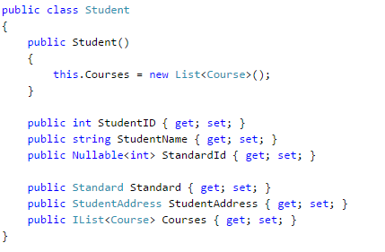
POCO Entity (Plain Old CLR Object)

Slide 26
Configure Domain Classes in Code-First
Code-First builds conceptual model from your domain classes using default conventions.
We can an override these conventions by configuring your domain classes to provide EF with the information it needs. There are two ways to configure your domain classes.
DataAnnotations
Fluent API
DataAnnotation:
DataAnnotation is a simple attribute based configuration, which you can apply to your domain classes and its properties. You can find most of the attributes in the System.ComponentModel.DataAnnotations namespace.

Slide 27
DataAnnotations in Code-First
EF Code-First provides a set of DataAnnotation attributes, which you can apply to your domain classes and properties. DataAnnotation attributes override default Code-First conventions. System.ComponentModel.DataAnnotations includes attributes that impacts on nullability or size of the column. System.ComponentModel.DataAnnotations.Schema namespace includes attributes that impacts the schema of the database.

Slide 28
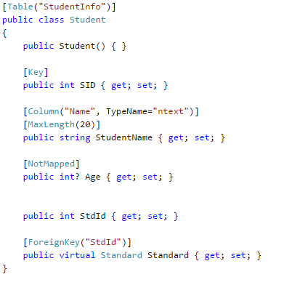
Configure Domain Classes in Code-First

Slide 29
System.ComponentModel.DataAnnotations
Attribute | Description
Key | Mark property as EntityKey which will be mapped to PK of the related table.
Timestamp | Mark the property as a non-nullable timestamp column in the database.
Required | The Required annotation will force EF (and MVC) to ensure that property has data in it.
MinLength | MinLength annotation validates property whether it has minimum length of array or string.
MaxLength | MaxLength annotation is the maximum length of property which in turn sets the maximum length of a column in the database
StringLength | Specifies the minimum and maximum length of characters that are allowed in a data field.

Slide 30
System.ComponentModel.DataAnnotations.Schema
ttribute | Description
Table | Specify name of the DB table which will be mapped with the class
Column | Specify column name and datatype which will be mapped with the property
Index | Create an Index for specified column. (EF 6.1 onwards only)
ForeignKey | Specify Foreign key property for Navigation property
NotMapped | Specify that property will not be mapped with database

Slide 31
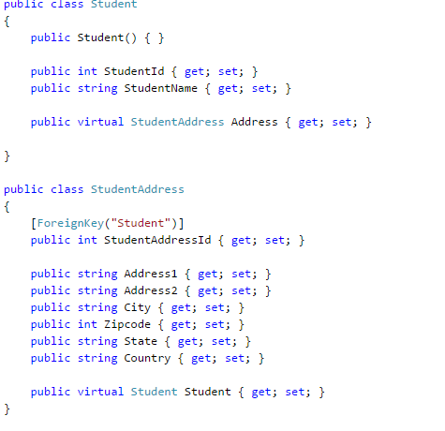
Configure One-to-Zero-or-One Relationship
we will configure One-to-Zero-or-One relationship between two entities, e.g. Entity1 can be associated with zero or only one instance of Entity2.

Slide 32
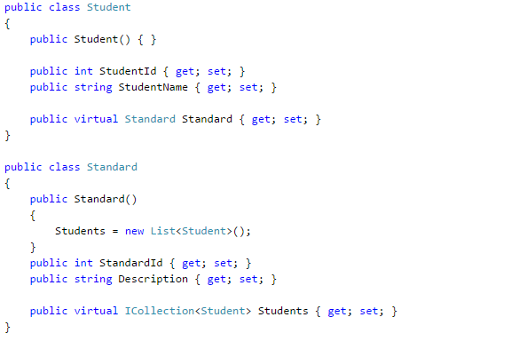
Configure One-to-Many Relationship

Slide 33
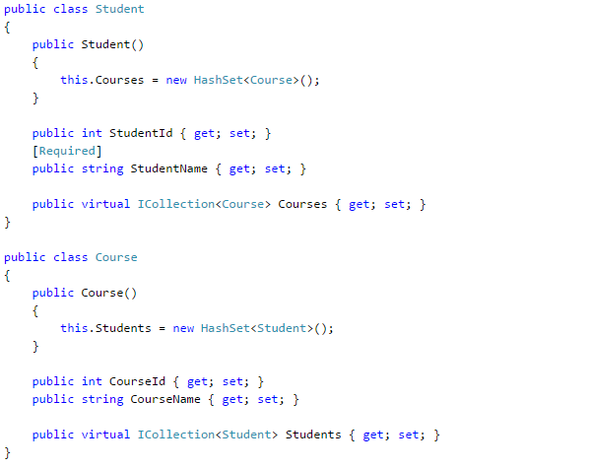
Configure Many-to-Many relationship

Slide 34
Creating a Model for an Existing Database in Entity Framework Core
PM> Scaffold-DbContext "Server=.\SQLExpress;Database=SchoolDB;Trusted_Connection=True;" Microsoft.EntityFrameworkCore.SqlServer -OutputDir Models
Update models when tables are updated
PM> Scaffold-DbContext "Server=.\SQLExpress;Database=SchoolDB;Trusted_Connection=True;" Microsoft.EntityFrameworkCore.SqlServer -OutputDir Models -force

Slide 35
Stored Procedure in Entity Framework Core
EF Core provides the following methods to execute a stored procedure:
DbSet<TEntity>.FromSqlRaw()
DbContext.Database.ExecuteSqlRaw()
Ex: context.Database.ExecuteSqlRaw("CreateStudents @p0, @p1", parameters: new[] { "Bill", "Gates" });

Slide 36
Tracking Changes of Entities in EF Core
DbContext tracks the changes of entities and modify their state.
This will allow it to perform insert, update or delete operation based on the states.
The DbContext in Entity Framework Core includes the ChangeTracker property of type ChangeTracker class which is responsible of tracking the state of each entity retrieved using the DbContext instance.
The ChangeTracker starts tracking of all the entities as soon as it is retrieved using the object of the DbContext class, until they go out of its scope.
EF keeps track of all the changes applied to all the entities and their properties, so that it can build and execute appropriate DML statements to the underlying data source.
An entity at any point of time has one of the following states which are represented by the enum Microsoft.EntityFrameworkCore.EntityState in EF Core.
Added
Modified
Deleted
Unchanged
Detached

