Slide 1
Docker Overview
Docker is an open-source platform
Docker lets you build, package, and run applications in lightweight, portable containers.
Docker is like a shipping container for software. It bundles your app with everything it needs—code, runtime, libraries—so it runs the same everywhere.
Docker is an open-source platform that helps developers build, ship, and run applications in lightweight, isolated environments called containers.
🧠 Think of Docker as a way to package your app so it runs the same everywhere — on your computer, on your friend's laptop, or on a cloud server.
Docker was Released in March 2013
Docker is a tool designed to make it easier to Build, Ship and Run applications by using containers.
Docker is for developers to easily build applications, ship them into containers which can then be deployed and run anywhere.

Slide 2
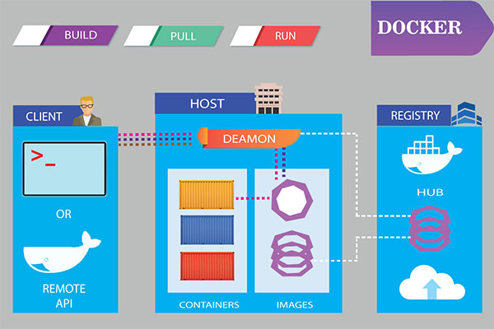
Docker Overview

Slide 3
📦 How Docker Works (High-Level)
🏗️ Basic Docker Workflow
🧑‍💻 Write your app
🛠️ Create a Dockerfile (recipe to build your app image)
📦 Build the image → docker build
🚀 Run the container →docker run
📌 Real-Life Analogy
Docker containers are like lunchboxes 🥡:
You pack food (your app) with everything it needs (utensils, napkin, sauce).
Anyone can open and eat from it, anywhere, without needing a kitchen.

Slide 4
Docker Advantages
Advantage | Description
1. Portability | Run containers anywhere: local, cloud, Linux, Windows — no reconfiguration.
2. Lightweight | Containers share host OS, use fewer resources, and start faster than VMs.
3. Consistency | Same environment for dev, test, and production — reduces bugs & issues.
4. Easy Deployment | Package and deploy the app with all dependencies using simple Docker commands.
5. Fast Testing & CI/CD | Spin up test environments quickly for automated pipelines and integration.

Slide 5
Docker Advantages
Advantage | Description
6. Isolation | Each container runs separately — no conflicts between apps or versions.
7. Microservices Support | Ideal for breaking large apps into smaller, scalable services.
8. Persistent Storage | Use volumes to store data outside containers — data survives restarts.
9. Version Control | Images are tagged and versioned — rollback or reuse any version easily.
10. Cloud & DevOps Ready | Easily integrates with AWS, Azure, Kubernetes, GitHub, Jenkins, etc.

Slide 6
Docker Overview
🧪 Where is Docker Used?
Software development
DevOps and CI/CD pipelines
Microservices
Cloud deployment (Azure, AWS, GCP)
Testing environments

Slide 7
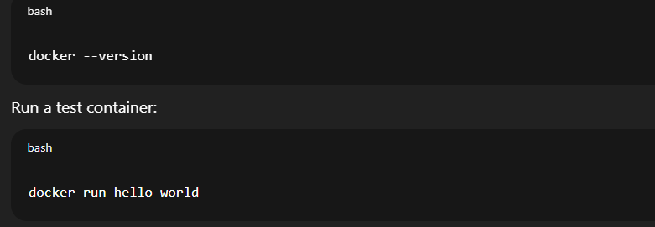
Docker Installation Steps
Step 1: Install Docker
Go to Docker's website: https://www.docker.com/products/docker-desktop/
Download Docker Desktop for your OS (Windows, macOS, or Linux).
Install and run Docker Desktop.
Ensure Docker is running (docker info in the terminal should show details)
Step 2: Test Docker Installation

Slide 8
Features of Docker
1. Lightweight
Containers share the host OS kernel, making them smaller and faster than virtual machines.
2. Portability
"Build once, run anywhere" – Docker containers run consistently across different environments (development, test, production).
3. Fast Startup
Containers start almost instantly, which improves speed during development and deployment.
4. Isolation
Each container runs in its own isolated environment with its own filesystem, processes, and network.
5. Version Control
Docker images can be versioned and rolled back easily, enabling better control over application versions.

Slide 9
Features of Docker
6. Reusability
Images can be reused across multiple containers, reducing duplication and resource use.
7. Scalability
Docker integrates well with orchestration tools like Kubernetes for scaling services efficiently.
8. Resource Efficiency
Containers use fewer resources than traditional VMs, making better use of hardware.
9. Security
Containers are isolated from the host and each other, enhancing application security.
10. CI/CD Friendly
Works seamlessly with continuous integration/continuous deployment pipelines for automated testing and deployment.
11. Docker Hub & Registry
Provides a central place to find, share, and distribute container images.

Slide 10
🔄 Docker vs Virtual Machines
Feature | Docker (Container) | Virtual Machine (VM)
Architecture | Shares host OS kernel | Runs a full OS with virtual hardware
Size | Small (MBs) | Large (GBs)
Startup Time | Very fast (seconds) | Slow (minutes)
Resource Usage | Lightweight — uses fewer CPU/RAM | Heavy — each VM needs its own OS and resources
Isolation | Process-level isolation (namespaces) | Complete OS-level isolation
Performance | Near-native performance | Slower due to full OS overhead
Portability | Highly portable — runs anywhere Docker runs | Less portable — dependent on hypervisor & OS

Slide 11
🔄 Docker vs Virtual Machines
Feature | Docker (Container) | Virtual Machine (VM)
Use Case | Microservices, DevOps, CI/CD, app isolation | Running multiple OSes, legacy systems, full-stack tests
Example OS Support | Linux containers on Linux, Windows on Windows | Run Linux on Windows, or Windows on Linux
Security | Less isolated than VMs (but improving) | Strong OS-level isolation

Slide 12
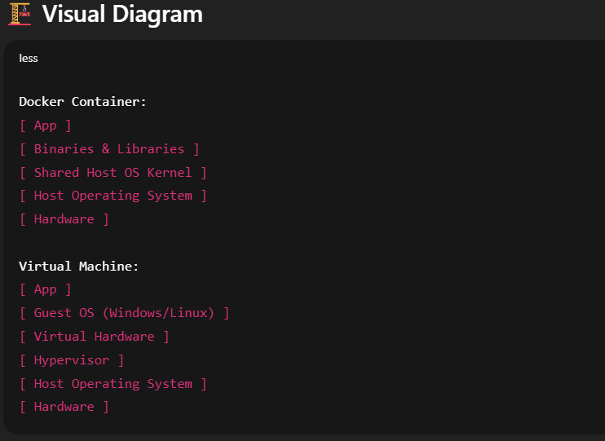
🔄 Docker vs Virtual Machines

Slide 13
🔄 Docker vs Virtual Machines
Topic | Docker | Virtual Machine
Speed | ⚡ Faster | 🐢 Slower
Size | 📦 Lightweight | 🧱 Heavy
Isolation | 🔓 Medium | 🔐 Strong
Use Case | ✅ Ideal for microservices & DevOps | ✅ Ideal for full OS simulation/testing

Slide 14
Docker Terminology
1. Docker
A platform to build, ship, and run applications in containers.
Think of it as a toolbox for developers to create self-contained app environments.
2. Container
A lightweight, isolated environment that runs your application.
It includes everything the app needs: code, libraries, config.
💡 Analogy: A lunchbox — holds your meal with all needed items.
3. Image
A read-only template used to create containers.
Like a recipe 🧾
You build a container from an image.
Example: nginx, python, microsoft/dotnet

Slide 15
Docker Terminology
4. Dockerfile
A text file with a list of instructions to build an image.
5. Docker Engine
The core service that runs Docker containers on your system.
It includes:
Docker CLI (Command Line)
Docker Daemon (background service)
6. Docker Hub
A cloud-based registry to find and share Docker images.
🔎 Like a Play Store for Docker images.
Examples: mysql, nginx, node, redis

Slide 16
Docker Terminology
7. Docker Compose
A tool to define and run multi-container apps.
8. Volume
A persistent storage option for containers.
Used to store data outside the container so it isn’t lost when the container stops.
9. Network
Docker provides internal virtual networks so containers can communicate.
📡 For example, your API container talks to a database container using db:5432.
10. Tag
A label used to version Docker images.
docker pull ubuntu:20.04

Slide 17
🛠 Tools Commonly Used with Docker
Docker Engine
The core software that runs and manages containers.
Docker Desktop
GUI application for managing containers, images, and volumes on Windows/macOS.
Docker CLI
Command-line interface to interact with Docker(e.g., docker run, docker build)
Docker Hub
Public registry where you can share and pull Docker images.
Docker Compose
Tool for defining and running multi-container applications using a YAML file.
Dockerfile
Text file with instructions to build a Docker image.
Kubernetes
Container orchestration tool often used with Docker in production environments.

Slide 18
Dockerfile
A Dockerfile is a plain text file that contains a set of instructions used by Docker to build a Docker image
🧠 Think of it like a recipe that tells Docker how to package your app and its environment
A Dockerfile produces a Docker image when you build it.
A Dockerfile must not have any extension and must be named as Dockerfile with capital D.
🔧 Why Do We Need a Dockerfile?
Define how your app should be built and run
Specify the OS, runtime (like .NET, Node.js), libraries, and code
Ensure consistent builds across environments (dev, test, production)

Slide 19
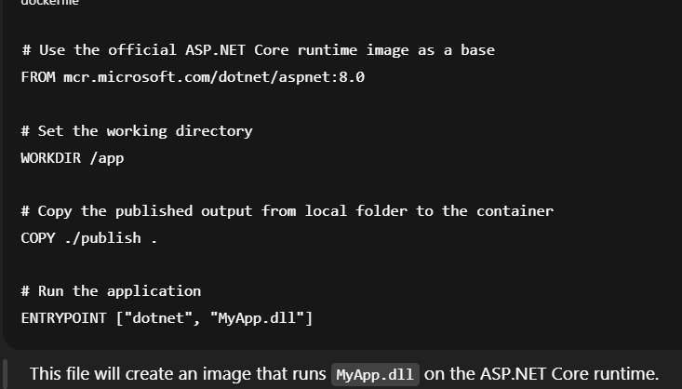
Example Dockerfile for a .NET Web API

Slide 20
🛠 Basic Syntax of a Dockerfile
# 1. Use a base image
FROM node:18
# 2. Set the working directory in the container
WORKDIR /app
# 3. Copy package files and install dependencies
COPY package*.json ./
RUN npm install
# 4. Copy the rest of the app code
COPY . .
# 5. Expose the port the app runs on
EXPOSE 3000
# 6. Define the command to run the app
CMD ["node", "index.js"]

Slide 21
Common Dockerfile Instructions
Instruction | Purpose
FROM | Specifies the base image to use.
WORKDIR | Sets the working directory inside the container.
COPY | Copies files from host/system to your container.
RUN | Executes/run commands (e.g., install packages).
EXPOSE | Indicate which port the app will listen on (e.g., 80)
CMD | Sets the default command to run the container.
EXPOSE | Documents which ports the container uses.
ENV | Sets environment variables.
CMD/ENTRYPOINT | Configures a container to run as an executable. Or Define the command to run the app

Slide 22
How to Build and Run a Dockerfile
# Build image from Dockerfile
docker build -t myapp .
# Run a container from the image
docker run -p 3000:3000 myapp

Slide 23
Docker Image
A Docker Image is a read-only template used to create Docker containers.
🧠 Think of it like a blueprint or recipe for running a containerized application.
It contains:
Your application code
The runtime (like .NET, Node.js, Python, etc.)
Any libraries, dependencies, and environment variables
Instructions on how to run the app (from the Dockerfile)

Slide 24

🔧 How Is an Image Built?
1.You write a Dockerfile (a script with build instructions).
2. Run:
3. Docker reads the Dockerfile and builds an image layer-by-layer.
4.The result is an image stored locally or pushed to Docker Hub.

Slide 25
🔁 Image vs Container
Docker Image | Docker Container
Blueprint (read-only template) | Running instance of the image
Like a class in OOP | Like an object created from that class
Built using docker build | Started using docker run

Slide 26
Docker Container?
A Docker Container is a running instance of a Docker image.
It is a lightweight, standalone, and isolated environment where your application runs.
🧠 Think of it as a live application box that has everything your app needs and runs exactly the same everywhere.
It runs consistently across any environment, whether it's your laptop, a test server, or a production cloud server.
✅ A Docker container includes
App code
Runtime (e.g., .NET, Node.js, Python)
System libraries
Configuration files

Slide 27
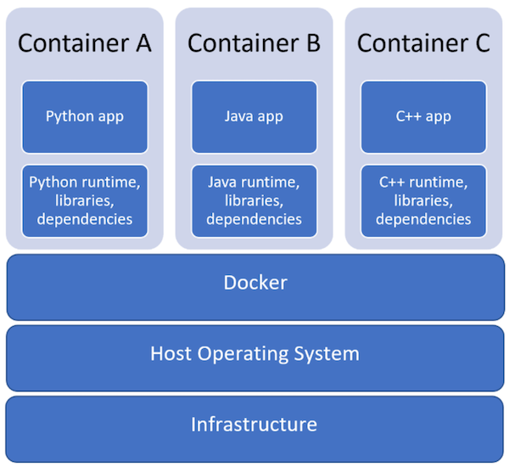
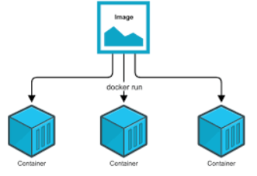
Why Use Docker Containers?
Portability: Works the same on any system with Docker.
Speed: Containers start almost instantly.
Isolation: Keeps environments clean and separate.
Scalability: Great for microservices and cloud-native deployments.

Slide 28
How a Container is Created
1. Write a Dockerfile (build instructions)
2.Build an image:
docker build -t myapp .
Run the container:
docker run -p 8080:80 myapp
Example: For a web app:
Docker Image → Contains .NET runtime, app code, libraries
Docker Container → Runs the web app, listens on port 8080
🧪 Real-World Analogy
A container is like a shipping container:
Inside: your application, tools, and environment
Outside: standardized box that fits on any truck, ship, or train (system)

Slide 29
Common Container Commands
Command | Description
docker run | Start a new container
docker ps | List running containers
docker stop <id> | Stop a running container
docker rm <id> | Remove a stopped container
docker exec -it <id> bash | Access a container’s shell

Slide 30
🚀 Basic Docker Commands
Command | Purpose
docker version | Show Docker version installed
docker info | Show system-wide Docker information
docker help | List all Docker command options

Slide 31
🧱 Image Management
Command | Purpose
docker build -t name . | Build image from Dockerfile in current dir
docker images | List all locally stored images
docker rmi <image-id> | Remove an image
docker pull <image-name> | Download image from Docker Hub
docker push <image-name> | Upload image to Docker Hub
docker tag <image> <new-name> | Tag image with a new name

Slide 32
📦 Container Management
Command | Purpose
docker run <image> | Run a container from an image
docker run -d <image> | Run in detached mode (in background)
docker run -it <image> bash | Run container interactively with shell
docker run -p host:container <image> | Map ports (e.g., -p 8080:80)
docker ps | Show running containers
docker ps -a | Show all containers (running and stopped)
docker stop <container-id> | Stop a running container
docker start <container-id> | Start a stopped container
docker restart <container-id> | Restart a container

Slide 33
📦 Container Management
Command | Purpose
docker rm <container-id> | Remove a container
docker logs <container-id> | View logs from a container
docker exec -it <container-id> bash | Access the container’s shell (interactive)
docker inspect <container-id> | View detailed container info

Slide 34
🗂️ Volumes & Networks
Command | Purpose
docker volume create <name> | Create a named volume
docker volume ls | List all volumes
docker volume rm <name> | Remove a volume
docker network ls | List all Docker networks
docker network create <name> | Create a custom network
docker network inspect <name> | Show details of a network

Slide 35
🧹 Clean-Up Commands
Command | Purpose
docker system prune | Remove unused data (images, containers, etc.)
docker image prune | Remove dangling images
docker container prune | Remove stopped containers
docker volume prune | Remove unused volumes
Command | Purpose
docker system prune | Remove unused data (images, containers, etc.)

Slide 36
📁 Docker Compose Commands
Command | Purpose
docker-compose up | Start all services defined in the file
docker-compose up -d | Start in detached mode
docker-compose down | Stop and remove containers, networks, volumes
docker-compose build | Build images defined in the compose file

Slide 37
🔄 Web Server vs Docker Container: Key Differences
Aspect | Web Server | Docker Container
Definition | Software that handles HTTP requests and serves content (e.g., Nginx, Apache, Kestrel). | A lightweight, isolated environment to run applications.
Purpose | Serves web content (HTML, APIs, etc.) over HTTP/S. | Runs an entire application (web server + app + dependencies).
Scope | Part of the application stack (mainly for handling requests). | Encapsulates the entire app stack: app code, web server, OS libs.
Example | Nginx serving static files, or Kestrel in ASP.NET. | A Docker container running your ASP.NET app with Kestrel inside.
Isolation | Shares the host OS. May conflict with other software. | Fully isolated. Each container has its own filesystem, network, etc.

Slide 38
🔄 Web Server vs Docker Container: Key Differences
Aspect | Web Server | Docker Container
Deployment | Must be installed/configured manually on the server. | Can be built once and run anywhere (portability).
Lifecycle | Long-running software service. | Starts/stops as needed; more ephemeral.
Management | Managed by sysadmin or DevOps tools. | Managed by Docker CLI or orchestration tools like Kubernetes.
🔁 Real-World Analogy
A web server is like a restaurant kitchen (serves food to guests).
A Docker container is like a food truck (everything needed to serve food is inside the truck; can move anywhere and start serving immediately).
📌 In Practice:
If you're running an ASP.NET Core app: Without Docker: You install .NET SDK, configure Kestrel or IIS, run the app.
With Docker: You package the app (including Kestrel) in a container, and just run the container.

