Slide 1








Naungan Kasih Hybrid Parenting Programme Onboarding
Name of the Facilitators
Month Year
Notes:
Opening slide

Slide 2
Session Overview
Structure of the Workshop
Welcome
Getting Started with ParentText
Break
Spending one-on-one time with your children
Closing
Notes:
Start by outlining the structure of today’s workshop. The workshop begins with a warm welcome and introductions to set the tone for the day. The first session will focus on ‘Getting Started with ParentText’ where they will explore the phone functionality, onboard on ParentText, and complete the first module. After that, there is a short break to recharge. Following the break, the workshop will delve into the first skill, “Spending One-on-One time with your children”, discussing practicial strategies and activities. Finally, the workshop will wrap up with a closing session. Encourage the parents to engage throughout the workshop, ask questions, and share their experiences.

Slide 3
Welcome
Let’s play a NAME GAME!
Stand in a circle.
One person says his/her name and makes a shape.
The entire circle then repeats that person’s name and makes the same shape.
The person sitting next to them says their name and makes a shape.
Repeat for everyone in the circle!
Notes:
Name Game (⏱️5 min)
💡Overview
This game helps the participants get to know each other.
✏️Arahan
Group stands in a circle
One person says his/her name and makes a shape
The entire circle then repeats that person’s name and makes the same shape
The person sitting next to them says their name and makes a shape
Repeat for everyone in the circle!

Slide 4
Welcome
Who is Naungan Kasih Hybrid Parenting Programme for?
For parents, like you, with children 4 to 6 years old enrolled in KEMAS pre-schools
Parents and Parenting includes all caregivers responsible for your child’s well-being. Caregivers include non-biological parents like aunts, uncles, siblings, cousins, foster parents.
What is the goal of the Naungan Kasih Hybrid Parenting Programme?
Build open, caring, and trusting relationships between caregivers and children.
Support healthy and positive relations to keep children safe and support their development.
Promote positive skills for parents to help them teach their children responsible and respectful behavior and instil parenting values
Notes:
The Naungan Kasih programme is for parents who have children between 4 to 6 years old attending KEMAS pre-school.
Now, when we say ‘parents’ and ‘parenting’, we mean someone who is caring for the children, whether that person is their biological parent or not. This includes any person who is a primary caregiver, responsible for the wellbeing of the child.
The goal of Naungan Kasih is to help build open, caring and trusting relationships between caregivers and their children. When we have healthy and positive relations, they help parents to keep their children safe and support their growth and development.
Positive parenting also helps parents teach their children responsible behaviour, respectful behaviour and instil parenting values.

Slide 5


Welcome
What makes Naungan Kasih Programme?
ParentText Chatbot:
Improve My Relationship with My Child
Prepare My Child for Success in School
Memahami Perkembangan Anak
Give My Child Structure
Support Positive Child Behaviour
Keep My Child Safe and Healthy
Have a Healthy Relationship with My Spouse
Build a Family Budget
Only 5 minutes a day!
Notes:
Main components of the Naungan Kasih Programme
Explain that participants will receive Naungan Kasih Hybrid content and support in three main ways:
📱ParentText chatbot
Parents receive daily parenting tips via WhatsApp to help them with their relationship with their child and families (requiring only 5 minutes per day). Parents can achieve the goals of Naungan Kasih in in any preferred order:
Improve My Relationship with My Child
Prepare My Child for Success in School
Memahami Perkembangan Anak
Give My Child Structure
Manage My Child’s Behaviour
Keep My Child Safe and Healthy
Have a Healthy Relationship with My Spouse
Build a Family Budget

Slide 6



Welcome
What makes Naungan Kasih Programme?
Onboarding Session
WhatsApp Support Group
Parent Reflection & Closing Session
ParentText
Notes:
📱WhatsApp Support Group
Parents participate in WhatsApp chat sessions to share their experiences and solve challenges around the skills offered via the ParentText chatbot.
The Facilitator will only share weekly discussion prompts in the WhatsApp Support group. Facilitators are not moderators, they will only interfere if the content discussed goes against positive parenting practices.
In-Person Session
Parents will participate in the two in-person sessions – one that they are currently participating in and one at the end of the programme to support parents to onboard to the Naungan Kasih programme and to reflect and celebrate the completion of the programme.
Parents will participate in two in-person sessions: one which they are currently attending and one at the end of the programme. These sessions serve to welcome parents into the Naungan Kasih programme, provide support for their onboarding process, and provide an opportunity for reflection and celebration upon completing the programme.

Slide 7
Welcome
Let us set up some GROUND RULES
Notes:
Ask the participants to think what is important to them to feel comfortable, respected, feel safe and supported in the group.
Naungan Kasih is a special programme! It brings families together to learn and share common experiences with each other.
When discussing Ground Rules, you can use the following format:
Put up two flipchart papers and write at the top:
Ground rules for ParentText chatbot
Ground rules for WhatsApp support group
Ask participants to share their suggestions.
Writes rules and comments on the flip chart to keep for later reference.
Make sure Ground Rules describe a positive behaviour.You can prompt for rules on specific issues like cell phone use, respect, etc.
You can repeat back what you hear and explore the rules to make sure everyone in the group agrees and understands.
For example, if someone mentions “Respect”, ask what that means to her or him. What sort of behaviour shows “Respect”?
Make sure everyone agrees and has the opportunity to contribute before moving on to another suggestion.

Slide 8
Getting Started with ParentText
Phone Use
Switch on and off the phone
Phone settings
WhatsApp settings
Phone charging
Data bundle
Internal phone storage
Digital awareness
Prevent damage to the phone
Notes:
To make this activity interactive, ask participants to demonstrate the following to the group (and correct/guide as needed):
1) Switching the phone on and off
Show participants:
How to turn the phone on and off. Clearly point out the three buttons on the side (on/off, volume up/down).
Where and how to insert a sim card and ensure that it is properly working once the phone is switched on.
Talk about sim card PIN and how your sim card can get blocked if the PIN is not entered correctly.
2) Navigating through the phone settings
Show participants:
How to increase and reduce phone brightness.
How to install and uninstall apps.
How to take and share screenshots (this is key when they experience technical issues).
3) Navigating through WhatsApp settings
Remind participants that they will receive their ParentText content via WhatsApp.
Show participants:
How to find and open WhatsApp.
How to respond to messages/prompts from ParentText (in order to receive the next content).
How to open images.
How to open audio/video files.
4) Charging the phone
Show how to properly insert the phone charger to avoid breaking the charging system.
Emphasise the importance of disconnecting the phone from the charger once it is fully charged to avoid overcharging.
Use the original phone charger to charge the phone.
5) Switching data bundle on and off
Show participants how to turn data on and off. Point out the change in the status bar when the data is on or off (the H+/3G/4G on the network bar).
Emphasise that data should not be left on non-stop, to minimise data bundle use and optimise battery use.
Show participants how to check data bundle balance and/or data bundle usage.
6) Managing internal phone storage
Ensure participants understand that apps, videos, music, and images all take up space on a phone, and that their phone will not function properly when it is too full.
Show participants how to free up storage space if needed by:
Deleting files such as videos, audios, images, etc.
Uninstalling apps
7) Digital awareness: Internet safety
Discuss the risks of clicking on phishing and suspicious internet links.
Ensure that participants understand that specific personal information should not be shared with unknown people or sources, for instance:
Passwords
Bank account information
Locations
Personal or sensitive images/videos
8) How to prevent damaging your phone
Show participants how to access the password/pattern lock to secure their phone from other unauthorised users.
Discuss how phones should be handled with care, for example:
Keeping phones out of reach from their children
Keeping phones away from direct sunlight
Keeping phones away from working stations that can cause damage to the phone for instance, water, fire etc.

Slide 9
Getting Started with ParentText
Getting into ParentText
Save the ParentText phone number (+60-12-292-7434) as a contact
Open WhatsApp → Search for ‘ParentText’ → Type START to start the chat
Choose a language
Choose how you would like to receive the message
Teks, imej, dan video
Teks, imej, dan audio
Teks dan imej sahaja
Watch the introduction video on your phone!
Notes:
🏅Getting into ParentText (⏱️20 min)
💡Overview
Participants will now have their first interaction with the ParentText chatbot on their phones
✏️Arahan
Take them through the following steps and respond to any questions or challenges that come up. Ensure that everyone has completed the previous step before moving onto the next one.
1. Start a WhatsApp chat with ParentText
Berikan peserta arahan yang berikut:
Open your phone
Save the ParentText phone number (+6-012-292-7434) as a contact
Open WhatsApp, search for ‘ParentText’ and start a chat by typing START
2. Tetapan
Tell participants to follow the ParentText prompts. ParentText will ask them to:
Choose a language
Choose how they would like to receive messages:
Teks, imej, dan video
Teks, imej, dan audio
Teks dan imej sahaja
3. Introduction video
Ask participants to watch the 5-minute introduction video explaining how ParentText works.
Ask participants if they have any questions.

Slide 10
Getting Started with ParentText
Prompts ParentText will ask:
User information (E.g. Age of your child, your gender, your child’s gender)
Taking a pause
Select your first goal “Improve My Relationship with My Child”
Your first skill “Spending One-on-One Time with My Child”
Any questions about using ParentText?
Notes:
4. User information
Tell participants to follow the ParentText prompts. ParentText will ask them to:
Answer short questions about yourself and your family so ParentText can send tailored content (child name, age, gender, and caregiver relationship status)
5. Taking a pause
Taking a pause is a short relaxation exercise that participants can use whenever they feel stressed or angry. This is a great parenting tool and life skill.
Tell participants to follow the ParentText prompts. ParentText will ask them to:
Do the Take a Pause exercise.
6. Select first goal and go through first skill
Participants are now ready to start their first Goal in ParentText.
Tell participants to follow the ParentText prompts. ParentText will ask them to:
Start Goal 1 (“Improve My Relationship with My Child”).
For the onboarding session all participants will work on Goal 1 so they can share their experiences and questions. After having completed this first goal, parents can complete any goal they like.
If a participant has selected a different Goal, tell them to type MENU and guide them on how they can change their goal: MENU > Track my progress > View Goals to Start > Start a new goal and leave my current goal incomplete.
Complete the first 5-minute Skill (“Spending One-on-One Time with My Child”) within this Goal.
Tell participants that ParentText will remind them to do their next Skill tomorrow (and daily afterwards until they have completed the programme).
Ask participants if they have any questions after completing Goal 1. You can prompt them by asking the following:
How was your experience interacting with ParentText?
Do you have any questions about how to interact with ParentText?
Do you have any concerns with how you will interact with ParentText when you are at home?
Praise participants for completing their first ParentText activities!

Slide 11
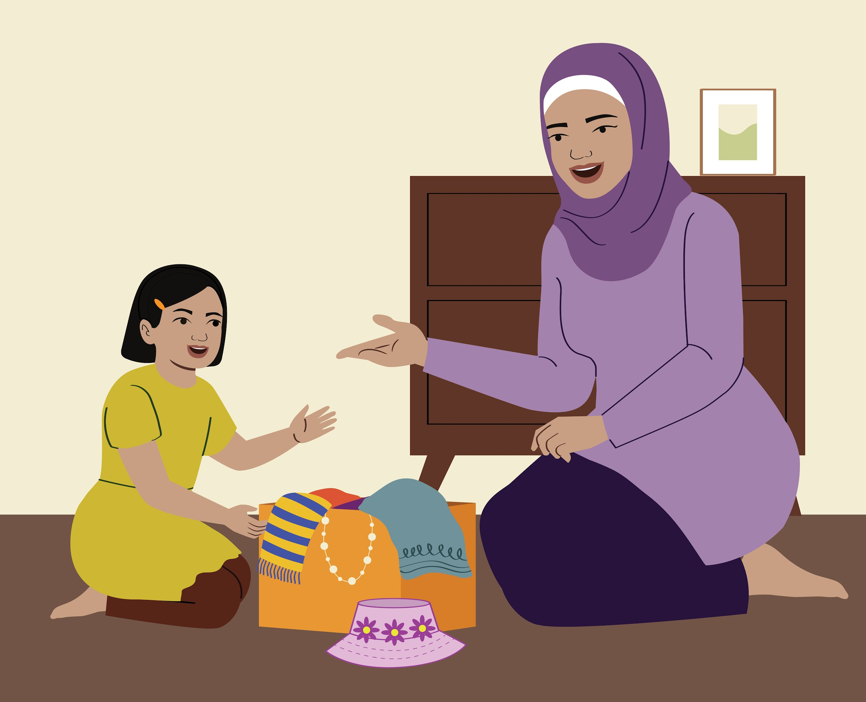
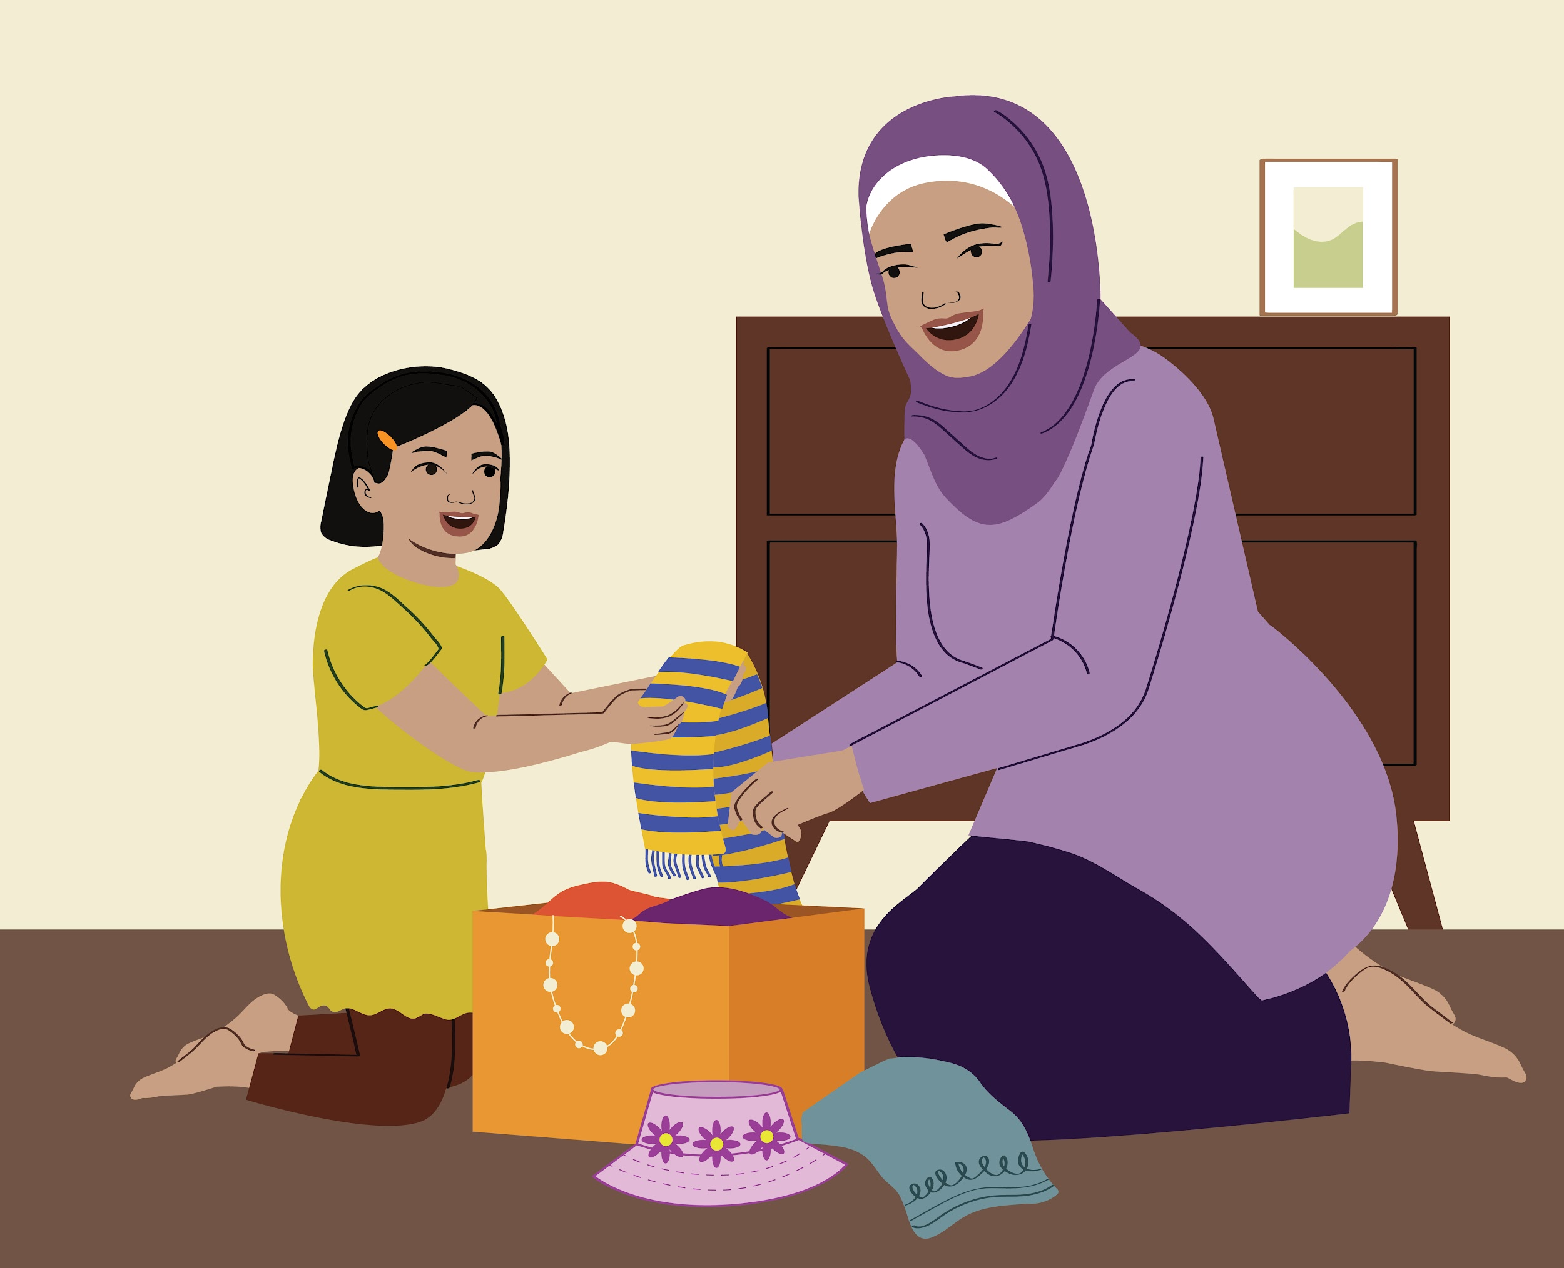
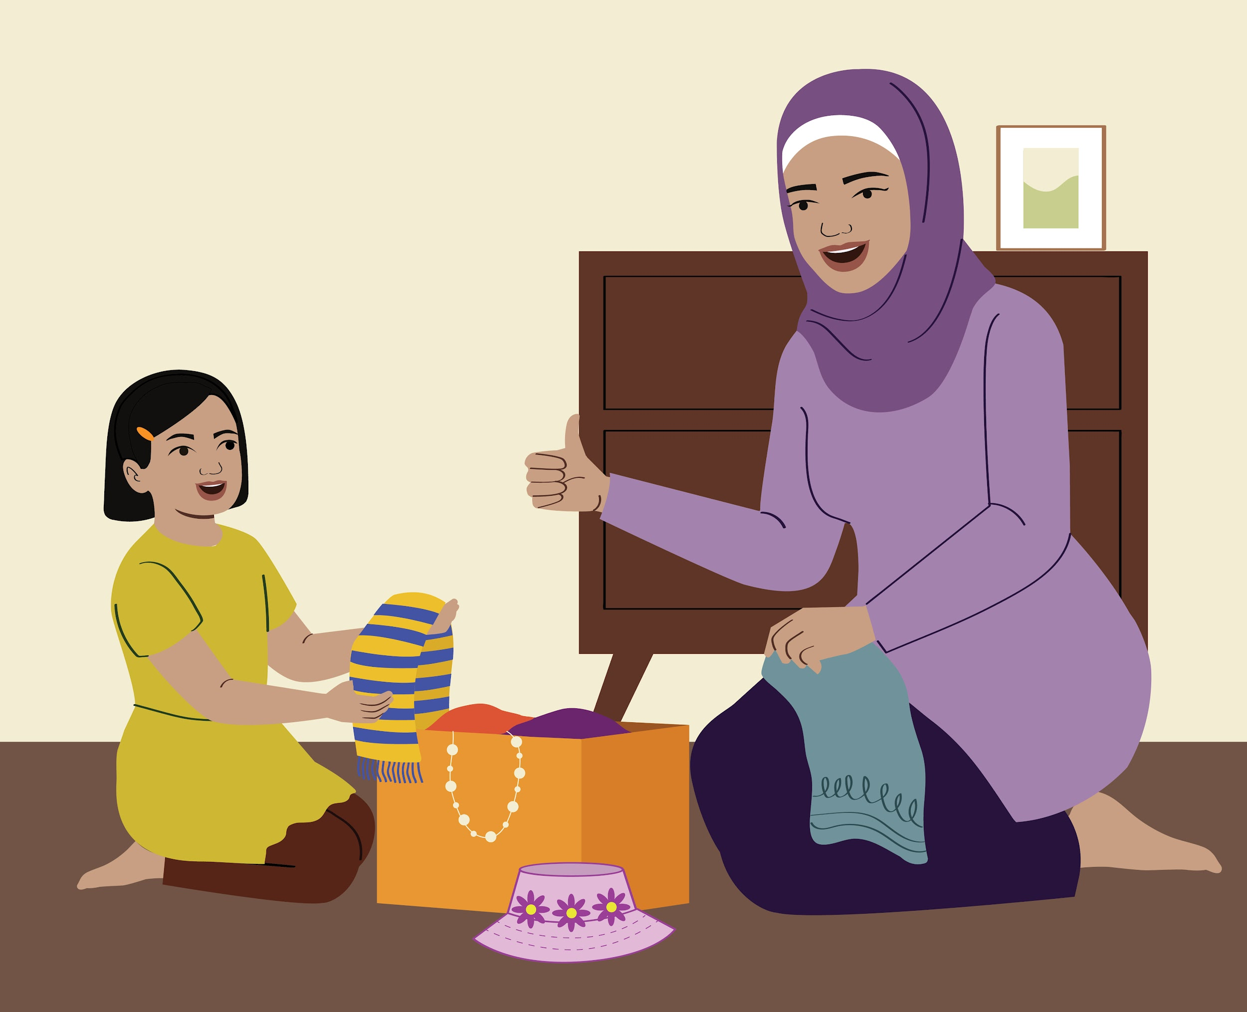
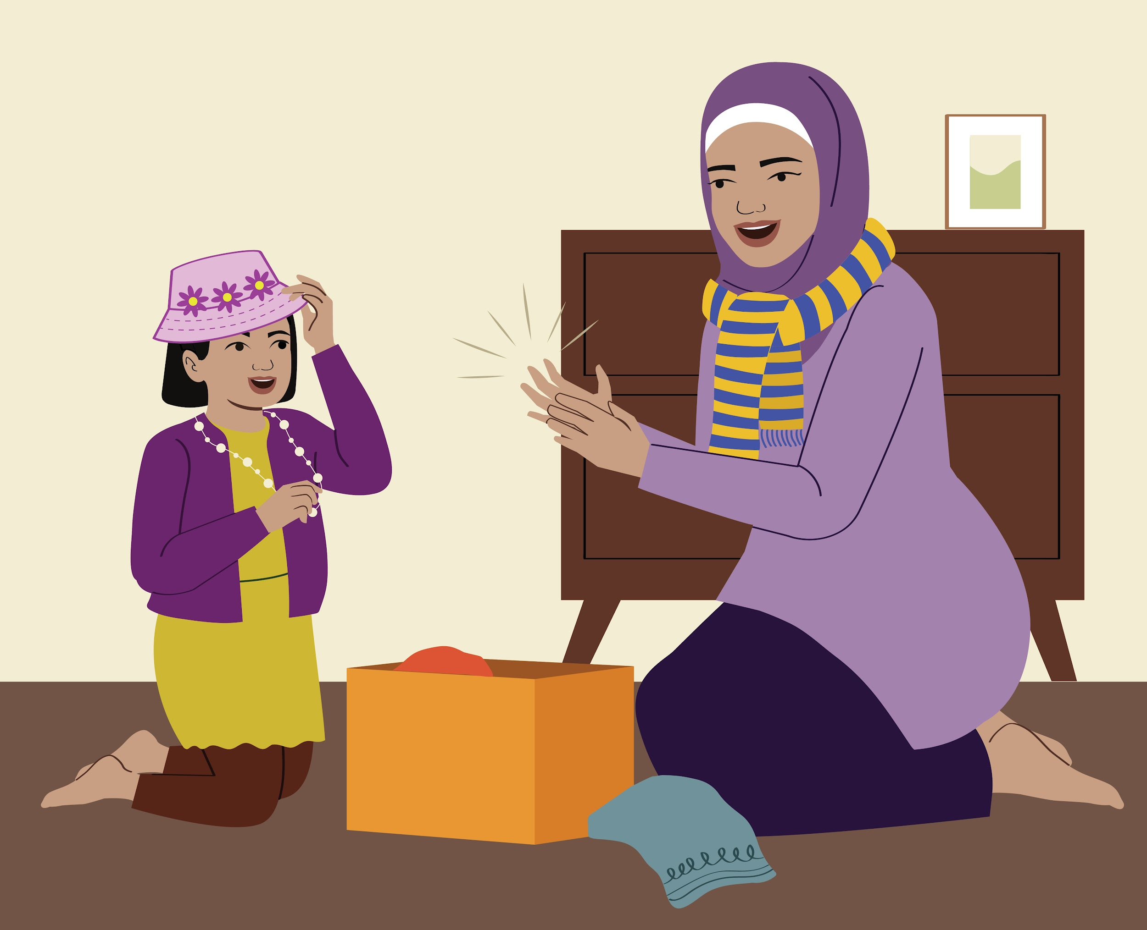
Spending One-on-One Time with My Child
Farah: I have 5 minutes of one-on-one time to spend with you, Mira. Apakah yang anda mahu lakukan?
Mira: I want to play dress up!
Mira: Ibu, it’s for you.
Farah: Thank you, I love it!
Mira: Wear it Ibu!
Farah: Wonderful idea, Mira! I see you are taking out the yellow scarf with blue stripes on it.
Farah: What a big girl you are, Mira to get dressed by yourself!
Notes:
💡Overview
Briefly introduce the main goal of the core lesson to the parents. You can say something like:
“Today’s main goal in ParentText was to learn how we can build positive relationships with our children through One-on-One Time. Let’s look at a story…”
Then move on to the comics.
Guided discussion for One-on-One Time comic:
Help the parents identify the following skills from the comic that they should use during One-on-One Time:
Get down to your child’s level
Look at your child and notice what s/he is doing
Use your child’s name when you speak to him or her
Accept what your child wants to do as long as it is a safe activity
Follow your child’s lead during One-on-One Time
Use words to describe what your child is doing
Block 1 introduces the parents to how to introduce One-on-One Time to children. Use questions to guide parents to notice how the mother introduces One-on-One Time to Mira by saying to her, “I have 5 minutes to spend One-on-One Time with you, what would you like to do?”
Tanya kepada ibu bapa:
How does the mother introduce One-on-One Time to Mira? What does she say to Mira? How long is One-on-One Time?
(Jawapan yang mungkin diberikan oleh ibu bapa: Dia menyebut nama Mira. She is at the same level as Mira. She is looking at Mira. She asks her what she wants to do. She allows Mira to choose the activity.)
How does Mira know how long is One-on-One Time? Why should the mother tell her how long One-on-One Time is?
(Jawapan yang mungkin diberikan oleh ibu bapa: Ibu memberitahu dia mempunyai masa selama 5 minit untuk diluangkan bersama Mira. Ibunya mungkin ada perkara lain untuk diuruskan).
Blocks 2 to Block 3 also show how mother allows Mira to take the lead. Tanya kepada ibu bapa:
What does the mother do physically to show that she is paying attention to Mira?
(Jawapan yang mungkin diberikan oleh ibu bapa: Dia memandang Mira. She says her name).
How does the mother allow Mira to be the leader in the activity?
(Jawapan yang mungkin diberikan oleh ibu bapa: Dia membenarkan Mira untuk memilih aktiviti. Dia menerima cadangan Mira. She observes what Mira is doing. She sits back and lets Mira direct what happens in One-on-One Time).
Block 3 also demonstrates how parents can use words to describe what their children are doing. Tanya kepada ibu bapa:
What does the mother say when Mira puts on her dress by herself?
(Possible answer from the parents: She uses words to describe what she sees Mira doing.)
Block 4 (and all of the other blocks) show how children might respond to spending One-on- One Time with their parents. Tanya kepada ibu bapa:
How does Mira feel when spending One-on-One Time with her mother?
(Jawapan yang mungkin diberikan oleh ibu bapa: Mira gembira. She feels loved. She feels important. She feels appreciated. She feels confident. Mira feels close to her mother).

Slide 12
Spending One-on-One Time with My Child
What are some of the
benefits of
One-on-One Time?
Notes:
Lead participants in a group discussion about the benefits of spending One-on- One Time with their children. Useful questions include:
Why would you want to have a positive relationship with your child?
How would spending One-on-One Time help you develop a positive relationship with your child?
How would your child benefit from the One-on-One Time with you? What would s/he learn?
Write down parents’ ideas, and praise them for sharing.
Here are some benefits of spending one-on-one time with your child:
Children feel that they are valuable and loved.
Shows your child that you think that what they are doing is important.
Helps children feel safe and secure.
Builds language and observation skills.
Builds learning skills and problem-solving.
Increases trust and improves communication with you and your child.
Helps children develop and explore the world.
Shows your child that you are present and focused on what the child is doing.
Children become more willing to help around the house.
Parents/caregivers feel like their hard work in the house is more valued.
Listening carefully to children and valuing their ideas encourages them to think for themselves and take the lead.
Gives you a chance to learn a lot about your child's interests and abilities.
Note:
The list above is just a suggestion. It is okay if they do not identify all of them. They may also provide other reasons about why spending One-on-One time with children would help improve their behaviour and development. This is wonderful!!

Slide 13
Spending One-on-One Time with My Child
What activities can you do
with your child
during One-on-One Time?
Notes:
Ask parents to think of activities that they could do with their child. These could be things that they know their child likes to do.
Allow parents to first share in pairs. Each pair should come up with at at least 3 different activities that they can do with their children.
Allow parents to talk in pairs for about a minute or two. Then share in a big group.
Write the suggestions on the flipchart!
Possible activities may include:
Playing with a ball or doll if the child has one
Dressing up in fun clothes or in adult clothes
Hide and seek – outside
Shopping game in the house
Jigsaw puzzles
Singing a song together
Telling a story
Encouraging the child to tell a story
Doing the laundry together

Slide 14
Spending One-on-One Time with My Child
Let’s
Berlatih!
Notes:
DAY, PLAY, and STAY
This is the first group practice when parents practise what they will be asked to do during Home Activities.
Group Practices allow parents to try out their home activities in the safe environment of the group. Parents/caregivers also have the opportunity to act in roles as “parents” and “children.”
Being the child in a practice helps parents see the world through their child’s eyes.
🔍Spotlighting Accessibility
If any of the parents has a child with disabilities, make sure the group practice includes a child with disabilities.
✏️Arahan
Format for leading the group practice:
Introduction
Introduce that parents are now going to practise allowing their children to take the lead and saying what they see during One-on- One Time.
Explain that practising now will make it easier to do the activities at home, especially since Letting Your Child Lead and Say What You See are new skills.
Explain that everyone will get a chance to practise new skills before using them at home.
Group Practice
Choose a participant to be the “Parent” and another to be the “Child”.
Be specific about the age of the Child. Ask the Child to be well behaved during the role-play.
The Parent should introduce One-on-One Time to his/her child by saying the following words:
“I have 5 minutes to spend One-on-One Time with you, what would you like to do?”
Child gives a simple suggestion: “Let’s play with my toy.”
Parent practices using words to describe what the Child is doing while following the Child’s lead.
Stay physically close to the Parent to give support if necessary. You may need to whisper words that the Parent can use to describe what the child is doing.
The Parent may need extra support in allowing the Child to be the leader in the activity. Be like a guardian angel!
Allow the practice to happen for about 1 minute.
Ask the parents who practised about what the experience felt like both as a Child and as a Parent.
Praise the Parent/Child enthusiastically for being the first to do a Practice!
Practice in Pairs
Divide parents into pairs and ask them to practise letting the child take the lead during One-on-One Time.
Each person should practise both the role of the parent and of the child. Remind the children to behave well!
Both facilitators should move around the room helping parents out.
Tell parents to switch roles after about one minute each. Bring the group back together for a discussion.
Ask for feedback from each pair in a group discussion on how the practice went.

Slide 15
Spending One-on-One Time with My Child
DAY
MAIN
KEKAL
Set aside a specific time to spend One-on-One Time with your child each day.
Switch off the television and put away smartphones.
Choose a time when you are unlikely to be interrupted.
Choose a time when your child does not have something else that they want to do.
Try to do something different than watching TV or playing with a tablet/phone.
Sometimes, it may be just enough to watch your child’s favourite TV programme with him/her.
S/he may feel comfortable doing other activities with time.
Give your child all your attention.
Beri arahan atau petunjuk seminimum mungkin.
Listen to what your child is saying and watch them.
Reflect back what your child says to you.
Make only positive comments and avoid critical comments.
Notes:
✏️Arahan
Review the following tips for On-on-One Time with your child with the parents:
DAY: Set aside a specific time to spend One-on-One Time with your child each day.
Choose a time when you are unlikely to be interrupted and when your child does not have something else that they want to do, like watching TV or playing with smartphones. Switch off the television and put away smartphones.
Tell your child that you would like to watch them play and that they can choose what to do. Your child might think this is weird at first but gradually will come to enjoy having this dedicated time with you!
PLAY: Try to do something different than watching TV or playing with a tablet/phone.
This is a lot more useful and enjoyable for your child than just sitting together in front of the television or playing with a smartphone. Sometimes, it may be just enough to watch your child’s favourite TV programme with him/her. S/he may feel comfortable doing other activities with time.
STAY:
Give your child all your attention.
Make sure that you will not be distracted by other children or other responsibilities so that you can give all of your attention to your child.
Beri arahan atau petunjuk seminimum mungkin.
When you are spending One-on-One Time with your child, s/he or she should lead the activity.
Listen to what your child is saying and watch them.
Listening to your child is more important than talking to them at this time. If your child asks a question, you can answer, but do not let them put you in a position of telling them what to do. Put the choice back to the child: “That is an interesting question, what do you think?”
Reflect back what your child says to you.
Repeat back what your child says when s/he speaks to you. You can use different words to show that you are really listening to your child. E.g., Child, “This math problem is really hard.” Parent, “Yeah, I see that you are finding it difficult.”
Make only positive comments and avoid critical comments.
Remember this is your child's activity. Can you think how you have felt recently when someone has been critical of you? There is no right or wrong during One-on-One Time. Your job is to show an interest and say something nice.

Slide 16
Spending One-on-One Time with My Child
Home Activity
Spend at least 5 to 15 minutes of One-on-One Time with your child each day
Where will you spend One-on-One Time with your child?
When will you spend One-on-One Time with your child?
What types of activities could you do during One-on-One Time with your child?
Notes:
The Home Activity for the module is to to spend at least 5 to 15 minutes of One-on-One
Time with your child each day. Make sure that each parent has identified a specific
goal for his/herself for One-on-One Time. Make sure they go home knowing the
following:
Where will they spend One-on-One Time with their child?
When will they spend One-on-One Time with their child?
What types of activities could they do during One-on-One Time with their child?
Write each parent’s home activity on a large piece of paper.

Slide 17
Closing
Reflections
Do you have any questions about:
Using ParentText
Participating in the WhatsApp Support Groups
Spending One-on-One Time with your child
Home Activity
Notes:
💡Overview
Reflect with parents on any specific areas of the Naungan Kasih Program that require support.
Encourage parents by using open ended questions, like, “Is there anything specific about using the ParentText chatbot that you'd like to know more about?" or "What are your initial thoughts on participating in the WhatsApp Support Groups?"
To respond to parents' questions, offer clear and concise information. Provide step-by-step guidance if necessary.
✏️Arahan
Ask the parents if they have any questions about:
Using the ParentText Chatbot
Participating in the WhatsApp Support Groups. Remind the participants that you would be sharing prompts for discussion later in the week.
Spending One-on-One Time with their child
Home Activity

Slide 18


Closing
You are here!
Selected your first Goal & Completed your first skill
Identifying Next Goal in ParentText
Bersikap Baik terhadap Diri Sendiri
Memberi Pujian
Bercakap tentang perasaan
Parenting Values and Spirituality
It’s time to pick a new parenting goal!
Which goal would you like to work on next?
Notes:
Explain to the parents that they selected their first goal, Improve My Relationship with My Child, and completed the first skill, Spending One-on-One Time with My Child.
In the upcoming days, ParentText will guide them through the remaining skills within this goal. Once all 5 skills are accomplished, ParentText will then prompt them to choose their next parenting goal.
Ask the parents to think about which goal would they like to practice next in the Naungan Kasih
Reassure participants that it may take some time for them to realise their goals. Encourage them to continue to interact with the ParentText chatbot, participate in WhatsApp Support Group, and do home activities!

Slide 19



Thank you Any Questions?
Notes:
Close with a goodbye activity. Allow participants to decide how they would like to end the session. This may be a prayer or a group clap.
✏️Arahan
Remind the participants to:
Complete their home activities.
Lookout for the next ParentText module.
Sharing their experiences and challenges on the WhatsApp Support Group.
Thank participants for the commitment they have made to each other by coming to the group!

Slide 20
Naungan Kasih Hybrid Parenting Programme Parent Reflection and Celebration
Name of the Facilitators
Month Year
Notes:
Opening slide

Slide 21
Session Overview
Structure of the Workshop
Welcome
Collaborative Art Activity
Keep the momentum going
Awareness Activity
Closing
Notes:
Welcome each parent warmly and enthusiastically when they arrive at the session.
When you start the session, praise the group for coming to the session and congratulate them for making it to the final group session for Naungan Kasih!
Share the agenda for the closing session – the session will begin with a collaborative art activity, followed by a story and discussion on keeping the momentum going. At the end of the session, we will do a short awareness activity and receive our certificates.

Slide 22
Welcome
Let’s
Berhenti Seketika
Notes:
💡Overview
Take a Pause with the participants. You can make it brief (about a minute).
Use the below text as a guide to leading parents in Taking a Pause.
You should pause for about 5 seconds at each [Pause] in the text. It will be more meaningful if you Take a Pause at the same time.
✏️Arahan
Step 1: Preparation
Find a comfortable sitting position, your feet flat on the floor, your hands resting in your lap. [Pause]
Close your eyes if you feel comfortable. [Pause]
Step 2: Becoming Aware
Ask yourself, “What is my experience at this moment?” [Pause]
Notice what thoughts you are experiencing. Notice if they are negative or positive. [Pause]
Notice how you feel emotionally. Notice if your feelings are pleasant or unpleasant. [Pause]
Notice how your body feels. Notice any discomfort or tension. [Pause]
Step 3: Gathering Attention
Bring your focus to your breath. [Pause]
You may want to place one hand on your stomach and feel it rise and fall with each breath. [Pause]
Follow your breath all the way in, how it pauses, and how it exhales out. [Pause]
If you notice that you have started to think about something, this is completely natural. [Pause]
If you notice that you are feeling very stressed, you may want to reassure yourself by saying “It’s okay. Whatever it is, I am okay.” [Pause]
Then bring your awareness back to the feeling of your breath. [Pause]
Keep your focus on your breath for a few moments. [Pause]
Step 4: Expanding Awareness
Allow your focus to expand to the whole body. [Pause]
Allow your focus to expand to the sounds in the room. [Pause]
Step 5: Reflecting
Taking a moment to reflect whether you feel any different from before Taking a Pause.
Apabila anda sudah bersedia buka mata anda semula. [Pause]

Slide 23
Art Activity
Let’s spend a few minutes reflecting on your
ParentText Journey…
Notes:
First take the participants through the entire programme as a review to help parents remember key moments and experiences that they may have had:
Ask parents to close their eyes and sit in a comfortable position.
Ask them to recall what their lives and children were like before the programme began.
Guide parents through each goal of ParentText:
Improving My Relationship with My Child: We started with focusing on improving our relationship with our children by spending one-on-one time, giving praise, talking about our feelings and values.
Prepare My Child for Success in School: In this goal, we prepared our children for success in school by supporting them in reading and Math.
Understand Child Development: Next, we learnt how to support our children’s healthy growth and development through play and learning from experiences.
Give My Child Structure: We also learnt how to give our children structure by creating routines and rules.
Supporting Positive Child Behaviour: Now, we also have skills to manage our children’s misbehaviours by redirecting them, ignoring demanding behaviour, and managing consequences.
Keep My Child Safe and Healthy: We focused on safe touch, community safety, responding to risks, and being safe online.
Have a Healthy Relationship with My Child: We built healthy relationships with our spouses by focusing on respect, responsibilities and conflict resolution.
Build a Family Budget: Lastly, we built a family budget by understanding our needs and wants, and making a monthly saving plan.
Ask parents to think about their experiences during the sessions and when they were practising the skills at home.
Remind the parents that it is okay if they have not finished all the goals yet.
Ask them to think about how they have changed, how their children and their children’s behaviours have changed, and how their families have changed.
Participants should also be invited to think about what they thought worked well during the programme, and how the programme has impacted their lives and homes.

Slide 24
Art Activity
Pick up paper and crayons, and draw pictures related to the questions:
What was your relationship with your child like before the programme?
How has the relationship changed? How have you changed? Your child? Your family?
What was the most important/significant thing that you learned? Why was this significant?
Notes:
Art Activity (⏱️15 min)
After the reflection, distribute paper and crayons for the Art Activity.
Ask the participants to draw pictures that relate to some of the following questions:
What was their relationship with their child like before the programme?
How has the relationship changed? How have you changed? Your child? Your family?
What was the most important/significant thing that you learned? Why was this significant?

Slide 25
Art Activity
Share your drawings
Notes:
Sharing (⏱️30 min)
Ask the participants to share their drawings in the larger group.
After each participant shares, s/he places his/her picture in the middle of the circle to show the communal vision of positive parenting.
⭐Note
Allow every participant to share but try to keep the sharing brief (1-2 minutes each).You can draw a picture and share too!

Slide 26
Keep the momentum going
The Stone Soup
Notes:
💡Overview
At this point in the session, the focus shifts to the future. The programme ending can be a very emotional time for parents.
Many may feel anxiety about the next chapter in their lives. It is important to provide parents with some support and encouragement.
The next activities help parents identify ways of continuing to support one another.
“Stone Soup” is a story about community building that is shared with the parents to help them take ownership of their own skills, knowledge, and wisdom.
✏️Instruction
Recite the following story:
Stone Soup - (traditional tale as narrated by Jamie McLaren Lachman)
There was once a beautiful village. The people of this village were always happy because they never needed anything. They had livestock, fruits, and vegetables, as theirs was a very fertile village. They never knew suffering.
However, after some time there was drought. There was no more rain and their livestock was dying. Times became difficult because now there was hunger in the village. The people stopped talking to each other because everyone was focusing on their own problems.
One day an old woman came to this village carrying a big black pot on her head and a small brown bag. When she arrived in the middle of the village, she placed the big black pot on the ground and sat next to it to take a rest. No one saw this woman, except a little boy who was out playing that day.
When the boy saw this old woman, he asked her "Granny, what are you doing with that big black pot?"
"I am going to make some Stone Soup!" answered the old woman. This confused the boy. Who ever heard of such a thing as Stone Soup?
Because he was a curious boy and always full of questions, he asked, "Can I please help you granny?"
The old woman was very happy when he asked to help. "Of course you can! Go and get some water and collect some wood, my child," she said.
So the boy collected some wood in the nearby forest. As the old woman was busy making the fire, he went down to the river to fetch some water.
By the time the boy returned with water, the old woman had a large, warm fire burning. She placed the big black pot on the fire and poured in the water. She then opened her small brown bag and took out a shiny, round white stone. She placed it in the big black pot and began to stir, humming an old cooking song.
Soon, the water began to boil. The old woman licked her lips and said to the boy, “Mmmmm...this is going to be a delicious pot of Stone Soup.”
It wasn’t long when the others began to notice the fire burning in the middle of the village. One by one, they left their homes to see what was happening.
"What is going on here?" asked one man. The boy answered, "She is cooking Stone Soup!"
Those who were there exchanged looks as if they had never heard of such a thing. Stone Soup?
The news spread fast and throughout the village. All the villagers left their homes to see this crazy old woman and her Stone Soup with their own eyes. As the people were arriving, the old woman continued to stir the pot while humming.
When she noticed that that there were many people gathered, she stopped stirring and tasted the watery soup. "Mmmmmmm... This is going to be the most delicious soup. It is just missing something. If only there were some onions...”
One woman had a few old onions that she had been saving. They were small and wrinkly but still good to eat. “I have some onions,” she offered. She fetched them from her home, chopped them up, and added them to the big black bubbling pot.
After a little while longer, the old woman tasted the soup again. “Yes, this soup is going to be so good. But it is missing something.... If only there were some more....”
“Vegetables!” said a voice from the crowd, “It needs more vegetables. I have some spinach. It’s not much but you can use it.” Another person brought a couple of old potatoes. Someone else had a cabbage. Another garlic. Carrots. A pumpkin. Salt. An old scrawny chicken. Some chilis. Spices.
[At this point, the storyteller can ask people for suggestions as to what to put in the soup]
The smell of the soup filled the village. It reminded people of the old days. They began to talk to each other, exchanging stories and news, even jokes. Laughter was heard again for the first time in many years.
At last, the old woman stopped stirring. She tasted the soup and declared with a twinkle in her eye, “This Stone Soup is nearly ready. And so much to eat. I wonder if you will help me finish it please.”
Everyone went back to his or her homes and brought bowls and spoons. Even though there were so many people, there was just enough for each person. They ate the soup until they were all full. And it was the most delicious Stone Soup they had ever tasted.
When they were done, the villagers brought out their drums and other musical instruments and began to sing songs and dance. They sang and danced until dusk. Then, the villages thanked the woman and returned to their homes chatting with each other. Once again, there was the sound of laughter and song in the air that evening.
As the evening stars began to shine, the old woman was left alone in the middle of the village. She gathered the white stone in her small brown bag and placed her big black pot on her head. Without a word of farewell, she slowly began to walk down the windy road that led out of the village.
Before she could leave, the boy saw her and ran to her. "Why are you leaving, granny?" he asked. “My work here is done,” the old woman replied. “But we need someone like you to help us,” said the boy.
She reached into her small brown bag and handed the boy the white stone. “You have all the ingredients that you need to make Stone Soup.” Then she slowly walked down the road. The boy watched and waved until he couldn’t see her any longer.
The villagers never saw that woman again. But life in the village continued to thrive – in the best of times and the worst of times they never lost their connection to each other again as they continued to make the most delicious Stone Soup.
The end.

Slide 27
Keep the momentum going
Discussion
What are some of the things that we can do to continue supporting each other as parents?
How can we continue to support our children’s development and our lives after the programme?
Notes:
Lead a discussion to help parents to identify specific ways in which they can continue to support their children’s development.
Useful questions to help prompt discussion may include:
What are some of the ingredients that we have in our community to continue supporting us as parents?
In what ways can we continue to support our children’s development and our lives after the programme?
📱For parent-led WhatsApp Support groups, it is important to identify the following:
Two peer-group moderators to lead the WhatsApp Support Group
The moderators recieve the guidelines for leading the group.
You have had a guidance call with both the moderators to answer any questions.
Time and day that will best suit everyone to have weekly chats.
Reinforcing the ground rules for the WhatsApp Support Group.
👥For parent-led in-person peer support groups, it is important to identify the following:
Person (or people) responsible for organising the support groups
Place where the parents can meet and if help can be provided from an organisation
Time and day that will best suit everyone
Whether facilitators can meet them from time to time
Tips for Continuing Support for In-person or Online Peer Support Groups:
Keep practising all the skills you learnt in ParentText.
There may be other parents who have done the Naungan Kasih programme in your neighbourhood. Start your own Naungan Kasih Support Group!
Learn what services and support you can get in your community.
Reiterate the ground rules to ensure a positive environment for all parents.
Emphasise once more, in situations involving significant concerns regarding safeguarding or confidentiality, parents will remove the group member from the group immediately.
Determine the topics, areas, or issues that you would like to explore and address during our upcoming session.

Slide 28
Awareness Activity
Connect with a sense of loving-kindness
Notes:
💡Overview
At the end of the session, parents learn one last stress reduction activity – a Loving Kindness exercise.
This activity helps participants connect with a sense of loving-kindness towards themselves and their families.
It brings closure to the culminating activity while reconnecting participants to a sense of wellbeing and calmness after all the excitement and anticipation for the closing.
Use the below text as a guide to leading the activity.
✏️Instruction (Slide 28)
Just like Taking a Pause, you can pause for about 5 seconds at each [Pause] in the text. Semasa berhenti, ia mungkin membantu jika anda mengikut arahan anda sendiri.
Step 1: Preparation
Sometimes when we are experiencing stress, feeling alone, or just needing support, it can be helpful to send thoughts of loving kindness to ourselves.
This exercise helps us to become more grounded and present – which increases well being and balance - helping us to manage stress, illness and difficulty. [Pause]
Find a comfortable sitting position, your feet flat on the floor, your hands resting in your lap. [Pause]
Close your eyes if you feel comfortable. [Pause]
Step 2: Becoming Aware
Ask yourself, “What is my experience at this moment?” [Pause]
Notice what thoughts you are experiencing. Notice if they are negative or positive. [Pause]
Notice how you feel emotionally. Notice if your feelings are pleasant or unpleasant. [Pause]
Notice how your body feels. Notice any discomfort or tension. [Pause]
Step 3: Opening to Loving Kindness
Connect to your heart in a kind and gentle way. You may want to place one hand on your heart or chest. [Pause]
You can then say the following words silently to yourself [Pause]
Semoga saya tenteram. [Pause]
Semoga saya selamat. [Pause]
Semoga saya sihat. [Pause]
Semoga saya gembira. [Pause]
Semoga saya rasa disayangi. [Pause]
Repeat slowly once or twice taking your time between each phrase.
If you feel comfortable, you can also send thoughts of loving-kindness to your child, your partner, your family, and anyone else who is close to you in your life. [Pause]
May you be peaceful. [Pause]
May you be safe. [Pause]
May you be healthy. [Pause]
May you be happy. [Pause] May you feel loved. [Pause]
Repeat slowly once or twice taking your time between each phrase.
Step 4: Expanding Awareness
Allow your focus to expand to the whole body. [Pause]
Allow your focus to expand to the sounds in the room. [Pause]
Apabila anda sudah bersedia buka mata anda semula. [Pause]
Step 5: Reflecting
Ambil masa sebentar untuk refleksi pengalaman anda.
Apabila anda sudah bersedia buka mata anda semula. [Pause]
Remember that you can do this activity at any time whenever you feel like you need extra support.

Slide 29

Closing
Certificate Distribution
Closing Remarks
Notes:
Certificates
Hand out certificates of completion to parents at the end of the session. This is a simple recognition for their accomplishment in finishing the programme.

Slide 30
Terima kasih!
Notes:
Goodbye
Thank and praise the parents for their commitment to loving and nurturing their children!

