Slide 1
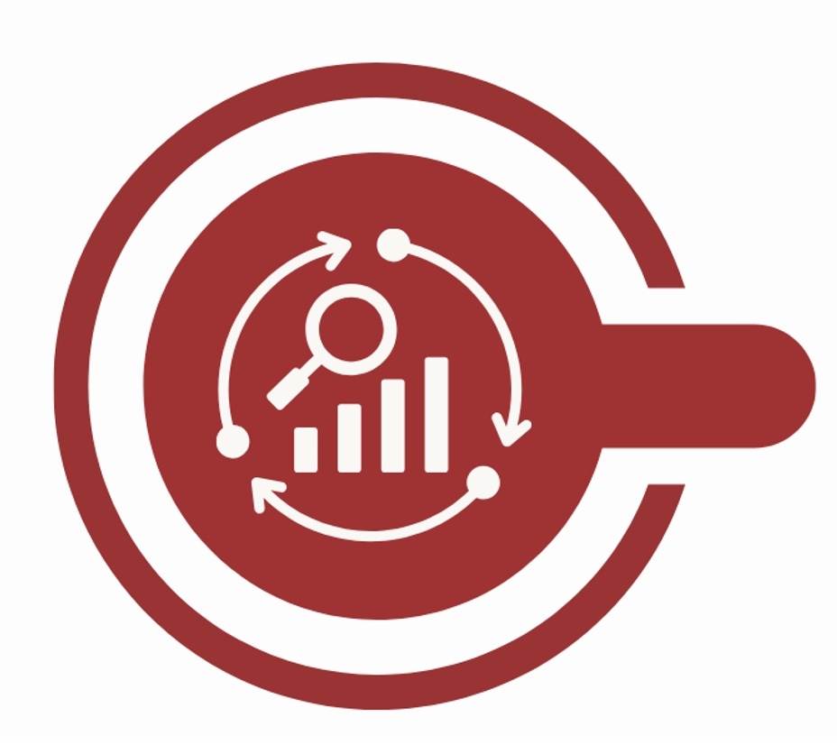
Phase 1
Step 1
Step 2
Gather historical data
Create synthetic catalogue

Slide 2
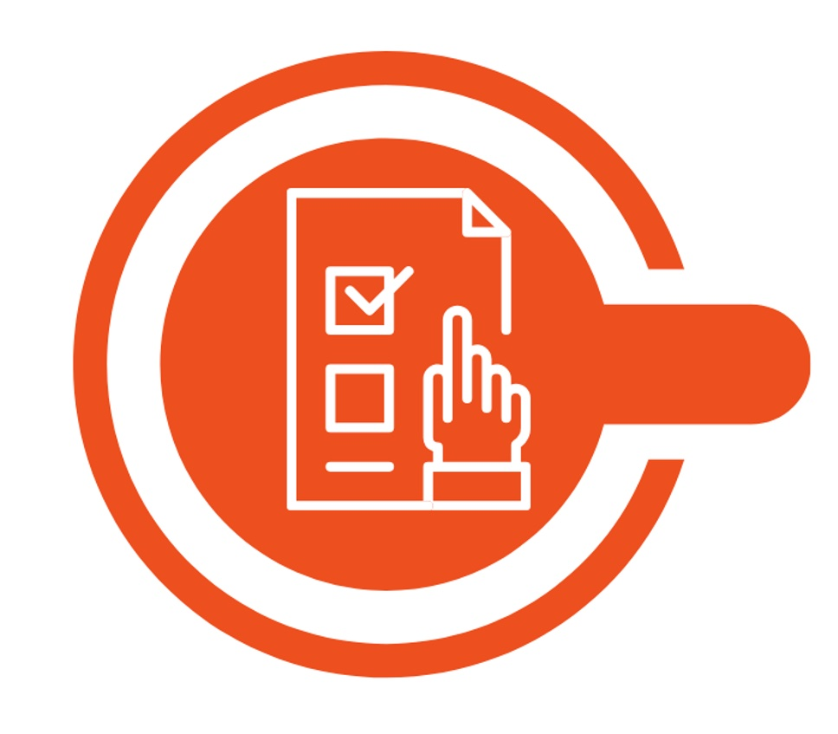
Phase 2
Step 3
Step 4
Step 5
Add simulated data to Risk Pooling Tool
Select countries and perils to include in risk pool
Set risk pool risk pool layers

Slide 3
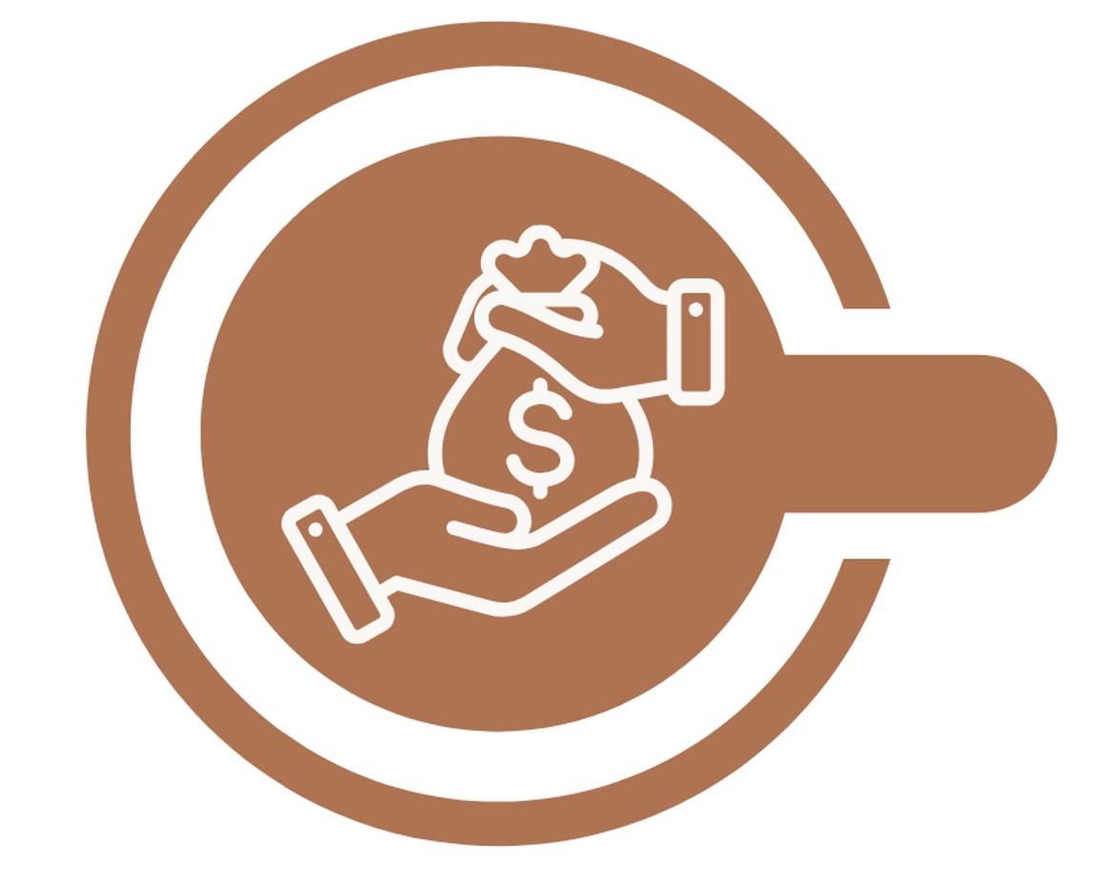
Phase 3
Step 6
Step 7
Step 8
Review funding coverage: across pool
Review funding coverage: each country
Check coverage vs. country needs

Slide 4
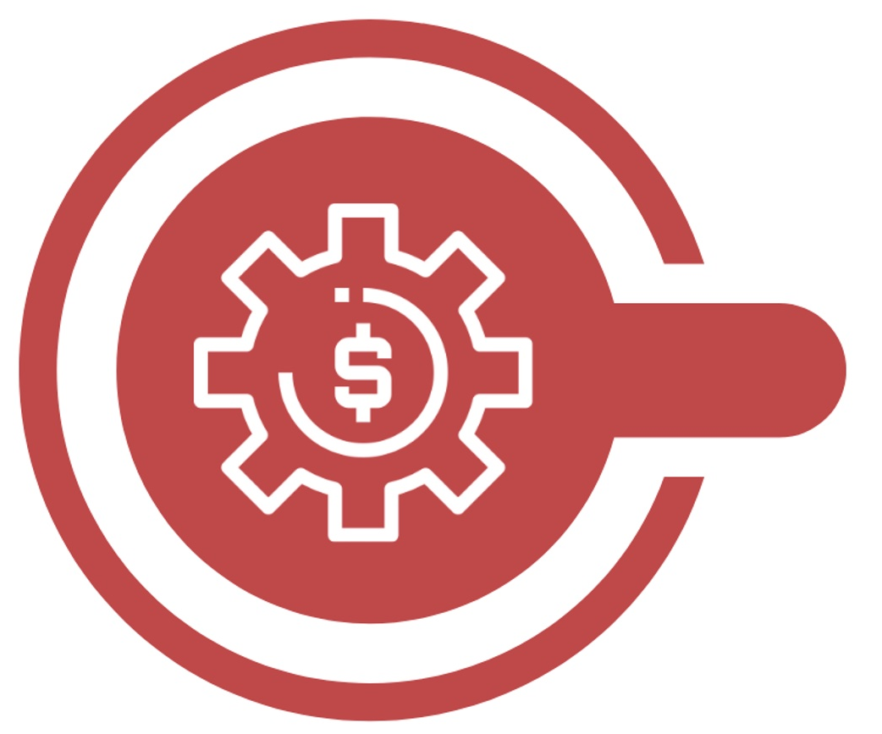
Phase 4
Step 9
Step 10
Check total liability on the pool
Decide how much to retain or transfer

Slide 5
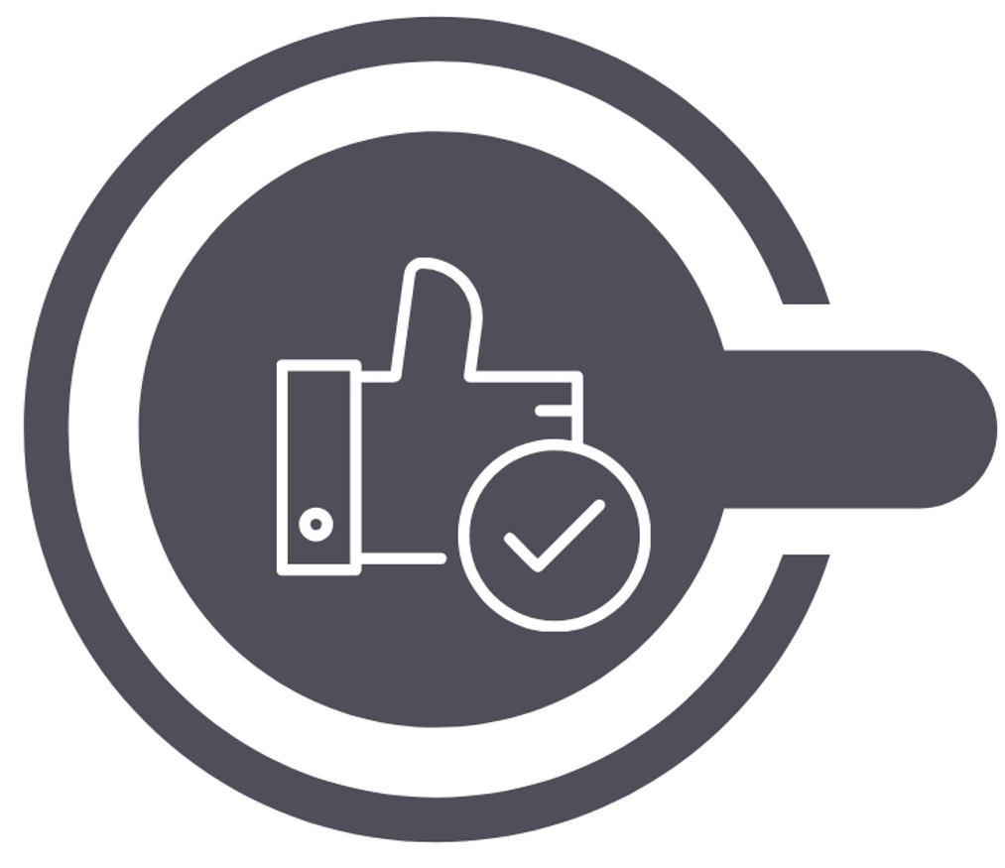
Phase 5
Step 11
Step 12
Adjust the financial structure
Finalise and communicate

Slide 6
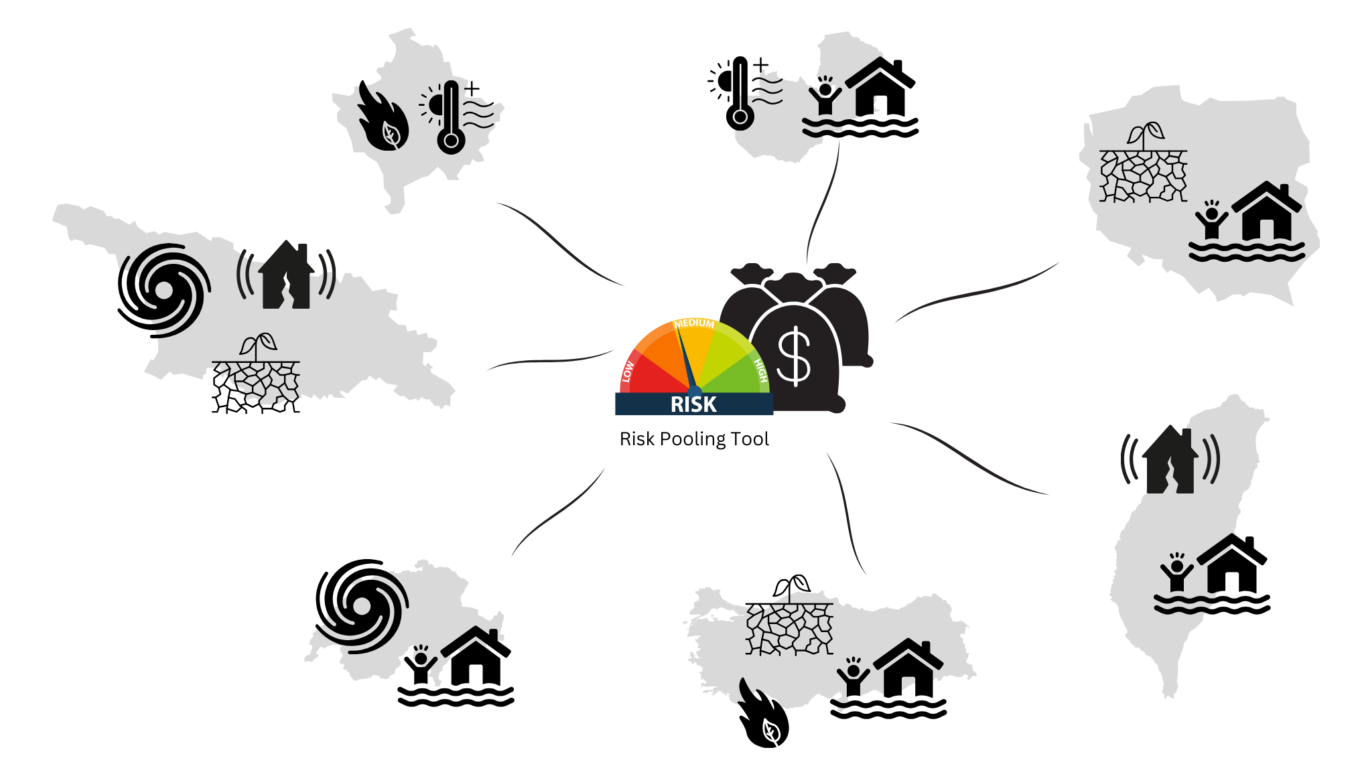
Country 1
Country 2
Country 3
Country 7
Country 4
Country 6
Country 5

