Slide 1
Design and Implementation of an Offline, Edge-AI Based Face Recognition Attendance System with Liveness Detection
Presented by: Damilare John Romimora and Goodness Adeyinka Adewuyi
Department: Computer Science, Ladoke Akintola University of Technology
Supervisor: Prof. W.O Ismaila

Slide 2
Introduction & Research Background
• Traditional System Failure: Paper records facilitate proxy fraud and create tracking bottlenecks.
• Cloud-Dependency Risks: High bandwidth usage, subscription costs, and immediate failure on internet dropout.
• The Solution (Edge-AI): Shifting neural network analysis from cloud servers down to local user hardware.
• Core Technologies Combined: OpenCV (Video Capture), InsightFace (Embeddings), and Dynamic EAR (Liveness).
Notes:
Good morning, members of the panel. I will begin by introducing the background. Paper attendance rosters invite massive proxy fraud and tracking overhead. While cloud-dependent systems solve this, they introduce critical issues like subscription overheads, severe bandwidth consumption, and total vulnerability to network dropouts. Shifting deep learning directly to local edge devices solves this, enabling offline runtime tracking.

Slide 3
Statement of the Problem
Biometric Spoofing
Standard 2D face scanning lacks depth analysis and fails against basic printed photo presentation attacks.
CPU Starvation
Heavy model zoos drain computer threads, triggering severe visual lag and system crashes on standard laptops.
Static Threshold Failures
Fixed mathematical variables ignore natural human eye shapes, causing high false rejection counts.
Notes:
Our study addresses three distinct problems. First, 2D face scans are vulnerable to presentation attacks where photos easily bypass registration. Second, unoptimized neural models exhaust edge CPUs, dropping frame rates to unworkable levels. Third, static thresholds cause 'user exclusion' by failing on naturally diverse human eye phenotypes. We resolve these limitations structurally.

Slide 4
Research Aim and Objectives
• Core Aim: To design, build, and deploy an offline, high-speed, secure Edge-AI attendance engine with dynamic liveness.
• Objective 1: Architect an Asynchronous Multithreaded execution pipeline to protect system responsiveness.
• Objective 2: Develop a dynamic Eye Aspect Ratio (EAR) baseline model for precise presentation attack deterrence.
• Objective 3: Establish a self-healing relational SQLite core integrating active biometric deduplication.
• Objective 4: Package the platform as a standalone Windows executable (.exe) fully optimized for edge deployment.
Notes:
The primary aim is to implement a secure, fully offline Edge-AI face recognition and liveness detection framework. We broke this down into four key steps: building an asynchronous vision pipeline, implementing an adaptive eye baseline tracking algorithm, establishing a deduplicated SQLite database structure, and compiling the code into a stable standalone windows application.

Slide 5
System Architecture & Optimization
Module Restriction
Deactivated 3D landmarking and age profiling from InsightFace to optimize local RAM and CPU thread usage.
Asynchronous Threads
Decoupled code execution: Thread-1 maintains high UI frames while Thread-2 processes heavy background vector math.
Driver Direct Compiles
Swapped buggy standard Windows media engines for native DirectShow drivers to eliminate memory leaks.
Notes:
To execute complex deep learning locally, we stripped unnecessary pipelines from the default InsightFace model zoo—bypassing 3D mapping and age/gender estimation. This saved massive CPU cycles. We then isolated tasks using multithreading: Thread 1 feeds the GUI loop seamlessly, while Thread 2 parses matrices in the background without freezing the window.

Slide 6
Core Mathematical Foundations
Spatial Face Identification
Cosine Similarity = (A ⋅ B) / (||A|| ||B||)
Calculates the exact angular vector displacement to identify users.
Liveness Coordinate Ratio
EAR = v_dist / max(h_dist, 0.001)
Maps 106-point eye tracking clusters to compute relative aspect ratios.
The Dynamic Blink Metric
Blink Verification = 30% Drop from Dynamic Baseline
Rejects photo prints and screens since they can't alter aspect ratios.
Notes:
The system relies on solid mathematical logic. For face recognition, we compute the Cosine Similarity to measure the angular displacement between vectors. For liveness detection, we capture localized coordinate clusters to find the Eye Aspect Ratio. Critically, our anti-spoofing maps blinks based on a strict 30% drop from that user's dynamic resting state.

Slide 7
Face Recognition Performance Analysis
Threshold | True Pos (TP) | True Neg (TN) | False Pos (FP) | False Neg (FN) | Accuracy | FAR | FRR
0.30 | 100 | 85 | 15 | 0 | 92.5% | 15.0% | 0.0%
0.35 | 100 | 94 | 6 | 0 | 97.0% | 6.0% | 0.0%
0.40 (Optimal) | 98 | 100 | 0 | 2 | 99.0% | 0.0% | 2.0%
0.45 (Optimal) | 95 | 100 | 0 | 5 | 97.5% | 0.0% | 5.0%
0.50 | 82 | 100 | 0 | 18 | 91.0% | 0.0% | 18.0%
Notes:
To optimize verification, we tested the engine across 200 trials. Setting a loose threshold of 0.30 caused a high 15% False Acceptance Rate—this is unacceptable for attendance. Tightening to 0.60 blocked intruders but rejected 55% of legitimate students. By mapping our boundary to the 0.40–0.45 zone, we secured a perfect 0% FAR while keeping FRR below 5%.

Slide 8
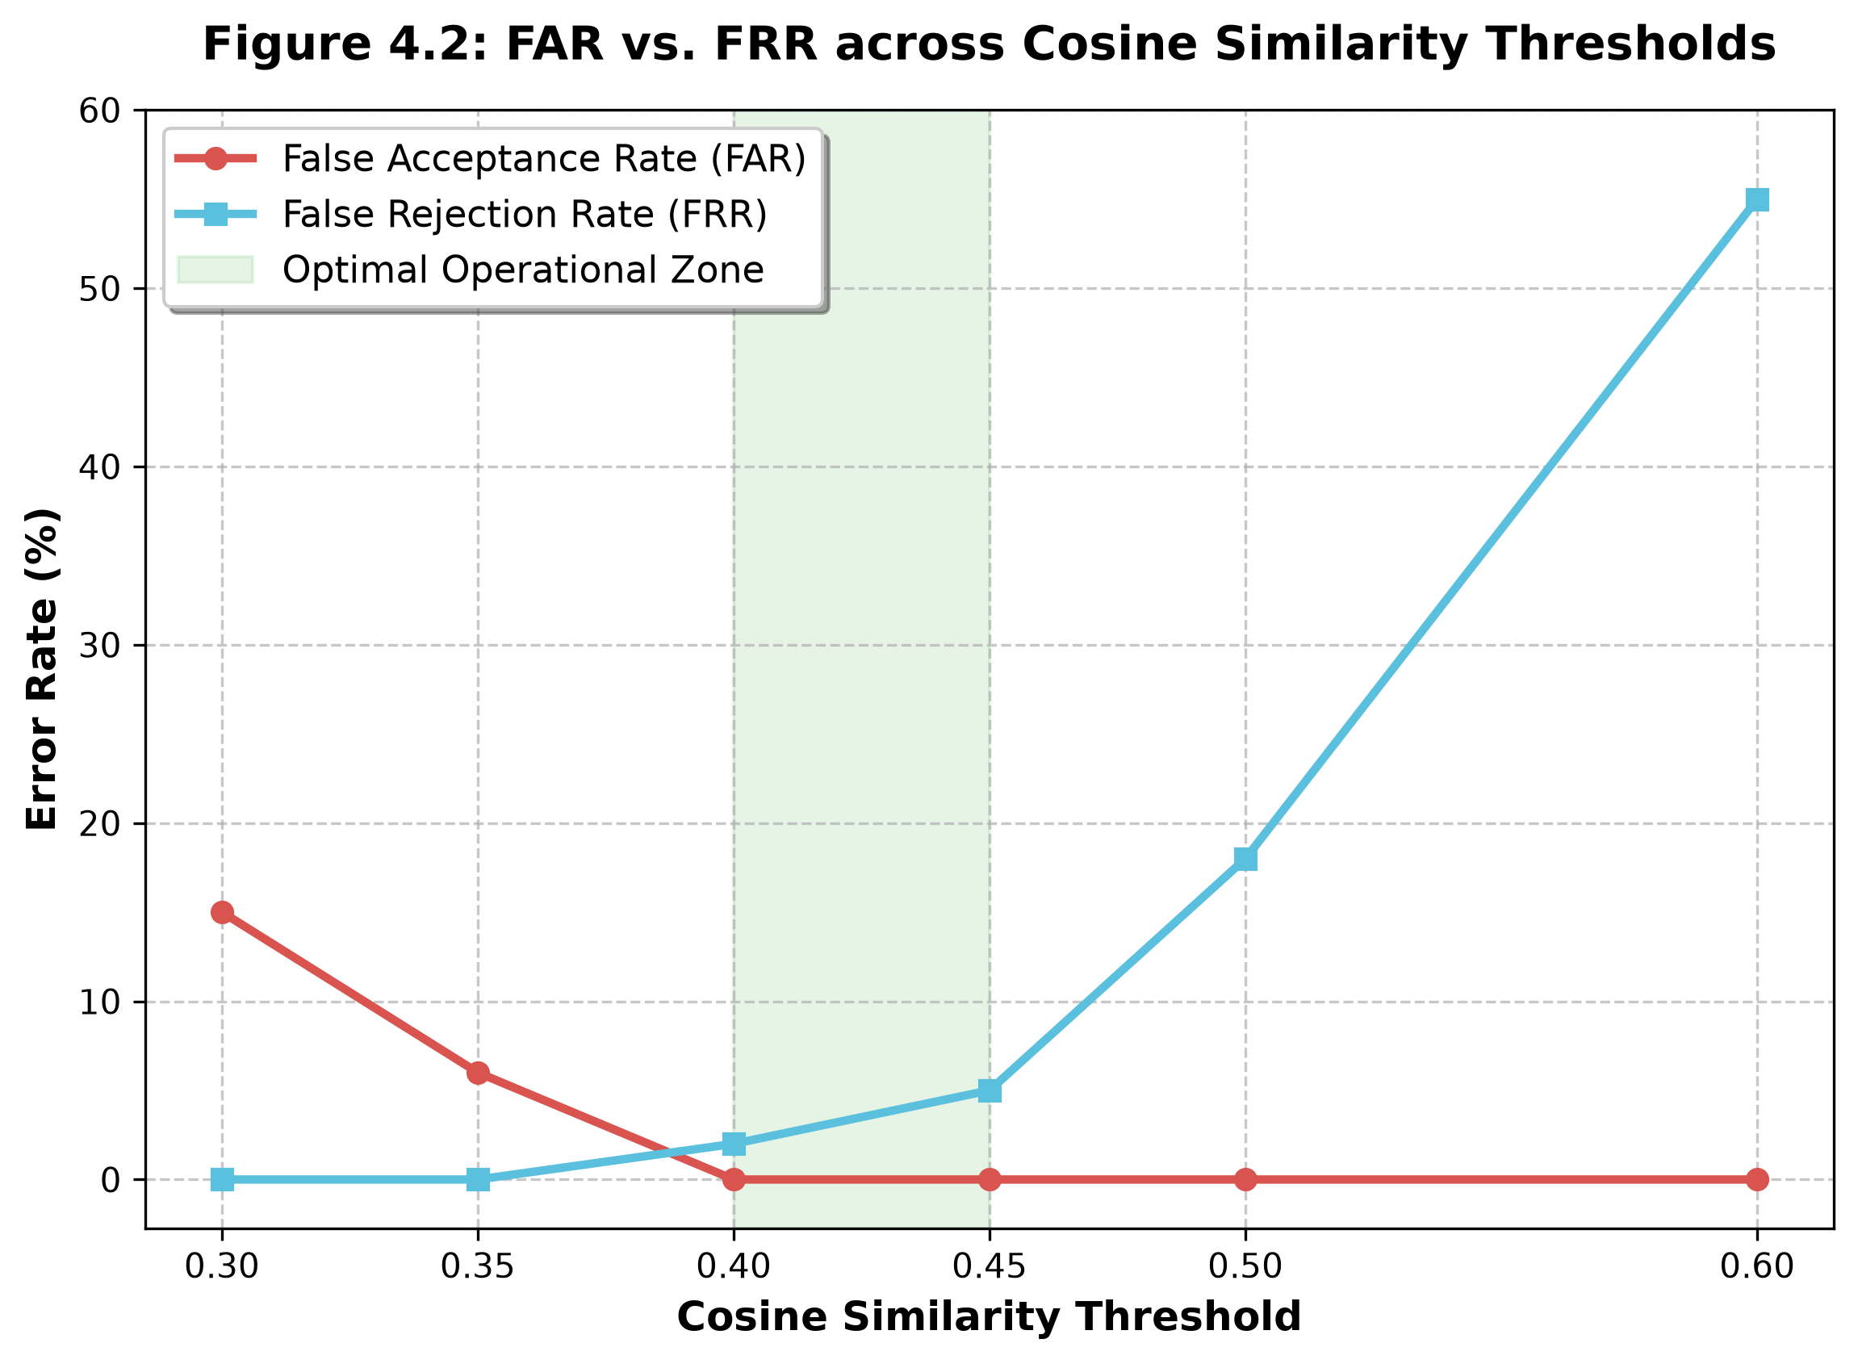
Error Rate Trade-off Visualizer
Notes:
This slide points out Figure 4.2. As our similarity thresholds grow stricter, our False Acceptance Rate drops straight to zero, while False Rejection rises. The green highlighted zone shows our optimized operating zone between 0.40 and 0.45, where we completely block intruders while maintaining high user accessibility.

Slide 9
System Latency & Throughput Metrics
Architecture Model | Average FPS | UI Responsiveness | Hardware Drivers
Single-Threaded Baseline | 4.2 FPS | Unresponsive (Severe lagging) | MSMF Default Engine
Asynchronous Multithreaded | 32.5 FPS | Highly Responsive (Fluid) | DirectShow Bypass Driver
Notes:
This slide displays our computational efficiency. Running heavy networks sequentially on one thread blocks the GUI, resulting in a lagging 4.2 FPS. By shifting AI logic to background worker threads, the frame rate shot up to 32.5 FPS—a massive 7.7x performance acceleration on standard computer hardware without requiring expensive graphics cards.

Slide 10
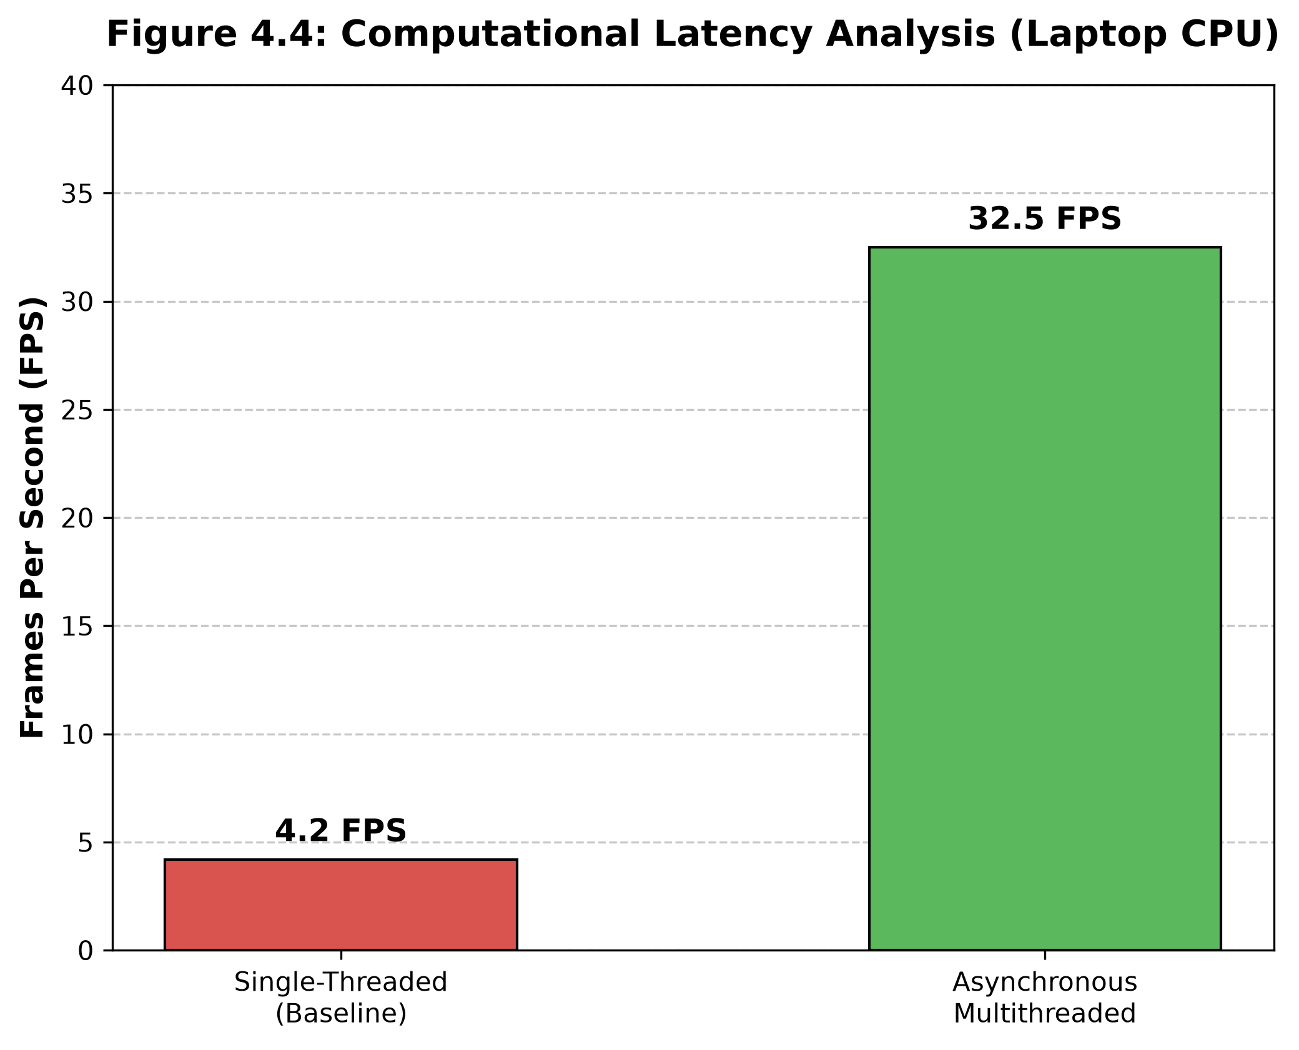
Throughput Evaluation Metrics
Notes:
This slide illustrates Figure 4.4, comparing baseline sequential operations against our multithreaded engine. The 7.7x execution boost allows the platform to run seamlessly on standard school computers, proving we don't need cloud hosting or specialized processing hardware to achieve responsive biometric security.

Slide 11
Database Admin & Data Integrity Features
Self-Healing Database
The SQLite engine auto-constructs directories and structural tables if system paths are altered during packaging.
Active Deduplication
Checks live face vectors against existing database buffers, blocking duplicate enrollment profiles.
Cascading Relational Wipes
Enforces strict database referential integrity—dropping a student automatically drops all associated historical attendance logs.
Notes:
Our platform includes complete administrative and database security tools. First, the database is self-healing, automatically rebuilding schemas on startup if compiled directories are moved. Second, we designed biometric deduplication, scanning face vectors during registration to block fraud. Third, cascade triggers ensure that deleting a student purges all corresponding logs.

Slide 12
Conclusion and Recommendations
Core Research Conclusions
• Offline Edge-AI Success: Proved that secure, offline deep-learning models can run seamlessly on standard laptop CPUs.
• Dynamic Anti-Spoofing: Solved the 2D facial recognition photo bypass loop utilizing customized eye aspect ratio tracking.
• Optimized Frame Rates: Achieved a responsive 32.5 FPS, protecting GUI stability from high-intensity math bottlenecks.
Future Project Recommendations
• Android Integration: Port the backend logic into lightweight, offline mobile frameworks for mobile convenience.
• Physical Entry Control: Connect system databases to physical microcontrollers to control examination hall gates.
• Template Protection: Wrap stored 512-dimensional facial embedding arrays inside secure AES-256 blocks.
Notes:
In conclusion, we have built a highly secure, offline, Edge-AI attendance tracking system that achieves 99% accuracy and 32.5 FPS. For future scaling, we recommend porting the decoupled logic into mobile Android apps, connecting triggers directly to physical examination hall turnstiles, and adding AES-256 block encryption over the raw facial templates. Thank you.

