Slide 1
Development of Final Project class: Creative Coding

Slide 2
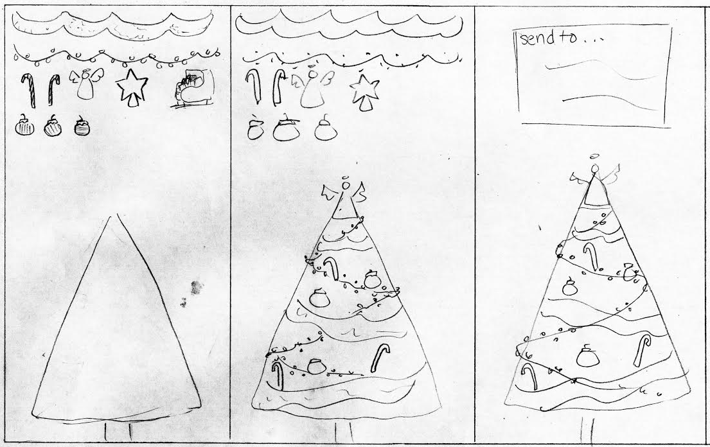

Idea #1
eCards that can be sent to other people

Slide 3
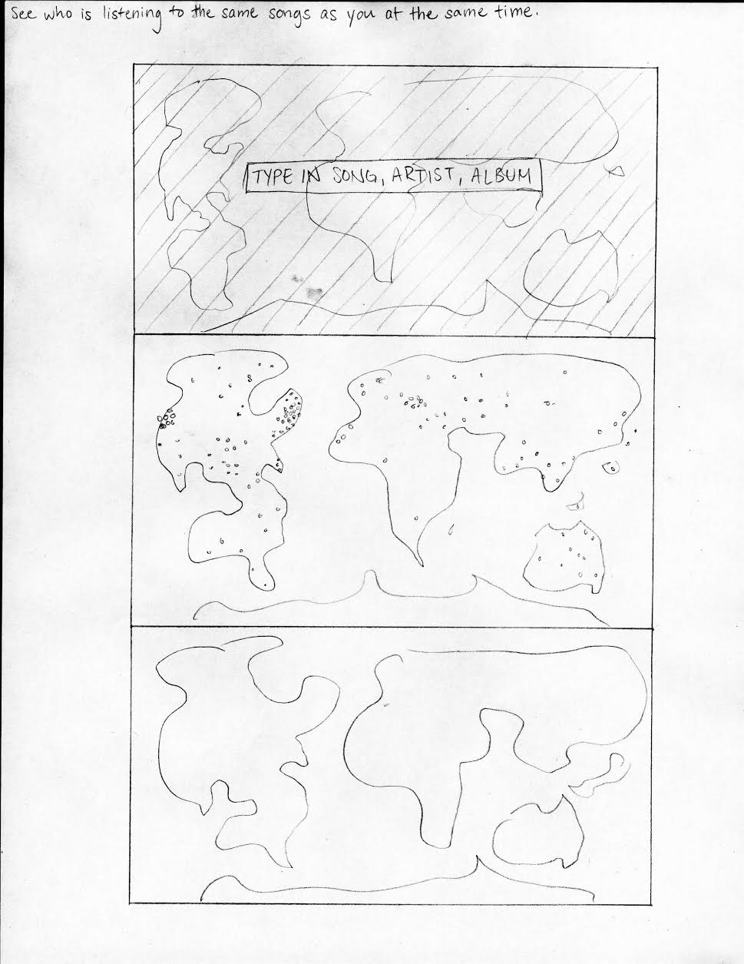
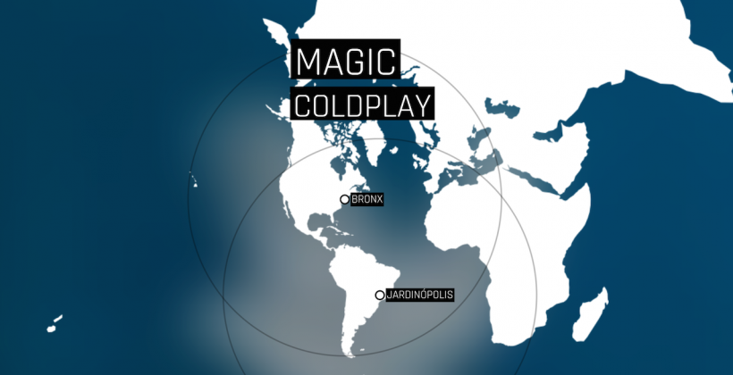
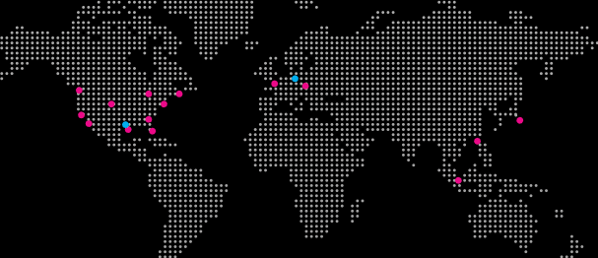
Idea #2
Spotify’s Serendipity WebApp by Kyle McDonald

Slide 4
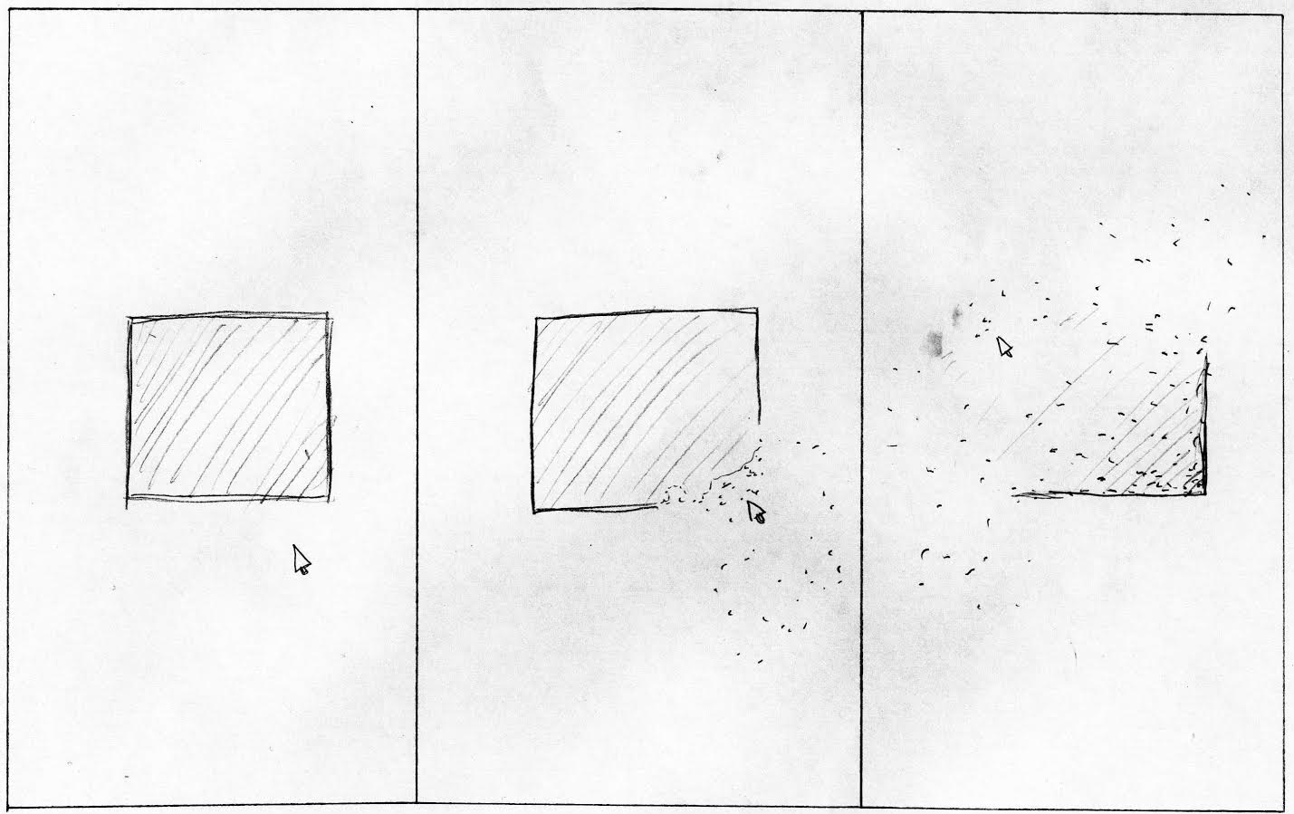
Idea #3
People stand strong together throughout any type of disturbances.
Possibly use with Kinect?

Slide 5
That’s all! Thanks! ☺

