Slide 1
Pooja Patel
Final Project Proposal

Slide 2
Idea #1
Weather Based Clothing App: Application that gives you clothing options based on the current weather of a major city.
Uses openWeather API
Done in p5.js
If cloudy: clouds appear
If rainy: rain appears
If sunny: sun appears
If windy: sound of wind
Background based on time of day (dark/sunny)
Landing screen asks you to pick a city
Different clothing options based on time of day (night and day)
3d models

Slide 3
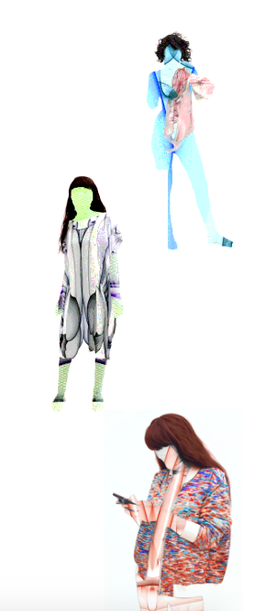
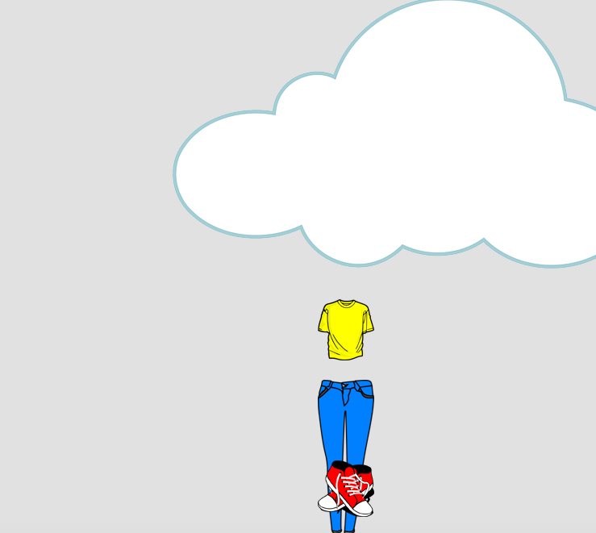
P5js.org

Slide 4
Idea #2
8 Spiders Game: Game in which character must avoid the spiders on the screen. Once attacked by 8, GAME OVER.
Spiders appear one by one
As game progresses, more spiders appear
Head/subject is controlled by mouse
With each attack, head gets bigger
After 8 attacks, game is over and stats are displayed
To win, user must play for a certain amount of time without being attacked 8 times
User can customize character head at the start of the game

Slide 5
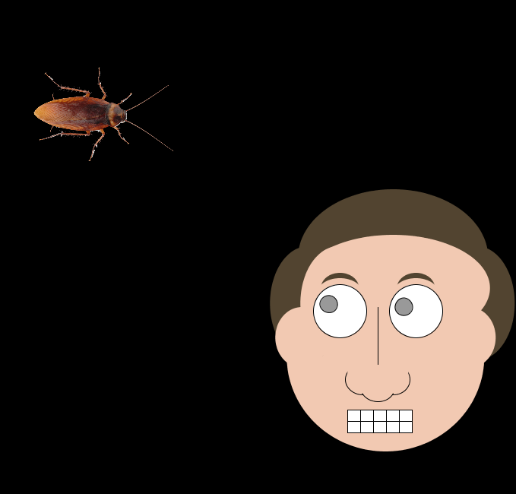

Slide 6
Idea #3
Musical Ballet: An application in which each key is associated with a sound, color, and movement.
First key pressed represents a musical note whose pitch is demonstrated through sound waves
Second key pressed represents a color
Each color is linked to a movement, which is triggered when that color is displayed

Slide 7


