Slide 1




The first social platform turning fashion inspiration into ethical choices.
Solo Founder · MVP Stage · Beta Launch 2026
https://wearaura.netlify.app/

Slide 2
The Fashion Conflict
Consumers want to be responsible, but the current ecosystem makes Fast Fashion the only convenient path.
👁
🌍
♻️
Dead-End Inspiration
Invisible Impact
Fragmented Alternatives
Style inspiration is everywhere (TikTok/Instagram), but it’s a dead-end. Users take screenshots but can't find or afford the items, leading to purchase abandonment
A total lack of transparency at the point of sale. Consumers buy on impulse, unaware of the water pollution or carbon footprint behind their 'cheap' choice.
The responsible market is fragmented. Finding the right style in the right size at the right price takes too much effort compared to the 1-click convenience of Fast Fashion.
Inspiration is high, but conversion to ethical choice is 0%.
Sustainability is a 'nice-to-have' but price still dictates the buy.
Users choose Zara by default, not by desire.
The fashion industry is responsible for 10% of global carbon emissions and 20% of industrial water pollution
Notes:
Turn the problems with quantiter

Slide 3
The Rising Ethical Mandate
~€4,6 Md
+128%
73%
French fashion second-hand market 2025
Growth of second-hand fashion purchases among 18–34s in France (2020–2024)
of Millennials & Gen Z willing to pay more for sustainability
Our Target Market
🎨 Fashion creators
👥 Conscious consumers
🏷️ Ethical brands
Build an engaged community by sharing their unique style, without promoting fast fashion.
Effortlessly find and buy ethical alternatives to any outfit they love.
Acquire high-intent customers quitting fast fashion by becoming the recommended ethical alternative
26.6M Instagram + 21.5M TikTok users in France
58% of French consumers say they would buy more sustainably if it were as easy as fast fashion
+15% annual market growth - EU ethical fashion market
Notes:
Turn the problems with quantiter

Slide 4
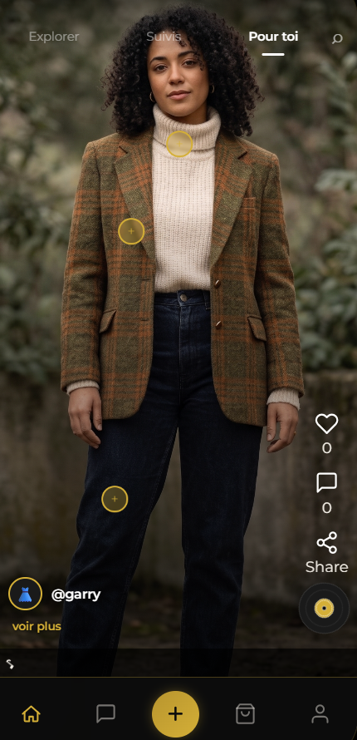
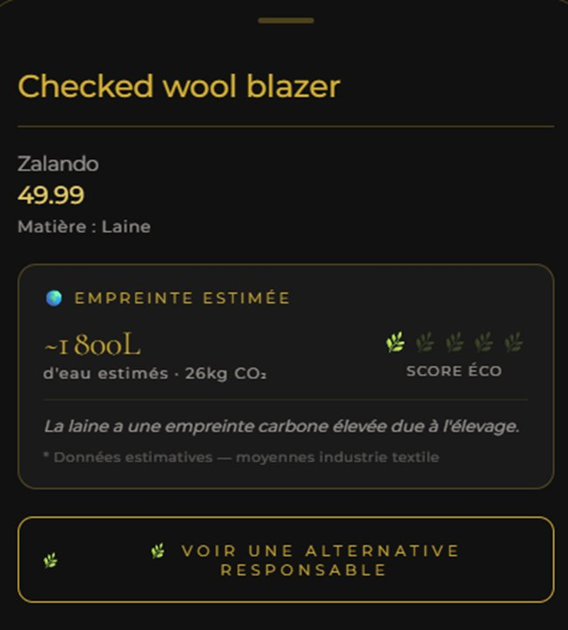
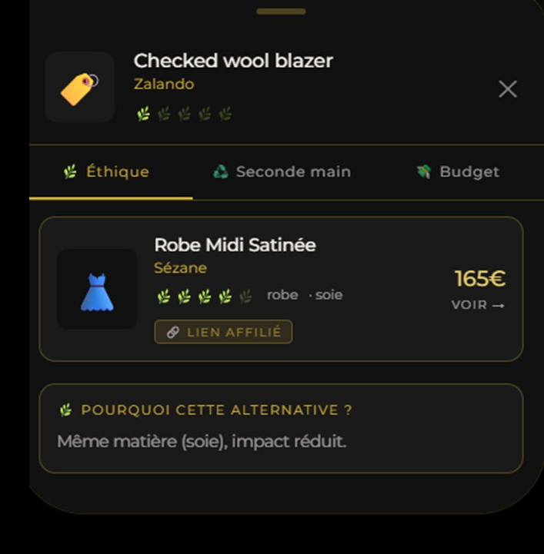
How It Works
From Inspiration to Impact in 3 Taps
👆 DISCOVER
🌍 UNDERSTAND
🌿 ACT
Discover looks that inspire you from the community
See the ethical & environmental score of any piece
Choose the best ethical match tailored to your size and budget
The only platform that turns a screenshot into a responsible purchase.
Notes:
Mettre le processus and

Slide 5
WearAura: The Ethical Bridge
Turning everyday style inspiration into instant ethical choices
Why it's different
📸 100% Privacy: Photos never leave the device
✨ The Social Feed
♻️ Vetted ethical database
♻️ Find your ethical match
✦ Aura Points: Rewarding the community for sustainable
investment
🌍Choose what feels right
Fashion you love. Without the guilt. With real impact.
Notes:
Mettre le processus and

Slide 6
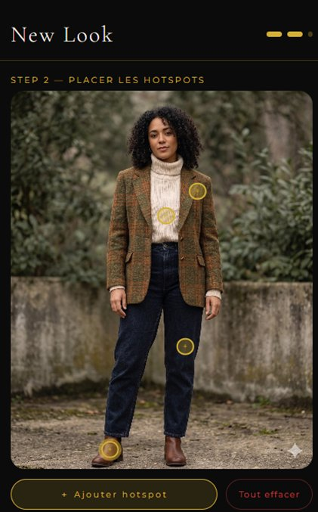
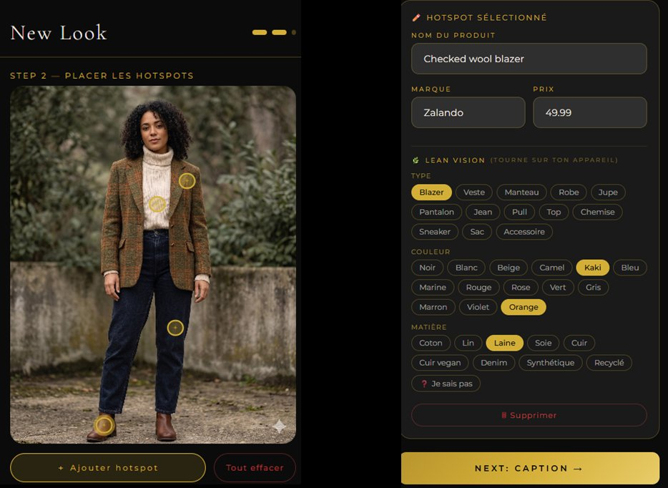
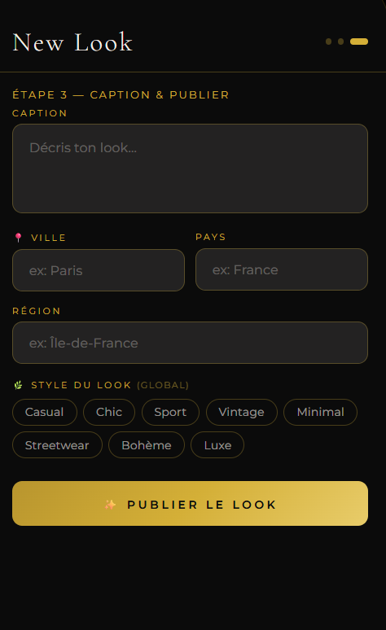
Empowering the Pack
Creator journey — from photo to community-powered ethical matching
1
SHARE
→
2
IDENTIFY
→
3
INSPIRE
Upload your style directly from your camera or gallery to inspire others
AI auto-detects fabric, type, and color. Tag pieces to enable ethical matching for the community.
Categorize by style and vibes. Your look becomes the answer to someone else's search
Privacy-First Contribution: Our Lean Vision AI processes everything on-device, your data and photos never leave your phone.
Notes:
Mettre le processus and

Slide 7
User insight
Persona | Motivation | The Barrier | WearAura Solution
The Pragmatist | Efficiency | High Search Friction | 1-Click AI Matching
The Conscious | Transparency | Limited Selection | Curated Ethical Hub
The Traditionalist | Aesthetics | Trust & Conformity | Aura Trust Verified
The Selective | Inclusivity | Size Exclusion | Smart Morpho-Filters
The Explorer | Inspiration | Information Loss | Screenshot-to-Look
5 different profiles. One shared need: to feel good about what they wear — without the effort of doing all the research themselves.
Notes:
Turn the problems with quantiter

Slide 8
Revenue Path
PHASE 1 · NOW
PHASE 2 · M+6
PHASE 3 · M+12
1
Affiliation
2
Marketplace
3
Ecosystem
Commission on purchases via existing partner platforms (Vestiaire Collective, Vinted, ethical brands). Zero inventory, zero upfront cost.
Own second-hand platform open to individuals and ethical brands. Higher margins, full data ownership, direct transactions with the community.
Creator Pro subscriptions, brand partnerships (CPA + CPC), and SaaS data insights for ethical brands designing smarter collections.
→
→
3–8% per sale · 0€ capex
~12% take rate · full data ownership
€9/mo · 10–15% CPA · SaaS recurring
Active from MVP launch
Trigger: 500 active users/month
Trigger: marketplace traction established
Capital-light start → Platform growth → Ecosystem monetization

Slide 9
Revenue Streams
1
Affiliation · Phase 1
2
Marketplace · Phase 2
3
Aura Pro · Phase 2–3
4
Brand & SaaS · Phase 3
Commission on purchases via partner platforms (Vestiaire Collective, Vinted, ethical brands). Zero inventory, zero upfront cost.
Own second-hand platform open to individuals and ethical brands. Direct transactions, higher margins, and full ownership of community data.
Creator subscription unlocking advanced analytics, priority feed placement, and a revenue share on every purchase generated by their looks.
Ethical brands: Direct Lead Generation (CPA) + Premium Placement (CPC). SaaS trend analytics for brands designing smarter collections.
3–8% per sale · 0€ capex · active NOW
~12% take rate · full data ownership · M+6
€9/month · revenue share per purchase
10–15% CPA · CPC placement · SaaS recurring
Capital-light start → own platform → data-driven ecosystem · each phase funds the next

Slide 10
Strategic Positioning
DIRECT COMPETITORS
INDIRECT COMPETITORS
Faircado / Gem App
Instagram / TikTok
Functional search tools, but lack social soul and the 'Pack' inspiration
Infinite inspiration, but zero ethical traceability or purchase conversion
LTK (LikeToKnowIt)
Vinted / Depop
High creator engagement, but fundamentally built to fuel fast-fashion overconsumption
Massive inventory, but plagued by 'Search Fatigue' and disconnected from real-time trends
WearAura is the only ecosystem merging High-Fashion Inspiration with Community-Powered Resolution and instant Ethical Matching.

Slide 11
Execution Roadmap
Business
Technical
Milestone
N
Beta
V1
V2
V3
NOW
M+1
M+3
M+4
M+6
M+9
M+12
M+15
Netlify deployment
Private beta (5 creators)
Private beta (5 creators)
Affiliate CPA live
Affiliate CPA live
20–30 creators onboarded
20–30 creators onboard…
KPIs tracked (Posthog)
KPIs tracked (Posthog)
Aura Verified certification
Aura Verified certific…
Brand partnerships
Brand partnerships
Public launch
Retail Media / CPC
Retail Media / CPC
B2B Direct Lead Gen
B2B Direct Lead Gen
SaaS Data Insights
SaaS Data Insights
UK & Europe expansion
UK & Europe expansion
PWA + Supabase backend
Lean Vision V1 (color+kw)
Airtable matching
Airtable matching
Follow / feed Suivis
Follow / feed Suivis
MobileNet V1 (on-device)
MobileNet V1 (on-devic…
Multi-photo posts
Multi-photo posts
Push notifications
Push notifications
1an FR / EN
lan FR / EN
React Native migration
React Native migration
App Store / Play Store
Lean Vision V2 (CLIP)
Lean Vision V2 (CLIP)
Stories & video posts
Stories & video posts
Brand analytics dashboard
Brand analytics dashbo…
Open API for brands
Open API for brands
Proprietary Lean Vision
Proprietary Lean Visio…
AI trend prediction
AI trend prediction

Slide 12





Core Team & Advisors
Idriss Bouamor
Founder
Designed, built and deployed WearAura solo
Supported by ESTIA students
Jérémie Faham
Start-up Advisor
Matti Laitinen
RDI Expert
Tommy Belvoix
Start-up Advisor

Slide 13
Potential Partners
🤝 Technical Partner
🏷️ Brand Partnerships
📣 Creator Network
We are seeking a React Native developer to scale the MVP into a native mobile app, and a product designer to co-shape the WearAura experience as a founding team member.
3–5 ethical brands to co-pilot our Direct Lead Generation model as founding partners — with exclusive early-mover advantages and featured positioning at launch.
20–30 fashion micro-creators aligned with sustainable fashion for the private beta — the humans who will make WearAura worth opening every day
Idriss.bouamor@etu.estia.fr · wearaura.netlify.app

Slide 14
WEARAURA
Style. Ethics. You.
0
40×
4
Server calls for AI analysis
Less energy than Google Lens
Revenue streams
Idriss.bouamor@etu.estia.fr · wearaura.netlify.app

