Slide 1
Use GARCH model to predict volatility
ARMA-GARCH model predicts the volatility of profit of SPX
Zihao Lin, Nov. 15, 2020

Slide 2

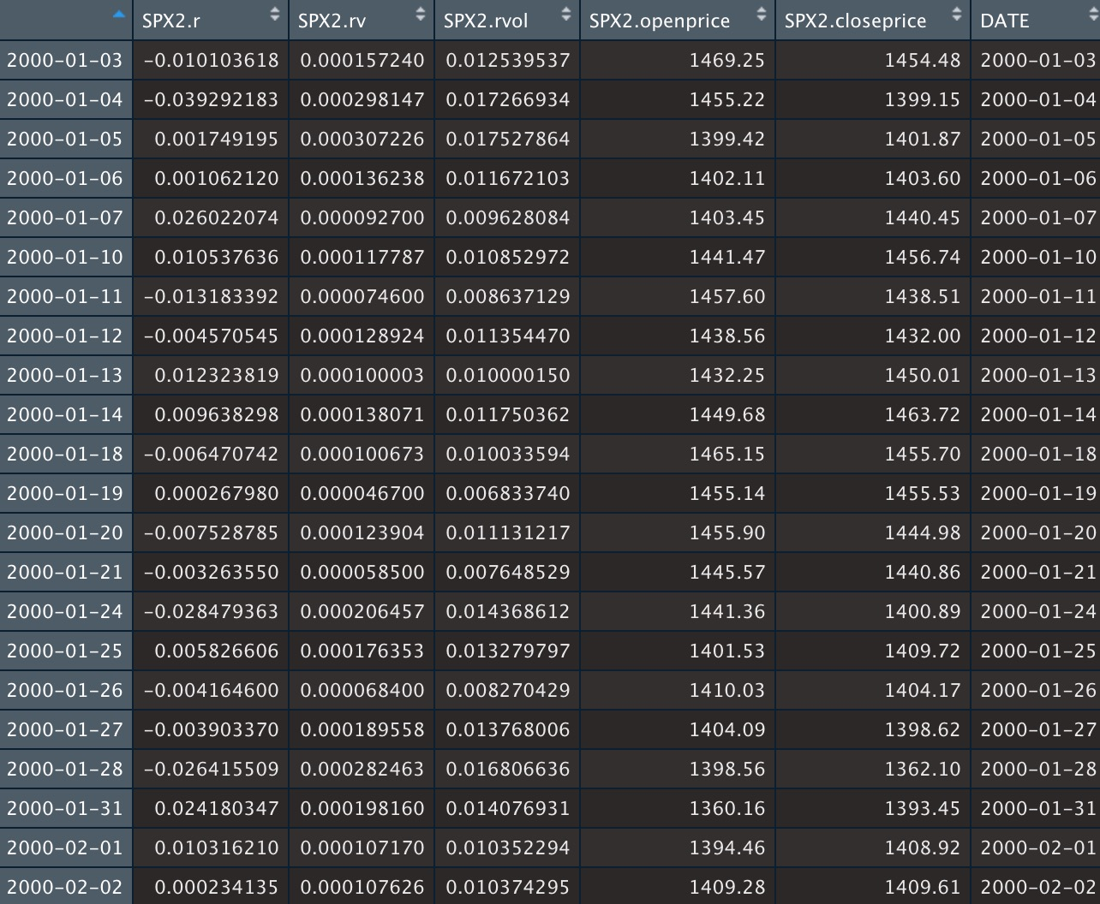
PURPOSE & DATA
This project aims to analyze the time series characteristics of everyday profit and forecast the real volatility of S&P 500 index.
The S&P 500 is a stock market index.
I should first estimate the real volatility using HEAVY model because it’s invisible
The dataset includes the estimated volatility. Here I assume that the estimated volatility from HEAVY model is believable and it is unbiased and efficient.

Slide 3
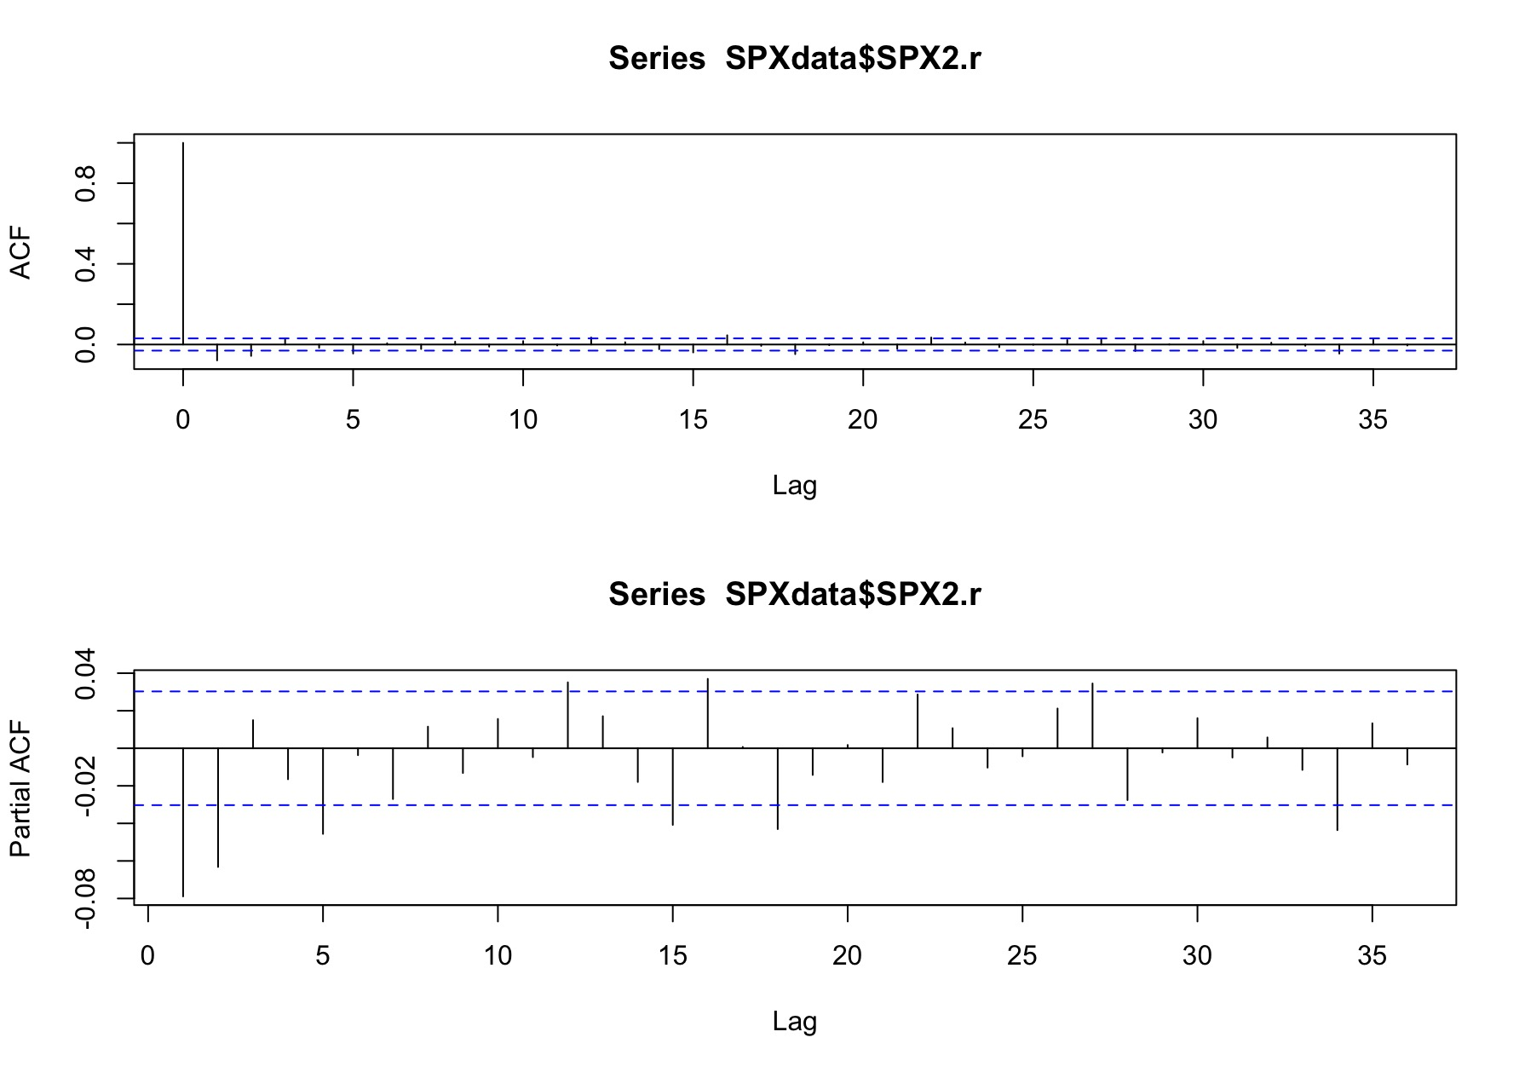
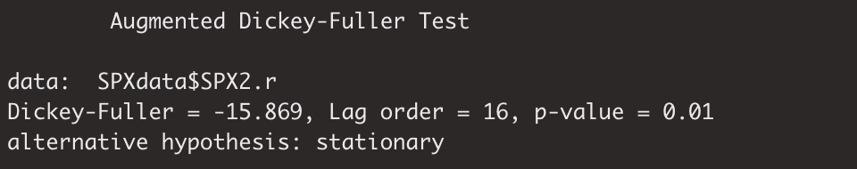
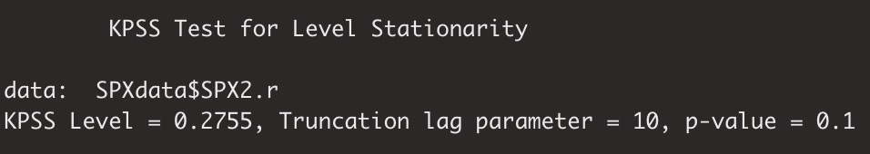
TIME SERIES CHARACTERISTICS
According to ACF, the profit obeys MA(0)
According to PACF, the profit obeys RA(2)
According to Dickey-Fuller Test and DPSS Test, the profit time series is stationary

Slide 4
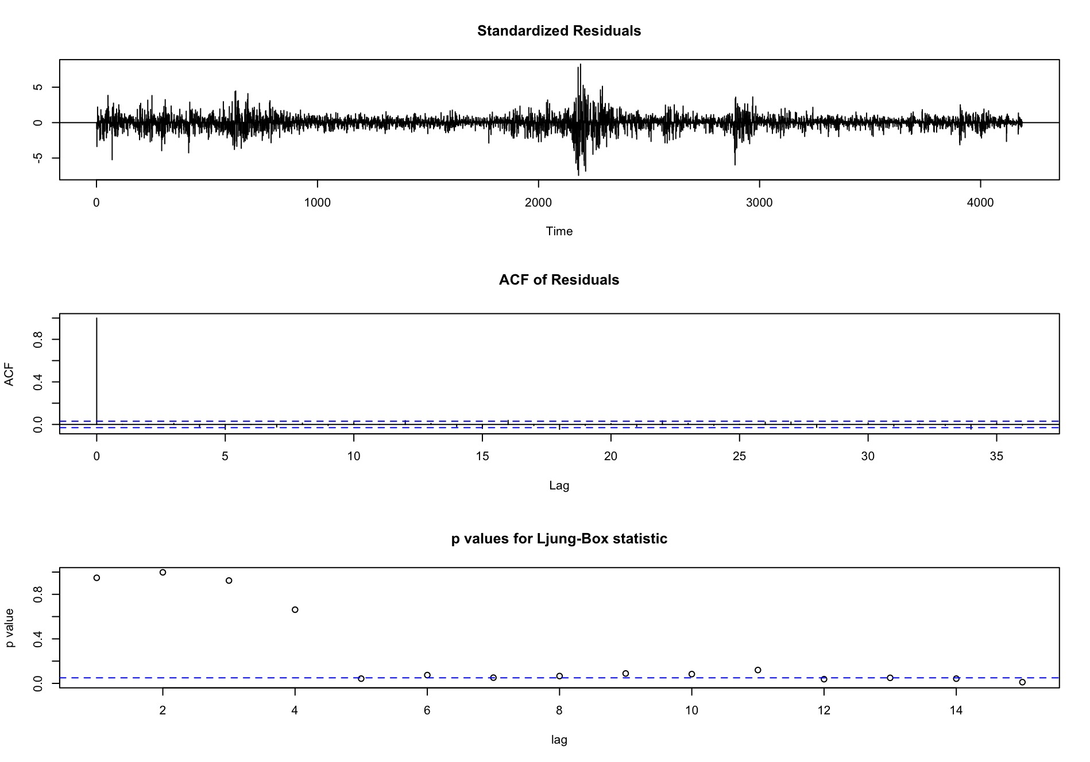
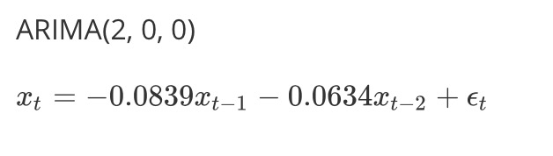
FITTING ARMA MODEL & DIAGNOSTICS
More than 10 residuals larger than 3 which is very unusual in a standard normal distribution.
There is no evidence of autocorrelation in the residuals of this model.
When lag is more than 4, the p-value of Ljung-Box statistic is near 0, which means that we should reject the null hypo, and there exists self-correlation.

Slide 5
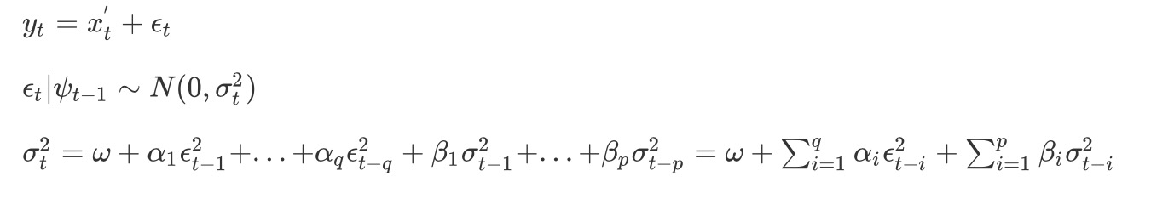
GARCH MODEL
ARCH model is a statistical model for time series data that describes the variance of the current error term.
If an ARMA model is assumed for the error variance, the model is a GARCH model
GARCH(p, q):
ARCH models are commonly employed in modeling financial time series that exhibit time-varying volatility and volatility clustering.

Slide 6
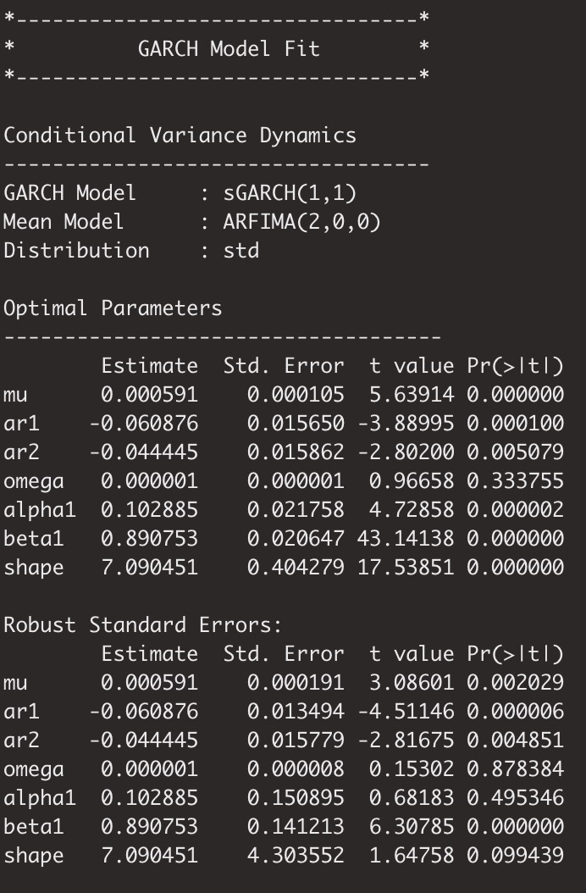
GARCH MODEL OF VOLATILITY
According to the ARMA(2,0) model of profit, I apply standard ARMA(2,0)-GARCH(1,1) model for profit to predict the volatility of profit.
I used 4189 observations to do back test (from Jan. 3rd 2000 to Oct. 06th 2016). I used the first 1000 observations to train the model and each time rolled to predict the next value and refitted the model every five observations.
The p-values of ar1, ar2, etc. are smaller than 0.05 which means that the items are significant.

Slide 7

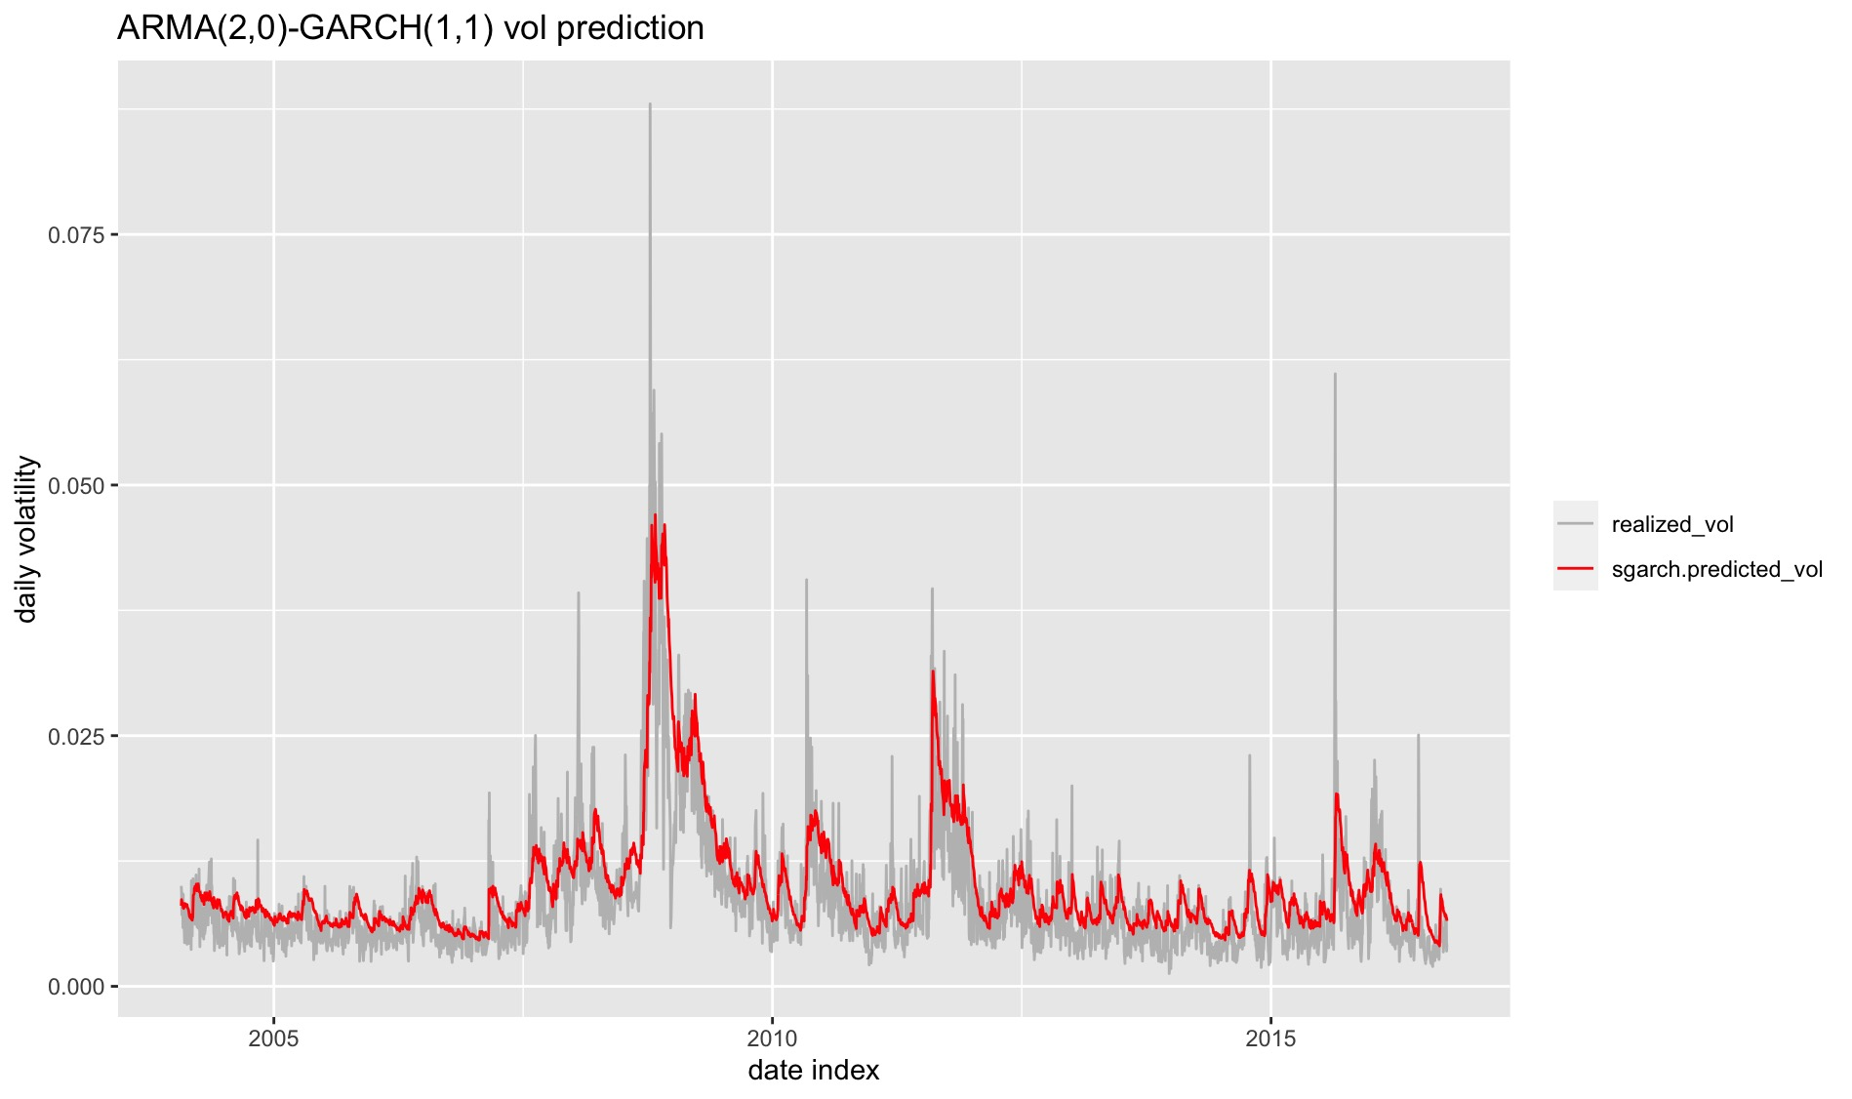



PREDICTION RESULT
MSE: 1.767135e-05
Correlation between the realized volatility and predicted volatility: 0.7960698
The result is good!

Slide 8
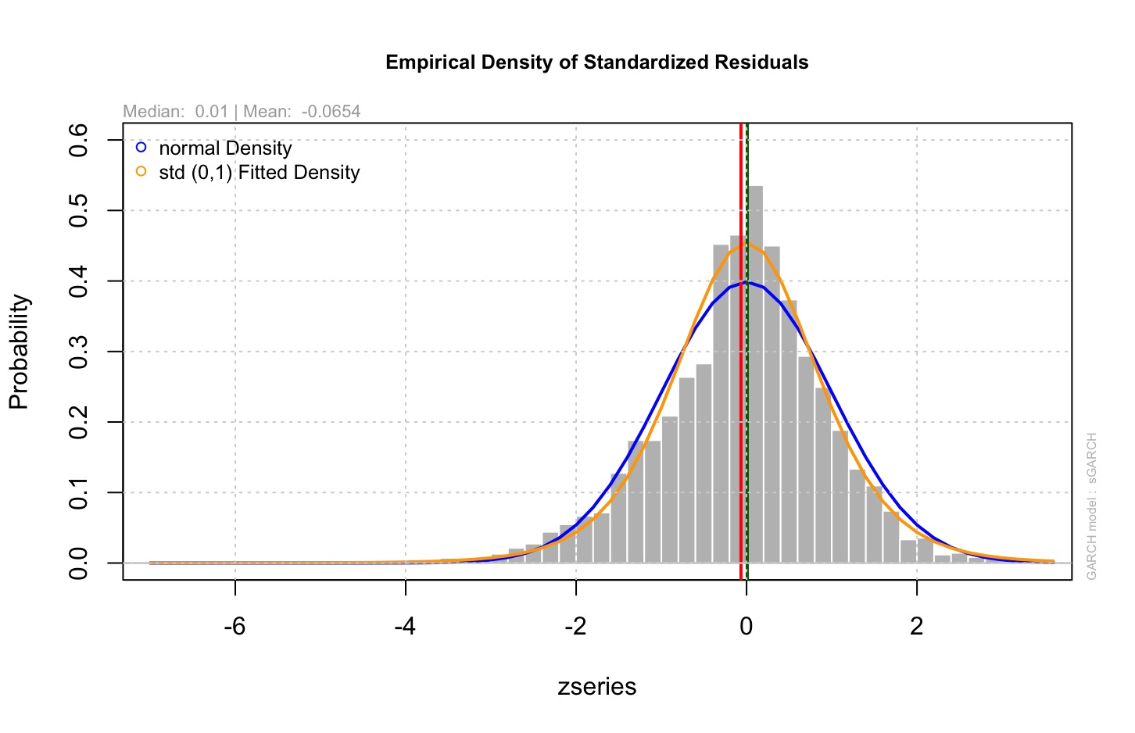
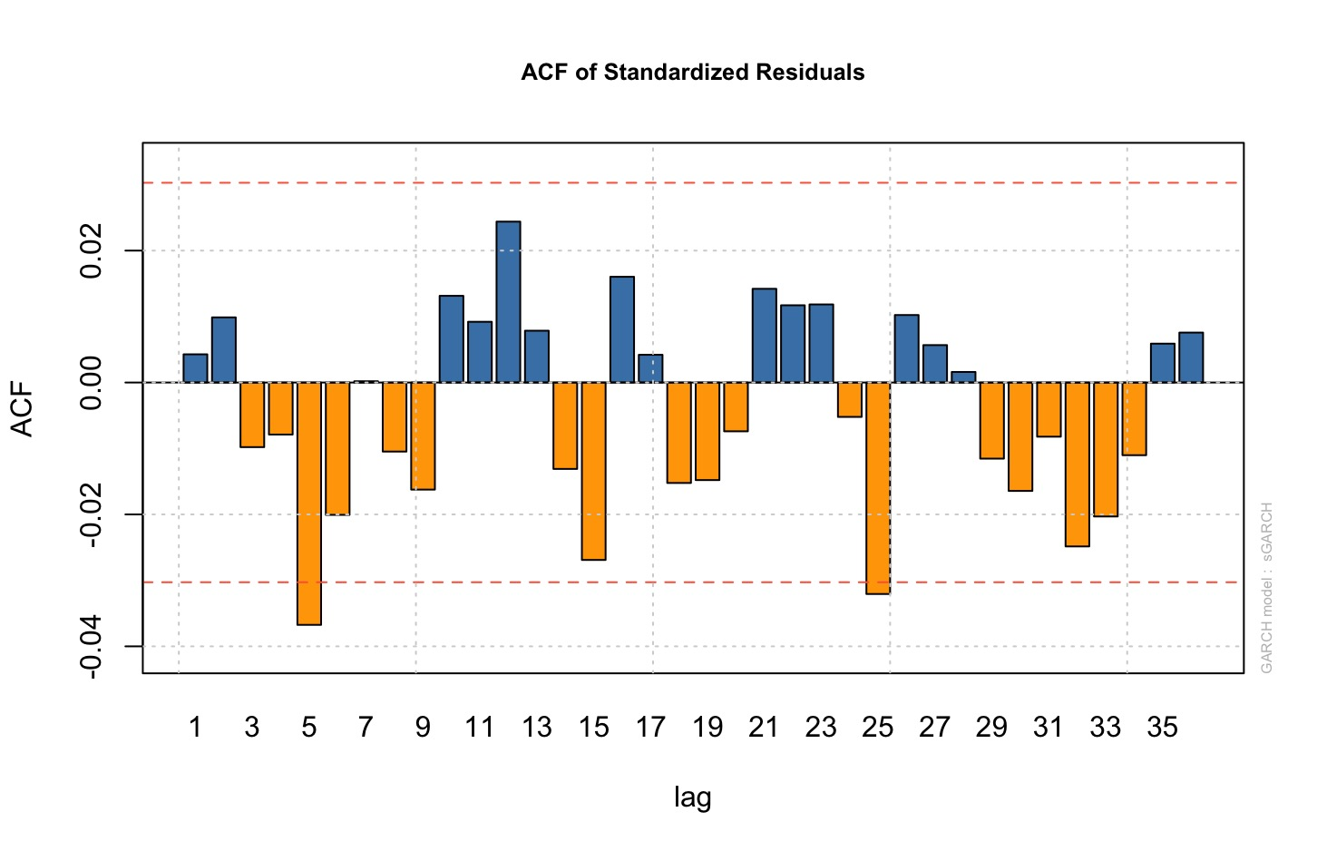
DIAGNOSTICS OF GARCH MODEL
Normality of residuals
Acf of residuals

Slide 9
Thank you! DUKE MIDS, Zihao Lin Nov. 15, 2020

