Slide 1
Effects of Job Training on Wages
Team 7
John Owusu Duah
Sarwari Das
Peining Yang
Michelle Van
Satvik Kishore
Notes:
Good Morning. Today, Team Silver will be talking about the National Supported Work Demonstration Experiment, and infer the impact that job training has on wages. Before we go ahead, I’d like to introduce my team. We have Peining, Sarwari, John, Michelle, and I am Satvik. Ok, so, this data contains a treatment group, that is disadvantaged male workers who received job training between 1975 and 1977. Our control group consists of unemployed males in 1976 whose income in 1975 was below poverty level.

Slide 2
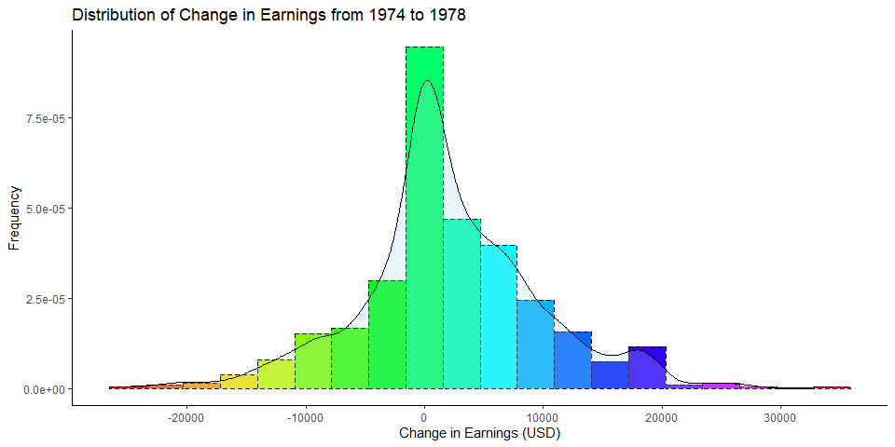
Outcome Variable: Change in Real Earnings from 1974 to 1978
n = 613
Notes:
Our outcome variable is the difference in Real Annual Earnings of the workers from 1974 to 1978. In our analysis, we aim to identify the factors that led to a change in real earnings over this time period, and whether job training had any significant impact on these real earnings. We also aim to identify if race was a factor influencing the impact of job training on change in income. The distribution appears to be bell-shaped, however it is not quite normal as there are many observations with value zero. These are the people who had zero real Real Annual Earnings in both these years. One of the observations had a very high change in income (>40000) and we have dropped it from our analysis

Slide 3
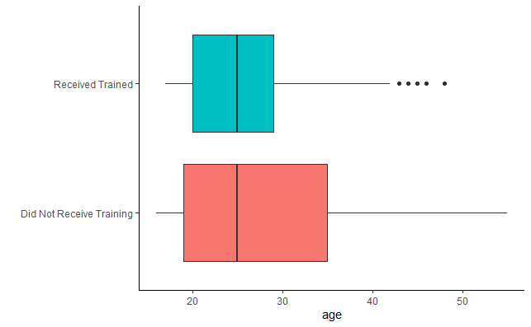
Inconsistency in ages between Control and Treatment group
Mean in Treatment group: 25.8 Mean in Control group: 28.3 t test results: Means are different with p-value= 0.003
Notes:
One discrepancy that we observed in our Control and Treatment groups was the differing age distributions, where the Control group clearly has a wider spread and higher mean. This could have an effect on our interpretations of results, especially age. We hope however that the regression model is able to adjust for this effect when we are interpreting the effect of training on change in real income.

Slide 4
Linear Regression Model
Predictor | Estimate | Std. Error | t value | Pr(>|t|)
Intercept | 2064.19 | 510.61 | 4.04 | 6.00E-05
Received Training | 2285.04 | 697.88 | 3.27 | 0.0011
Age Centered | -205.56 | 49.56 | -4.15 | 3.80E-05
Is Married | -1731.92 | 685.1 | -2.53 | 0.012
Interaction of "Received Training" and "Age Centered" | 283.57 | 85.81 | 3.3 | 0.001
Interaction of "Married" and "Age Centered" | 132.82 | 67.74 | 1.96 | 0.05
Adjusted R-squared: 0.07144
p-value: 1.328e-09
Notes:
We fitted a linear regression model for our outcome variable. After optimizing our model, our final model had results as illustrated. Our final model adhered to all assumptions of linear regression. Our predictor variables were “Whether the subject receieved any Job Traaining”, ie Treatment vs Control group; Age (centered for ease in analysis), whether the subject was married, an interaction effect between training and age, and an interaction effect between Married and age. <Interpret Intercept>. <Interpret received Training>.
??Do we need an equation

Slide 5
Limitations and Future work
Notes:
Need discussion on this

