Slide 1
Effects of Job Training for Disadvantaged Workers
IDS702 Team Project Group Yellow

Slide 2
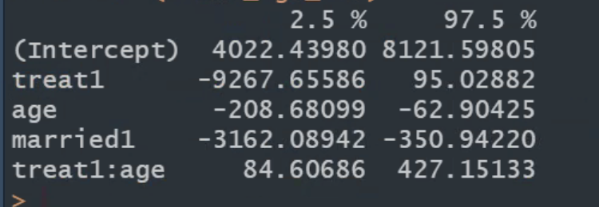
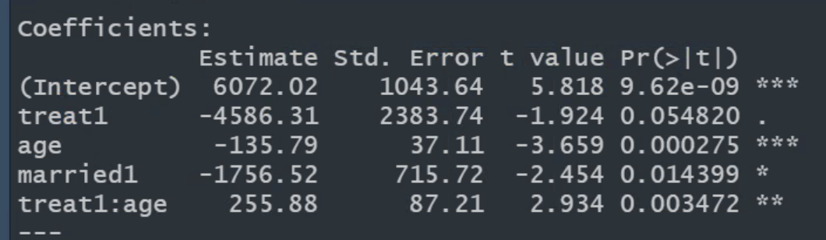
Final model AIC + treat x age
Plan Part I
EDA
Pretty plot
Experiments
Issues with re78 (zero inflation)
Process description
Stepwise
Null: only treat
Full: All mean effects
Uses: treat + age + married
Test interactions of these 3
Anova: SIG: Treat x age | NS: Treat x married, married x age
Test interactions between demographic groups
No sig interactions for AIC result VS. AIC result + race x treat interaction
Model assessment
Nuice, but a couple of outliers, they are not influential -> ignore

Slide 3
Data & Modeling Process
Data Set
Collected by Robert LaLonde [1] in the 1970s
Studies effect of job training for disadvantaged workers on earnings
Recorded information on demographics, education status and prior wages
Only male participants
Paid participation
Modeling Process
EDA
Experiments
Stepwise Regression
Testing Interactions
Model Assessment

Slide 4

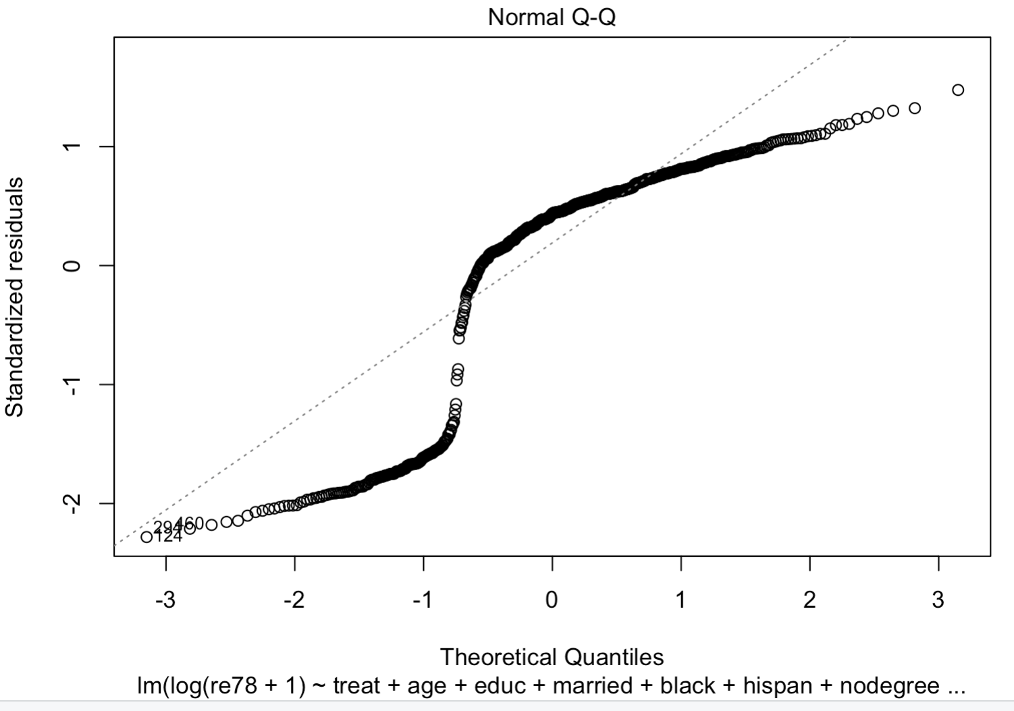
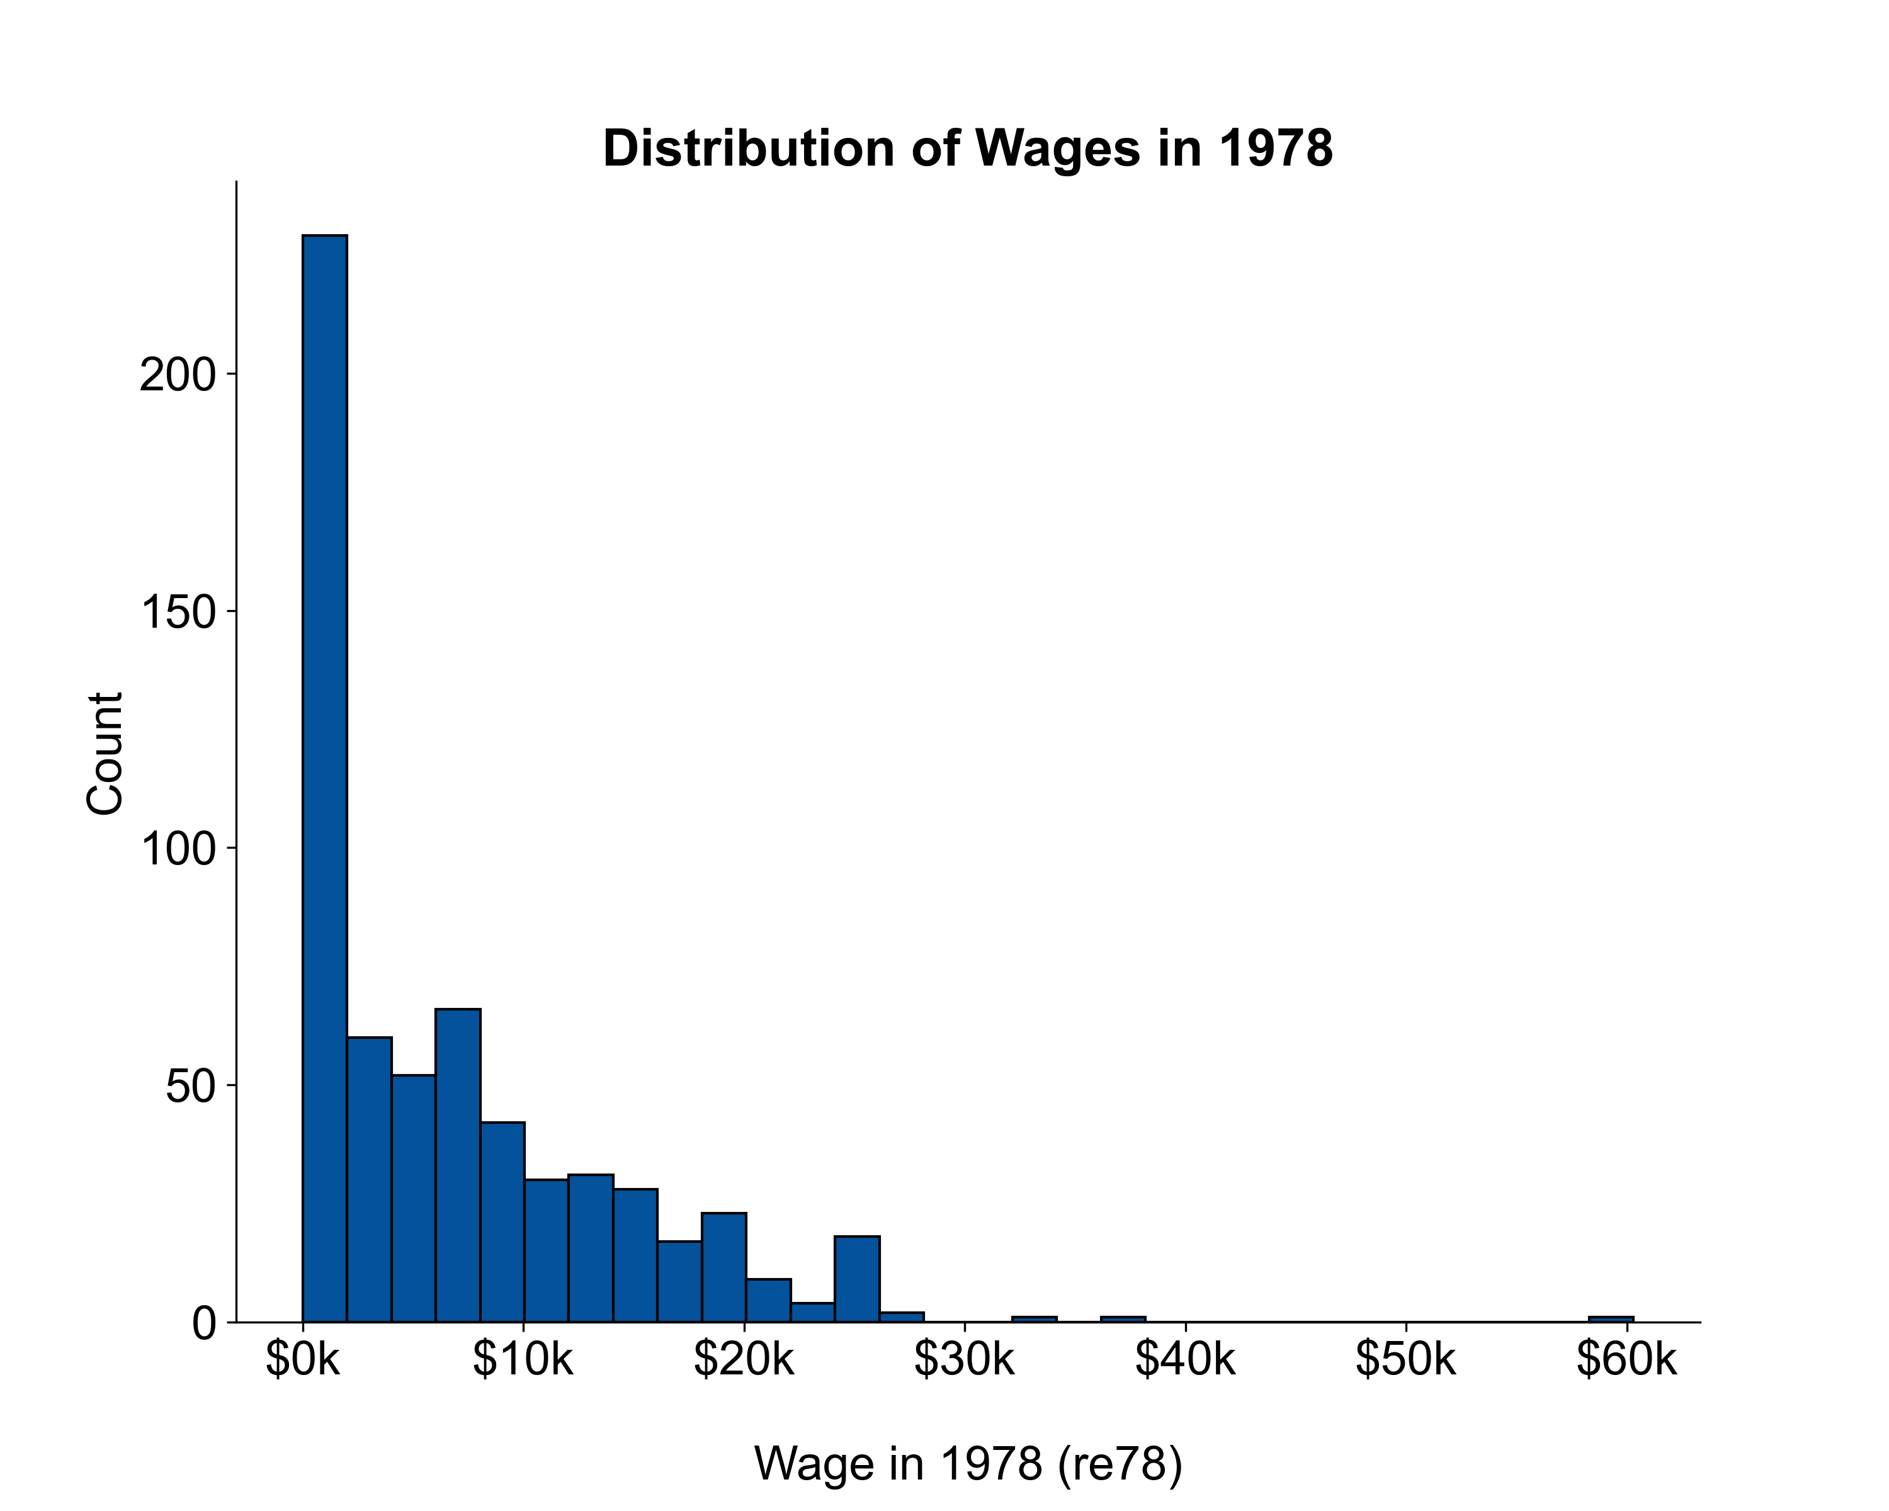

EDA & Experiments
Univariate
Perfectly normally distributed residuals
Zero inflation $→$ model $re78−re74$ instead

Slide 5
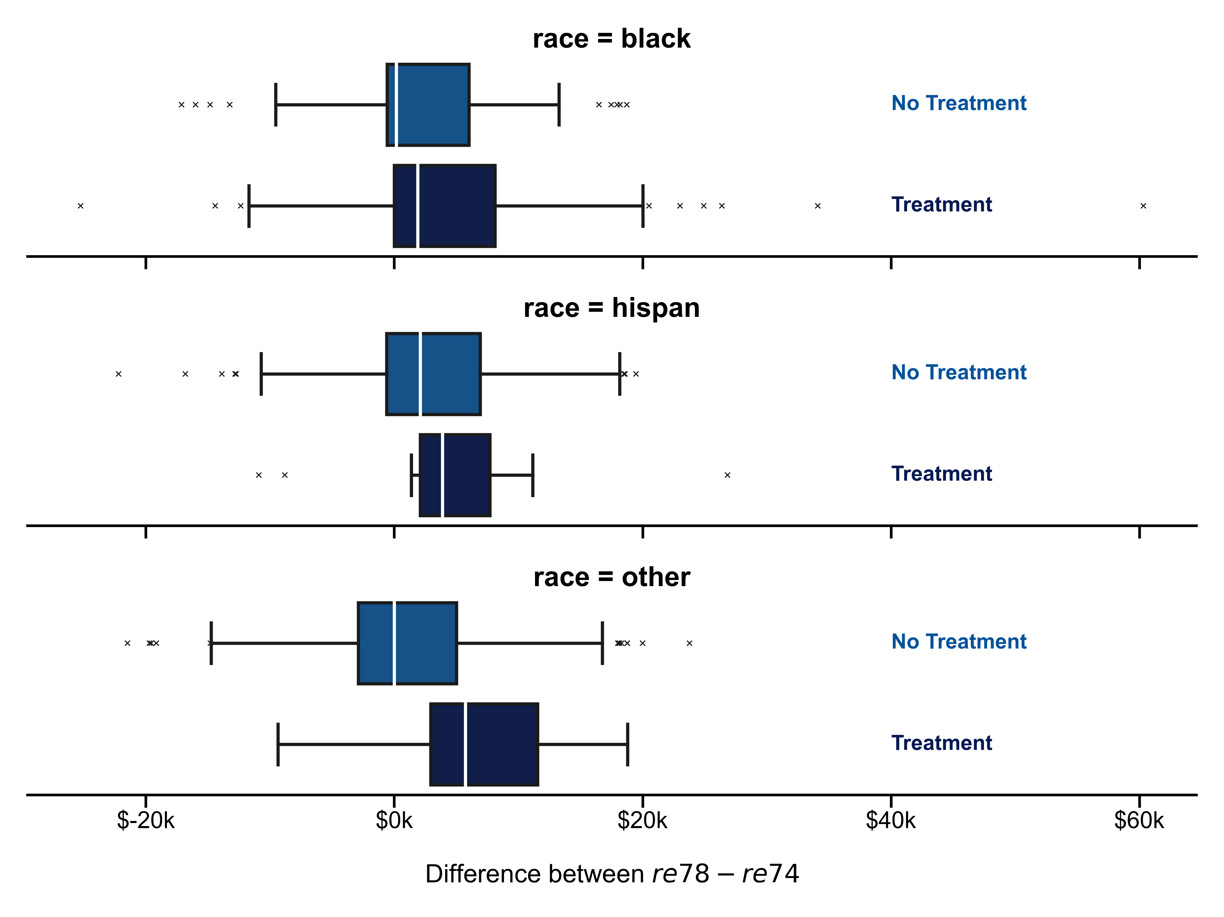
EDA & Experiments
Univariate
Interactions
Zero inflation $→$ model $re78−re74$ instead
No interaction between treatment and race

Slide 6

Stepwise Regression
Null Model
Treatment only
Full Model
All mean effects
Parameters
AIC
Direction = both
Resulting Model
$$\hat{y}=\hat{β_{0}}+\hat{β_{1}}⋅treat+\hat{β_{2}}⋅age+\hat{β_{3}}⋅married$$
Notes:
Dauren

Slide 7


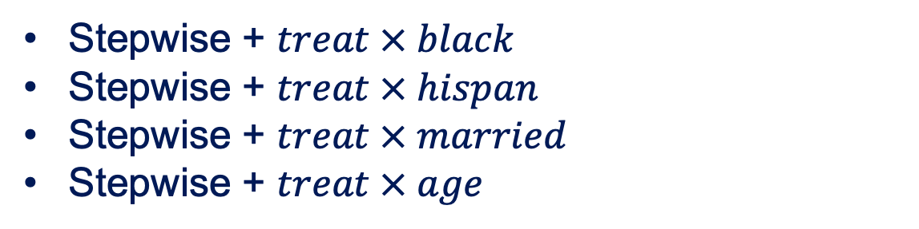
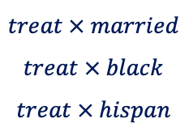
Testing Interactions
Testing stepwise model against….
Stepwise + $treat × black$
Stepwise + $treat × hispan$
Stepwise + $treat × married$
Stepwise + $treat × age$
$treat × married$
$$treat × black$$
$$treat × hispan$$
F Test for $treat × age$ interaction
The treatment effect differs by age group, but not by any of the other demographics
Notes:
Himangshu

Slide 8
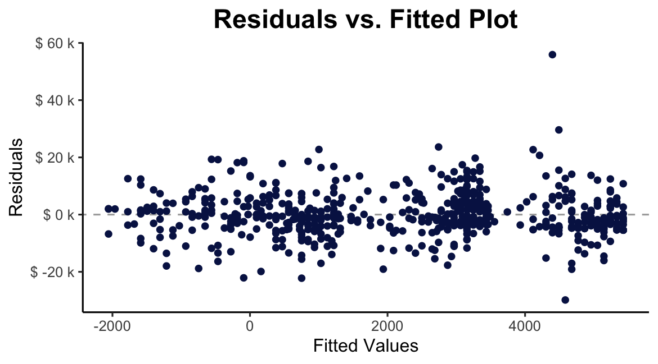
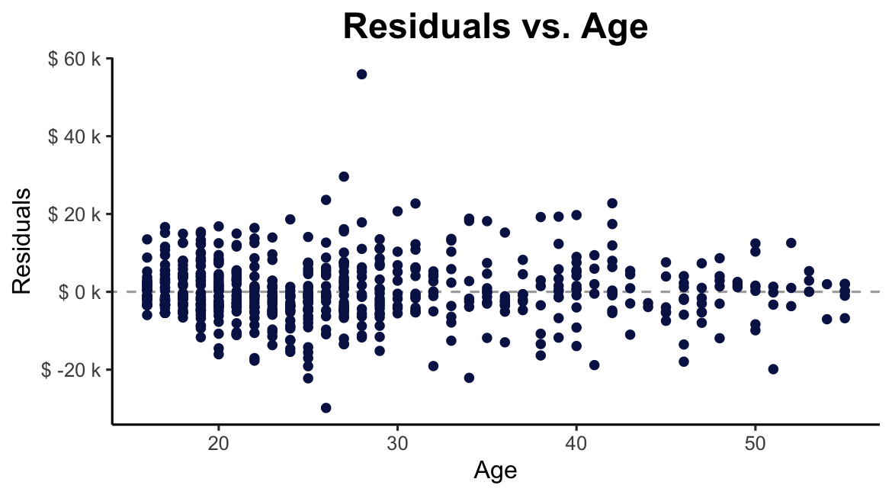
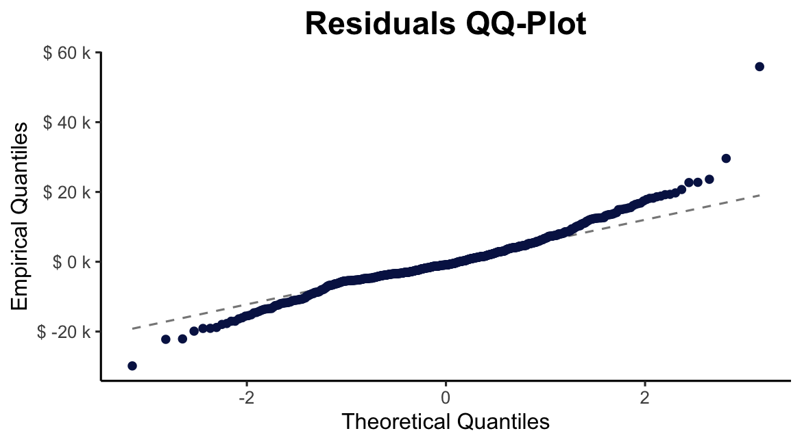
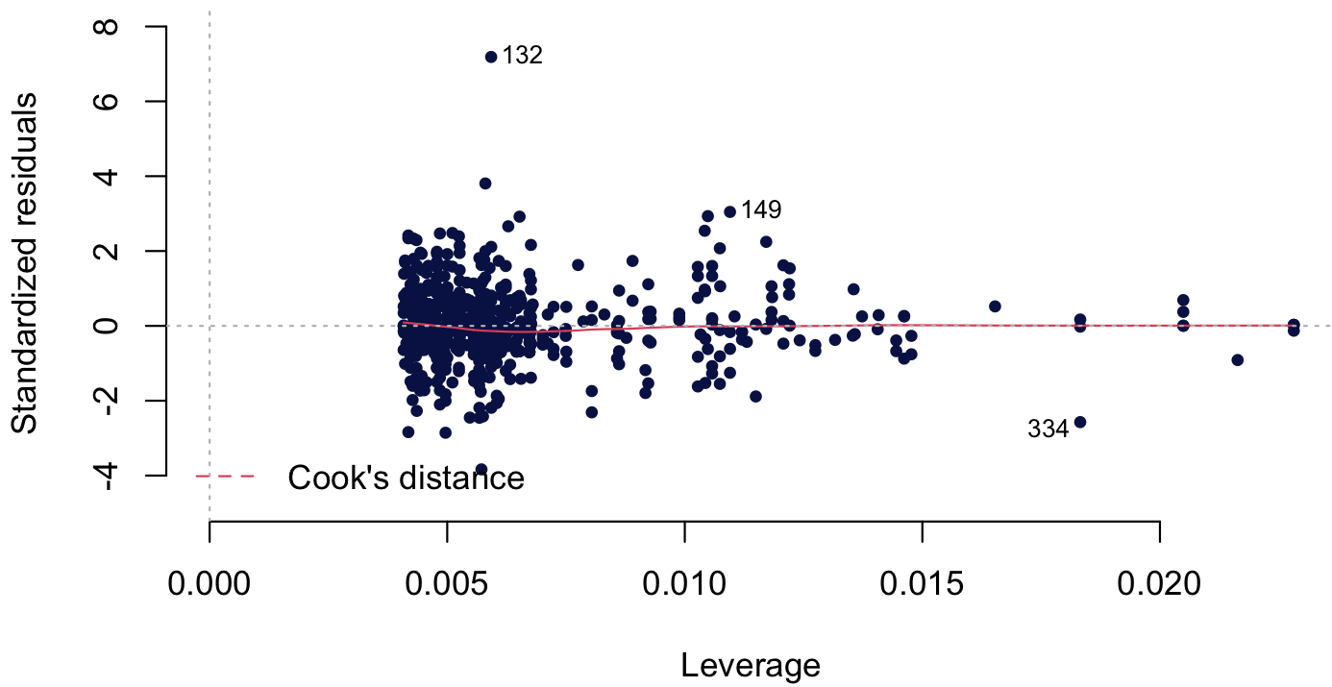
Model Assessment
$$\hat{y}=\hat{β_{0}}+\hat{β_{1}}⋅treat+\hat{β_{2}}⋅age+\hat{β_{3}}⋅married+\hat{β_{4}}⋅treat×age$$
No major assumption violations
+
no multicollinearity issues (VIF)
Residuals vs. Leverage
Notes:
Himangshu
Equal variance and independence FINE (Plot 1)
Linearity FINE (Plot 2)
Normality FINE (Plot 3)
One outlier, but: non-influential

Slide 9
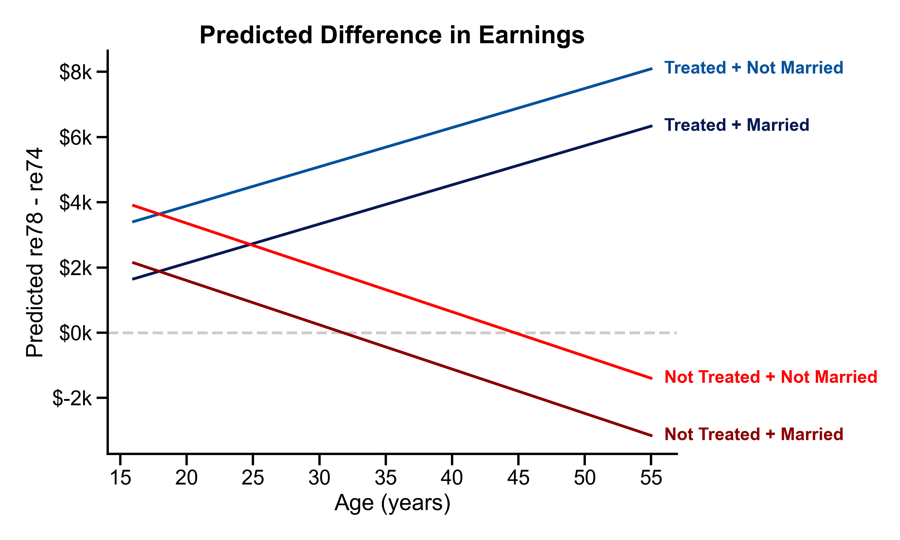
Interpretation
Model
Limitations
- Low R2
TODO: CI for all vars in sep table
Notes:
Moritz

Slide 10
References
Lalonde, R. J. (1986), Evaluating the econometric evaluations of training programs with experimental data, The American Economic Review, 76, 604 - 620.

Slide 11
This is a Title

