Slide 1
Effects of Job Training for Disadvantaged Workers
IDS702 Team Project Group Yellow

Slide 2
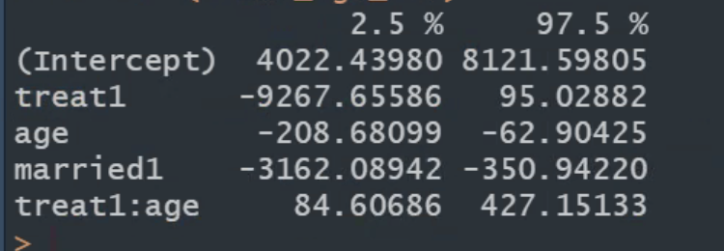
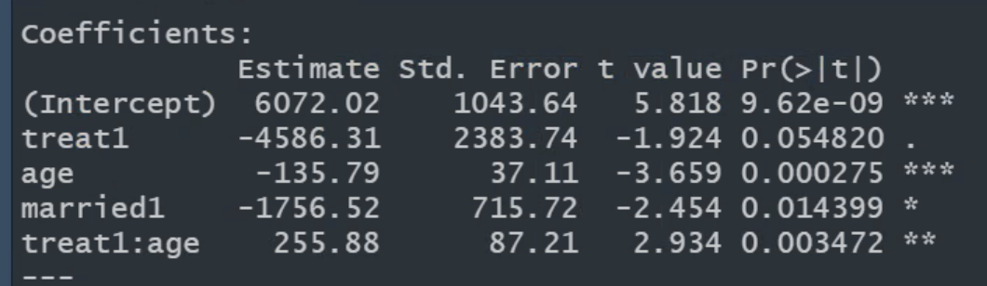
Final model AIC + treat x age
Plan Part I
EDA
Pretty plot
Experiments
Issues with re78 (zero inflation)
Process description
Stepwise
Null: only treat
Full: All mean effects
Uses: treat + age + married
Test interactions of these 3
Anova: SIG: Treat x age | NS: Treat x married, married x age
Test interactions between demographic groups
No sig interactions for AIC result VS. AIC result + race x treat interaction
Model assessment
Nuice, but a couple of outliers, they are not influential -> ignore

Slide 3
Modeling Process
EDA
Experiments
Stepwise Regression
Testing Interactions
Model Assessment

Slide 4
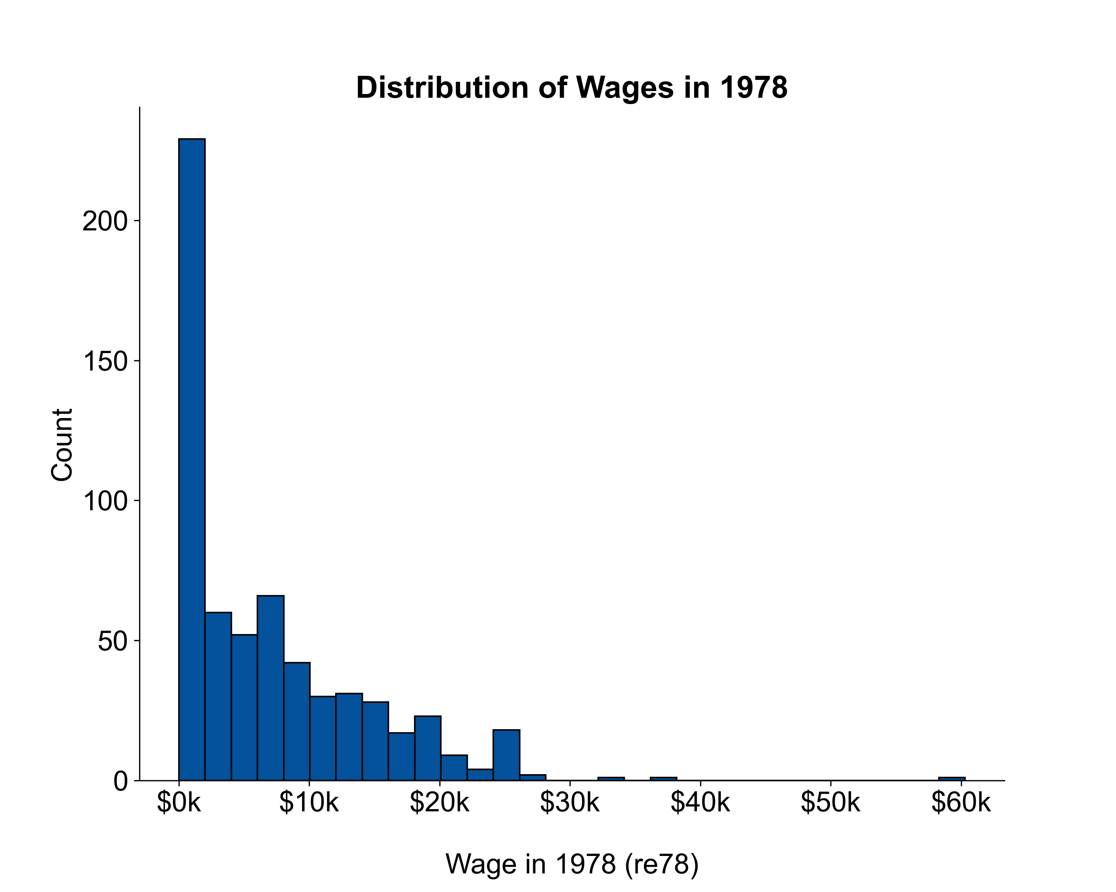

EDA
Univariate
Bivariate
Zero inflation $→$ model $re78−re74$ instead

Slide 7
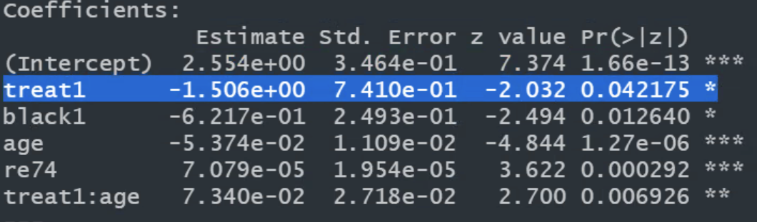
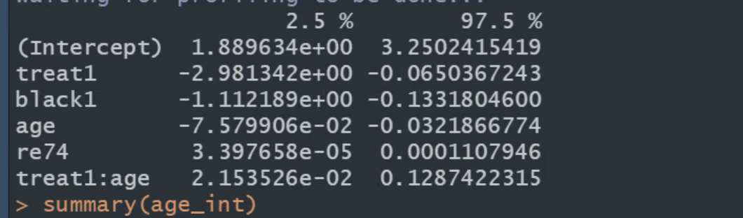
Plan Part II

Slide 9
This is a Title

