Slide 1






Welcome!
dO yOu NeEd HeLp wiTh ThAt?
Anna, Dauren, Athena. Himangshu, m0RITZ

Slide 2
Black Market Methadone Prices Across the United States
(just kidding)
IDS702 Team Project Group Yellow

Slide 3
Outline
Data Background
Process
Data Cleaning
EDA
Linear Model Fitting
Hierarchical Model Fitting
Interpretations
Conclusion

Slide 4
Data & Modeling Process
Data Cleaning
StreetRx
Crowdsourced data on diverted prescription drugs
Unreliable data inputs
EDA
Predictors, levels and interactions
Linear Model Fitting
Fit base-level linear model
Model assessment
Hierarchical Model Fitting
Fit hierarchical model
Model assessment
Interpretations
Interpretations and drawing conclusions
Notes:
Moritz

Slide 5

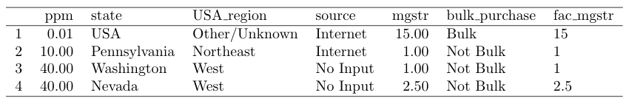
Data Cleaning
Consolidation of source inputs
Missing values
Removed blank values in ppm
Which also eliminated values in mgstr
Internet
http://...
Google
Pharmacy
StreetRx
Internet
Implications here
mgstr groupings
Heard it
Blanks
N/A
None
No Input
Personal
Removed error-like mgstr and factorized mgstr
Notes:
Moritz

Slide 6
EDA
Distribution of PPM
Distribution by location
plot of distribution > 95% percentile/research shows > plot of new distribution
Price by state >> take it out of our linear model as level
Notes:
Moritz

Slide 7

Linear Model Fitting
Null Model
Intercept only
Full Model
All non-location predictors
Parameters
AIC
Direction = both
Testing interactions
All trash
Final model
$$\hat{ppm}= \hat{β_{0}}+\hat{β_{1}}⋅$$
Notes:
Moritz

Slide 8
Linear Model Assessment
Do we want some assessment graphs or is that a bit much?
ALSO WE NEED SOME MEMES
Notes:
Moritz

Slide 9
Hierarchical Model Fitting
Testing by state and region against just by state
Testing state, region and state+region
Final model
Notes:
Moritz

Slide 10
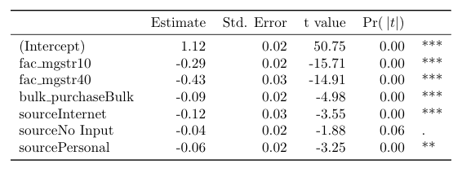
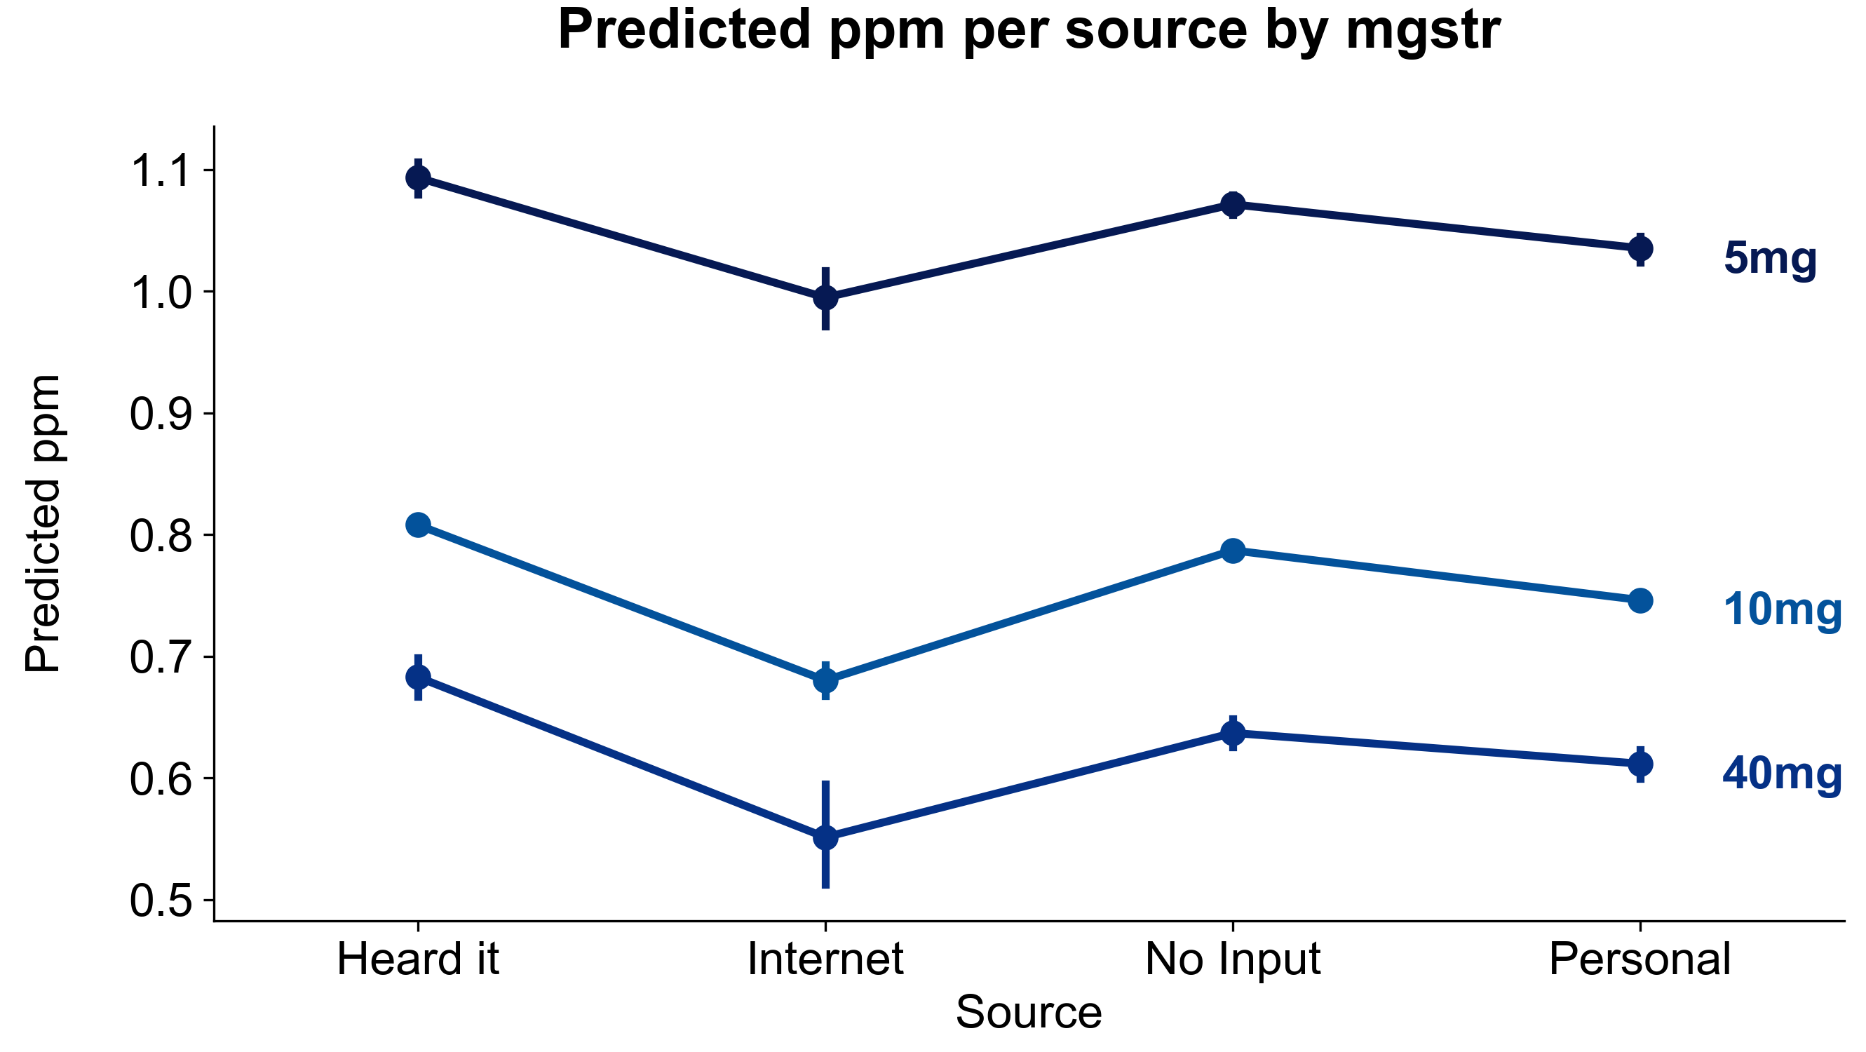
Interpretation
Level 1
Level 2
Key stats above
Dot plot here
Some conclusion
Notes:
Moritz

Slide 11
Geographical Visualization
map
Notes:
Moritz

Slide 12
References
TBD

Slide 13
Title
Subtitle
Notes:
Moritz

