Slide 1

Electricity Usage Optimizer
get your bills under control!

Slide 2
Money savings for you with hourly rate!
Cut costs by planning your near-future consumption!
Is it cheaper to charge your electric car tomorrow or perhaps the day after tomorrow?
Warm your house just before the weather turns cold and prices rise!

Slide 3
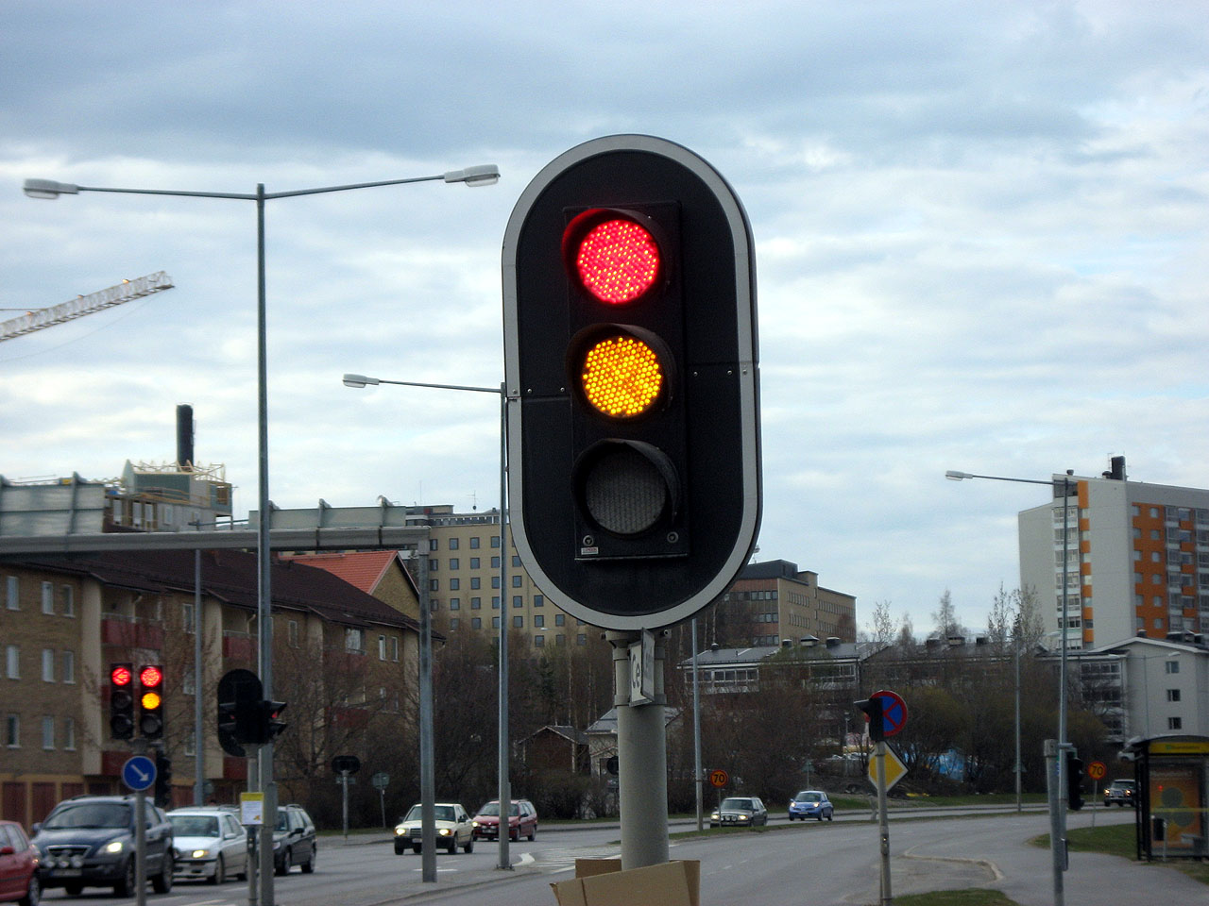
Easy-to-use
No mobile app
No IoT nonsense
No registration
No graphs or figures
Just three recommendation levels per hour!

Slide 4
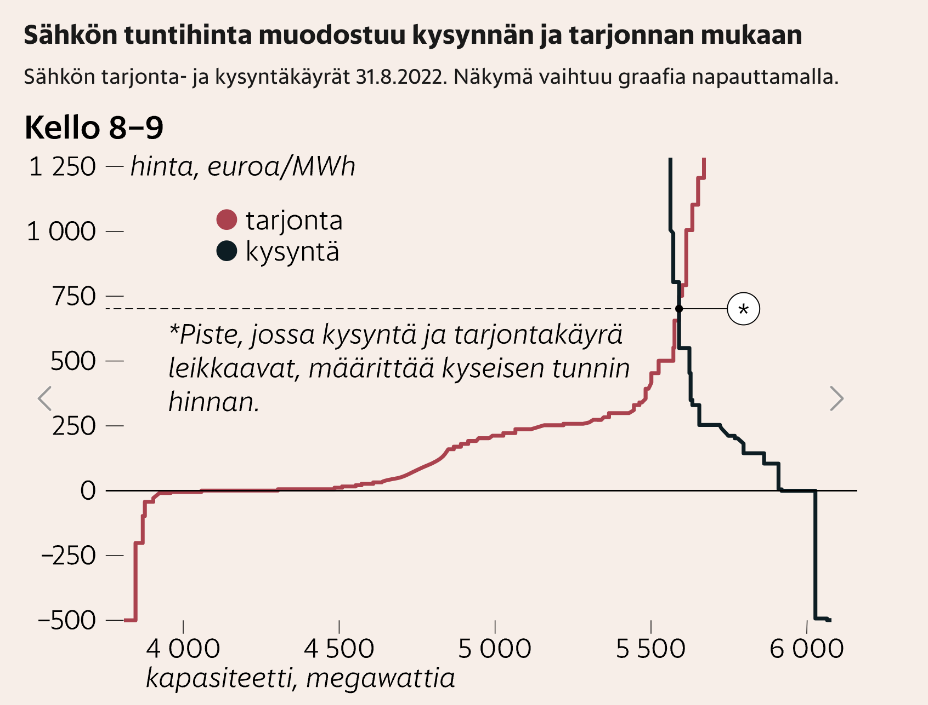
…because planning is now needed more than ever!
When demand is high, prices climb FAST!
Every new unit of production costs more than the previous
Prices also drop sharp
By planning you save but so will your neighbor!

Slide 5
Key take aways:
Avoid costly hours by planning a few days ahead
Help the whole society during peak-hours
No nonsense, just one pageload, one glance!

