Slide 1



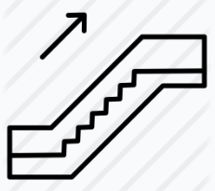

INPUTS
passEntryRate
passExitRate
passengerMoveRate
passengerIsActiveRider
SYSTEM
escalatorBaseSpeed
escalatorLength
escalatorEntryLength
escalatorExitLength
escalatorAllowsActiveTranslate
escalatorCapacity
OUTPUTS
passengersTranslated(t)
Icon credit to:

Slide 3
 | Entrance/Exit Rate Low | Entrance/Exit Rate High
Active Walk Speed Null | Transport Count: Medium | Transport Count: High
Active Walk Speed Low | Transport Count: Low | Transport Count: Medium
Active Walk Speed High | Transport Count: Medium | Transport Count: High

Slide 4

Passengers
Escalator
maxFlowRate
exitArea
maxFlowRate
entranceArea
maxOccupancy
baseMoveRate
passengerSection
activeMoveRate
entranceMoveRate
exitMoveRate
activePassengers
baseMoveRate
maxOccupancy
baseMoveRate
maxOccupancy
passiveRideSection
activeRideSection
entranceMoveRate
exitMoveRate
passivePassengers

Slide 5
Passengers
Escalator
exitArea
entranceArea
passengerSection
activePassengers
passivePassengers
passiveRideSection
activeRideSection

Slide 6
Passengers
entranceArea
Escalator
exitArea
walkSpeed
isPassive
isEntering
isRiding
isExiting
maxCapacity
entranceRate
entranceLength
escSpeed
escLength
passiveCapacity
activeCapacity
maxCapacity exitRate
exitLength
move()
enter()
exit()
countEntered()
countExited()

