Slide 1





INPUTS
passEntryRate
passExitRate
passengerMoveRate
passengerIsActiveRider
SYSTEM
escalatorBaseSpeed
escalatorLength
escalatorEntryLength
escalatorExitLength
escalatorAllowsActiveTranslate
escalatorCapacity
OUTPUTS
passengersTranslated(t)
Icon credit to:

Slide 2
X
entStart
entEnd
exStart
exEnd
entEscEnd
entEscStart
ENTRANCE
EXIT
exEscStart
exEscEnd

Slide 3
 | Entrance/Exit Rate Low | Entrance/Exit Rate High
Active Walk Speed Null | Transport Count: Medium | Transport Count: High
Active Walk Speed Low | Transport Count: Low | Transport Count: Medium
Active Walk Speed High | Transport Count: Medium | Transport Count: High

Slide 4
Passengers
Escalator
exitArea
entranceArea
passengerSection
activePassengers
passivePassengers
passiveRideSection
activeRideSection

Slide 5
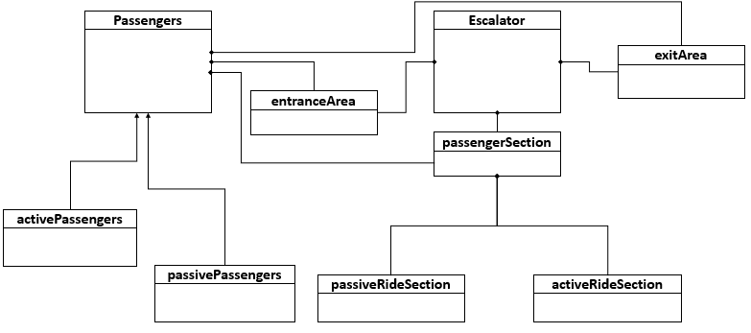
Subway

Slide 6
Passenger
moveRate: float
isActive: Boolean
currentLocation: string
position: (float)
isEnteringPassenger: Boolean
enter()
move()
exit()
board()
isEntranceEscalator: boolean
escBounds: [float,float]
Escalator
maxFlowRate: float
currentFlowRate: float
exitBounds: [float,float]
generatePassenger()
exitArea
maxFlowRate: float
currentFlowRate: float
entranceBounds: [float,float]
generatePassenger()
entranceArea
maxOccupancy: integer
canAddPassenger: boolean
passengerSection
activeMoveRate: float
walkSpeed: float
escMoveRate: float
activePassenger
baseMoveRate: float
passiveOccupancy: integer
baseMoveRate: float
activeOccupancy: integer
passiveRideSection
activeRideSection
walkSpeed: float
escMoveRate: float
passivePassenger

Slide 7
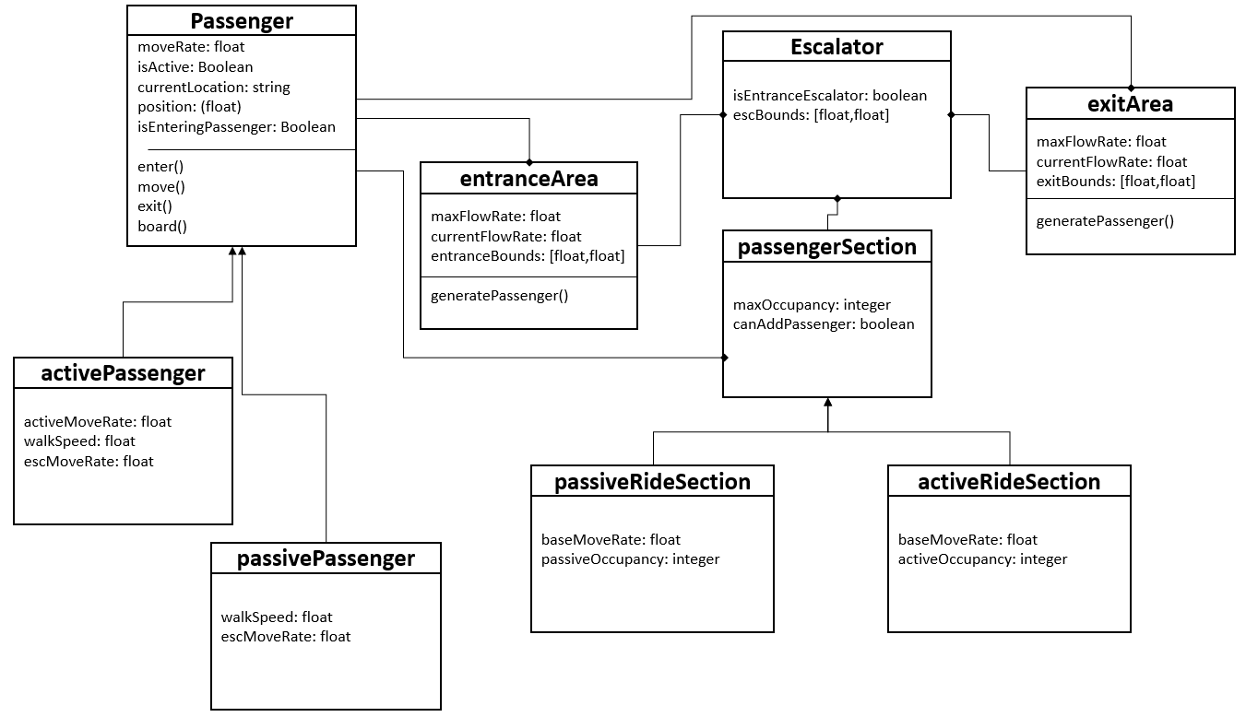
activePassengers: integer
exitCount: integer
entCount: integer
numberEntEsc: integer
numberExEsc: integer
time: float
dt: float
Subway

Slide 8
Subway System
Entrance
spawnPassenger()
Passenger
Move through entrance
Board escalator
Ride escalator
Offboard Escalator
Exit
Exit
spawnPassenger()
Passenger
Move through exit
Board escalator
Ride escalator
Offboard Escalator
enter

Slide 9
Passenger
move()
TRUE
FALSE
If (isEnteringPassenger):
If (currentLocation):
position = position + moveRate*dt
Escalator
Entrance
Exit
position = position - moveRate*dt
TRUE
FALSE
If (isActive)
> escBounds
< escBounds
Else
If (position):
position = “Exit”
moveRate = activeMoveRate
position = “Entrance”
moveRate = escMoveRate
TRUE
FALSE
If (exEscalator, canAddPass)
> entBounds
< entBounds
Else
If (position):
ent():
entCount = entCount + 1
moveRate = walkSpeed
> exBounds
< exBounds
Else
If (position)
moveRate = walkSpeed

