Slide 1
Welcome!
This application guides you through the concept of odds ratio (OR), a measure of association between an exposure and a categorical outcome.
Through this app, you will learn
Definition of odds ratio
When it is used
Sample odds ratio and its confidence interval
How to interpret the odds ratio
When you’re ready, click on “Start” to begin the learning!
References
Boast OR app
https://www.ncbi.nlm.nih.gov/pmc/articles/PMC2938757/

Slide 2
Definition of odds ratio (OR)
An odds ratio relates the odds of an event (outcome) under two different conditions (exposure). In other words, an odds ratio represents the odds that an outcome will occur given a particular exposure, compared to the odds of the outcome occurring in the absence of that exposure.
Quiz: Beyonce and Jay-Z threw their Oscar after-party inviting over 1000 guests. During the party, some food and beverages were served. The morning after the party, Beyonce received a call from Jason Momoa that he’s having nausea and diarrhea. He told her that he’s suspicious of the pizza he ate last night at the party and she should investigate whether pizza caused the sickness.
What is the potential exposure of interest? – eating pizza
What is the outcome of interest? – getting sick

Slide 3

Calculating odds ratio (OR)
Odds ratios (OR) can be calculated using a two-by-two frequency table (also called cross-tabulation or contingency table)
Odds of event under exposure to treatment = a/b
Odds of event without exposure to treatment = c/d
Odds ratio of event between treatment and control = (a/b)/(c/d) = ac/bd
Let’s look at the previous example: Upon calling several friends who attended the party, Beyonce and Jay-Z gathered information that 8 out of 27 friends who ate pizza at the party got sick, and 4 out of 31 friends who did not recall eating pizza got sick.
a = Number of exposed cases
b = Number of exposed non-cases
c = Number of unexposed cases
d = Number of unexposed non-cases
 | Got sick | Did not get sick
Ate pizza
Did not eat pizza
Q. Can we make them fill in the correct number for the table?
Q. What is the odd of getting sick among those who ate pizza?
Q. What is the odd of getting sick among those who did not eat pizza?
Q. What is the odds ratio of getting sick among those who ate pizza vs. those who did not eat pizza?

Slide 4
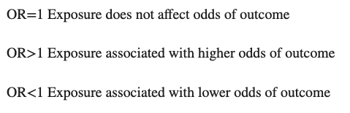
When is it used?
Odds ratios are most commonly used in case-control studies to compare the relative odds of the occurrence of the outcome of interest (e.g. disease or disorder), given exposure to the variable of interest (e.g. health characteristic, aspect of medical history). Ruby’s example is a simple case-control study!
They can also be used in cross-sectional and cohort study designs as well to determine whether a particular exposure is a risk factor for a particular outcome, and to compare the magnitude of various risk factors for that outcome (with some modifications and/or assumptions).
Example (Cohort study): In an article published in the Journal in November 2008, Greenfield and colleagues looked at previously suicidal adolescents (n=263) to analyze the associations between presence of psychiatric disorder and suicidal behavior at six-month follow-up (Greenfield et al., 2008). In the study, 186 of the 263 adolescents did not exhibit suicidal behavior (non-suicidal, NS) at six months follow-up. Of this group, 86 young people (86/186) had been assessed as having depression at baseline. Of the 77 young people with persistent suicidal behavior at follow-up (suicidal behavior, SB), 45 had been assessed as having depression at baseline (45/77).
Q. Can we make them fill in the correct number for the table?
Q. What is the odds ratio of exhibiting persistent suicidal behavior given the baseline depression in comparison to no base line depression?

Slide 5
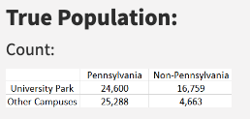
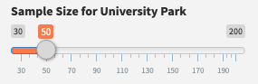
True odds ratio vs. Sample odds ratio
In most of case-control or cohort studies, sample population used to calculate the odds ratio is not the TRUE representative of the entire population. In this case, calculated odds ratio is the approximation of the true odds ratio.
Let’s look at the example: Beyonce and Jay-Z decided that they need to report this incidence to the health authority and launch a larger-scale investigation. Given the large number of people who attended the party, investigators decided to draw a subset of attendants to investigate their food consumption history and the presence of illness to draw inference on the entire party guests. See how the estimated odds ratio changes as you draw random samples of attendants from the party guests. The exposure and symptom status of the entire party guests (provided in the table on the right) are not known to the investigators.
Specify the number of samples from the party guests:
 | Got sick | Did not get sick
Ate pizza | 630 | 249
Did not eat pizza | 236 | 152
 | Got sick | Did not get sick
Ate pizza
Did not eat pizza
True OR = (630*152)/(239*236) = 1.63
Sample OR =

Slide 6


Confidence Interval
When sample population is used to calculate the OR, The confidence interval (CI) is used to estimate the precision of the OR. A large CI indicates a low level of precision of the OR, whereas a small CI indicates a higher precision of the OR.
Under the assumption of multinomial sampling, the log-odds ratio (log OR) has a better normal approximation than natural OR does. Therefore, we usually obtain a confidence interval on the log scale (log here means natural log). Variance of the log OR is calculated as below:
The most common level of confidence used is 95% CI, which corresponds to the Z-score value of 1.96. We get a 95% confidence interval for OR by exponentiating the endpoints of:
Specifying different confidence level only changes the value 1.96 in the above equation. You can get the corresponding Z-score of your confidence level of choice in R by:

Slide 7
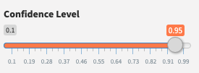

Confidence Interval (contd.)
Let’s go back to the previous example:
Specify the sample size and the confidence level for the investigation of party attendants using the sliders.
Your sample population
 | Got sick | Did not get sick
Ate pizza
Did not eat pizza
 | Got sick | Did not get sick
Ate pizza | 630 | 249
Did not eat pizza | 236 | 152
Sample OR =
Upper CI =
Lower CI =
True OR = (630*152)/(239*236) = 1.63

Slide 8
Interpretation
It is important to note however, that unlike the p value, the 95% CI does not report a measure’s statistical significance. In practice, the 95% CI is often used as a proxy for the presence of statistical significance if it does not overlap the null value (e.g. OR=1). Nevertheless, it would be inappropriate to interpret an OR with 95% CI that spans the null value as indicating evidence for lack of association between the exposure and outcome.
Quiz: After investigating 500 attendants, the epidemiologist concluded that the odds of having diarrhea and nausea within a day from Beyonce and Jay-Z’s party was higher among those who consumed pizza than those who did not consume pizza during the party (OR 1.2, 95% CI: 0.98 – 1.56). Based on this result, can you conclude that there is a significant association between the pizza consumption and the sickness?
Yes
No

Slide 9
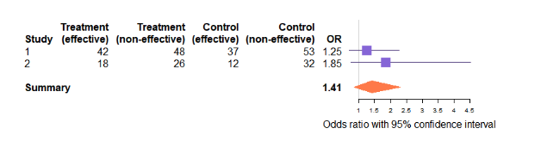
(Optional) Use your own data
Upload the data
Choose the exposure variable
Choose the outcome variable
Specify the confidence level

