Slide 1
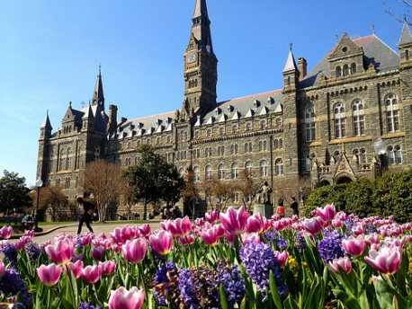
DahShu Innovative Design Scientific Working Group (IDSWG): Introduction
Robert A. Beckman, M.D.
Chair, DahShu IDSWG
Professor of Oncology, and of Biostatistics, Bioinformatics, & Biomathematics
Innovation Center for Biomedical Informatics and Lombardi Comprehensive Cancer Center
Georgetown University Medical Center
Scientific Advisor, Office of the Senior Vice President for Research
Georgetown University
Elected Fellow, ASA

Slide 2
Agenda DahShu Innovative Design Scientific Working Group
5:30-5:35 Welcome!
Introductory Talks:
5:35-5:55 Intro to IDSWG (Bob Beckman, Georgetown University)
5:55-6:05 Intro to DahShu (Ruixiaio Lu, Alumis)
6:05-6:15 Intro to BSWG and Collaboration Opportunities (Yuan Ji, University of Chicago)
6:15-6:25 STATBridge Future Leaders Program (Bryan McComb, Pfizer)
Selected Subteam Reports:
6:25-6:30 ASA-IDSWG Master Protocol Collaboration: Concept and Methodology (Bryan McComb, Pfizer)
6:30-6:35 ASA-IDSWG Master Protocol Collaboration: Regulatory Subteam (Peter Mesenbrink, Novartis)
6:35-6:40 Randomization Subteam (Alex Sverdlov, Novartis)
6:40-6:45 AI/ML Subteam (Alex Sverdlov, Novartis)
6:45-6:50 NEED Subteam (Mercedeh Ghadessi, Bayer)
6:50-6:55 IDSWG KOL Lecture Series (Yi Pan, Bristol Myers Squibb.)
6:55--7:00 Wrap-up

Slide 3
Outline of This Talk
Vision and Leadership
Structure and Opportunities for Members
Subteam and Initiative Updates
Selected Past Work

Slide 4
IDSWG
Membership: approximately 200 members from pharma, biotech, academia, and health authorities in the US, Europe, and Japan

Slide 5
IDSWG Vision/Mission Statement
Vision: Ensure that innovative designs including adaptive designs, when applied appropriately, are well recognized and broadly utilized to improve drug development and global health initiatives for the benefit of patients around the world.
Mission:
To facilitate the understanding, adoption, and appropriate use of innovative designs of different levels of complexity and contribute to progress in methodology by:
Creating a scientific forum for the discussion and development of innovative designs, their analysis and implementation
Providing education on and promoting the dissemination of methods and best practices by writing white papers and publications, and sharing experiences.
To engage in dialogue and advocacy efforts with industry leaders, the scientific community, patient advocacy groups and regulators to facilitate world-wide utilization of innovative designs
To foster diversity in membership and leadership across:
Geographical locations
Institutions (e.g. academia, government, industry, and patient advocacy groups)
Stakeholders (e.g. statistics, medicine, pharmacometrics, operations, patient advocacy groups, regulatory agencies, and payers)

Slide 6
Organizational
Leadership Team
Bob Beckman, Georgetown, Chair (eniac1915@gmail.com)
Mercedeh Ghadessi, Bayer, Co-Vice Chair and Leader of Community (mercedeh.ghadessi@bayer.com)
Alex Sverdlov, Novartis, Co-Vice Chair and Leader of External Collaborations (alex.sverdlov@novartis.com)
Two openings to be filled this year—nominations welcome—Core Team will vote on appointments
Thanks to Zoran Antonijevic, Sammi Tang, and Philip He
Core team
Composed of sub-team chairs
New this year: Will add leaders of initiatives
New this year: Regular quarterly meetings
Activities
Presentations and publications from working subgroups
Annual F2F
Organize meetings and workshops
Books, special issues

Slide 7
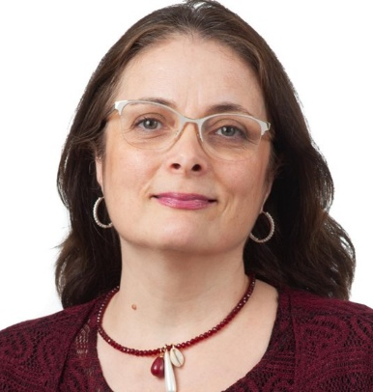

Mercedeh Ghadessi, Co-Vice Chair and Leader of Community
Extensive Experience: Over 22 years in biostatistics and 15 years in computer science and data analysis, with a strong focus on oncology and cardiovascular research.
Innovative Research: Pioneered the application of innovative methods in oncology observational studies, including causal inference-targeted learning and functional data analysis, Supervised and Unsupervised. Developed the first digital biomarker evaluation plan for a Phase 2 clinical trial in heart failure patients. Initiated two information hubs at Bayer for external controls and Use of sensors including wearable devices in RCTs.
Collaborative Projects: Worked with multidisciplinary teams and external collaborators to investigate clinical and genetic risk factors in cardiovascular diseases and to develop guidelines for analyzing digital biomarkers, controls and decentralized clinical trials.
Biostatistics Leadership: Established and led a biostatistics group in a startup biotech company, providing training in statistical concepts and methodologies to a diverse team. Providing statistical support and leading the stat team members in oncology observational studies as a core member.
Statistical Methodology Development: Designed statistical analysis plans and executed analyses for the validation of prognostic and predictive biomarkers in prostate and bladder cancers.
Publications and Patents: Authored several publications in high-impact journals and contributed to multiple patents related to cancer diagnostics and biomarkers.
Professional Engagement: Actively participated in conferences and seminars, presenting research findings and collaborating with peers in the field to enhance knowledge sharing and innovation. Co-leading ASA-DahShu IDSWG Needed for Rare Diseases (NEED) Sub-team, an external multidisciplinary research team, which resulted in several publications.
Mentorship and Training: Mentored interns and junior colleagues, contributing to their professional development and fostering a collaborative working environment.
Software Development: Contributed to the development of software pipelines for clinical data analysis, including quality control metrics and patient reporting systems.
Mercedeh Ghadessi
Director Oncology Medical Statistics
////////////////////////////////////////////////
Bayer U.S. LLC
Oncology, Pharmaceuticals
Medical Statistics
Building B200
Whippany, United States
Mobile: +1 862 4655018
E-mail: mercedeh.ghadessi@bayer.com

Slide 8
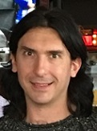
Alex Sverdlov, Co-Vice Chair and Leader of External Collaborations
Alex Sverdlov, PhD has over 18 years experience in the pharmaceutical industry. He is currently Senior Director of Biostatistics at Novartis.
He has co-authored more than 50 peer-reviewed journal publications in the field of biostatistics and clinical trials and co-authored 4 books in the CRC Biostatistics Series.
Alex specializes in adaptive clinical trial designs, statistical modeling and simulation, and is committed to bridging statistical theory and innovation in clinical research.
Alex is a co-lead of two IDSWGs: Randomization WG and Integrated Scientific Learning (ISL), and he is an active contributor to two other cross-industry innovation efforts - IDSWG on Master Protocols, and ASA BIOP Cell & Gene Therapy SWG

Slide 9
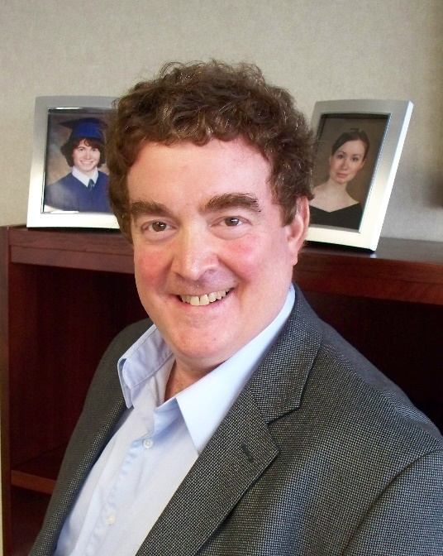
Bob Beckman – Chair IDSWG
Pediatric oncologist and mathematical biologist
5 decades of modeling various biological phenomena
Enzymatic mechanisms of DNA replication fidelity
Carcinogenesis
Treatment sequences in oncology
Optimizing oncology clinical trial designs
18 years in pharma Cancer therapy development
23 therapies first in man
5 therapies advanced to late development
2 therapies approved
Approximately 130 scientific publications emphasizing quantitative approaches to biology and medicine; 4 patents
Edited Platform Trials in Drug Development with Zoran Antonijevic
Professor of Oncology and of Biostatistics, Bioinformatics, & Biomathematics, Georgetown University
Scientific Advisor to Senior Vice President for Research, Georgetown University
Elected Fellow, ASA

Slide 10
Opportunities for Members: Join A Subgroup or Initiative
Observe
Contribute
Lead
Form your own
To volunteer email Bob (eniac1915@gmail.com or robert.beckman@georgetown.edu), Mercedeh (mercedeh.ghadessi@bayer.com), or Alex (Alex.Sverdlov@novartis.com)

Slide 11
Leadership Team Available for Consultation
Thinking of forming a new subgroup?
New to subgroup leadership?
We recommend you produce a one page or one slide concept and schedule an appointment with the leadership team
We will spend 30-60 minutes discussing
Whom should we recruit for the group
How to recruit them
How this fits in with other IDSWG activities
What can the leadership team do to help make your new group a success

Slide 12
Leadership and Core Team Members Available for Mentorship
New subteam leaders can work with a Leadership Team member or Core Team member Leadership Team member or Core Team member will be available for consultation as needed
Leadership Team member will share experience in managing large, volunteer teams

Slide 13
Staying Informed
Watch for emails from Mercedeh!
Subteam and initiative leads are responsible for providing leadership team with members list and current emails
Further updates will be communicated to your sub-team or initiative lead quarterly
Other initiatives to further improve communication are in the works

Slide 14
Subteams (Chairs)
KOL Lecture Series (Heng Zhou, Merck)
Master protocols (collaboration with American Statistical Association and BSWG) (Cindy Lu (ASA), Kyle Wathen (BSWG), Bob Beckman (IDSWG))
Concept/Methodology (Bryan McComb, Courtney Henry (GSK))
Regulatory (Peter Mesenbrink, Novartis)
Implementation (Marianne Chase, Mass General/Harvard; Matthew Gribben, Amgen)
Patient engagement (TBD, formerly Deborah Collyer, PAIR; Needs volunteer to lead)
Basket Trials (Bob Beckman)
StatBridge Future Leaders Program (Bryan McComb, Courtney Henry)
Oncology (Phillip He, Daiichi Sankyo; Laura Fernandes (COTA))
NEED subteam (Mercedeh Ghadessi; Sammi Tang, Astellas)
AI/Integrated Scientific Learning (Alex Sverdlov)
Randomization (Kerstine Carter, Boehringer Ingelheim; Alex Sverdlov)
RWE (James Chuo, Gilead)

Slide 15
Initiatives, Ongoing (Chairs)
Future Leaders/Statbridge Program (Bryan McComb/Courtney Henry
Special issue, Therapeutic Advances in Rare Diseases (Bob Beckman; Zoran Antonijevic;)
Special issue, Therapeutic Innovation and Regulatory Science (Philip He)

Slide 16
Initiatives, Planned
Newsletter
Website
Book series (Philip He)
Joint workshops with patient communities
Collaborations with EU societies such as PSI
Need volunteers!

Slide 17
Current Subteam Reports

Slide 18
ASA-DahShu IDSWG Master Protocol Working Group (MPWG)
Joint Working Group (ASA/DahShu IDSWG/BSWG) (Cindy Lu, Astra Zeneca; Kyle Wathen, Cytel; Bob Beckman co-chairs)
Vision: Multidisciplinary collaboration; promote master protocol framework;
Year 2025:
Book “Master Protocol Clinical Trial for Efficient Evidence Generation - Development Strategies, Study Designs, Operational Engagement, and Case Studies”: close to finalization stage. 12 out of 20 chapters submitted to the publisher and the rest 8 chapters will be submitted in Sep 2025
A manuscript summarizing the multidisciplinary work was ready to submit for Contemporary Clinical Trials
A manuscript examining subgroup heterogeneity in 36 phase 3 trials is ready to submit
A manuscript on the similarities/dissimilarities in strategic and operational challenges from company-sponsored platform trials and non-profit sponsored platform trials is under preparation

Slide 19
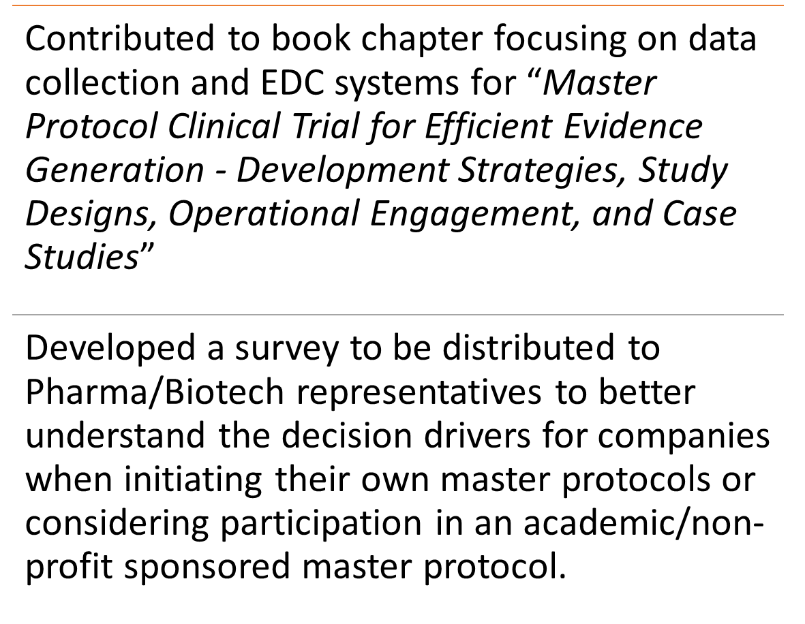
ASA-DahShu IDSWG MPWG: Implementation Team 2025 update
Current Membership
Matthew Gribbin (Amgen) Co-Chair
Marianne Chase (Mass General Brigham) Co-Chair
Marlene Jones (Amgen)
Elaine Mcleod (Astrazeneca)
Priscilla Montez (Amgen)
Nicole Li (Beigene)
Michelle Detry (Berry Consultants)
Cindy Lu (Astrazeneca)
Kyle Wathen (Cytel)

Slide 20
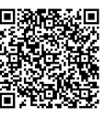
Master Protocols in Clinical Research – Pharma/Biotech Focus Survey
Please provide us with you feedback and share this with others in your organization!!
This survey explores the similarities and differences of Master Protocols sponsored by pharmaceutical/biotech companies versus academic/ non-profit organizations. The ASA-DahShu Master Protocol Working Group Implementation Team is interested in hearing from you and others within your organization. Responses will support research that is planned to be submitted to the 2026 Society for Clinical Trials (SCT) meeting.

Slide 21
ASA-DahShu IDSWG MPWG Basket Trial Subteam
Martin Posch (Med U Vienna); Olivier Collignon (GSK); Thomas Gwise (ex-FDA); Nicole Li (Beigene); Kit Roes (EMA); Kristine Broglio (AstraZeneca); Cindy Lu(AstraZeneca); Philip He (Daiich Sankyo); Heng Zhou (Merck);Helen Zhou (GSK); Cong Chen (Merck); Linchen He (Novartis); Valeriy Korostyshevskiy (Georgetown); Sathvik Narayana (Albany Medical College); Sammi Tang (Astellas); Ruixiao Lu (Alumis); Patrick Roney (Georgetown); Bob Beckman (Georgetown, Chair)
Goals:
Educate community about basket trial methodology and benefits
Pioneer basket trial designs for confirmatory setting
Accomplishments:
Contributed extensive basket trial chapter to MPWG book
Metanalysis of subgroup heterogeneity in conventional Phase 3 trials leading to approval

Slide 22
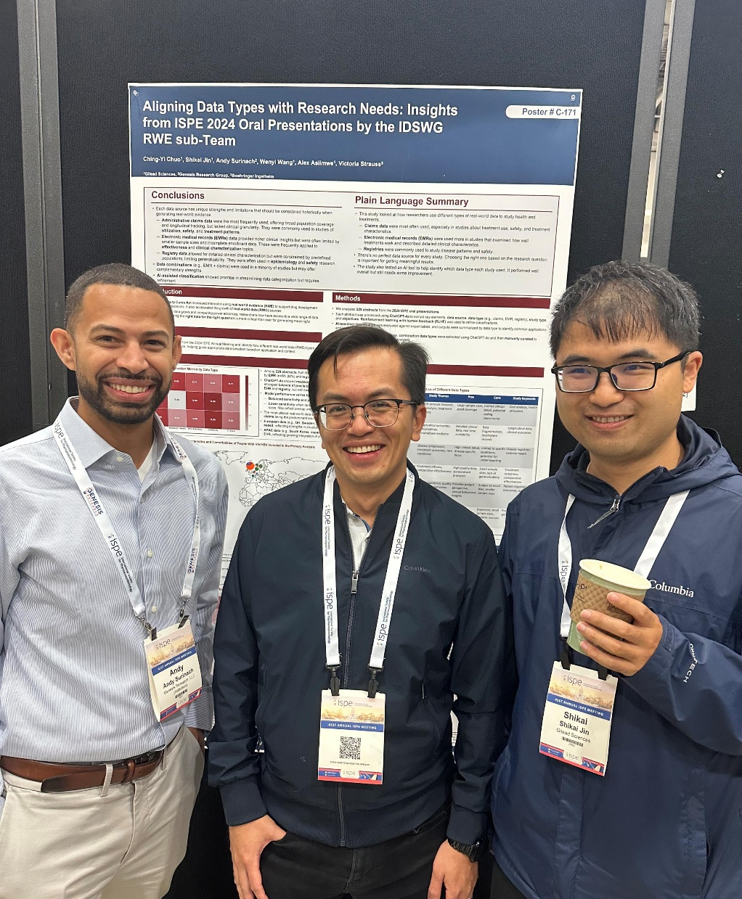
IDSWG Real World Evidence (RWE) Subteam
Vision: Promote the use of RWE in the pharma industry ; utilize the latest technology to next generation RWE
Main achievement- ISPE 2025 poster on aligning data types with research needs
Main deliverables for year 2025-2026
Identify key areas/unmet needs for RWE in the pharmaceutical industry and publish at least one white paper or conference presentation
Utilize new technology for better RWE utilization and interpretation
Current member: James Chuo (Gilead), Shikai Jin (Gilead), Andy Surianch (Genesis Research), Wen-Hsing Wu (Moderna), Victoria Strauss (Boehringer Ingelheim)
Please reachout to Ching-Yi (James) Chuo: chingyichuo@gmail.com if interested

Slide 23
Oncology Subteam
Chairs: Philip He, Laura Fernandes
High productive subteam
Information available at oncologytrialdesign.org

Slide 24
Selected Past Work

Slide 25
Complex Innovative Design (CID) Conference
March 2020 Silver Spring Maryland
Last great meeting before the lockdown! ☹
Collaboration between IDSWG, BSWG, FDA, DIA, BIO, and PhRMA
Sessions covered FDA pilot program, master protocols, adaptive designs, Bayesian techniques, external controls, regulatory harmonization across US, EU, and Japan
Emphasis on delivering value for patients and meeting regulatory requirements for scientific rigor
Comment published in Nature Reviews Drug Discovery 2022
Now annual DIA meeting; reprised virtually in 2021
2022 meeting November 3 and 4, 2022 Tysons Corner Virginia

Slide 26
Recent Conference Activity
IDSWG Members Served on Steering and Scientific Programming Committees for 2024 International Society of Biopharmaceutical Statistics (ISBS) meeting, March 2024, Baltimore, Maryland
IDSWG members developed a session at DahShu annual meeting for 2024
IDSWG members serving on RISW 2026 steering committee

Slide 27
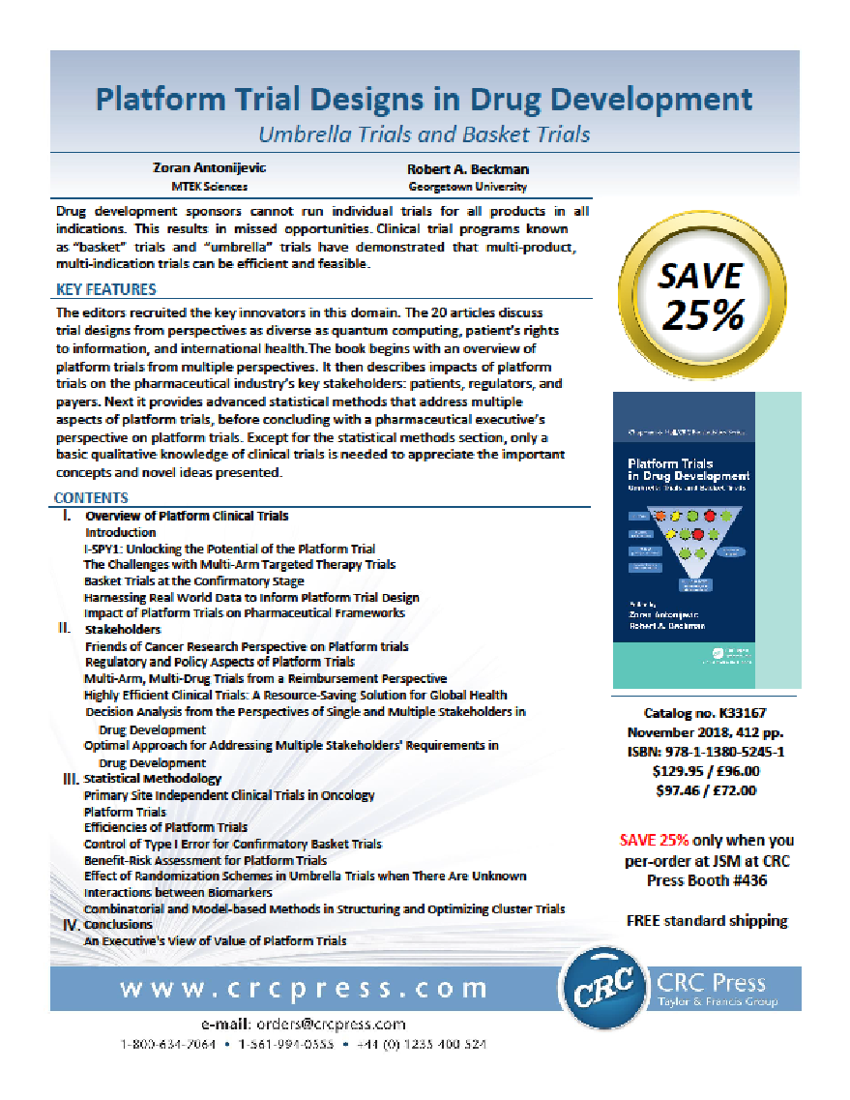
IDSWG Book Project: Participants from IDSWG
Authors:
Ohad Amit
Carl-Fredrik Burman
Cong Chen
Olivier Collignon
Valerii Fedorov
Qi Jiang
Sebastian Jobjornsson
Franz Koenig
Sergei Leonov
Janet Li
Ed Mills
Martin Posch
Satrajit Roychoudhury
Anja Schiel
Nigel Stallard
Kristian Thorlund
Sammy Yuan
Authors/Editors:
Zoran Antonijevic
Bob Beckman

Slide 28
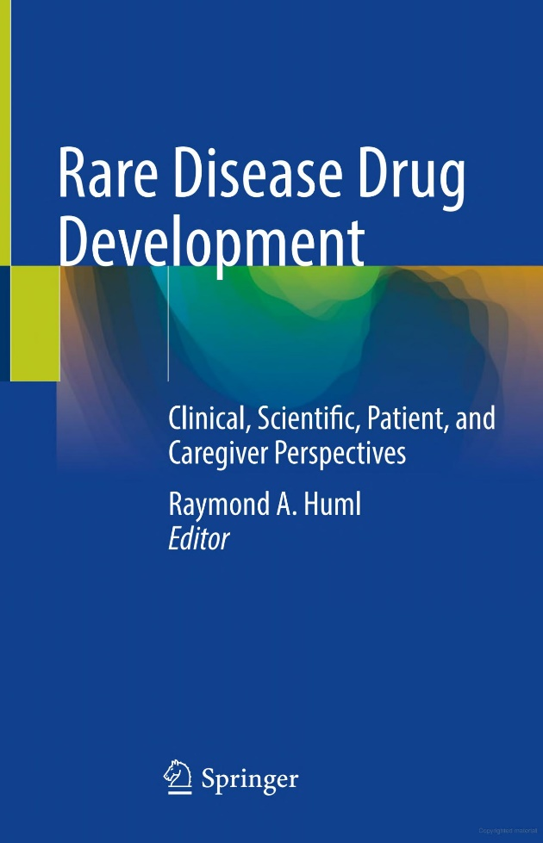
Rare Disease Book Project With Ray Huml
IDSWG Participants: Gigi McMillan, Zoran Antonijevic, Sammi Tang, Yi Liu, Cristiana Mayer, Bob Beckman, Mercedeh Ghadessi, Cong Chen, Heng Xu

Slide 29
Contact Us
Mercedeh Ghadessi: mercedeh.ghadessi@bayer.com
Alex Sverdlov: alex.sverdlov@novartis.com
Bob Beckman: eniac1915@gmail.com; robert.Beckman@georgetown.edu

