Slide 1
Introduction to GIT

Slide 2
what is it?
checking over time
local repository and remote repositories
three states and local operations
install and configure your git

Slide 3
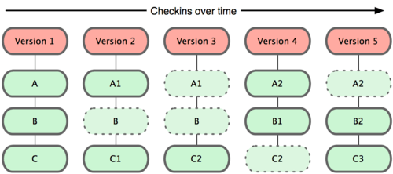
Checking over time

Slide 4
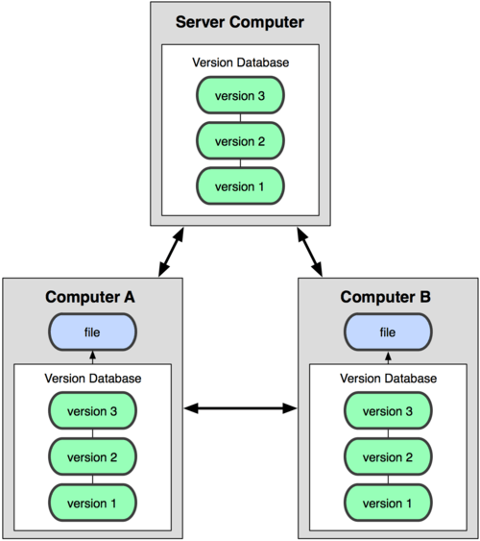
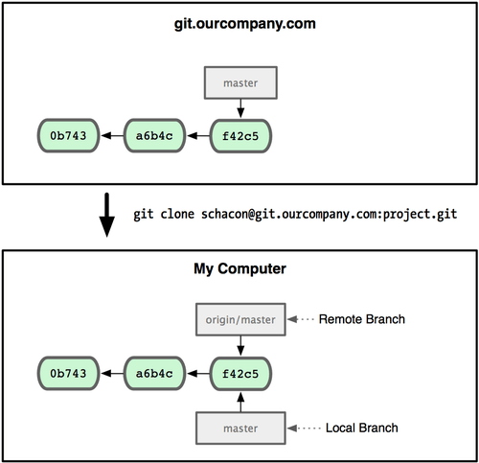
Local AND REMOTE Repositories

Slide 5

THREE STAGES and local operations

Slide 6
INSTALL AND CONFIG GIT
https://gitforwindows.org/
MAIN GIT CONFIG COMMAND
$ git config –l
$ git config --global user.name “Davish”
$ git config --global user.mail “davish@gmail.com”
$ git config --global core.editor=“’c:/program files/sublime text 3/sublime_text.exe’ –w”

