Slide 1
Jumpin’ Jack Simplex CX Framework
Work in progress proposal
JJSCXF v0.2
August 2025
Lima - Peru, London - UK
I+D+i Peru
www.idiperu.org
Cristian Amayo
cristian.amayo@idiperu.org

Slide 2
Table of Contents
Features and resources
Dev Envs
Device runtime
Topology:
P2P vs Controller
Grid
Cluster
Transmission
Non-scheduled
Scheduled
In-revision
additional configuration: amplitude, frequency, band

Slide 3



Features & Resources
Simplex signal
Interchangeable TX/RX roles
Self-aleatory configuration (schedule, encryption, messaging, protocol, frame)
Non standard custom broadcast
uniqueness broadcast
Single/multi part messaging
Hard/soft coding
Star-P2P / CS-controller approaches
Full TX/RX registry
CONFIGURATION INPUT
IMPLEMENTATION
LIBRARIES
JJSCXF v0.1
<AES.h>
input
output
<ECC.h>
device
catalog
input
output
ids
schedule
keys
cyphers
. . .
rx
tx
< . . . .h>
frame
timestamp
encryption
source
target
message
delay
. . .

Slide 4









Dev Envs
PROS Always updated libraries, self-management, 24x7, contingency responses, on-demand costs
CONS exposure, dependent running, partial control, contractual terms, remote allocation
PROS full confidentiality, independent running, full control, own terms, 24x7, contingency responses
CONS maintenance workload, on-hands management, knowledge acquisition, cost wasting
DISTRIBUTED
IMPLEMENTATION
JJSCXF v0.1
CENTRAL
IMPLEMENTATION
JJSCXF v0.1

Slide 5
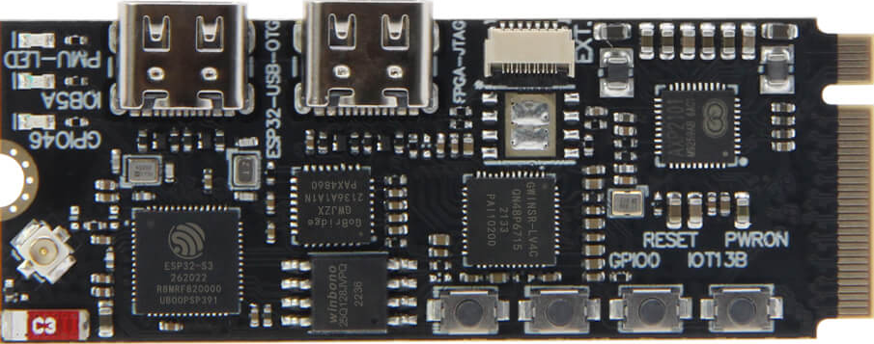
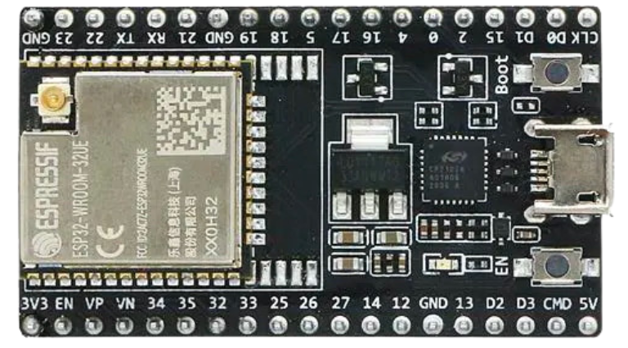
Device Runtime
Single-role
Multi-role
TX
RX
TX
RX
TX/RX
RX implementation
TX implementation
TX implementation
RX implementation
TX implementation
RX implementation
JJSCXF v0.1
JJSCXF v0.1
JJSCXF v0.1
JJSCXF v0.1
LIBs
LIBs
LIBs
LIBs
Catalog
& Log
Catalog
& Log
Catalog
& Log
Catalog
& Log

Slide 6
Topology: P2P vs Controller
P2P
Controller
TX
RX
RX
TX
TX
RX
RX/TX
TX
RX
TX/RX

Slide 7
Topology: Grid
RX
TX
TX
RX
RX/TX

Slide 8
Topology: Cluster
RX/TX
RX
TX
RX
TX
TX
RX
TX
RX
RX/TX
RX/TX

Slide 9
Transmission: non-scheduled
1 1 1 0 1 0 0 0 1 0 0 1 1 0 1 0 0 1 0 0 0 1 0 0 1 1
TX
prepare() runs with/without args, to gather all config dx from catalog/args (sizes, ciphers, parts, delays, sources, targets, ids, formats, protocols, logs, uniqueness, order, . . . ) and to perform every required process to complete config specification
collect()
process()
prepare() builds and stacks all frames according config specification
cipher()
assembly()
stack()
log()
transmit() successively iterates along frames’ stack until complete all frames sending
send() sends a specific frame according configured order, time, target, . . .
log() records last send() dx and results
RX
…..()… …………..
…..()
….()
……() …. . . … . . ..
…..()
…..,,,,()
…..()
………….()
…..()… …………..
…..()
….()
TX
RX
RX implementation
TX implementation
JJSCXF v0.1
JJSCXF v0.1
LIBs
LIBs
Catalog
& Log
Catalog
& Log

Slide 10
Transmission: scheduled
1 1 1 0 1 0 0 0 1 0 0 1 1 0 1 0 0 1 0 0 0 1 0 0 1 1
TX
…..()… …………..
…..()
….()
……() …. . . … . . ..
…..()
…..,,,,()
…..()
………….()
…..()… …………..
…..()
….()
RX
…..()… …………..
…..()
….()
……() …. . . … . . ..
…..()
…..,,,,()
…..()
………….()
…..()… …………..
…..()
….()
TX
RX
RX implementation
TX implementation
JJSCXF v0.1
JJSCXF v0.1
LIBs
LIBs
Catalog
& Log
Catalog
& Log

Slide 11

In-revision: amplitude, frequency, phase, band

