Slide 1

Excitation and Identification of the Complete Inertial Parameters of a Humanoid Robot Limb
A Per-Parameter Identifiability and Physically Consistent Convex Estimation Approach
Presenter:
Supervisor:
Examiner:
Xiaoran Yang
Dr.-Ing. Julio Rogelio Guadarrama Olvera
M.Sc. Simon Armleder
Prof. Dr. Gordon Cheng
Master’s Thesis Midterm Presentation
Chair for Cognitive Systems
School of Computation, Information and Technology
Technical University of Munich
July, the 14th, 2026
Notes:
Hello and welcome to my today’s presentation of the midterm of my master’s thesis. My topic is A Simplified Approach to Robot Identification using Balanceweight

Slide 2
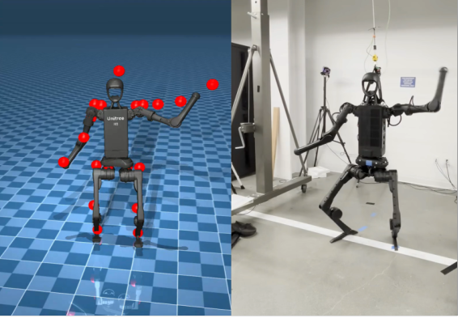
Motivation
Sim-to-Real with Unitree H1*
* NVIDIA, What Is Sim-to-Real? Train an SO-101 Robot From Sim-to-Real With NVIDIA Isaac, https://docs.nvidia.com/learning/physical-ai/sim-to-real-so-101/latest/03-sim-to-real.html#what-is-sim-to-real
Notes:
A same policy would act extremely different on the true hardware from in the simulation, this problem is called sim-to-real gap is one of the most cutting-edge issues in the field of robot control. There are many reasons to this problem, one of the leading reason is, in the urdf we used during training, the inertial and joint friction parameters are literally always different to the real robot. In this case, the policy is basically handling a different robot in the real world.

Slide 3
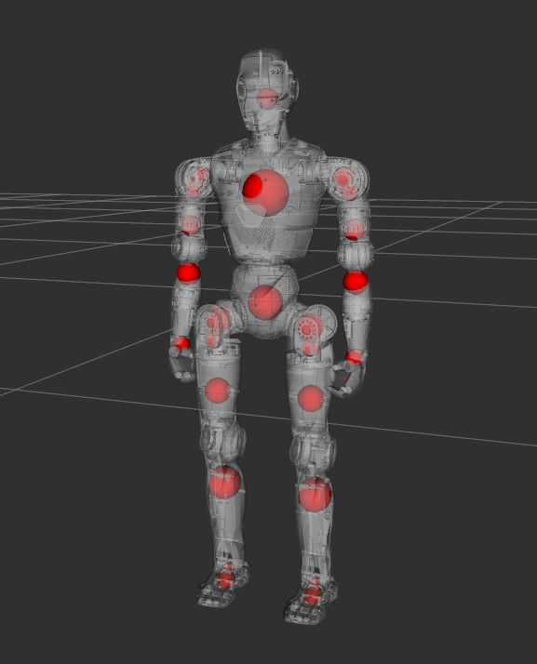
Motivation
Undesigned parts: screws, cable, …
The density of the material not exactly as expected…
Different manufacturing processes from different suppliers...
Notes:
The real robot is different, why would this the case? The urdf provided by manufacturer are mostly based on designed CAD file. Yet due to the complexity of the production process the true robot would always be a little bit different.
There is a field of research dedicated to address and correct this different called robot excitation and identification.

Slide 4
Thesis Goal
Deploy an Identification procedure to reconstruct an URDF with more precise inertial parameters
Using joint states and torques measured from the true robot to calculate the realistic parameters:
Link inertia
Joint friction
Joint armature
Notes:
The goal of the thesis is to excite and identify the RM01 humanoid limb to get an improved urdf with more precise dynamic parameters, which include link inertia, joint armature and friction parameters.

Slide 5
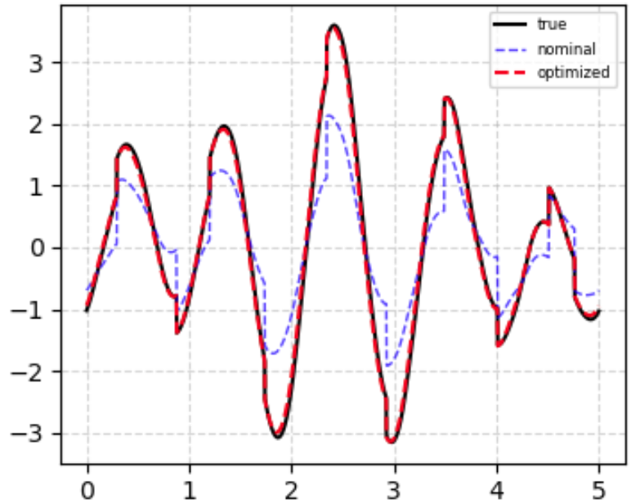
Project Pipeline
Excitation
(From real robot)
Identification
URDF from manufacturer
URDF with more precise inertia parameters
Notes:
This pipeline illustrates a typical robot excite and identify process.
First, using the original urdf, an excitation trajectory would be designed and applied to the real robot.
The joint position, velocity, acceleration and torques for target joints would be measured. Using these observed values we will reconstruct the true parameters and get an improved version of urdf.
According to the current plan, we’ll only identify the parameters of the four limbs of the humanoid. The torso would be held fest and is not under discussion.

Slide 6
Rigid Body Dynamic
mass
Com position
Inertia tensor
Armature
Damping, Friction
Notes:
Let’s do a quick recap of the rigid body dynamic.
For identification problems, we prefer to express rigid-body dynamics in this form.
Theta is the dynamic parameter matrix we need to identify. Each degree of freedoms correspond to 13 parameters, which are the mass, the center of mass position, the inertia tensor of each link and the armature, the coulomb and viscous frictions from the joint. The armature express the inertia effect from the joint motor gear box.
Y is the regression matrix based on joint angular condition which represent how each parameter would influence the target joint torque.
What we can measure from from robot would be tau and Y. Using those data to reconstruct theta, mathematically is a linear regression problem.

Slide 7
Issues with linear regression
The effects of individual parameters on output torque are highly coupled, the regression matrix is ​​rank-deficient, not all parameters are identifiable.
The parameter identification results must be reasonable, such as satisfy physical consistency conditions.
Notes:
Unfortunately, this linear regression problem does not yield any direct analytical solution. The reasons are as follows:
First, with 13 parameters for each dof to identify, what we can observe is only the joint position, velocity, acceleration and torque which means the system is actually not observable.
Second, many parameters are linear correlated, some of them are just due to robot structure not identifiable
Third, robot identification is not pure mathematic problem. The results must be physical consist for example we can’t accept negative mass.
Is there anything we can do to simplify this process? Based on the real situation, we make two assumptions:
Although our mission is to correct the urdf, we should know that the urdf is actually already pretty precise. The identification is more a small step tune based on it.
Second, the difference between the robot and the urdf almost always come from unexpected part during production, which make the true robot mostly heavier than the urdf.

Slide 8
Parameters Identifiability Optimization
Regression matrix Y is build using samples from excitation trajectory, so optimize the trajectory can be directly reflected in the optimality of regression matrix Y.
Notes:
Unfortunately, this linear regression problem does not yield any direct analytical solution. The reasons are as follows:
First, with 13 parameters for each dof to identify, what we can observe is only the joint position, velocity, acceleration and torque which means the system is actually not observable.
Second, many parameters are linear correlated, some of them are just due to robot structure not identifiable
Third, robot identification is not pure mathematic problem. The results must be physical consist for example we can’t accept negative mass.
Is there anything we can do to simplify this process? Based on the real situation, we make two assumptions:
Although our mission is to correct the urdf, we should know that the urdf is actually already pretty precise. The identification is more a small step tune based on it.
Second, the difference between the robot and the urdf almost always come from unexpected part during production, which make the true robot mostly heavier than the urdf.

Slide 9
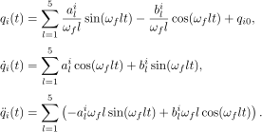
Excitation Trajectory
A well designed excitation trajectory can maximize the influence of the values ​​to be identified on the observed data, thereby enhancing parameter identifiability.
* J. Swevers, C. Ganseman, D. B. Tukel, J. de Schutter and H. Van Brussel, "Optimal robot excitation and identification," in IEEE Transactions on Robotics and Automation, vol. 13, no. 5, pp. 730-740, Oct. 1997, doi: 10.1109/70.631234.
Notes:
To design the excitation trajectory to each joints, we chose a 5 order Fourier serial method. In this case the trajectory would periodic do we can let the trajectory be repeated and collect the average for denoising. Also it is differentiable so we can directly calculate the velocity and acceleration.
For each trajectory, we need several coefficients. Omega f represent the base frequency, q0 stands for the neutral position. For each harmonic we need to design the amplitude for sinus and cosinus part, a and b.

Slide 10

Excitation Trajectory
Singular Value Decomposition,
find minimum condition number
Maximize the range of motion and the number of velocity zero-crossings.
Particle Swarm Optimization (PSO)
Notes:
To further reduce the dimension to be identified by the same time, the identification process is split into 2 stages and therefore need to design 2 excitation trajectories.
The first stage we identify the inertial parameters of the balance weight, which are likely the main causes of the error. A robot regression matrix is ​​constructed by collecting a number of states from the excitation trajectory. An excitation trajectory would be judged as optimal, when the condition number of this regression is small because that means the the influence of inertial parameters would be more obvious in output torque.
For second part, we freeze the balance weight and fine tune the armature and friction. In this stage we want the motion to be as rapid as possible.
The coefficient generating and optimizing is handled by particle swarm optimization, a lightweight machine learning algorithms. The idea is in short spread massive particles in the total space and keep discovering new possibilities while refine searching near the area with current highest reward.

Slide 11
Project Framework
The whole project is planed to be coded with Python as a ROS2 package.
fourier_trajectory.py
Generate excitation trajectory.
target_limb_regressor.py
Using joint state q, dq, ddq, return regressor, collision and excess state.
pso_excitation_stage.py
Generate coefficients for Fourier trajectory, optimize based on given criterion using PSO.
sysid.py
Use gradient descent method to reconstruct desired parameters.
Notes:
The project would be coded with python as a ros2 package. There are some codes already ready to work. These are four most important for now.
The fourier trajectory .py is a script to build the joint trajectory with input coefficients.
The target limb regressor .py uses rigid body dynamic library pinocchio to build the limb regressor with given joint conditions. It will also check whether the velocity or torque has excessive and will also return if with given condition some link will collide.
Pso excitation stage .py combine the two scrips by using pso to generate the coefficient for fourier trajectory and use the regression matrix to justify if the trajectory is good.
Sysid .py is a script still under process. By using mujoco to apply the designed trajectory to the robot in simulator and get the joint state data, we use a gradient descent tool from mujoco sysid library to try to identify all desired parameters of balanceweight beginning with an urdf with fake parameters.

Slide 12
Work Plan
Identify target
Boundary
Residual
processing
Regression
method
Goal
Excitation
trajectory
Data from robot
Denoise and
eliminate bias
Notes:
This is a more detailed work plan. The complete plan is divided mainly in 3 parts: define the values to be identified, collect data from robot, and apply the regression.

Slide 13
Current Process
Done
Identify target
Constrains
In process
Missing
Residual
processing
Regression
method
Goal
Excitation
trajectory
Data from robot
Denoise and
eliminate bias
Notes:
My current process is roughly as follow:
The balanceweight method provides a clear view which parameters under what constrains should be identified, so this two parts I mark as done. We only can measure the joint conditions, the residual would only come from these but further process like normalize should be applied, so I mark it as in process.
The excitation trajectory is also marked as in process because the criterion of excitation trajectory design still missing some optimization. Data collecting from robot is only a ros2 bag, which would be easy, so I mark it as done. What critical is the denoise and debias of the measure result. We need to apply proper filter based on sensor features, so I mark it as missing.
As for the regression method, as mentioned, mujoco sysid provides a well-tested linear regression tool based on the gradient descent method; however, further working is required to determine if there is room for improvement. So I also mark it as in process.

Slide 14
Thank you for your attention.
Questions?
Notes:
That’s all of my presentation today. I hope it helped you to know better about what am I doing right now and I’m glad to answer any of your questions.

