Slide 1

Excitation and Identification of the Complete Inertial Parameters of Humanoid Robot Limbs
A Per-Parameter Identifiability and Physically Consistent Convex Estimation Approach
Presenter:
Supervisor:
Examiner:
Xiaoran Yang
Dr.-Ing. Julio Rogelio Guadarrama Olvera
M.Sc. Simon Armleder
Prof. Dr. Gordon Cheng
Master’s Thesis Final Presentation
Chair for Cognitive Systems
School of Computation, Information and Technology
Technical University of Munich
July, the 20th, 2026
Notes:
Hello and welcome to my today’s final presentation of the of my master’s thesis. My topic is ---

Slide 2
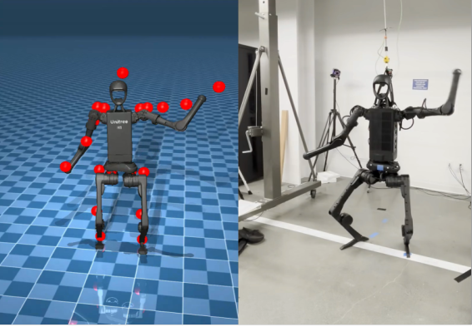
Motivation
Sim-to-Real with Unitree H1*
* NVIDIA, What Is Sim-to-Real? Train an SO-101 Robot From Sim-to-Real With NVIDIA Isaac, https://docs.nvidia.com/learning/physical-ai/sim-to-real-so-101/latest/03-sim-to-real.html#what-is-sim-to-real
Notes:
Learning based control has played an more and more important role in humanoid robot control. However, learning based control suffers from well known sim to real gap problem. A same policy would act extremely different on the true hardware from in the simulation.

Slide 3
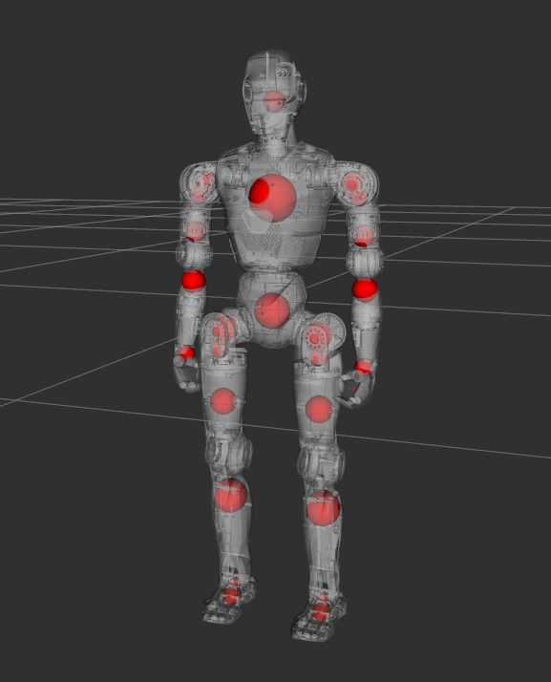
Motivation
The difference between the URDF provided by the manufacturer and the actual robot is usually significant
Current research on system identification typically does not identify the complete set of parameters, yet learning based training requires complete inertial parameters
Notes:
There are many reasons causing this gap, one of the most impotent reason is, the inertial parameters of the URDF used during training, which is provided by the manufactor, always has a huge difference from the true hardware.
There is a method to solve this problem called identification, which use the measurements from the true robot to reconstruct the true inertia parameters. However, previous studies primarily use this process for model based control and therefore barely identify the complete parameters, which is not enough for the learning based case.

Slide 4
Thesis Goal
Design a comprehensive identification workflow for humanoid limbs, that yields an enhanced URDF—suitable for immediate use in learning and training environments—by maximizing parameter identifiability and applying appropriate constraints.
Notes:
This thesis attempts to further expand this field and presents its own contributions: ------------------

Slide 5
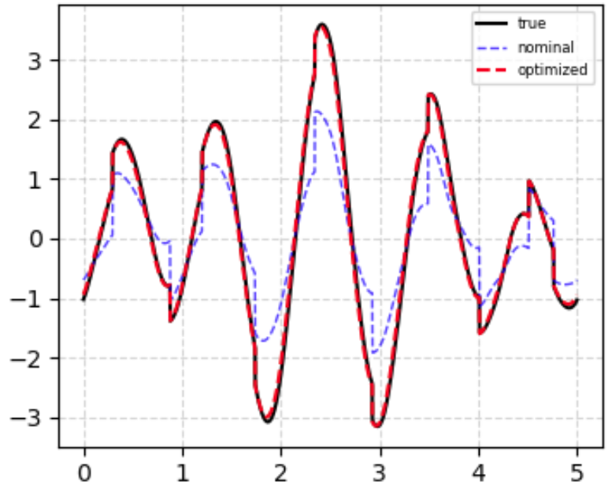
Thesis Pipeline
Excitation
(From real robot)
Identification
URDF from manufacturer
URDF with more precise inertia parameters
Notes:
This page illustrates the pipeline of this thesis, which is also a typical robot excite and identify process.
First, using the original urdf, an excitation trajectory would be designed and applied to the robot to be identified.
The joint position, velocity, acceleration and torques for target joints would be measured. Using these observed values we will identify and reconstruct the true parameters and get an improved version of urdf.
It need to be mentioned that only the parameters of the four limbs of the humanoid are identified. The torso would be held fest as a non floating base and is not under discussion.

Slide 6
Rigid Body Dynamic
mass
Com position
Inertia tensor
Armature
Damping, Friction
Notes:
Why is this identification problem mathematically possible?
For identification problems, we prefer to express rigid-body dynamics in this form.
Pi is the dynamic parameter for each link we need to identify. Each degree of freedoms correspond to 13 parameters, which are the mass, the center of mass position, the inertia tensor of each link and the armature, the frictions and dampings from the joint. The armature express the inertia effect from the joint motor gear box.
Y is the regression matrix based on robot states sampled from the excitation trajectory.
What we can measure from from robot would be tau and Y. Using those data to reconstruct Pi, mathematically is a linear regression problem.

Slide 7
Issues with ordinary linear regression
The effects of individual parameters on output torque are highly coupled, the regression matrix is ​​rank-deficient, not all parameters are identifiable.
The parameter identification results must be reasonable, such as satisfy physically consistent conditions.
Notes:
Unfortunately, this linear regression problem does not yield any direct analytical solution. The there are two main reasons:
First, the effects of many parameters on the output are strongly coupled with others, which cause the regressor matrix Y strongly rank deficient and not direct inversable. With psudo inverse, there would be a huge null_space.
Second, parameter identification problem is not a pure math problem, the results must satisfies physical consistency constraints, which for example, the mass should never be negative.
We address these two issues in two steps: first, design an optimal excitation trajectory to maximize the identifiability of parameters; second, set proper constraints during identification process to ensure the quality of the output.

Slide 8
Parameters Identifiability
Regression matrix Y is build using samples from excitation trajectory, so optimize the trajectory can be directly reflected in the optimality of regression matrix Y.
Each row $v_i$ of $V$ represents a set of orthogonal basis vectors for the input of $Y$, each row $u_i$ of $U$ represents a set of orthogonal basis vectors for the output of $Y$, and each element $\sigma_i$ on the main diagonal of $\Sigma$ represents a singular value of the matrix. These three satisfy the following relationship:
Notes:
Let’s begin with the excitation trajectory.
As mentioned previously, the regression matrix Y is sampled directly from the excitation traj, so the optimization of the trajectory can be directly reflected in Y.
First of all, let’s have a quick review of the singular value decomposition of the matrix. The matrix Y is decomposed into three matrices U, Sigma and V. Sigma is a diagonal matrix of all singular values of Y; U and V represents the output and input vector directions of Y.
For each rows of U and V and the corresponding singular value sigma, they satisfy the following relations:

Slide 9
Identifiability Optimization (Global)
Smaller singular values ​​indicate that the direction $v_i$ has a lesser influence on the output; consequently, it is more difficult to observe and more susceptible to noise.
Therefore: Maximize all $\sigma_i$ as much as possible, and avoid an excessive gap between the maximum and minimum values
Notes:
Simply speaking, this can be understood as follows: for any given input direction v, the larger the corresponding singular value, the more easily its impact on the output can be observed. Conversely, the smaller the singular value, the poorer the observability and the greater the susceptibility to noise interference.
Therefore, we aim to maximize the singular value ​​while minimizing the differences between them. Consequently, the sum of the logarithms of all singular value ​​is adopted as the optimization criterion; a higher value indicates better overall identifiability of the current trajectory. This is called D-Optimalbility and is also the most commonly used criterion in previous studies.

Slide 10
Identifiability Optimization (Individual)
Rapid Filtered Parameters
The regression matrix $Y$, calculated based on the prior data provided in the URDF, contains weights that are exactly 0 for some parameters. Under the assumption of ideal mechanics, the mechanical structure of the joint itself cancels out all effects caused by these parameters. We define these parameters as null parameters.
Certain parameters—primarily those within the inertia tensor—are inherently very small (less than $1 \times 10^{-4}$). These parameters typically arise from slight rotations of the inertia box. We define these parameters as small parameters.
Notes:
Next, we introduce the core innovation of this paper: the calibration of individual parameter identifiability.
Certain parameters can be quickly filtered out using a simple criterion: the effects of some parameters—primarily those associated with the root link—are completely neutralized by the mechanical structure. Variations in these parameters have no impact on joint torques. We label them as "null parameters" and freeze them during identification process.
Beside that, There are certain parameters that are extremely small, such that even a minute perturbation can cause a change several times their original magnitude. Those parameters are labeled as “small parameters” and would be specially treated.

Slide 11

Parameters Identifiability Optimization (Individual)
Rank Deficient Parameters
If the impact of a parameter change falls primarily within the null space, we define these parameters as rank_deficient parameters.
Notes:
The problem of rank deficiency is the greatest obstacle in the identification process. To find out the rank_deficient parameters which means their own effects are hard to observe and represent, we calculate the nullspace weight of each parameters.
In short, for those directions v, where their singular values are very small, their effect would more fall on the null space. So we check the sum of the V values of each parameters. If the null space weight is larger than 30%, we label those parameters as rank deficient.

Slide 12


Parameters Identifiability Optimization (Individual)
Identifiable Parameters
For identifiable parameters, we classify them according to their level of confidence.
Notes:
After all these, all rest parameters should be identifiable. However there are still differences. We introduce the relative identification uncertency RIU, which comes from the variance of the linear regression process of the parameters. The smaller the variance is, the more possible the identification result would fall closer to the true value, and the parameter would be better identifiable.
Based of the RIU, we classify all parameters in good, ok and bad identifiable We want as much parameters as possible classified as good or ok identifiable.

Slide 13
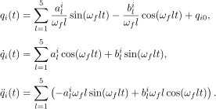
Excitation Trajectory
A fifth-order Fourier series trajectory:
* J. Swevers, C. Ganseman, D. B. Tukel, J. de Schutter and H. Van Brussel, "Optimal robot excitation and identification," in IEEE Transactions on Robotics and Automation, vol. 13, no. 5, pp. 730-740, Oct. 1997, doi: 10.1109/70.631234.
Notes:
The excitation traj is presented as a 5 order fourier series. The advantage of this formulation is that the traj is smooth so we don’t need to compute differences for traj to get the speed and acceleries. Each trajectory can be represented by a set of parameters: the amplitudes of the sine and cosine components and the midpoint of the trajectory.

Slide 14

Excitation Trajectory
Particle Swarm Optimization (PSO)
Notes:
We use partical swarm optimization to train an optional trajectory. Each particle is a full parameter sets for one trajectory. A trajectory, which the singular values of Y are larger, and more parameters are good identifiable, is defined as better optimal.

Slide 15

Parameter Identification as Optimization Problem
Torque Residual
Ultimate optimization goal: minimize the residual between the calculated joint torque and the measurement.
Notes:
Then let’s see the identification process. The identification is treaded as a optimization problem with the object to minimize the residual between the calculated joint torque and the measured value when tracing the excitation traj.

Slide 16

Parameter Identification as Optimization Problem
Prior Parameters Ridge Regression
Based on the analyses result of the per-parameters identifiability, we apply a per-parameter prior ridge:
Notes:
To prevent parameter explosion caused by rank deficient, we apply a ridge regularization towards prior value from the URDF to each parameter. Which is again a core innovation of this thesis.
The ridge weight is settled based on the identifiability of each individual parameters. For those parameters which are good identifiable, we set the weight smaller to give the solver more freedom to explore; for bad identifiable or rank deficient parameters, the weight is larger to hold the parameters closer to the prior value. For small parameters, we also set a smaller weight and by the same time set the magnitude normalization number larger to offer a larger absolute freedom.

Slide 17

Parameter Identification as Optimization Problem
Physical Consistency
The constrains of physical consistency can be broken down into three specific components:
Notes:
The physical consistency can be settled as a constraint which contains three parts: the mass need to be positive, the inertial tensor must be positive definite, and the inertial tensor of the three main axis must satisfied the triangle inequality.

Slide 18

Parameter Identification as Optimization Problem
Physical Consistency
The constrains of physical consistency can be broken down into three specific components:
Notes:
All this three conditions can be represents as one linear matrix inequality. As long as this matrix is positive definit, the link is physical consistent.

Slide 19

Parameter Identification as Optimization Problem
Inertia Tensor Shape
By constraining the margin of the triangle inequality, we can prevent the tensors in the result from being "flattened."
Notes:
To avoid the inertial tensor being flatted, we also set a constrain to the triangle inequality.

Slide 20
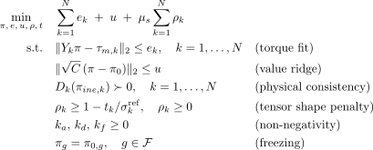
Parameter Identification
Notes:
After all of these, we have a clear view of the whole identification process. Small things are added as the friction damping and armature shall also ne non negative, and the null parameters are frozen.

Slide 21
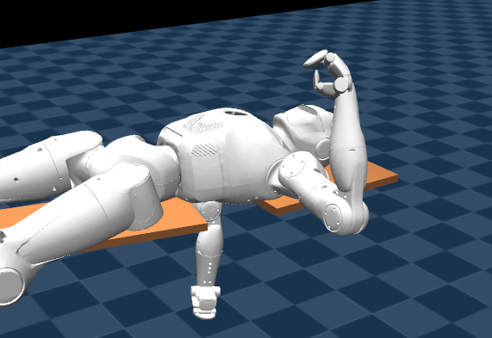
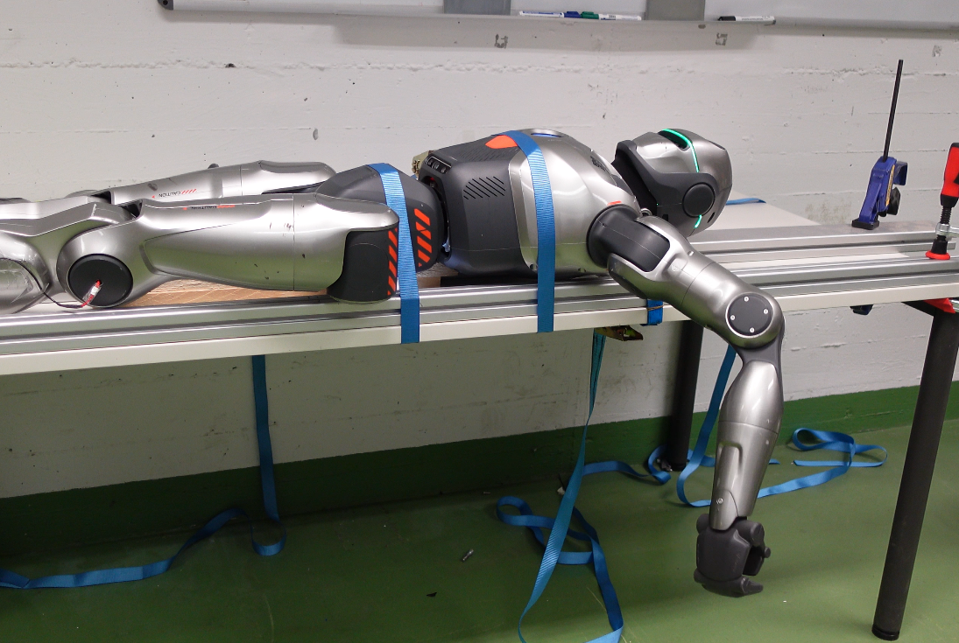
Experiment Validation
Notes:
We applied the process on both simulation environment and true tobot hardware. The identification goal used in the simulator is a modifed version of origional URDF which has different inertial parameters.

Slide 22
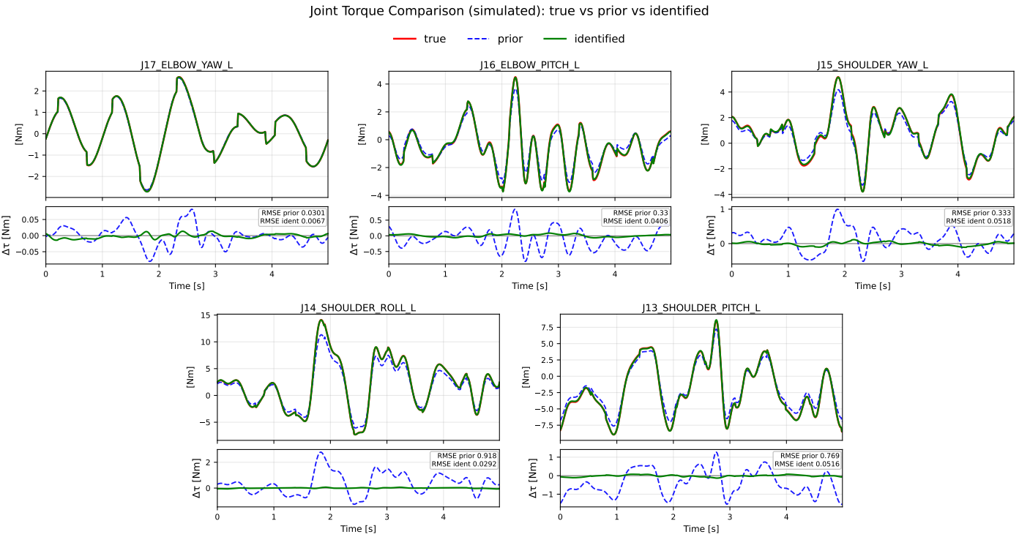
Identification Result (sim)
Notes:
This is the torque result of the simulation. Clearly the residuals after identification become much smaller.

Slide 23
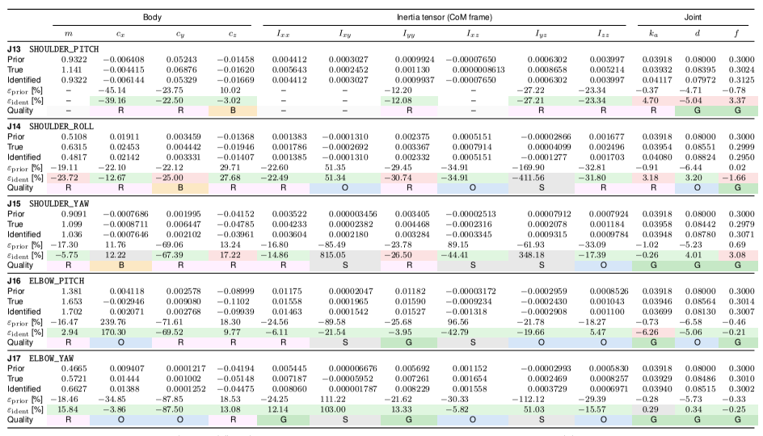
Notes:
Another thing which can only be done in simulator is that we know the true value of each parameters. From the result we can see although the error did not becomes zero, but for the vast majority of parameters the errors were reduced, and no parameter explosion occurred.

Slide 24
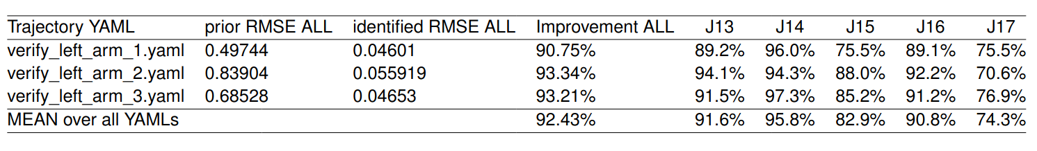
Cross-Validation (sim)
Notes:
Improvements from only one trajectory don’t show us whether it is really an improvement or just overfitting on one example, so we tried using identification result to track different trajectories. In compare with the origional parameters we can see the improvement is not local.

Slide 25
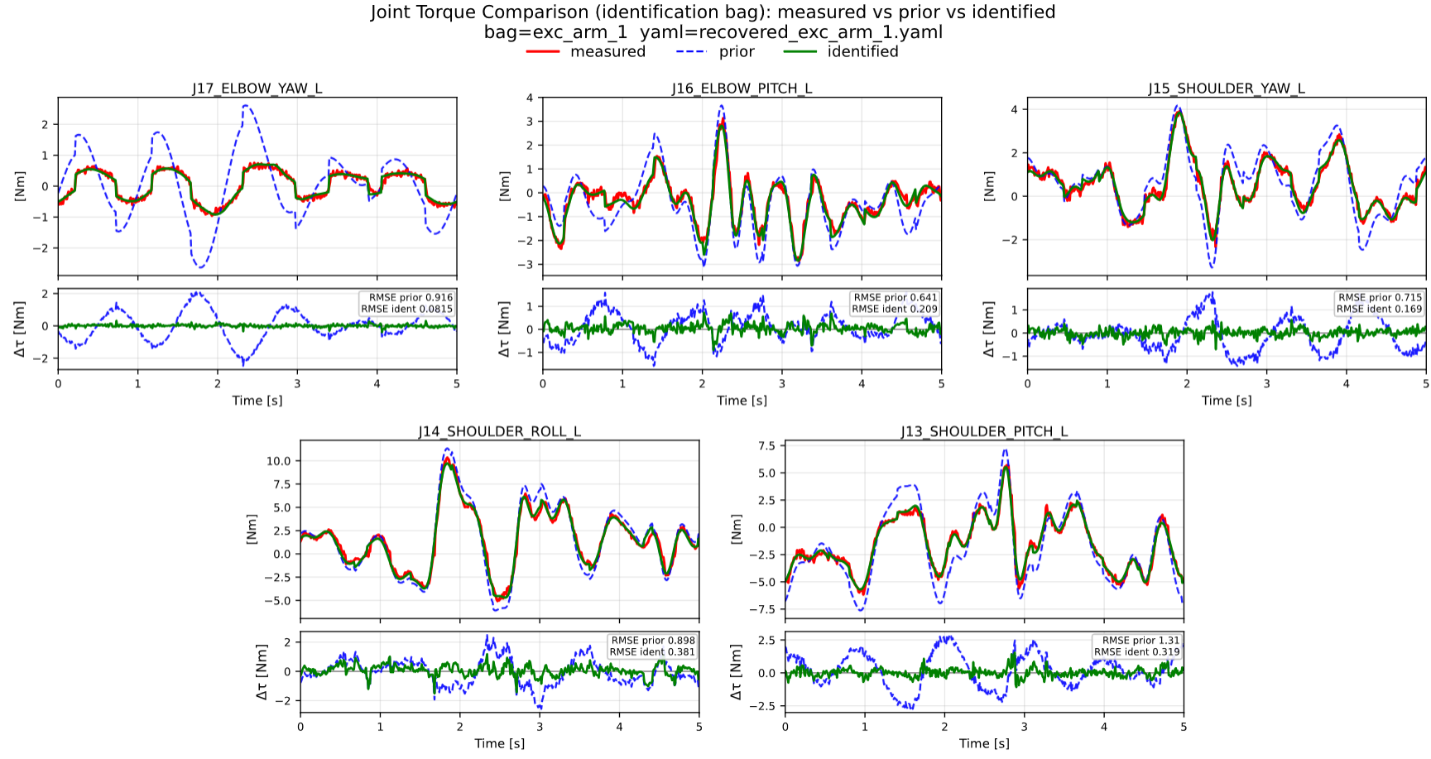
Identification Result (true)
Notes:
These are the result from the true hardware. Obviously the improvements are clear.

Slide 26
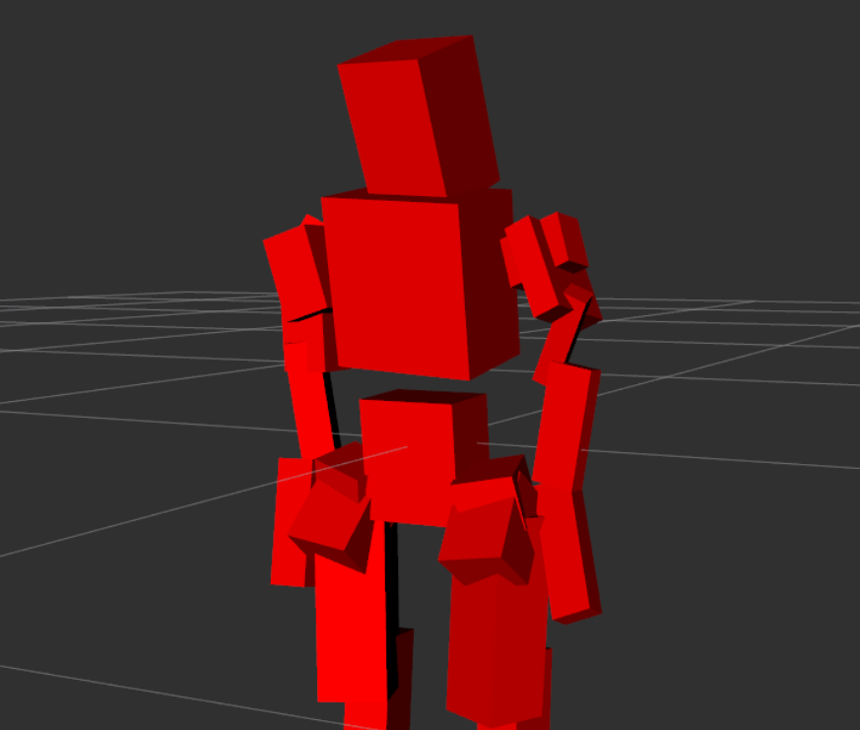
Identification Result
Notes:
From the inertial tensor box, we see all shapes are resonable, no boxes are flatted.

Slide 27
Leg Case Study
Notes:
We deploied the same policy of the leg. The improvements are still.

Slide 28
Conclusions and Open Topics
Through the comprehensive procedure design of this project, we can directly obtain new inertial parameters—which are more accurate and physically consistent—from the results of a single designed measurement.
Threshold and ridge weight design for parameter identifiability label
Effort of other machine learning method for trajectory training
Floating base identification
Test zero shot on trained policy
Notes:
As conclusions, we can see this work provided a complete process which can provide a open-to-use imorived URDF for learning based training. The project is already complete, but there are still possibilities for improvement. For example, the threshold and weight design for parameter identifiability can still be researched; the training result between different ML methods for trajectory can be compared; this work didn;t offer a solution for floating base identification.

Slide 29
Thank you for your attention.
Questions?
Notes:
That’s all of my presentation today. I hope it helped you to know better about what am I doing right now and I’m glad to answer any of your questions.

