Slide 1





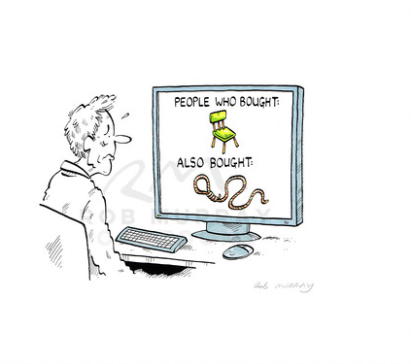
Movie Recommendation System
Using Scala
Dinesh Varma Indukuri
MS Business Analytics, 2019
The University of Texas at Dallas
Source: Google

Slide 2
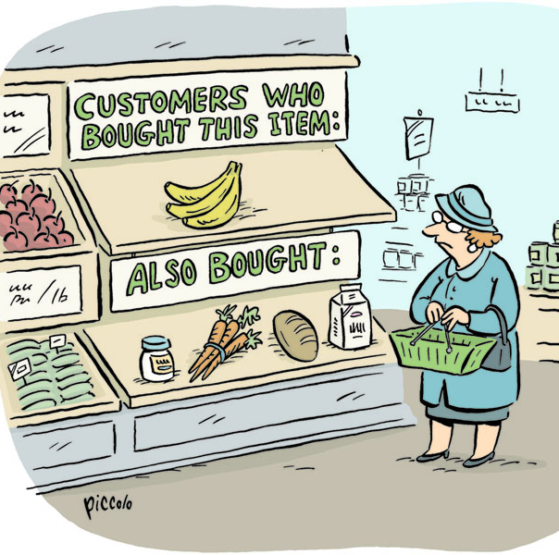
Types of Recommendation Systems
Collaborative Recommender System
Content based Recommender System
Demographic based Recommender System
Utility based Recommender System
Knowledge based Recommender System
Hybrid Recommender System
Source: Google

Slide 3
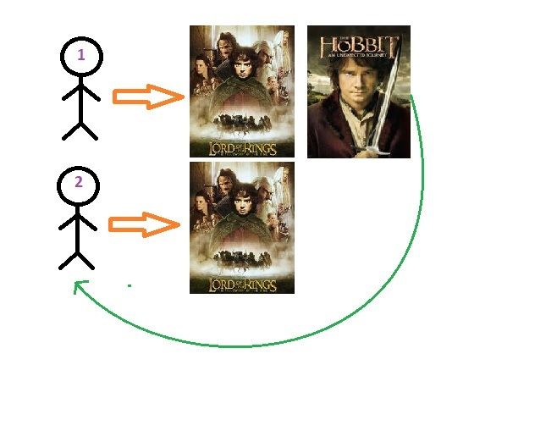
Collaborative Recommender System
A.) User Based Collaborative Filtering
Hard Computations, Costly computational power for comparing and finding similarities
Habits of people can be changed. Therefore making correct and useful recommendation can be hard in time
Source: Kaggle.com

Slide 4
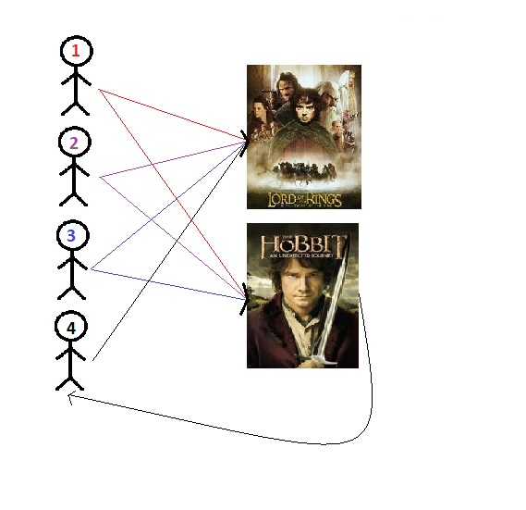
Collaborative Recommender System
B.) Item Based Collaborative Filtering
Instead of finding relationship between users, used items like movies or stuffs are compared with each others.
Similarities between lord of the rings and hobbit movies because both are liked by three different people.
If the similarity is high enough, we can recommend hobbit to other people who only watched lord of the rings movie
Source: Kaggle.com

Slide 5
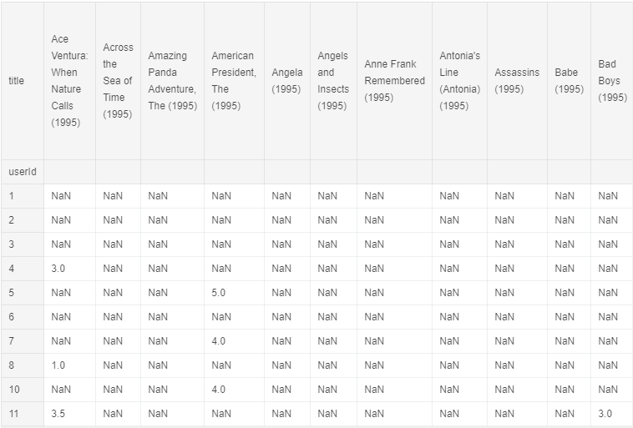
How to recommend movies?
a.) Correlation
Recommend "Headless Body in Topless Bar (1995)" movie to people who watched "Bad Boys (1995)"
Title | Correlation
Bad Boys(1995) | 1.000
Headless body in Topless Bar (1995 | 0.7237
Last Summer in the Hamptons (1995) | 0.6075
Two Bits (1995) | 0.5070
Shadows (Cinenie) (1998) | 0.49418

Slide 6
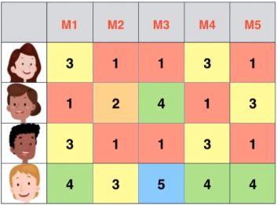
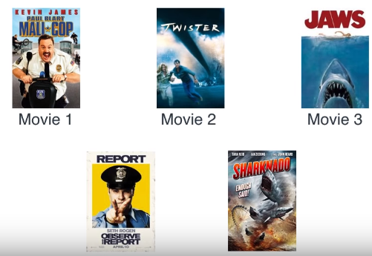
How to recommend movies?
b.) Matrix Factorization
Reference: Luis Serrano

Slide 7






Matrix Factorization
Factorization: 6 * 4 = 24

Slide 8

Matrix Factorization
Feature | M1 | M2 | M3 | M4 | M5
Comedy | 3 | 1 | 1 | 3 | 1
Action | 1 | 2 | 4 | 1 | 3
Comedy | Action
Reference: Luis Serrano

Slide 9
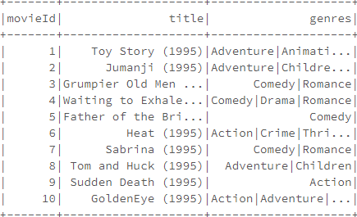
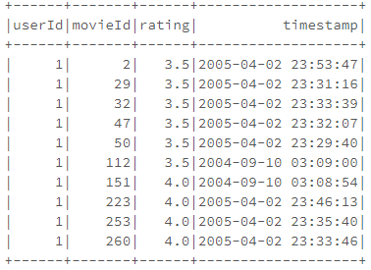
Data
Environment
Data Source: Movie Lens Dataset (20 M)
Movie.csv
Rating.csv
Data Bricks Community Edition
Spark 2.4.4
Scala 2.11
Cluster: Memory = 6 GB, Cores = 0.88
Movie
Rating

Slide 10
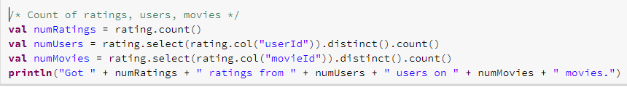
Data Statistics
Ratings
Users
Movies
200,00,263
1,38,493
26,744

Slide 11
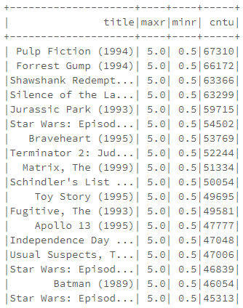
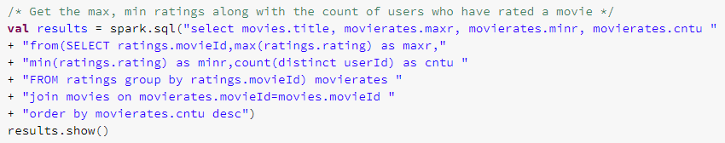
Inferential Statistics
Movie
Max. Rating
Min. Rating
User’s Rated

Slide 12
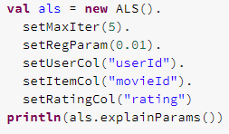
Building the model
Important hyper parameters in Alternating Least Square (ALS)
maxIter : Max. interations (defaults to 10)
Rank: number of latent/hidden factors (defaults to 10)
regParam: Regularization Parameter (λ) (defaults to 1.0)

Slide 13

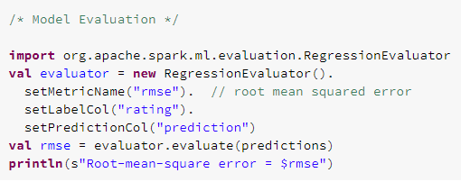
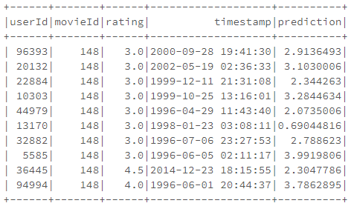
Model Prediction
Model Evaluation
Reference: Collaborative Filtering

Slide 14

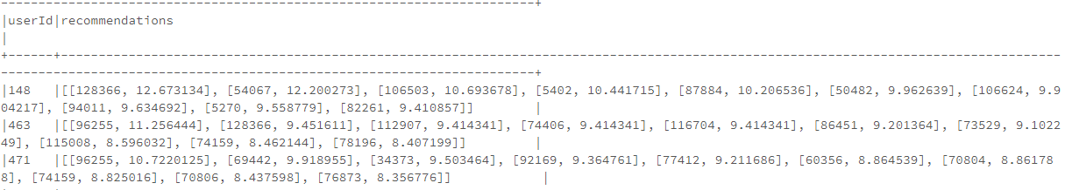
Top 10 movie recommendations for each user
Reference: Collaborative Filtering

Slide 15

Any Queries?

