Slide 1
DV2
File created on: 8/5/2021 11:33:16 PM

Slide 2
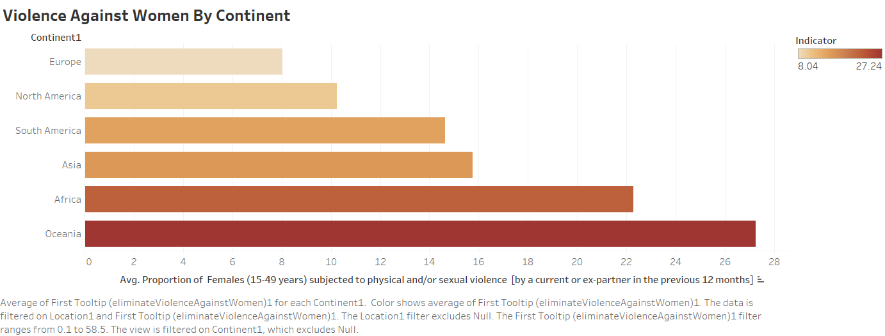

Slide 3
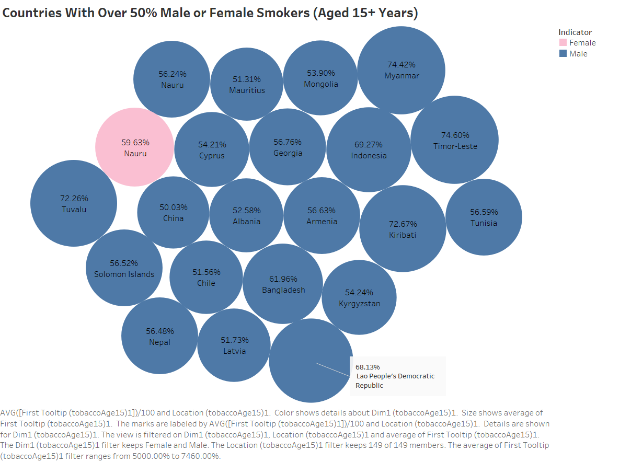

Slide 4
