Slide 1
map
File created on: 8/5/2021 9:19:14 PM

Slide 2
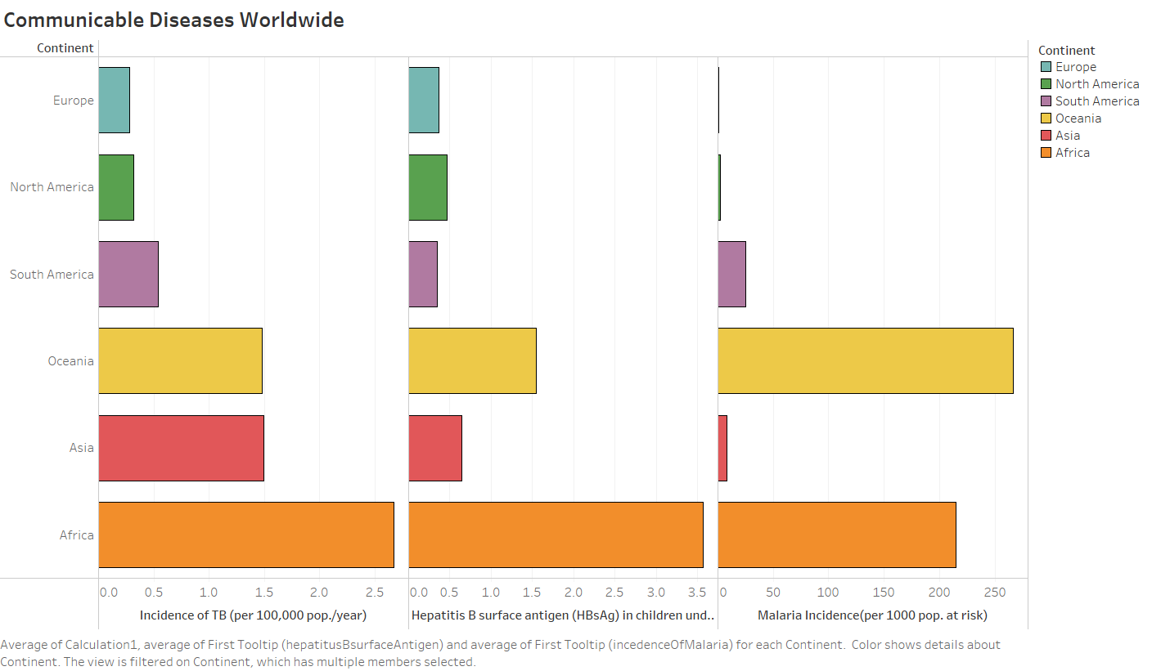

Slide 3
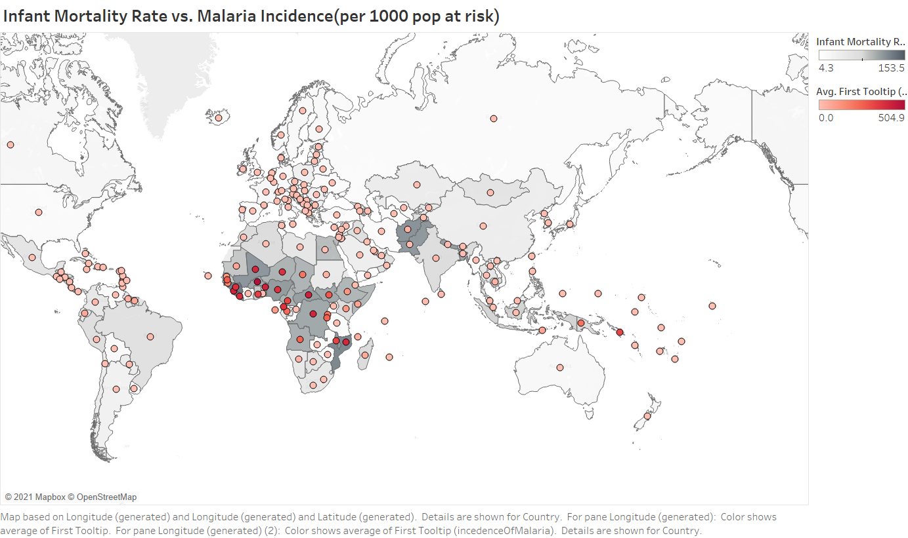

Slide 4
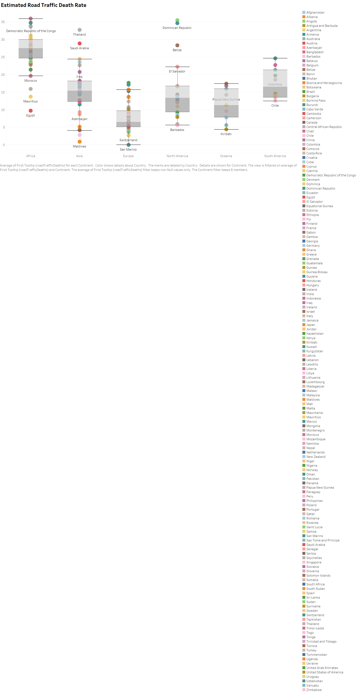

Slide 5
