Slide 1
NYC Building Permits
Deep Dive 4

Slide 2
DOB Permit Issuance
The Department of Buildings (DOB) issues permits for construction and demolition activities in the City of New York. The construction industry must submit an application to DOB with details of the construction job they would like to complete. In this project, we are going to use the features from “DOB_Permit_Issurance” dataset to predict the types of building permits that are being issued.
Industrial Engineering/ME434 Deep Learning Maths

Slide 3
Data Information
“DOB_Permit_Issurance” is a dataset provided by Department of Buildings (DOB) in NYC.
It has 60 columns and about 4 million rows. Each row in this dataset represents the life cycle of one permit for one work type. Each column is an information that is related to the permit application for construction and demolition activities in New York City.
The data type includes numeric, categorical, time-based, and textual classes.
Industrial Engineering/ME434 Deep Learning Maths

Slide 4
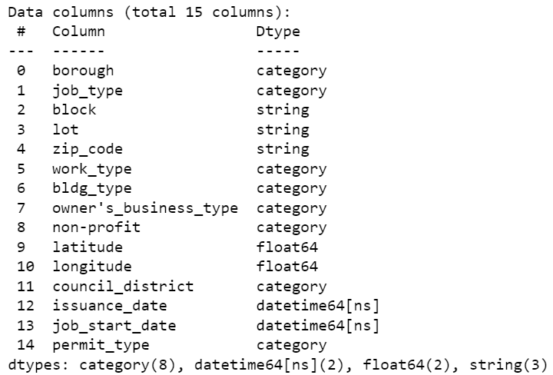
Data Preprocessing
The original dataset has 60 columns.
We first drop columns with lots of missing values.
We next check the definition of each column to decide whether to keep it.
The finial data for training has 14 features besides the target value, “permit_type”.
Industrial Engineering/ME434 Deep Learning Maths

Slide 5
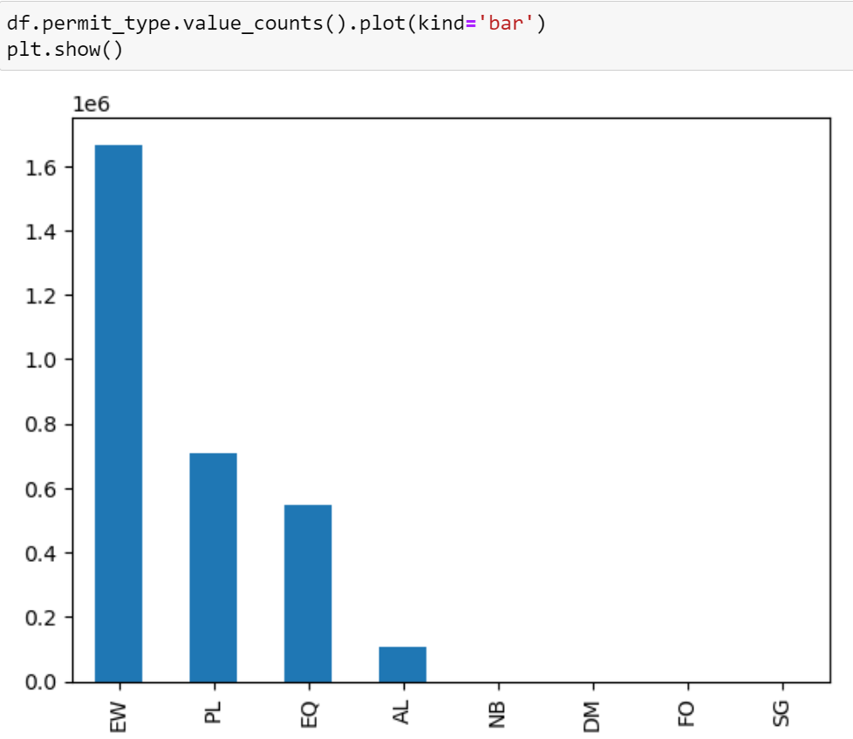
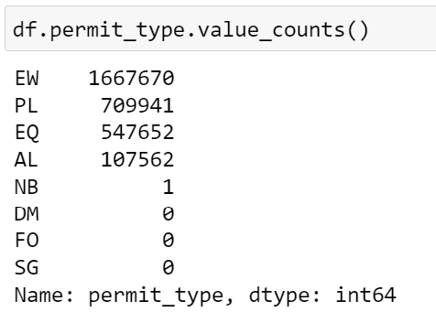
EDA
There is a lot of bias among the label values. One method we thought of was over-sampling, but it was impractical since we would have over-sample the low frequency data by a factor of 10 and also there are a lot of categories with no records.
Industrial Engineering/ME434 Deep Learning Maths

Slide 6
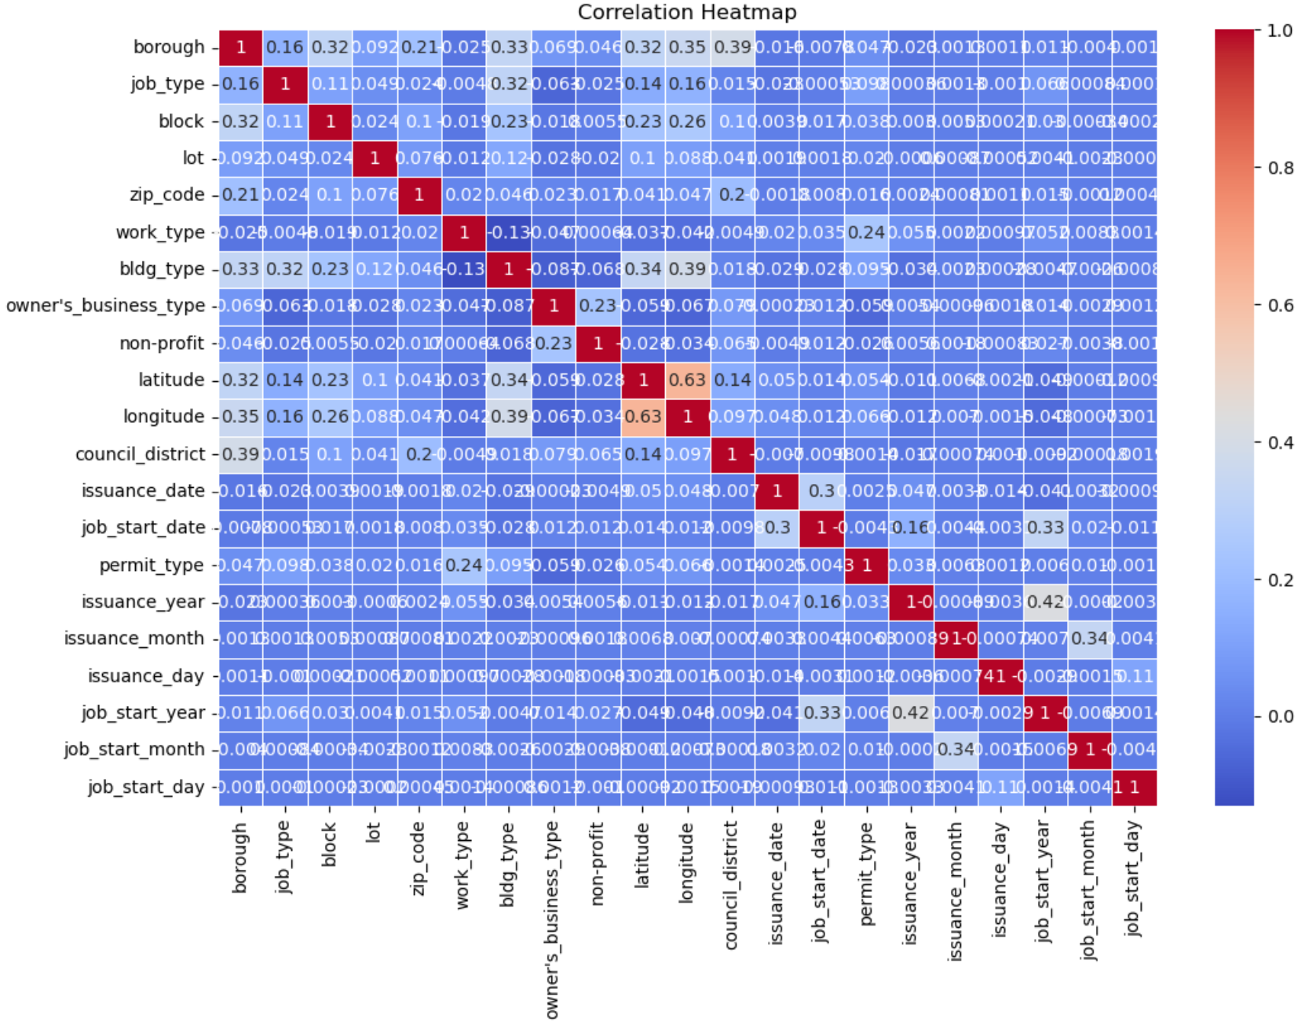
Heat Map
We see that there is minimal correlation among the feature variables which is a desirable characteristic for our baseline model.
Industrial Engineering/ME434 Deep Learning Maths

Slide 7
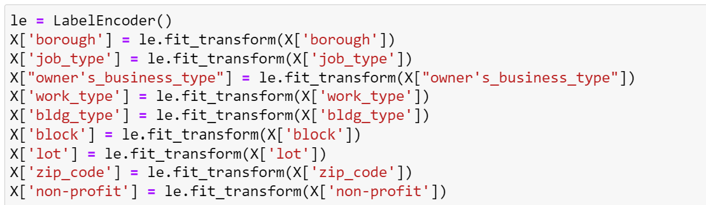
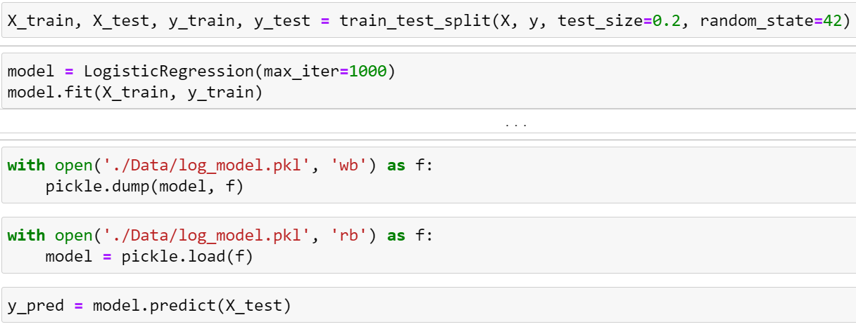
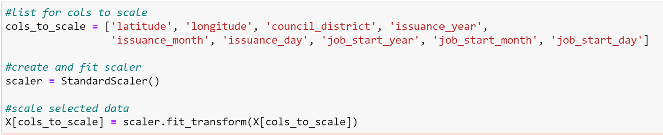
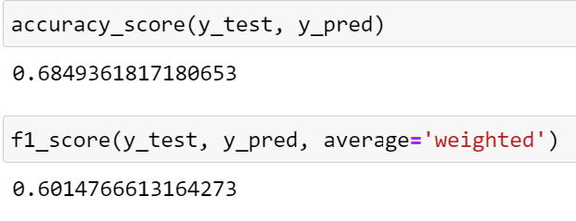
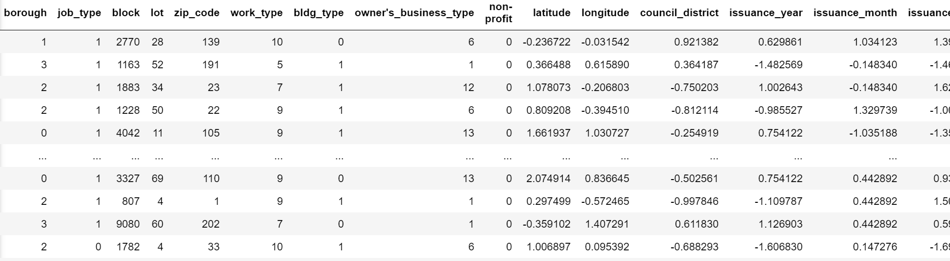
Logistic Regression
Label Encoding
Data Split and Model Training
Standard Scaling
Performance Metrics
Scaled and Encoded Data
Industrial Engineering/ME434 Deep Learning Maths

Slide 8
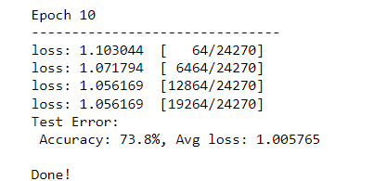
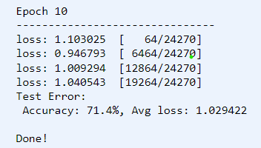
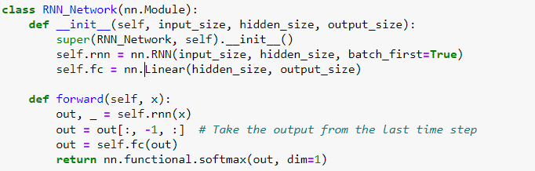
Deep Learning Model
Flexible Architecture: The model employs a Recurrent Neural Network (RNN) with adjustable input size and hidden size
Sequential Information Capture: The RNN layer processes input sequences over time steps, capturing sequential dependencies and patterns
Efficient Output Selection: Extracting output only from the last time step ensures that the model focuses on the most relevant information for making predictions.
Classification Capability: The model's fully connected layer maps the RNN output to the desired class size, utilizing softmax activation for effective multi-class classification.
1
Model and Neural Network Architecture
Applied on Debug Data:
Batch Normalization consistently improves training stability and model performance. The BN-equipped model with a batch size of 64 achieved 97.35% accuracy, demonstrating its significant impact. Even with a larger batch size of 256, the BN model outperformed, achieving 92.42% accuracy. Overall, Batch Normalization enhances convergence and performance in deep learning models, showcasing its robustness.
2
Effects of Mini-Batch
Learning
The observed results indicate minimal difference in performance between the Adam and SGD optimizers, as both achieve similar accuracy and loss values on the test set. This suggests that, in this particular scenario, the choice of optimizer may not significantly impact the model's convergence or generalization. Further investigation into hyperparameter tuning or exploring alternative optimizers might be beneficial to discern any nuanced effects.
Effects of Different
Optimizers
3
Fig 1: Optimizers: SGD vs Adam
Fig 2: Recurrent Neural Network (RNN)
Industrial Engineering/ME434 Deep Learning Maths

Slide 9
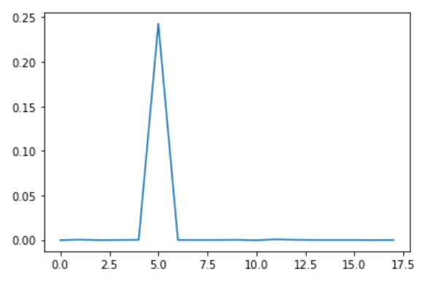
Feature Importance
Procedures:
1. Randomly shuffle the values of each feature at a time on test data set.
2. Measure how much the performance drops.
A significant drop indicates the feature is important.
The above is the plot of the feature importance. Y-axis indicates the performance drops after shuffle the features, and the X-axis indicates the feature index.
It shows that 6-th feature "work_type" is the most important one. The test performance would drop about 25% after we shuffle the values.
Industrial Engineering/ME434 Deep Learning Maths

