Slide 1
IEA Wind Task 52 – Wind Lidar Ontology Group
Task 52 General Meeting 2023
WG7 presentation
Francisco Costa
@University of Stuttgart - SWE
Online
13 June 2023

Slide 2
WG7 – Wind Lidar Ontology Group
The team
Aidan Keane – Renewable energy consultant @wood – aidan.keane@woodplc.com
Andy Clifton – Andy @Enviconnect – andy.clifton@enviconnect.de
Ashim Giyanani – @Fraunhofer – ashim.giyanani@iwes.fraunhofer.de
Carlo Albreto Ratti – Wind Farm Analyst @Enlight – carloar@enlightenergy.eu
Dexing Liu – Associate researcher @University of Stuttgart – SWE – liu@IFB.Uni-Stuttgart.de
Francisco Costa – PhD student @University of Stuttgart – SWE – costa@ifb.uni-stuttgart.de

Slide 3
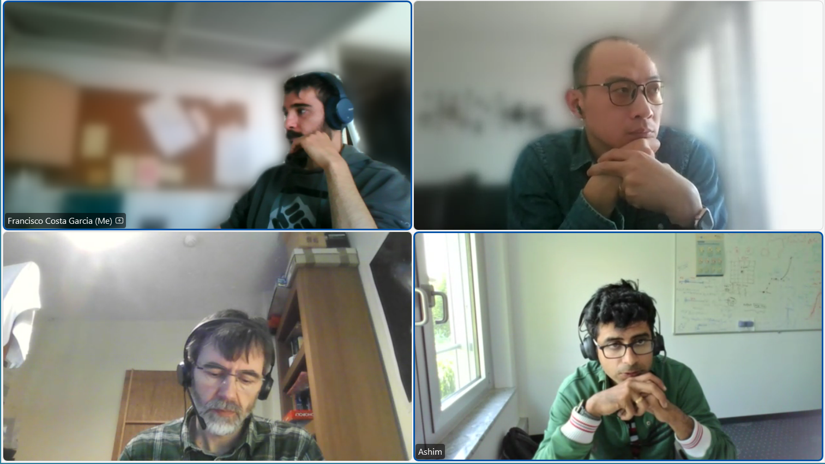
WG7 – Wind Lidar Ontology Group
Bi-weekly meetings

Slide 4
WG7 – Wind Lidar Ontology Group
Objectives
Develop a formal, clear and dedicated controlled vocabulary for lidar terms
Convert lidar knowledge into FAIR (Findable, Accessible, Interoperable and Reusable) lidar knowledge
Long term updates and maintenance of the ontology

Slide 5
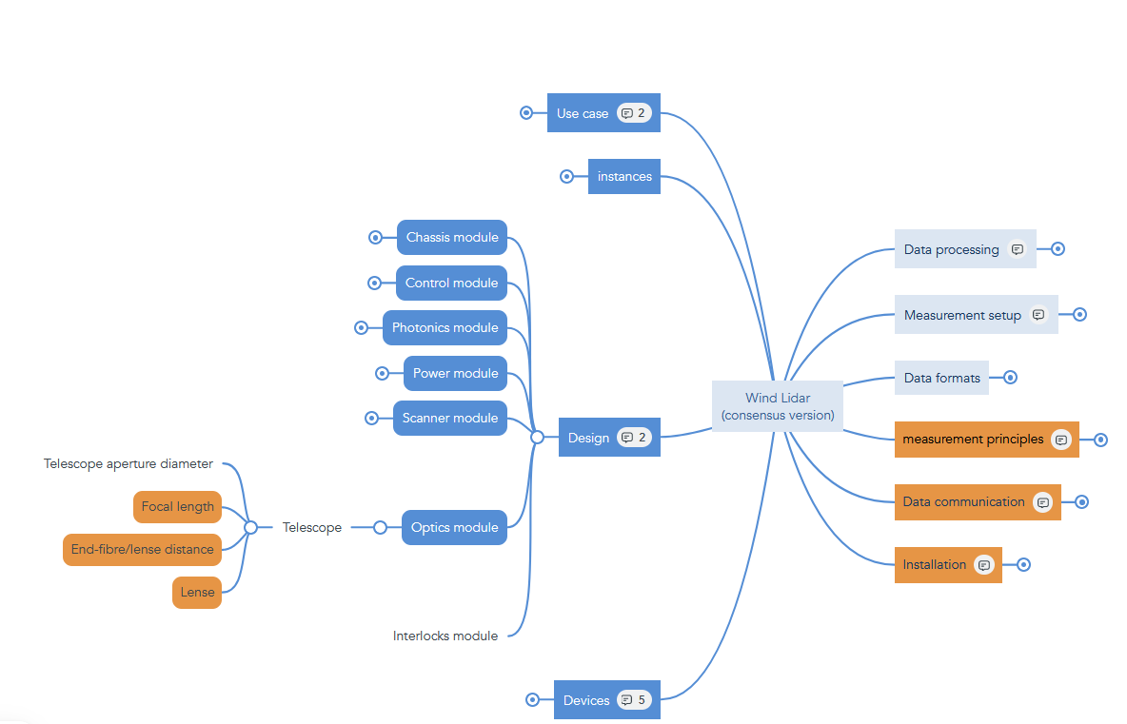

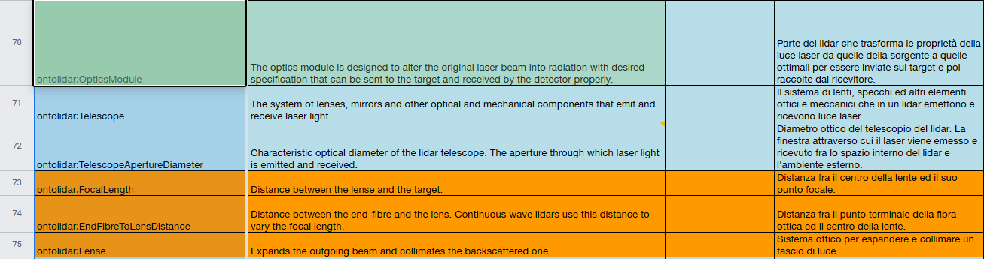
WG7 – Wind Lidar Ontology Group
The plan
Create a working group
The Mind map → Taxonomy
Define lidar concepts
Deploy lidar ontology
Definitions
Notes:
Following transitive and parent-child relationships defined in the mind map

Slide 6
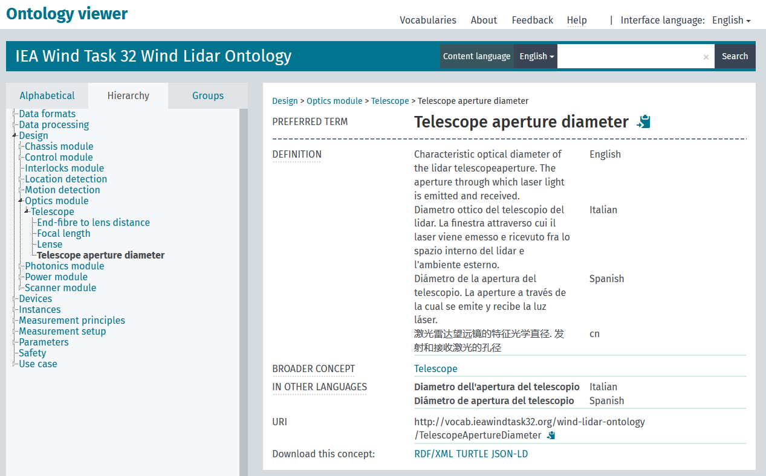
WG7 – Wind Lidar Ontology Group
The Lidar Ontology

Slide 7

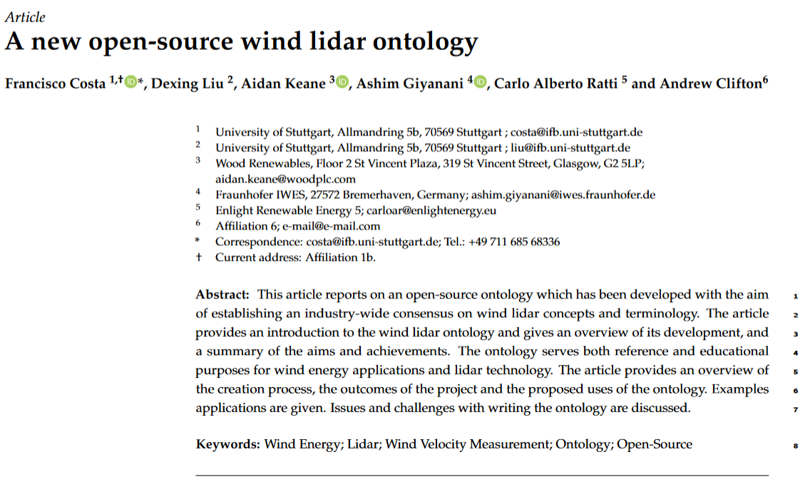
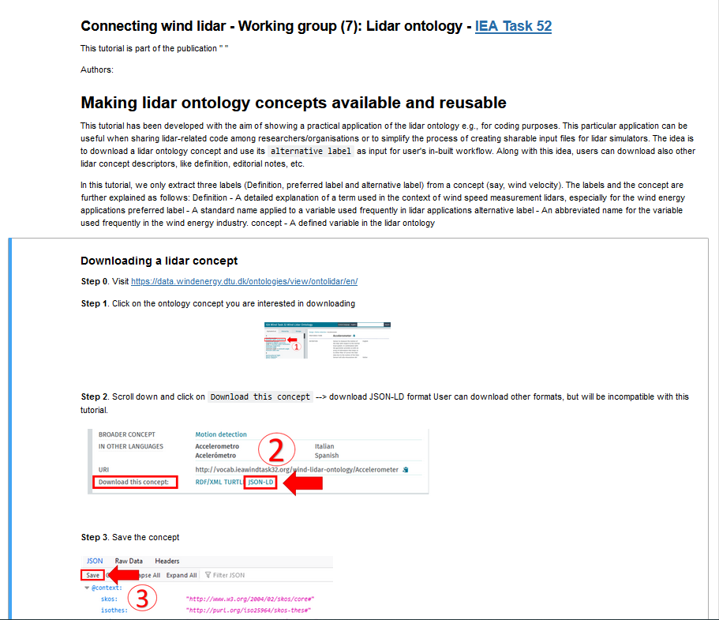
WG7 – Wind Lidar Ontology Group
Deliverables
Notes:
Download a lidar concept
Extract data
Update user‘s lidar simulator local template with data from ontology

Slide 8
Jupyter notebook
Webinar

Slide 9
WG7 – Wind Lidar Ontology Group
Supporting large-scale wind lidar deployment
Simplify the lidar design process
Manufacture
Deployment and operation
Maintenance
Data analysis
Lidar task-specific optimization
Lidar assisted wind turbine control
Pre- and post- campaign preparation
Market acceptance
IEC standards
Notes:
Avoid lidar black boxes
Reduce the possibilities for innovation
Sharing data and resources (code or template for a lidar simulator)
Safety : Lidar safety class for public purposes
IEC definitions

Slide 10
WG – Wind Lidar Ontology Group
Help us to build this!
C. Ratti – carloar@enlightenergy.eu
D. Liu – liu@ifb.uni-stuttgart.de
A. Clifton – andy.clifton@enviconnect.de
A. Keane – aidan.keane@woodplc.com
A. Giyanani – ashim.giyanani@iwes.fraunhofer.de
F. Costa – costa@ifb.uni-stuttgart.de
IEA Wind Task 52 Wind Lidar Ontology

