Slide 1
IEA Wind Task 52 – Wind Lidar Ontology Group
Task 52 General Meeting 2023
WG7 presentation
Francisco Costa
@University of Stuttgart - SWE
Online
13 June 2023
Notes:
The point of the meeting is to give an update on the tasks carried out by the Wind lidar ontology group members these last months, what are we up to nowadays and what the group‘s plans are for the near future.

Slide 2
WG7 – Wind Lidar Ontology Group
The team
Aidan Keane – Renewable energy consultant @wood – aidan.keane@woodplc.com
Andy Clifton – Andy @Enviconnect – andy.clifton@enviconnect.de
Ashim Giyanani – @Fraunhofer – ashim.giyanani@iwes.fraunhofer.de
Carlo Alberto Ratti – Wind Farm Analyst @Enlight – carloar@enlightenergy.eu
Dexing Liu – Associate researcher @University of Stuttgart – SWE – liu@IFB.Uni-Stuttgart.de
Francisco Costa – PhD student @University of Stuttgart – SWE – costa@ifb.uni-stuttgart.de
Notes:
The team is a multidisciplinary team including folks from academia and industry.
Breaf introduction of the members:
Aidan keane based in Scotland and working for wood. Present in many parts of the world wood covers a wide range of activities, among which are renewables.
Andy Clifton, now freelancer and Business manager in enviconnect → wind lidar consultancy service
Carlo Alberto Ratti also from industry working at enlightenergy, a renewable energy platform delivering solar, wind and storage projects at scale.
Ashim Giyanani: Halfway between industry and academia we have the Fraunhofer Institute
Dexing Liu and Francisco Costa from SWE, focused on research in wind energy and wind lidar
This is the current Ontology Group, but others others have contributed as much or even more to this work. People like Peter Clive, Nikola Vasiljevic or the FAIR data Collective need to be acknowledge here as well.
Introduction to next slide:
A quick review of the group's objectives might help to understand what are we doing and how can this help the lidar community – Next slide

Slide 3
WG7 – Wind Lidar Ontology Group
Objectives
Develop a formal, clear and dedicated controlled vocabulary for lidar terms
Convert lidar knowledge into FAIR (Findable, Accessible, Interoperable and Reusable) lidar knowledge
Long term updates and maintenance of the ontology
Notes:
The main goal is to support the lidar community. We know that a lidar community already exists, but it is made up of many parts that speak different jargons and use different terms for lidar concepts → tools like the Lidar Ontology can help bring these parts together. Agreeing on a single lidar language can greatly benefit this process.
To do so, it is needed:
A formal, clear and dedicated controlled vocabulary for lidar terms. In the context of lidar would be useful to come up with a shared lidar language to help transfer data and knowledge. That‘s where ontologies come in
Convert lidar knowledge into Fair lidar knowledge. This will encourage collaboration and information exchange among researches and institutions. Also, facilitates participation of new entrants and dissemination among non-experts in lidar
Ideally, the version is under continuous update. Due to evolution of new lidar applications and technology, frequent addition and edition of terms will be needed
Introduction to next slide:
To meet these objectives, we set out a plan.

Slide 4
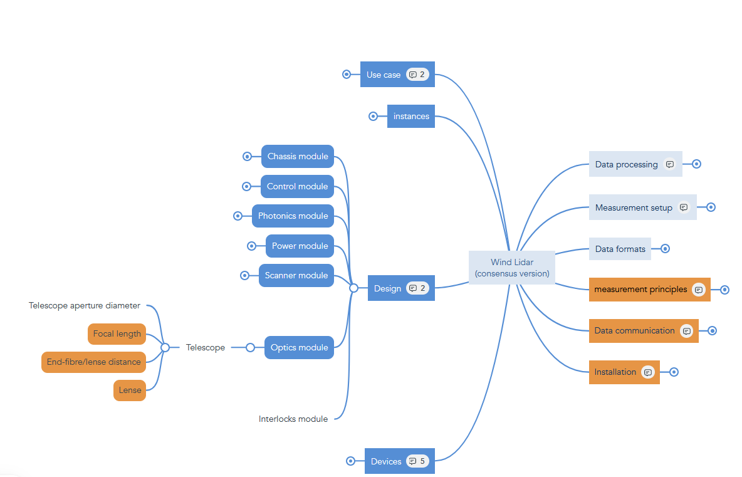

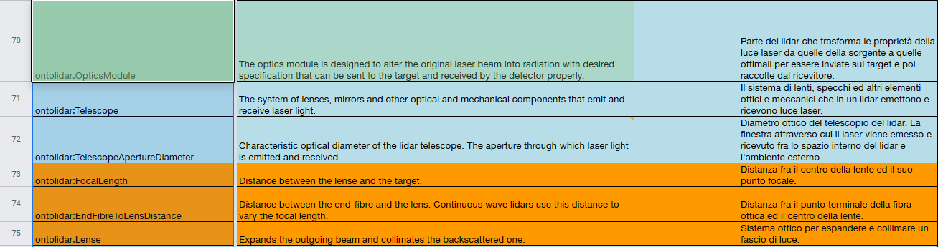
WG7 – Wind Lidar Ontology Group
The plan
Create a working group
The Mind map → Taxonomy
Define lidar concepts
Deploy lidar ontology
Definitions
Notes:
Create a woking group as the one presented before
First step was to come up with a list of most relevant lidar terms and arrange them following transitive and parent-child relationships thus, defining an orderly classification for the defined domain or taxonomy
Lidar concepts definition. Concepts were assigned according to authors’ expertise to be elaborated and the results of their implementations were exposed, discussed and agreed upon by the members of the ontology group in recurrently scheduled meetings.
Deployment of the lidar ontology. The ontology homepage contains information about the title of the ontology, a short description of the lidar ontology website and resource counts by type. Hosting for the online deployment is provided by the Technical University of Denmark (DTU) as an ontostack instance in the form of a human-friendly look-up table.

Slide 5
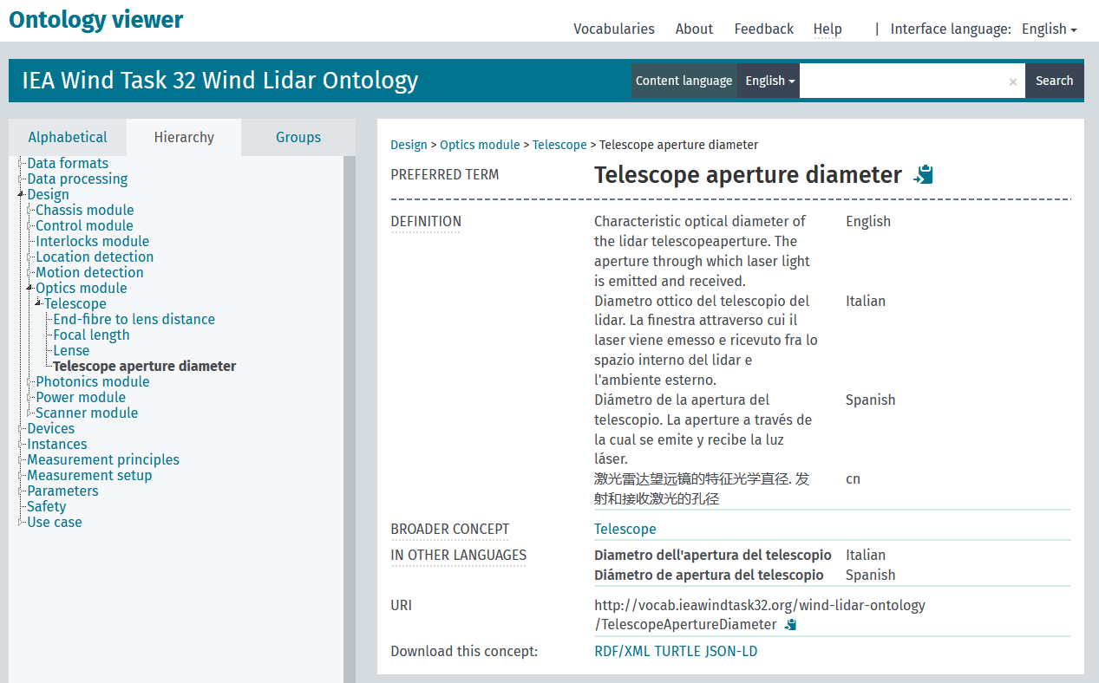
WG7 – Wind Lidar Ontology Group
The Lidar Ontology
Notes:
The human-friendly version of this interactive look-up table can be found at \cite{}.

Slide 6

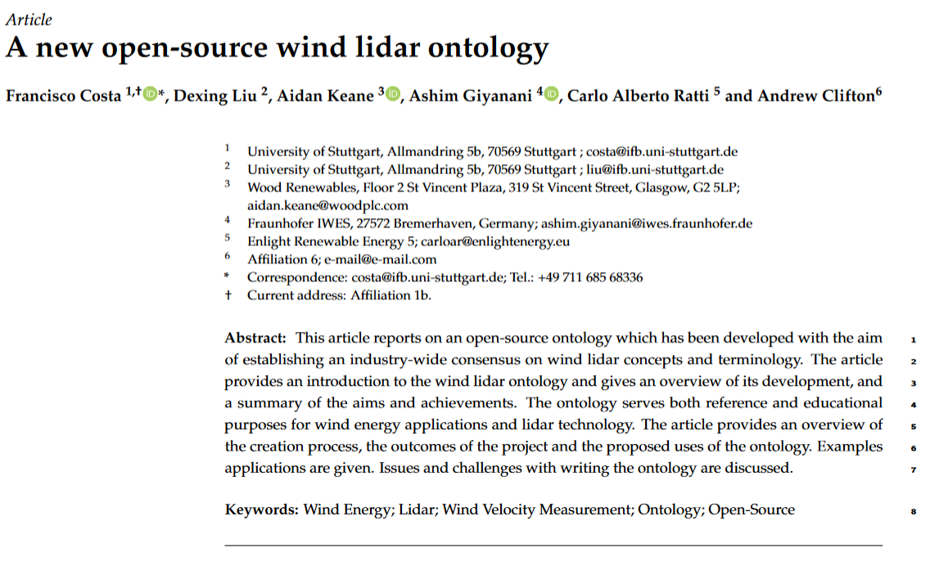
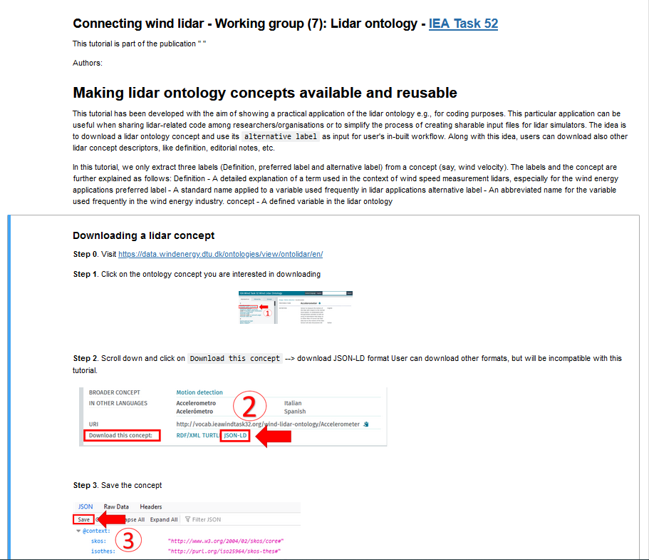
WG7 – Wind Lidar Ontology Group
Deliverables
Notes:
Concerning deliverables
We are about to submit an article where we explain the work done so far and moreover most interestingly, we present an Ontology use case through a Jupyter notebook. In this Jupyter notebook we explain how to:
Download a lidar concept from the ontology viewer
Extract the desired data from the downloaded data
And an application case.
Jupyter notebook – We want to present it in a WEBINAR!

Slide 7
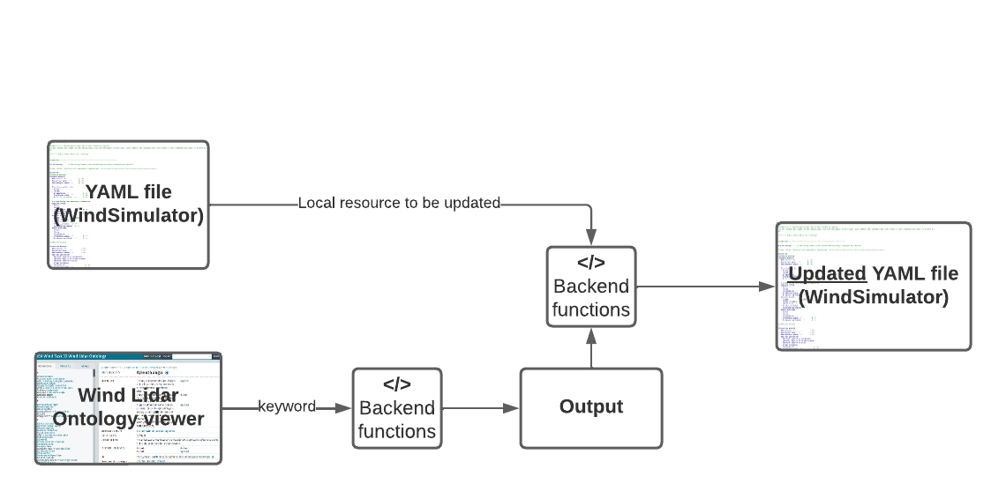
Jupyter notebook
The application: Wind simulator
Notes:
In the Jupyter notebook we illustrate an application on how to facilitate the aquisition of information from the ontology viewer and use it for further purposes, in this case for updating a YAML file used as a template for a lidar simulator. This slide illustrates the workflow.

Slide 8
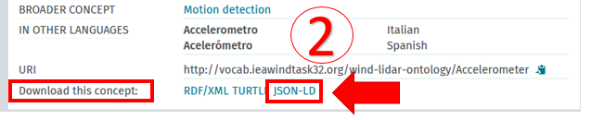
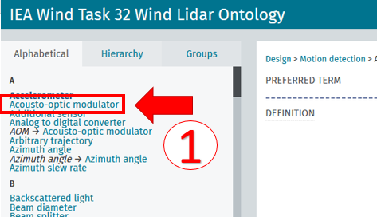
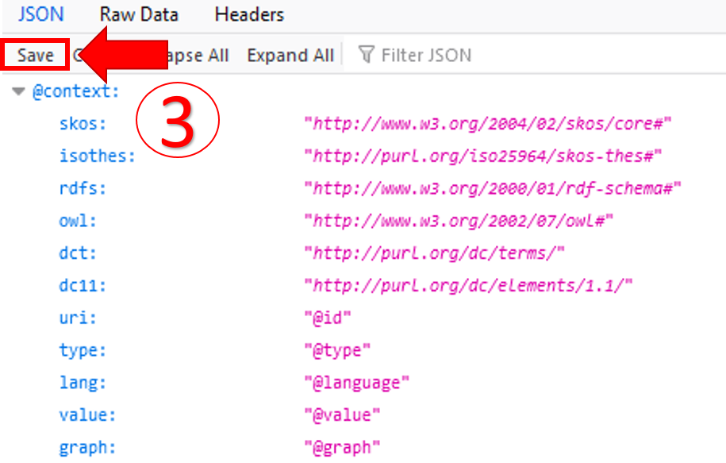
Jupyter notebook
The inputs
Visit https://data.windenergy.dtu.dk/ontologies/view/ontolidar/en/
Notes:
In a first step the information of the ontology viewer is downloaded and saved in user‘s working directory.

Slide 9
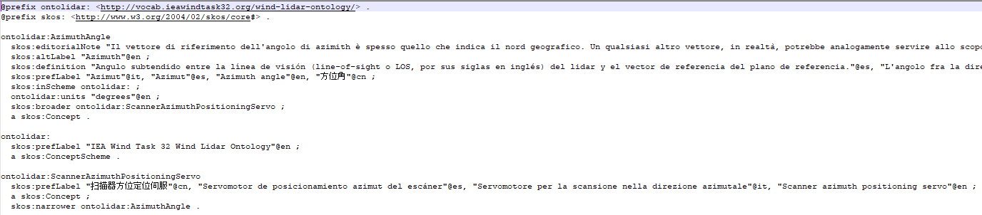
Jupyter notebook
Jupyter notebook
The output
Notes:
This is how the output looks like in ttl format

Slide 10
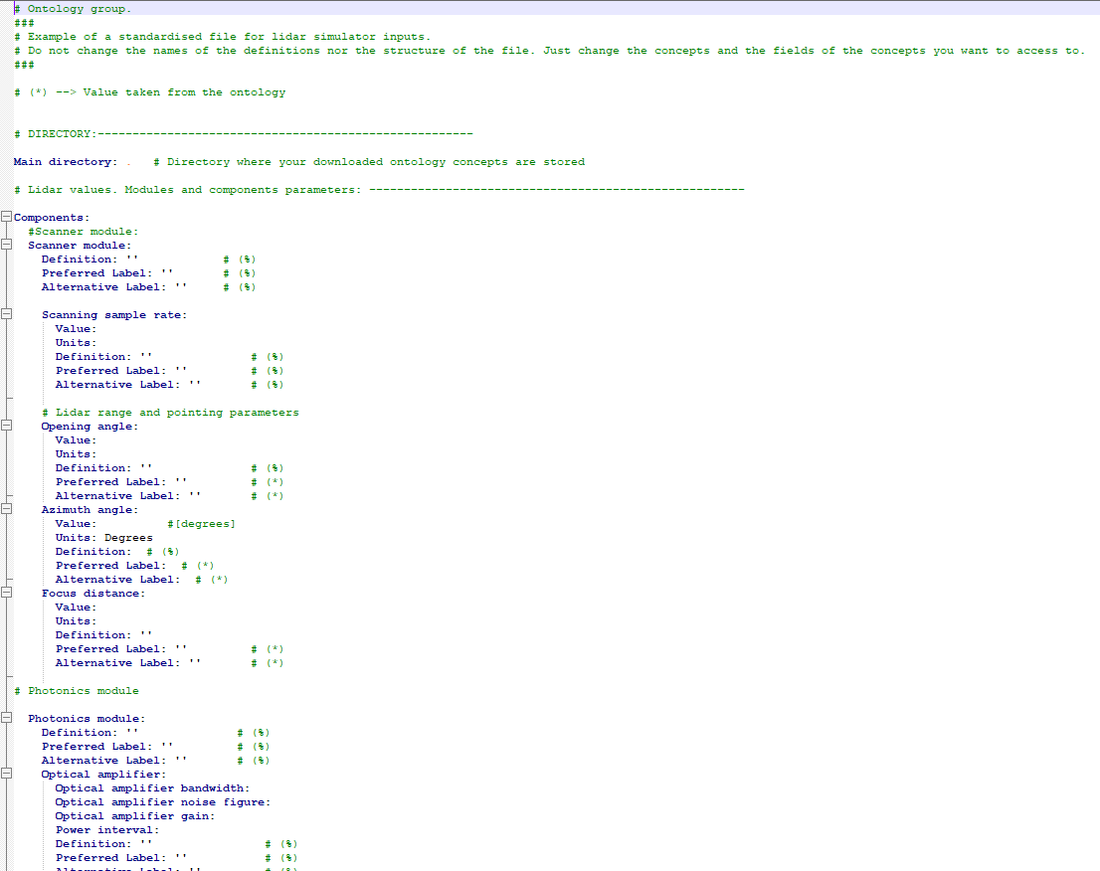
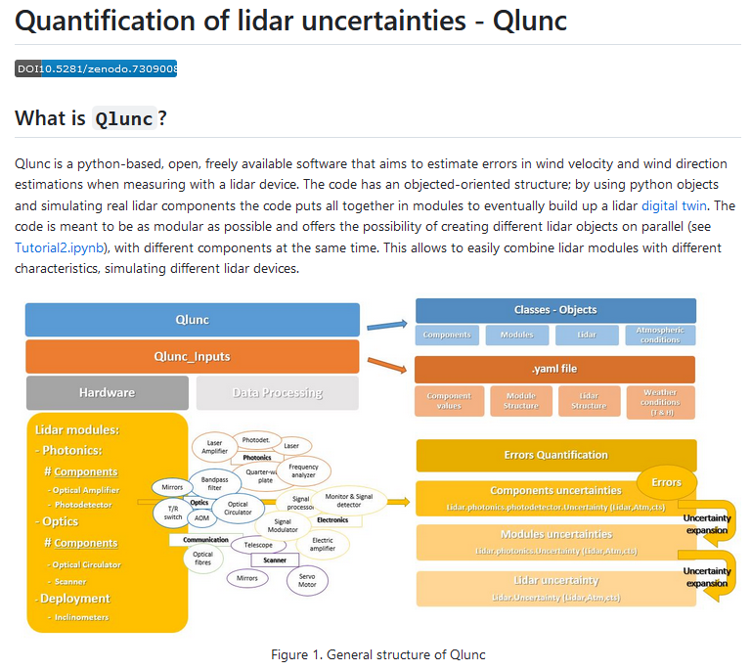
Jupyter notebook
The application: Wind simulator
Notes:
To introduce one of the use cases for the Lidar ontology we have developed an Jupyter notebook. With this tool we aim to illustrate how the ontology can be used to simplify the process of editing/updating input files for lidar simulators. In this slide we see a local YAML file used as input for a lidar simulator. Many fields can be aligned with the ontology.

Slide 11
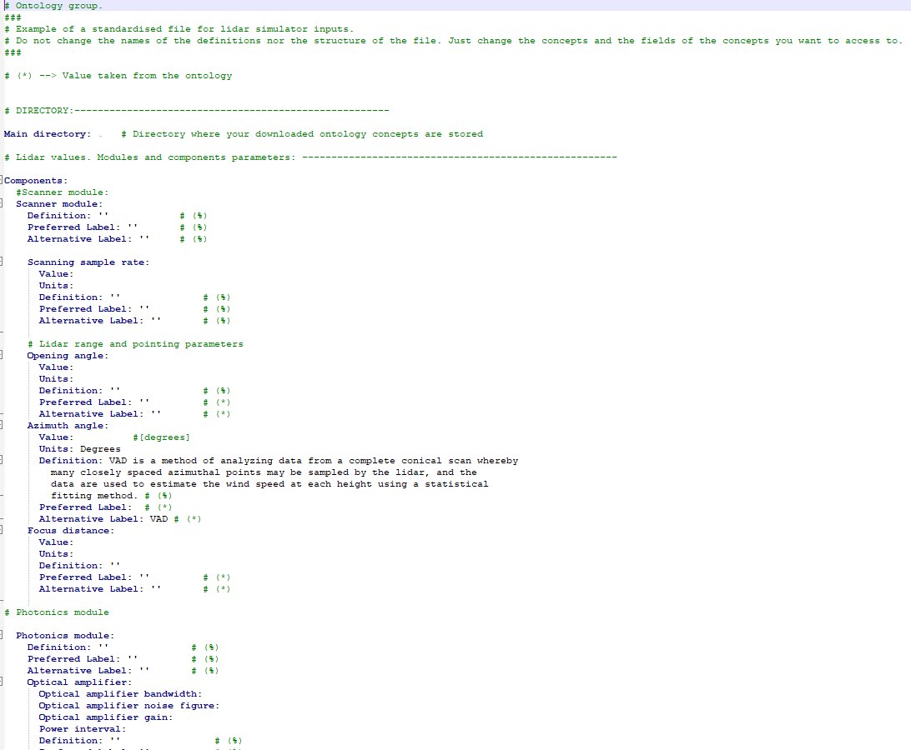
Jupyter notebook
The application: Wind simulator
Notes:
Eventually, we obtain the local YAML file updated with the information extracted from the lidar ontology. In this case we have updated the Definiton and the Alternative label

Slide 12






WG7 – Wind Lidar Ontology Group
Supporting large-scale wind lidar deployment
Design and use
Task-specific optimization
Lidar assisted wind turbine control
Pre- and post- campaign preparation
Market acceptance
DevOps
Fonts: iStock, Wikimedia Commons, ASP, Freeiconspng, CleanLink and EuroLab, Accessed: 04/0.8.06.2023
Notes:
To end with we need to talk about how does your working group address the overall theme of the task “Large-Scale Deployment of Wind Lidar”?
Desing and use of lidar
Manufacture
Deployment, operation and test
Maintenance
Speed up data analysis
Lidar task-specific optimization
Lidar assisted wind turbine control
Pre- and post- campaign preparation
Market acceptance
IEC standards
Safety protocols
With this ontology we make available a common CV that unambiguously defines the many aspects of a wind lidar. The ontology can be used to help transfer data, tools, and knowledge.
Avoid lidar black boxes
Reduce the possibilities for innovation
Sharing data and resources (code or template for a lidar simulator)
Safety : Lidar safety class for public purposes
IEC definitions

Slide 13
WG – Wind Lidar Ontology Group
Help us to build this!
C. Ratti – carloar@enlightenergy.eu
D. Liu – liu@ifb.uni-stuttgart.de
A. Clifton – andy.clifton@enviconnect.de
A. Keane – aidan.keane@woodplc.com
A. Giyanani – ashim.giyanani@iwes.fraunhofer.de
F. Costa – costa@ifb.uni-stuttgart.de
IEA Wind Task 52 Wind Lidar Ontology

