Slide 1
OHDSI Tutorial: Overall process of Population-Level Estimation
Seng Chan You

Slide 2
Goal of the Tutorial
All happy families are alike; every unhappy family is unhappy in its own way (Все счастливые семьи похожи друг на друга, каждая несчастливая семья несчастлива по-своему)
Every ATLAS-generated non-actionable OHDSI package has errors in its own way
➔Build Actionable PLE package
➔Presentation of the Results

Slide 3
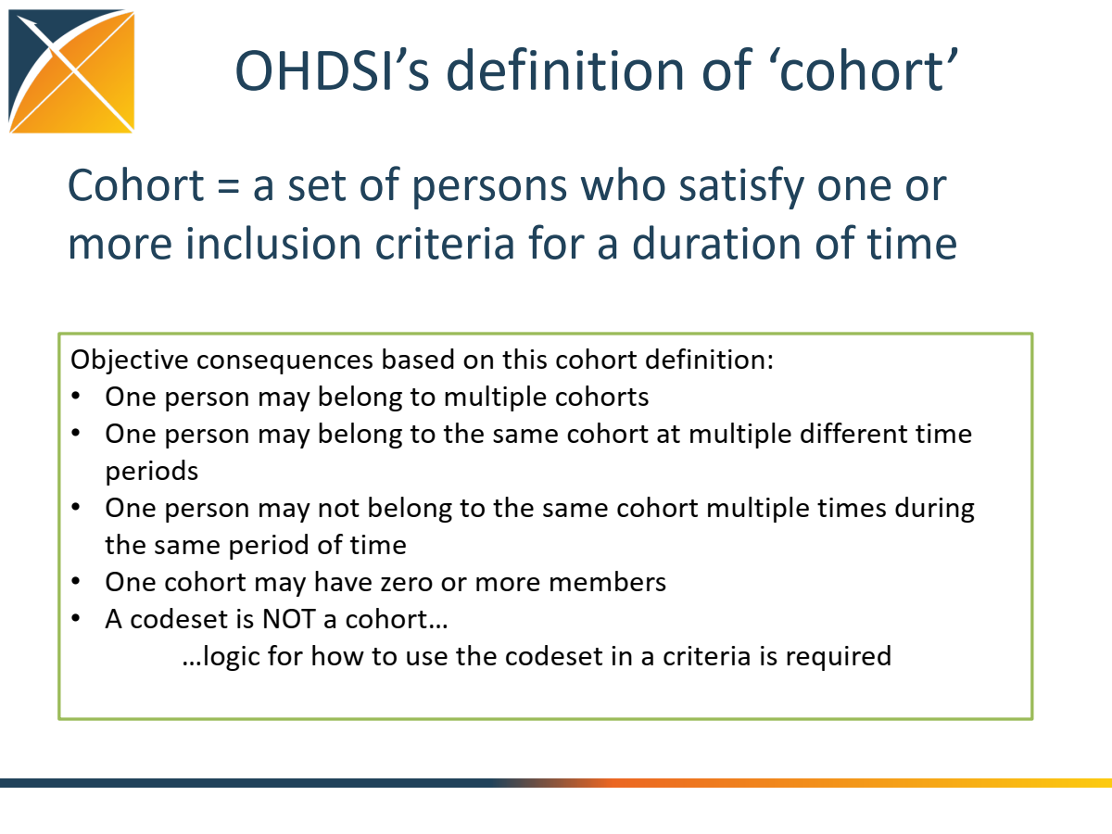

Slide 4
Exercise: Define target and outcome cohort for Lactic acidosis in metformin users
What initial event(?) define cohort entry?
What inclusion criteria are applied to the initial events?
What defines a person’s cohort exit?
OHDSI Cohort must have:
Start Date & End Date

Slide 5
Demo: Defining cohort using ATLAS
Follow along at: http://ohdsi.org/web/ATLAS
ID/PW: demo/demo

Slide 6
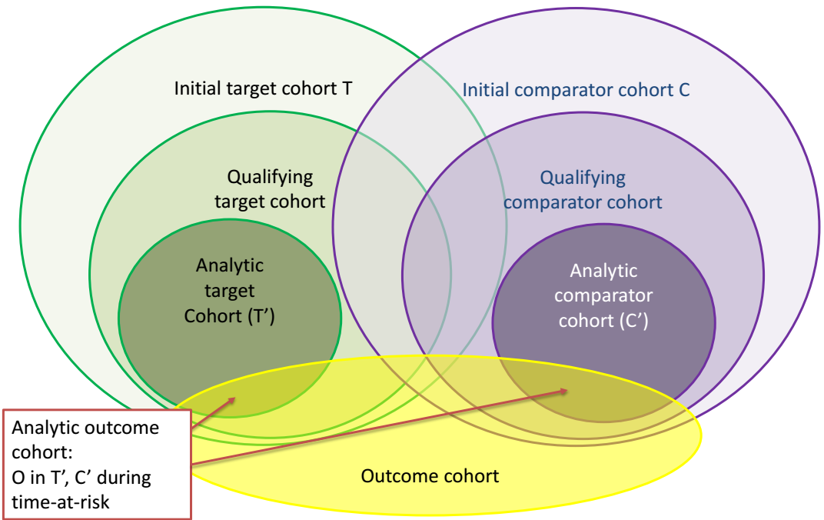
Define cohort: A database is full of cohorts, some of which may represent valid comparisons

Slide 7
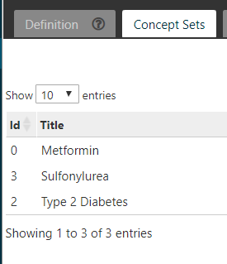
Before start: Making Concept Sets
http://www.ohdsi.org/web/atlas/#/cohortdefinition/1769410

Slide 8
Define cohort: Process flow for formally defining a cohort in ATLAS
Cohort entry criteria
Initial events
Events are recorded time-stamped observations for the persons, such as drug exposures, conditions, procedures, measurements and visits
All events have a start date and end date, though some events may have a start date and end date with the same value (such as procedures or measurements).
Initial event inclusion criteria
Additional qualifying inclusion criteria
The qualifying cohort will be defined as all persons who have an initial event, satisfy the initial event inclusion criteria, and fulfill all additional qualifying inclusion criteria
Each qualifying inclusion criteria will be evaluated to determine the impact of the criteria on the attrition of persons from the initial cohort
Cohort exit criteria
Initial cohort
Qualifying cohort

Slide 9
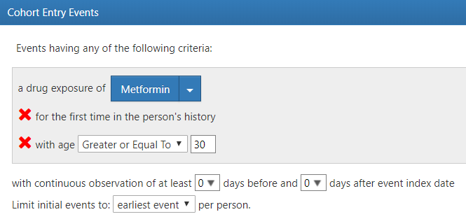
Demo: [Target] Metformin User – initial event
http://www.ohdsi.org/web/atlas/#/cohortdefinition/1769410

Slide 10
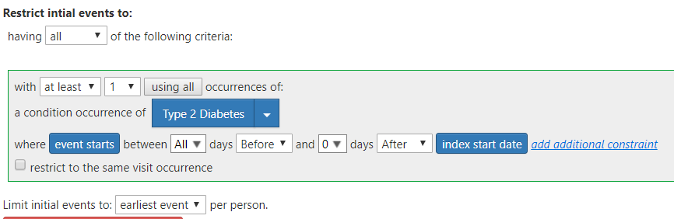
Demo: [Target] Metformin User – initial event inclusion criteria
http://www.ohdsi.org/web/atlas/#/cohortdefinition/1769410

Slide 11
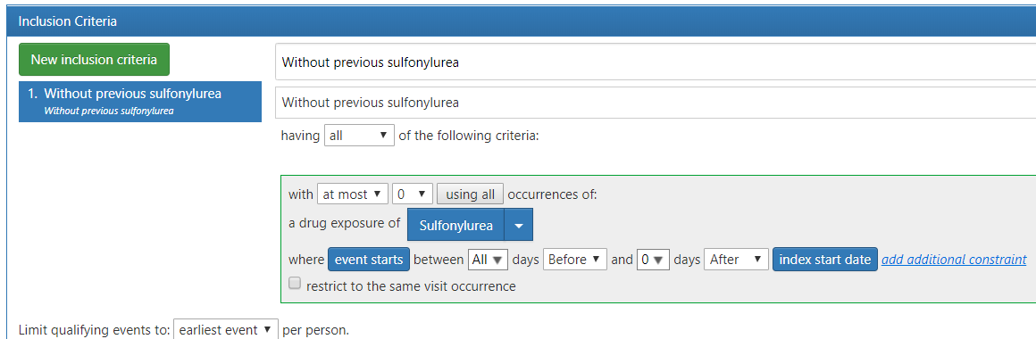
Demo: [Target] Metformin User – additional qualifying inclusion criteria
http://www.ohdsi.org/web/atlas/#/cohortdefinition/1769410

Slide 12
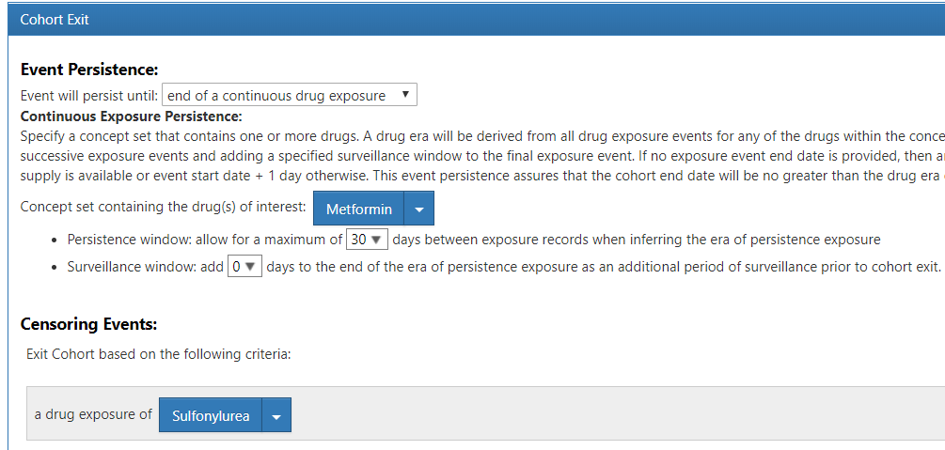
Demo: [Target] Metformin User – cohort exit criteria and censoring event
http://www.ohdsi.org/web/atlas/#/cohortdefinition/1769410

Slide 13
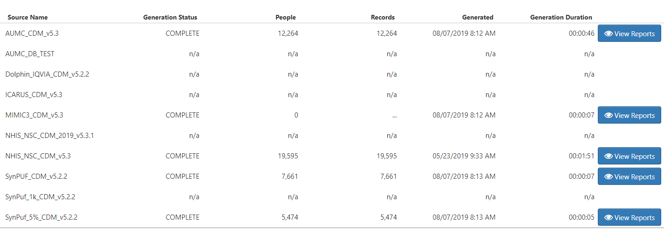
Demo: [Target] Metformin User – Result
http://www.ohdsi.org/web/atlas/#/cohortdefinition/1769410

Slide 14
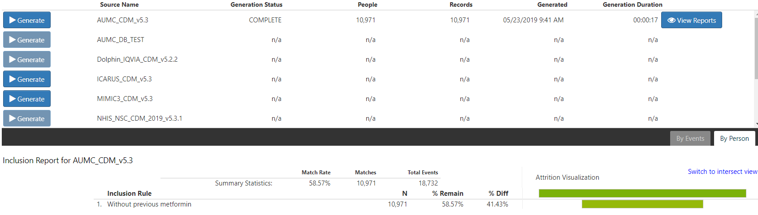
Demo: [Comparator] Glyburide User
http://www.ohdsi.org/web/atlas/#/cohortdefinition/1769411

Slide 15
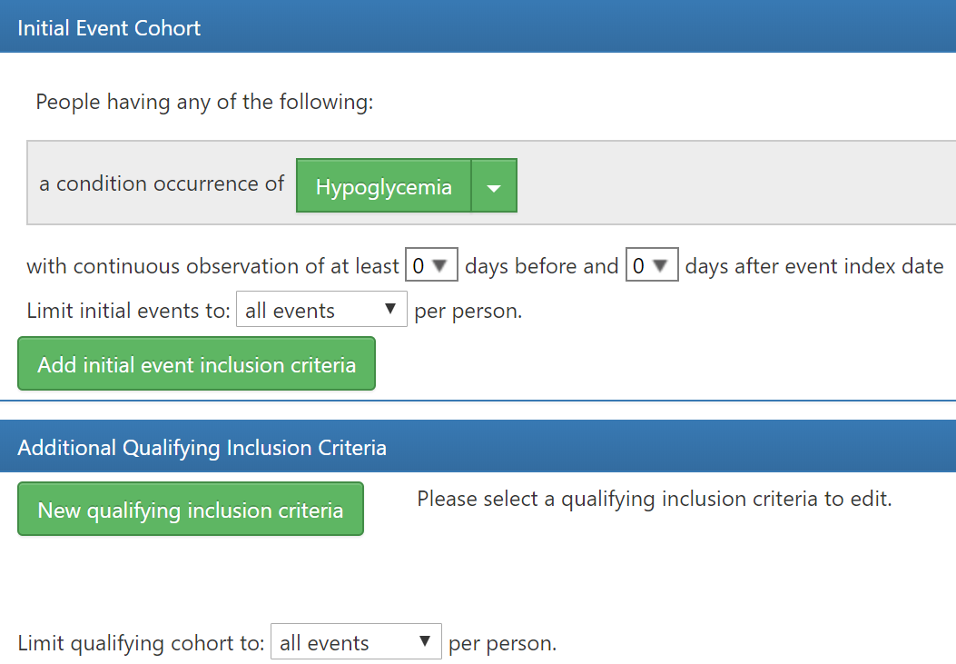
Demo: [Outcome] Hypoglycemia
http://www.ohdsi.org/web/atlas/#/cohortdefinition/1769412

Slide 16
What evidence does OHDSI seek to generate from observational data?
Clinical characterization
Natural history: Who are the patients who have diabetes? Among those patients, who takes metformin?
Quality improvement: What proportion of patients with diabetes experience disease-related complications?
Population-level estimation
Safety surveillance: Does metformin cause hypoglycemia?
Comparative effectiveness: Does metformin cause hypoglycemia more than glyburide?
Patient-level prediction
Precision medicine: Given everything you know about me and my medical history, if I start taking metformin, what is the chance that I am going to have hypoglycemia during the first 30 days?
Disease interception: Given everything you know about me, what is the chance I will develop diabetes?

Slide 17
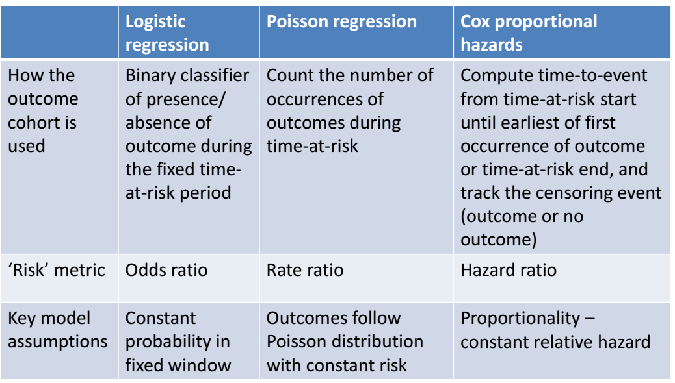
3. Define statistical model: The choice of the outcome model defines your research question

Slide 18
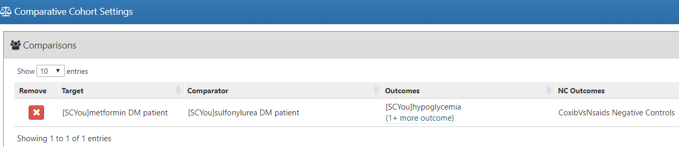
Population Level Estimation: Comparative Cohort Settings

Slide 19
Best practices (new-user cohort design)
Use propensity scores (PS)
Build PS model using regularized regression and a large set of candidate covariates (as implemented in the CohortMethod package)
Use either variable-ratio matching or stratification on the PS
Compute covariate balance after matching, and terminate study if a covariate has standardized difference > 0.2
Open questions:
Terminate study if there’s insufficient overlap in PS distributions?
Require outcome model to be conditioned on matched sets?
Prescribe Cox models over Poisson and logistic?
Is there any merit to the dogma stating PS models mustn’t include instrumental variables?

Slide 20
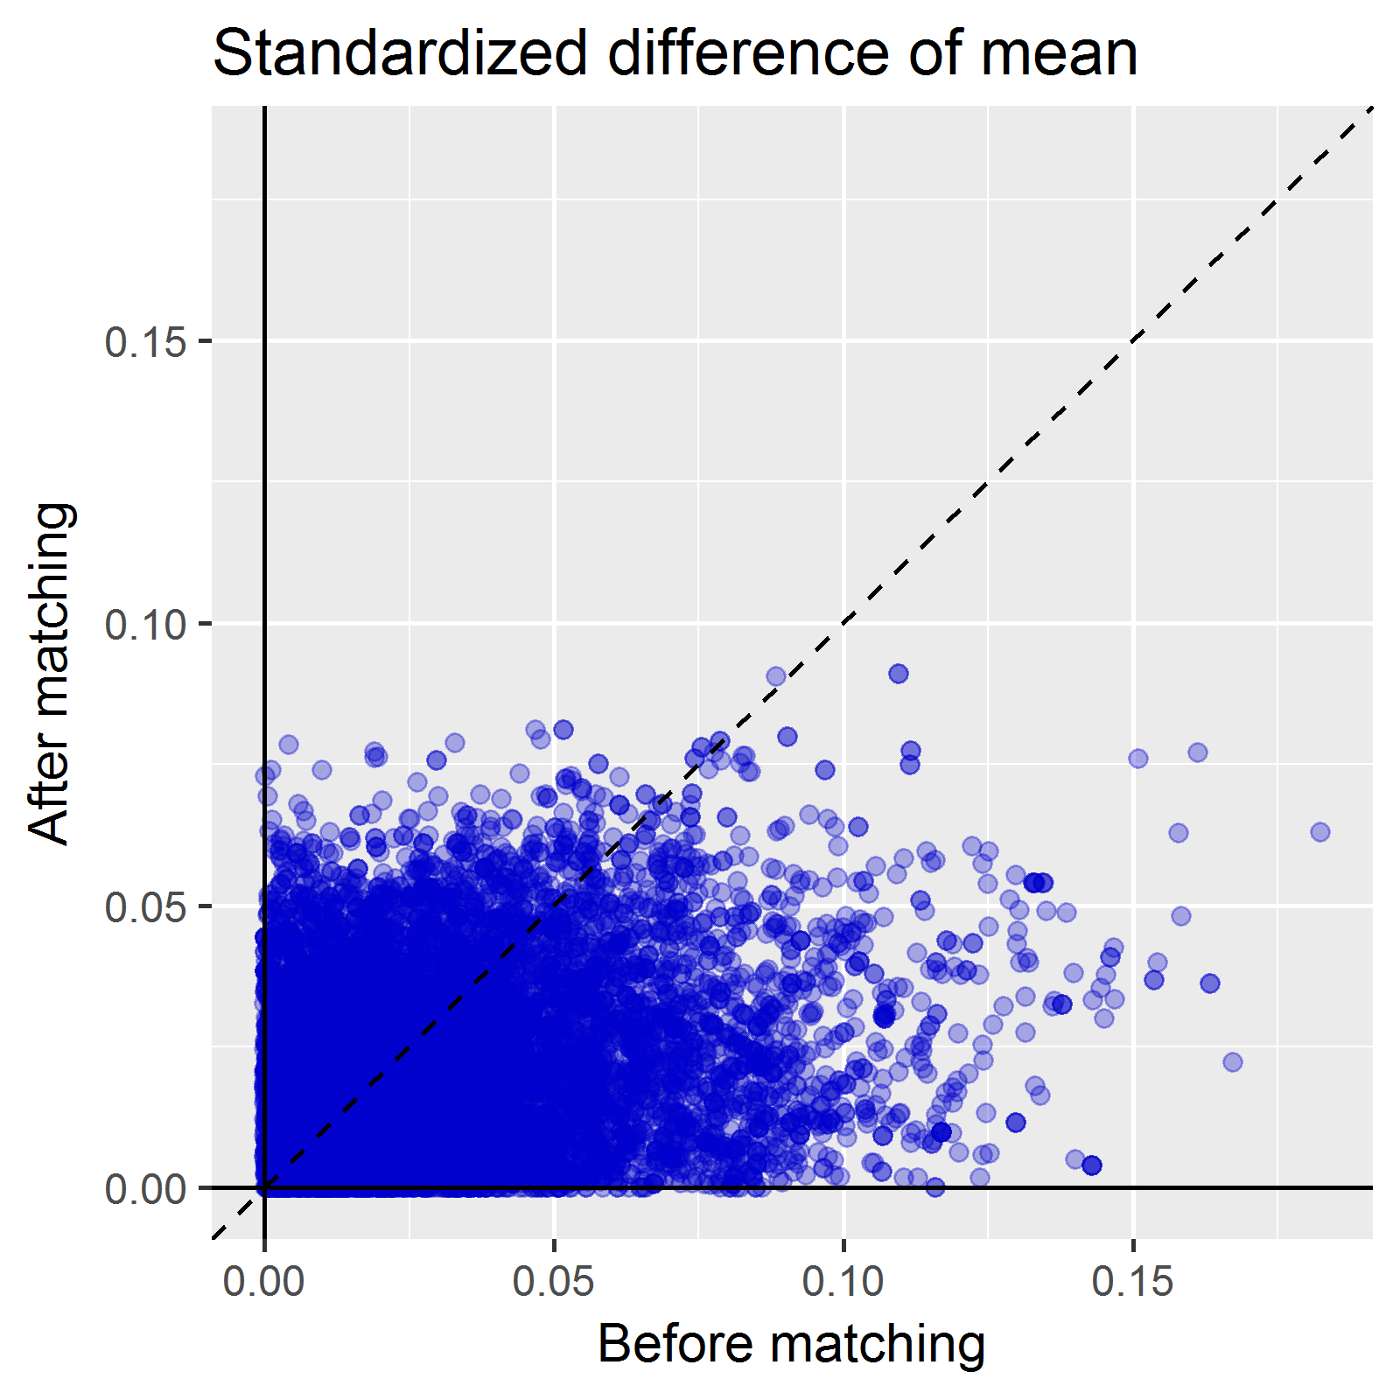
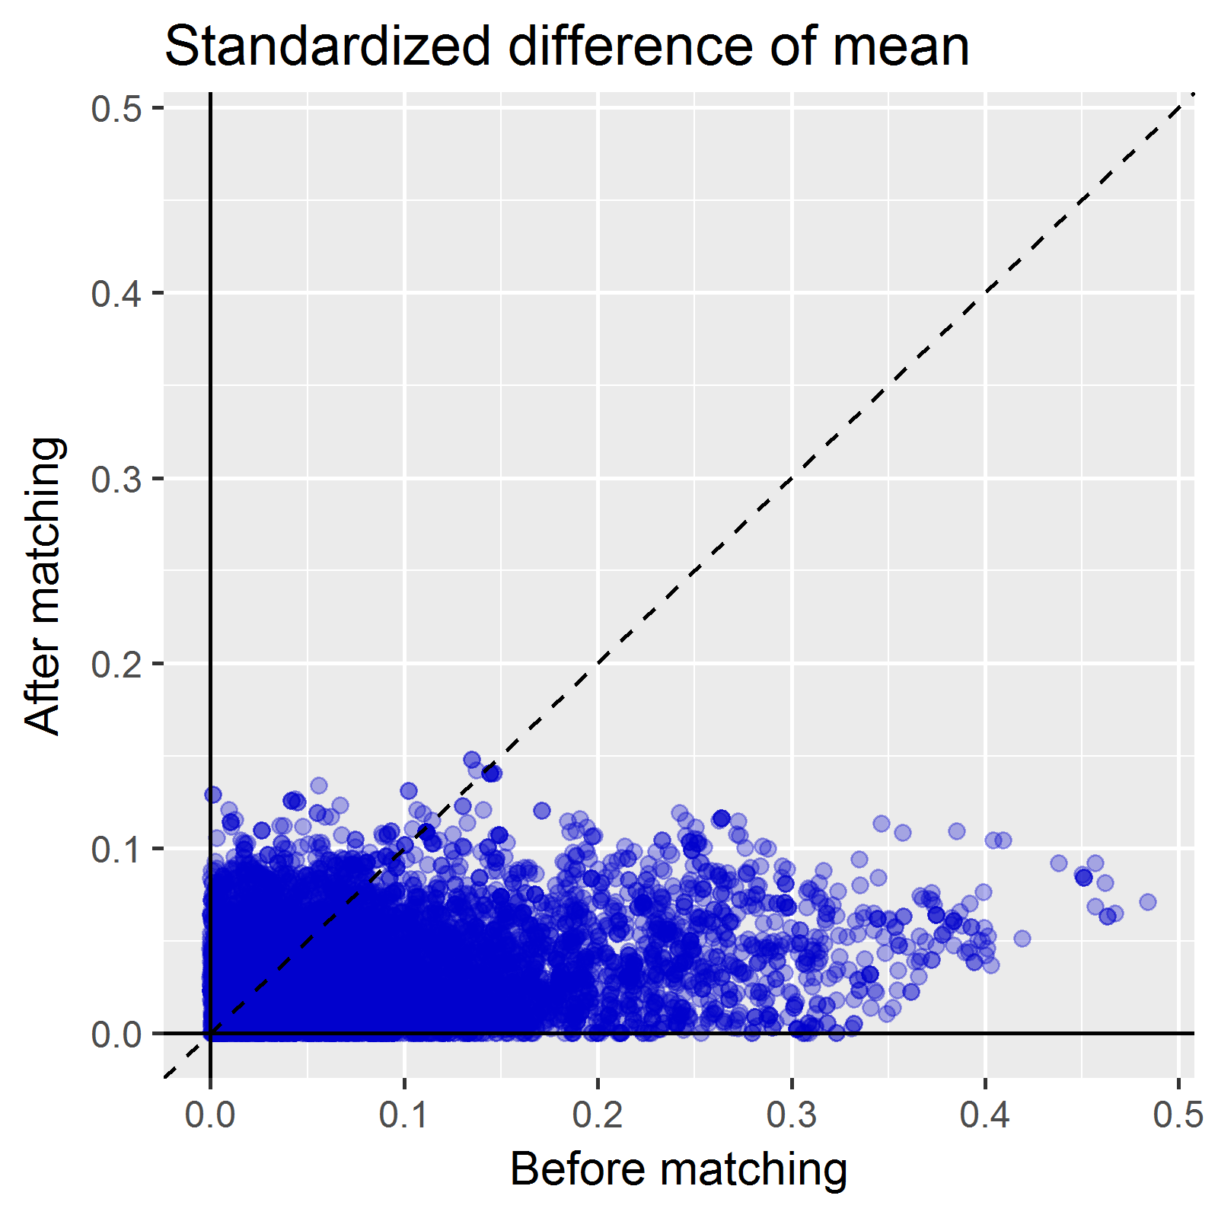
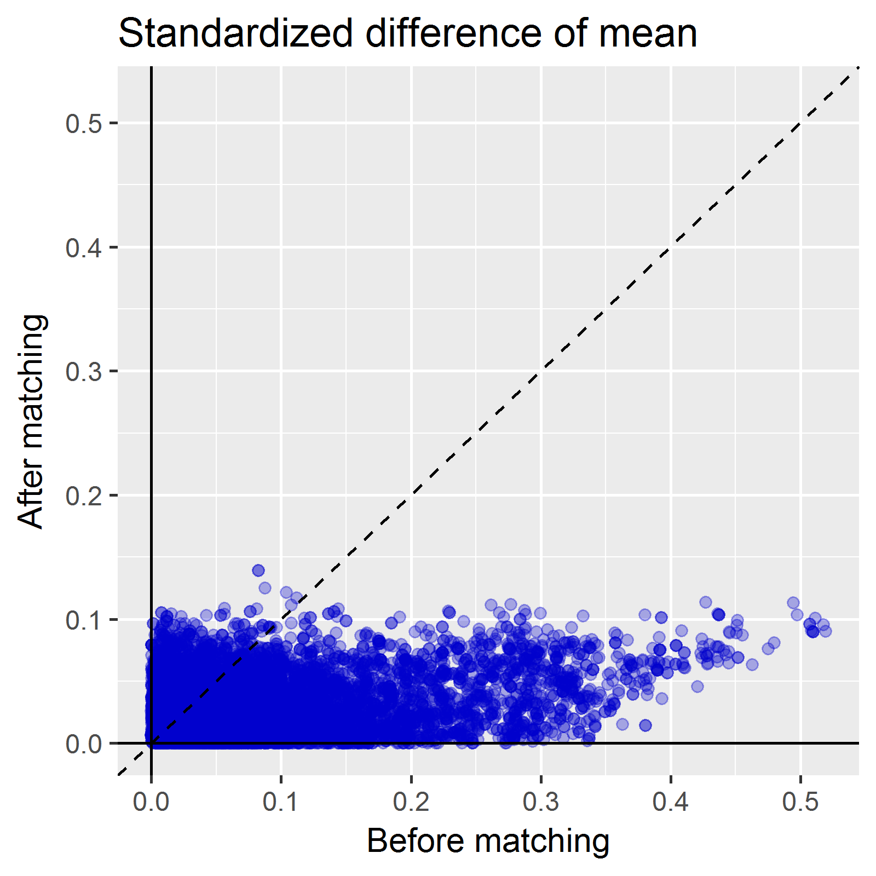
3. Define the statistical model and Compare: large scale propensity matching
AC vs AD
CD vs AC
CD vs AD
You et al., ESC Congress[Abstract], 2017
Notes:
Guertin, Jason R., Elham Rahme, Colin R. Dormuth, and Jacques LeLorier. “Head to Head Comparison of the Propensity Score and the High-Dimensional Propensity Score Matching Methods.” BMC Medical Research Methodology 16 (February 19, 2016). doi:10.1186/s12874-016-0119-1.

Slide 21
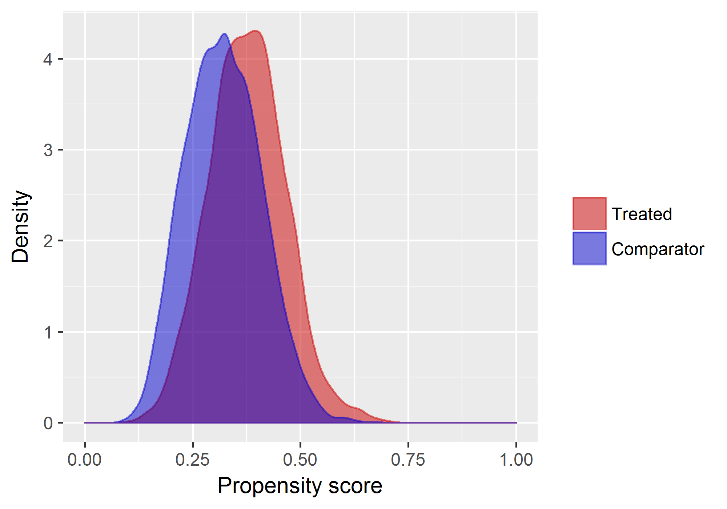
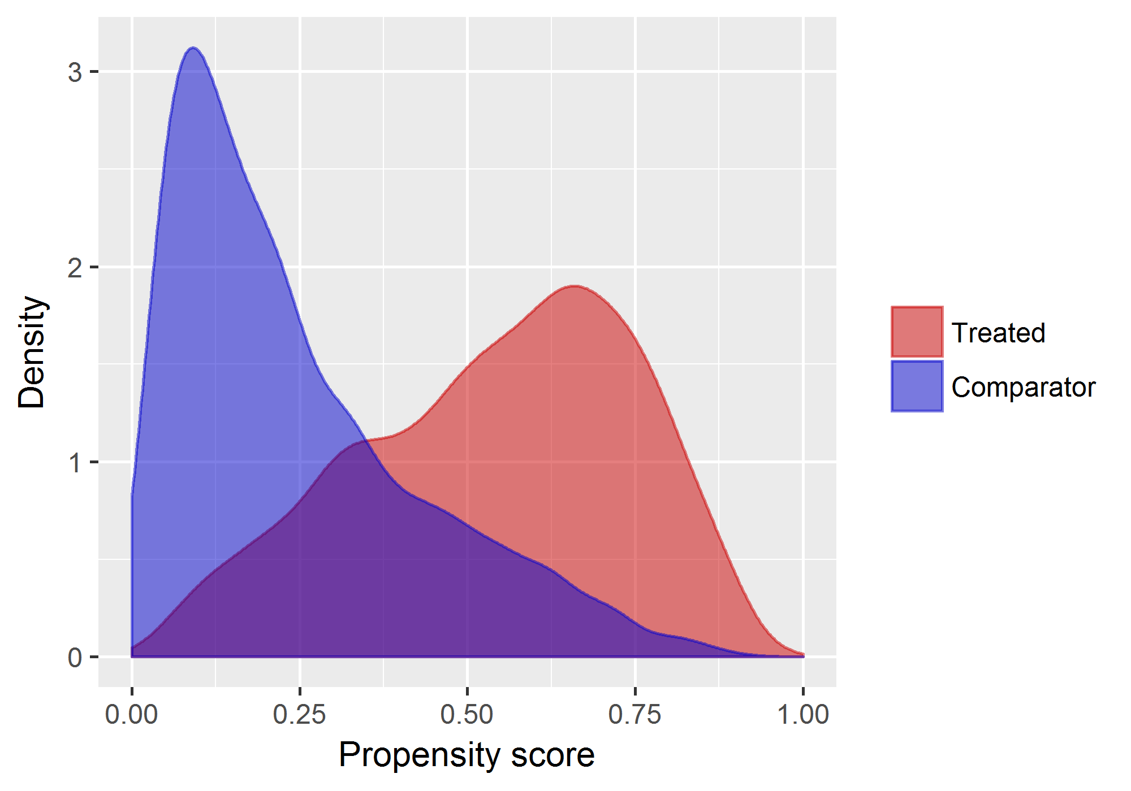
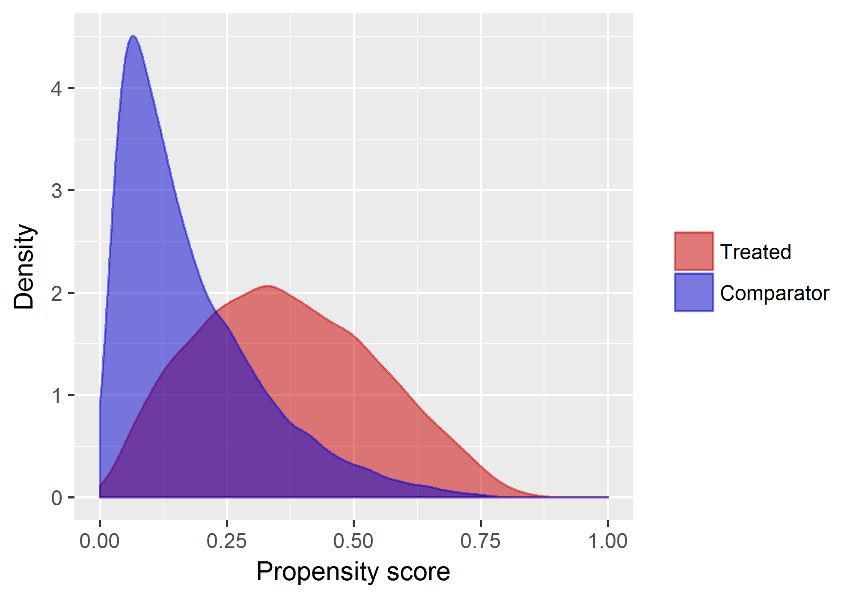
3. Define the statistical model and Compare: large scale propensity matching
AC vs AD
CD vs AC
CD vs AD
You et al., ESC Congress[Abstract], 2017
Notes:
Guertin, Jason R., Elham Rahme, Colin R. Dormuth, and Jacques LeLorier. “Head to Head Comparison of the Propensity Score and the High-Dimensional Propensity Score Matching Methods.” BMC Medical Research Methodology 16 (February 19, 2016). doi:10.1186/s12874-016-0119-1.

Slide 22
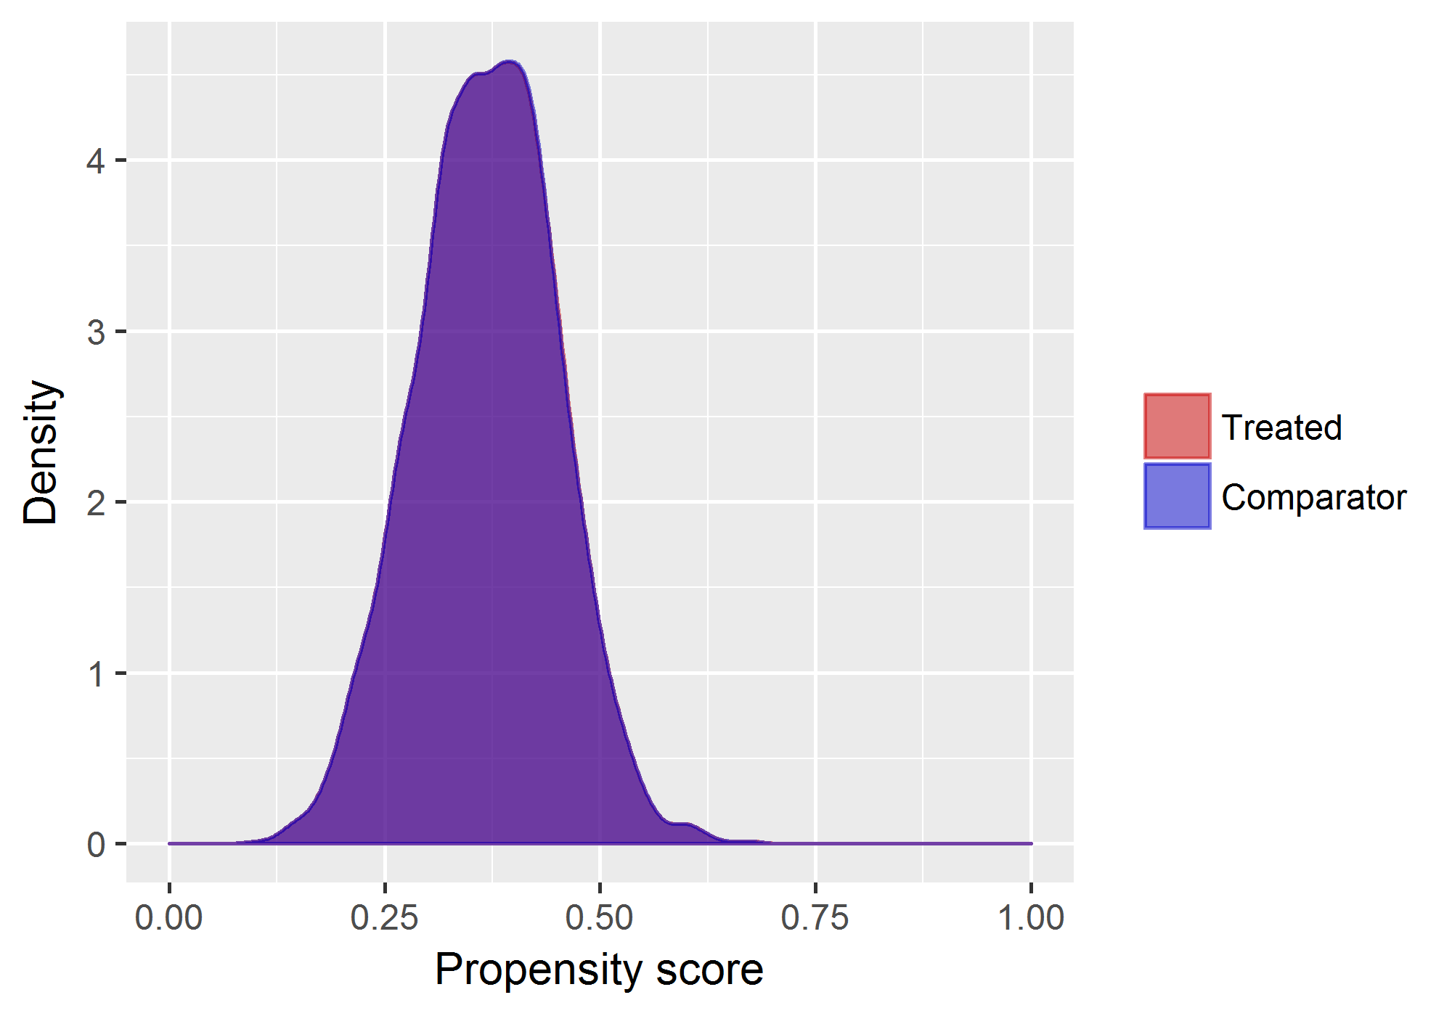
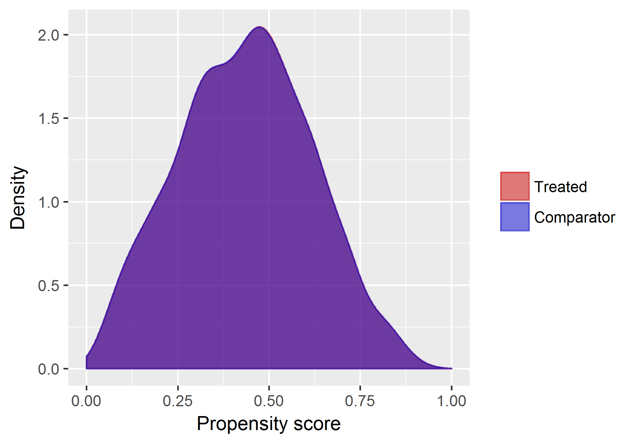
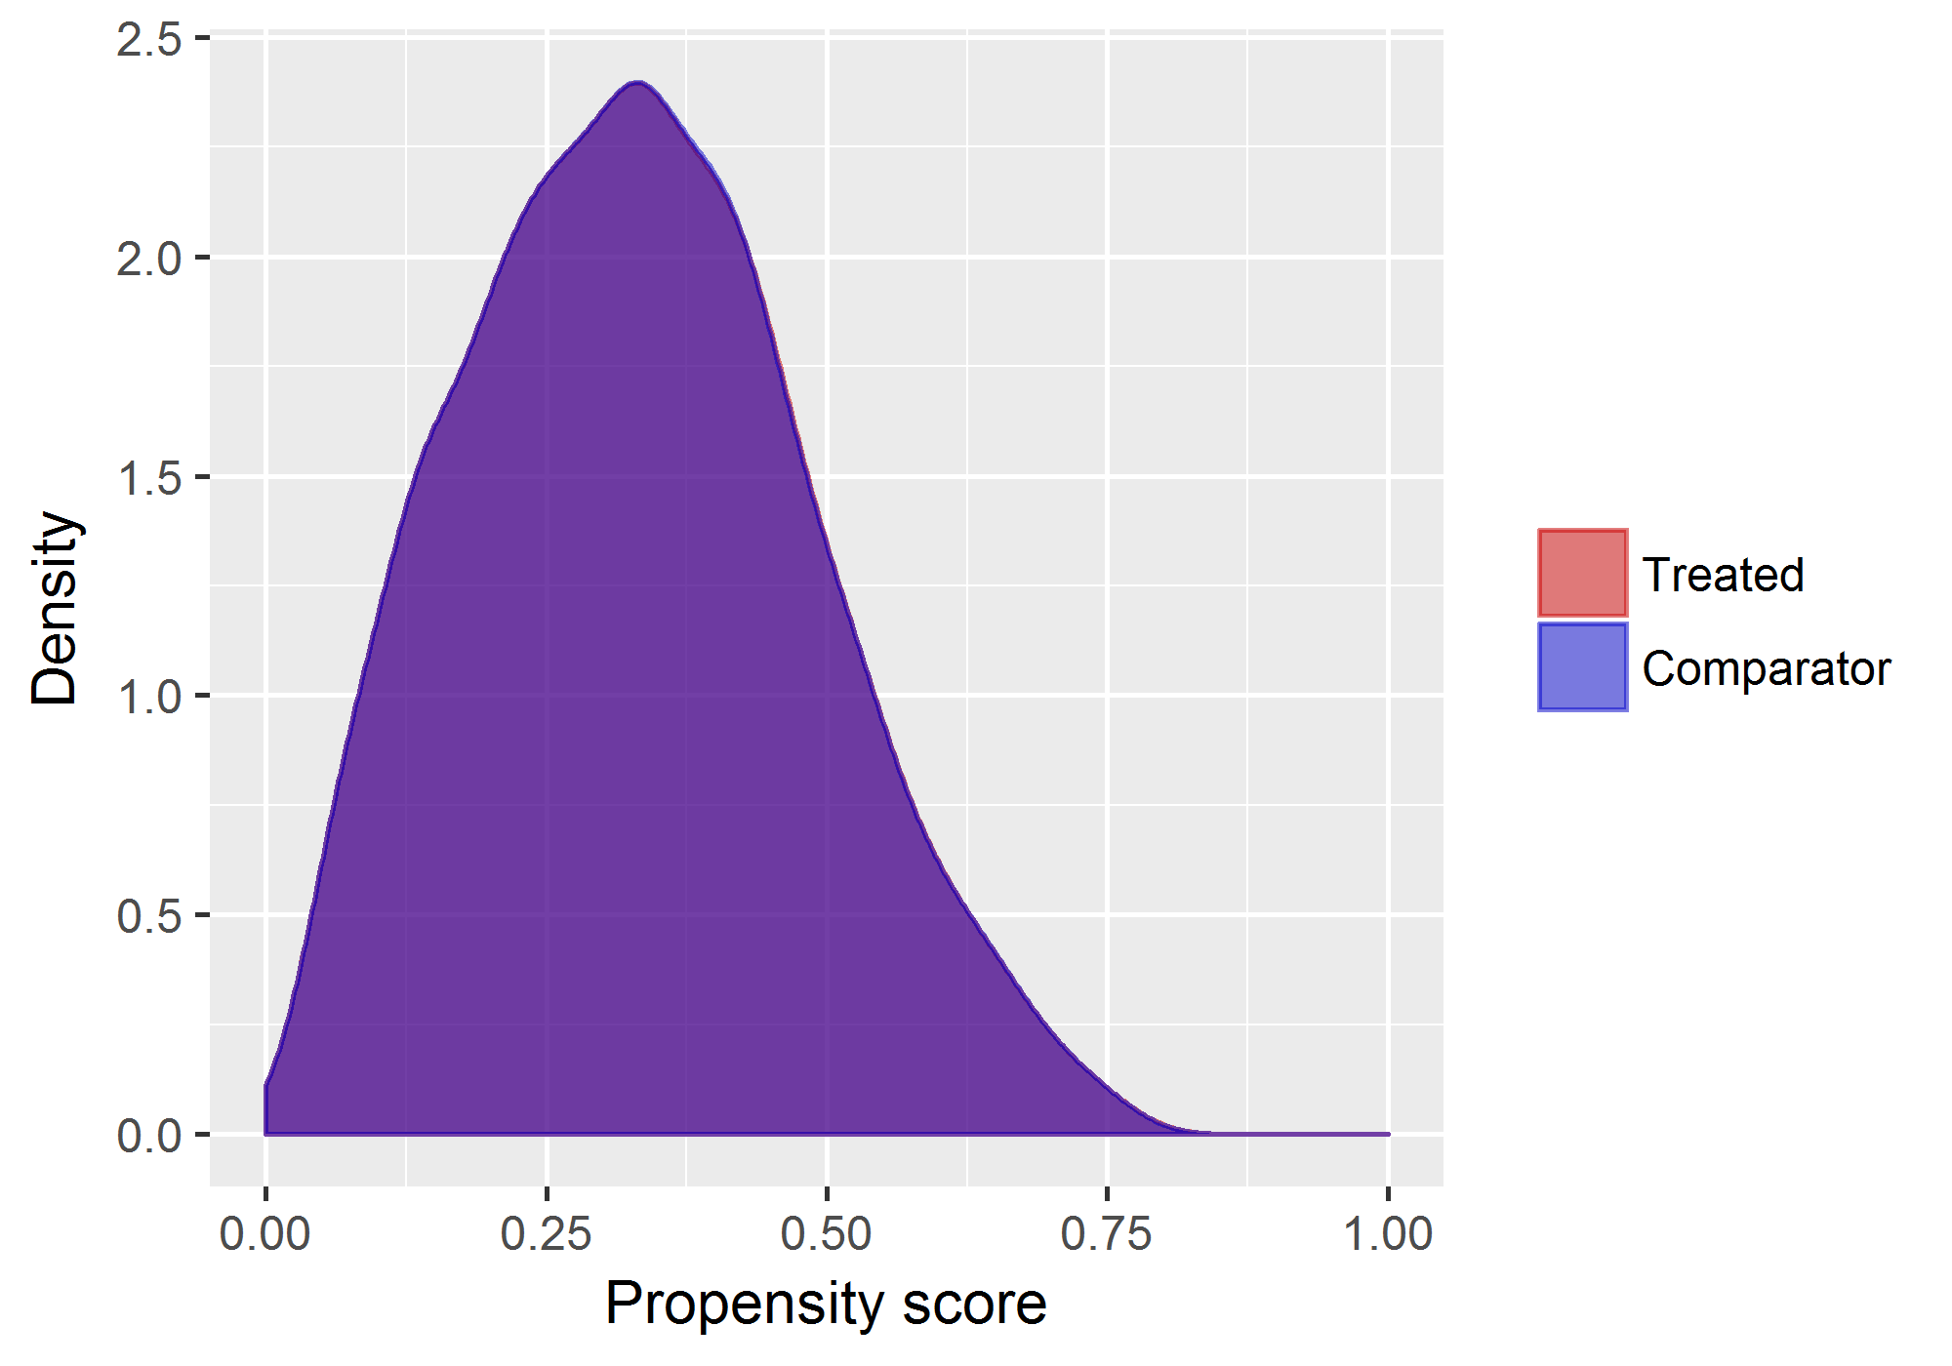
3. Define the statistical model and Compare: large scale propensity matching
AC vs AD
CD vs AC
CD vs AD
You et al., ESC Congress[Abstract], 2017
Notes:
Guertin, Jason R., Elham Rahme, Colin R. Dormuth, and Jacques LeLorier. “Head to Head Comparison of the Propensity Score and the High-Dimensional Propensity Score Matching Methods.” BMC Medical Research Methodology 16 (February 19, 2016). doi:10.1186/s12874-016-0119-1.

Slide 23
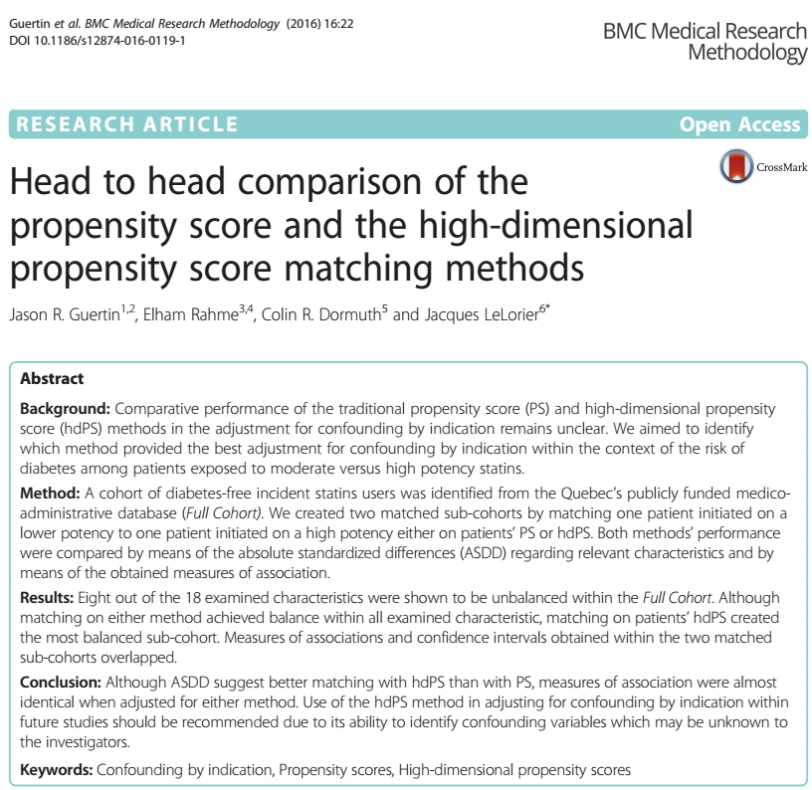
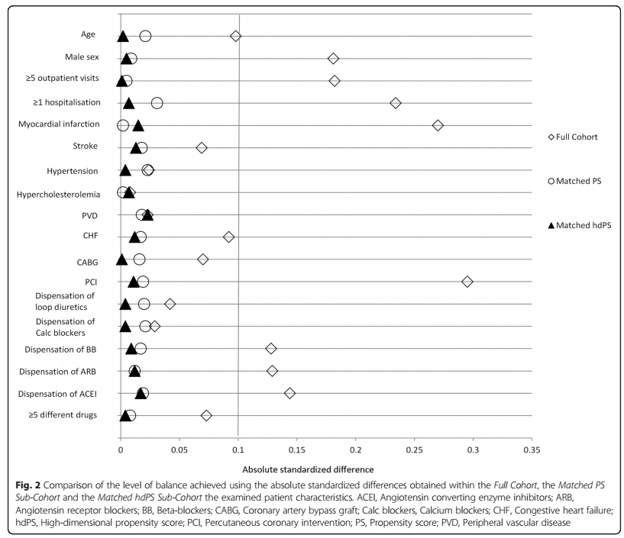
3. Define the statistical model and Compare: large scale propensity matching
Guertin et al., BMC Medical Research Methodology, 2016
Notes:
Guertin, Jason R., Elham Rahme, Colin R. Dormuth, and Jacques LeLorier. “Head to Head Comparison of the Propensity Score and the High-Dimensional Propensity Score Matching Methods.” BMC Medical Research Methodology 16 (February 19, 2016). doi:10.1186/s12874-016-0119-1.

Slide 24
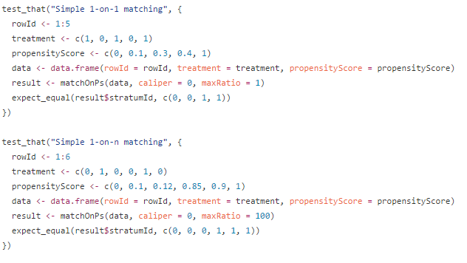
4. Validation: We can check for correctness
We can review the study code
We should make the study code publicly available as part of the paper
Large parts of the study are automatically checked using unit tests

Slide 25
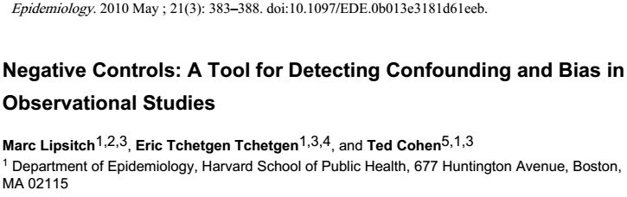
4. Validation: We can evaluate how well the study worked
Included 100 negative control outcomes
Results show little residual confounding when using propensity score matching
Lipsitch et al., Epidemiology (2010)
Notes:
Lipsitch, Marc, Eric Tchetgen Tchetgen, and Ted Cohen. “Negative Controls: A Tool for Detecting Confounding and Bias in Observational Studies.” Epidemiology (Cambridge, Mass.) 21, no. 3 (May 2010): 383–88. doi:10.1097/EDE.0b013e3181d61eeb.

Slide 26
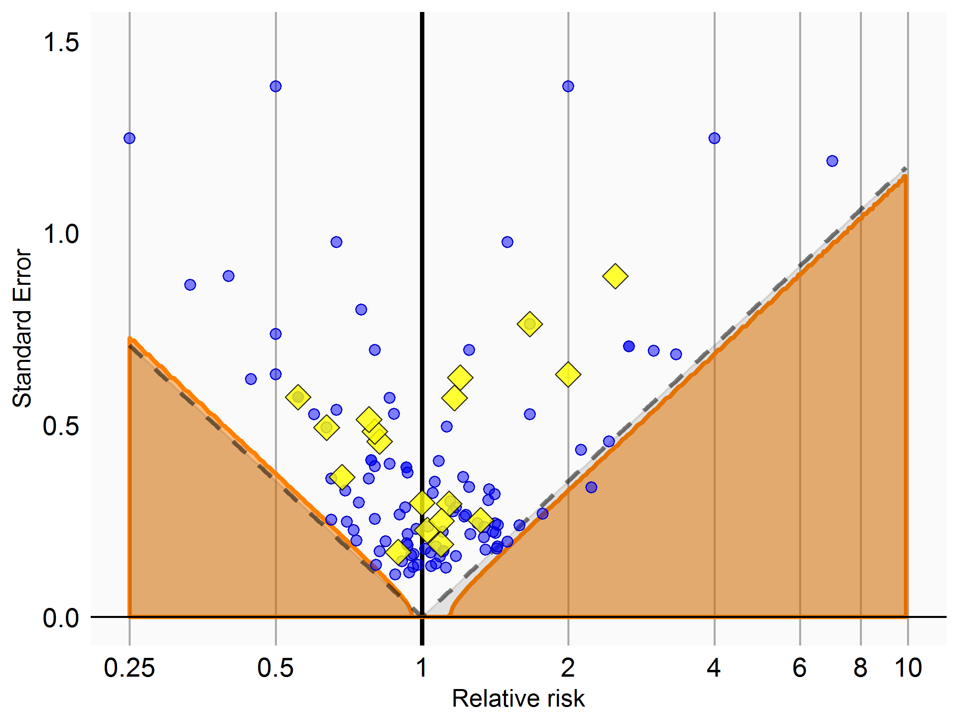
4. Validation: We can evaluate how well the study worked
You et al., ESC Congress[Abstract], 2017

Slide 27
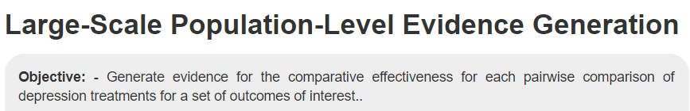
4. Validation: Validation of OHDSI statistical tool

Slide 28
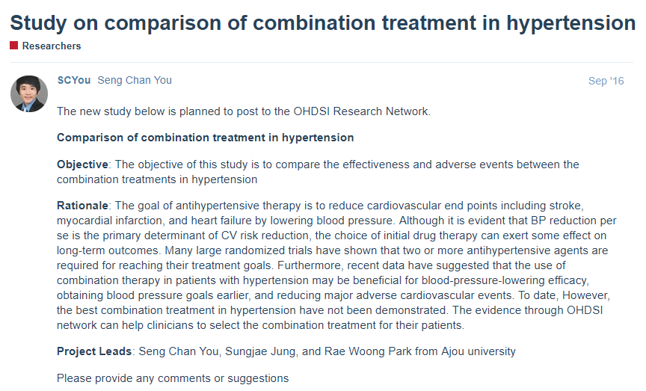
5. Recruiting data partners and Aggregating their results
Recruiting data partners
Posting on Forum

Slide 29
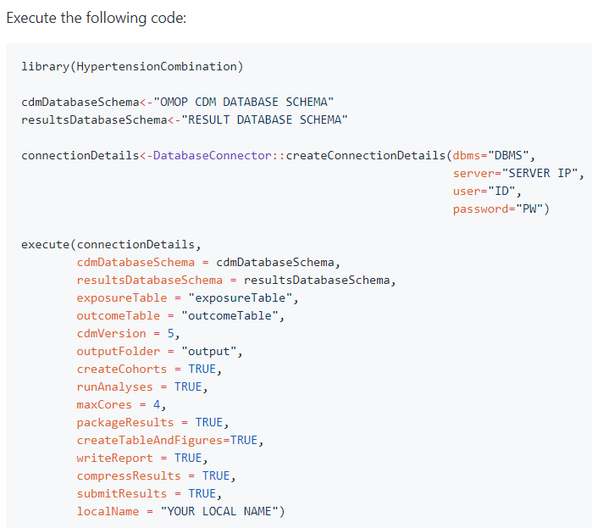
5. Recruiting data partners and Aggregating their results
Whole process of analysis was packaged as a software in R and released for reproducible research
https://github.com/OHDSI/StudyProtocolSandbox/tree/master/HypertensionCombination
Notes:
Martijn J. Schuemie, Marc A. Suchard and Patrick B. Ryan (2017). CohortMethod: New-user cohort method with large scale propensity and outcome models. R package version 2.4.3.

Slide 30
5. Recruiting data partners and Aggregating their results
Whole process of analysis was packaged as a software in R and released for reproducible research
https://github.com/OHDSI/StudyProtocolSandbox/tree/master/HypertensionCombination
The whole analytic process was prespecified before conduction
Only pre-specified aggregated results absent of patient-level information is collected for meta-analysis and interpretation
Meta-analysis: Random-effect model
Notes:
Martijn J. Schuemie, Marc A. Suchard and Patrick B. Ryan (2017). CohortMethod: New-user cohort method with large scale propensity and outcome models. R package version 2.4.3.

Slide 31
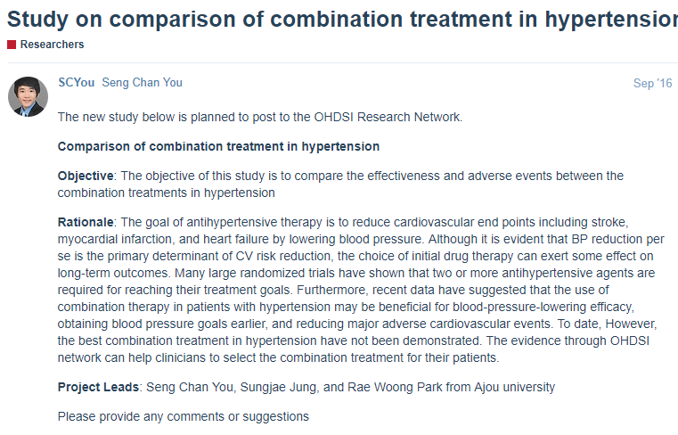
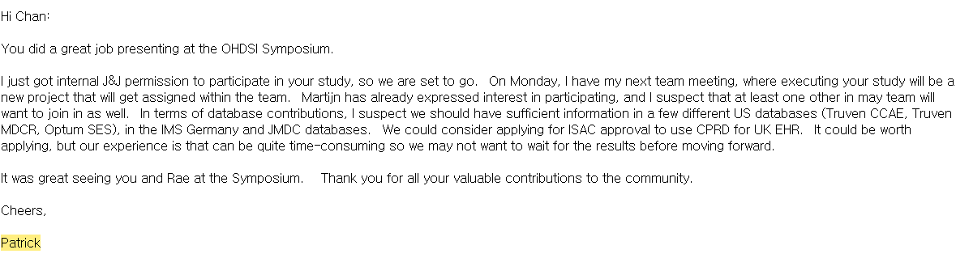

5. Recruiting data partners and Aggregating their results

Slide 32
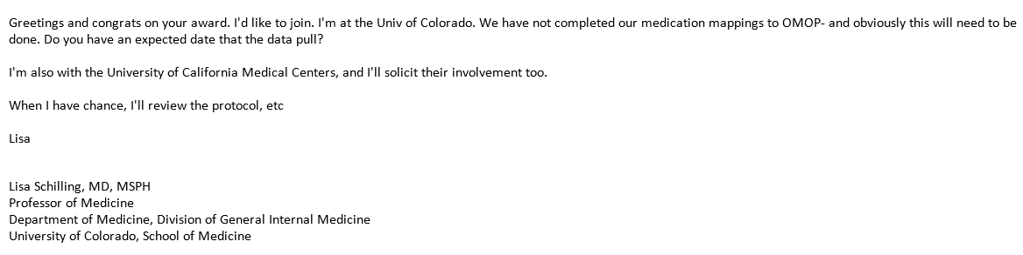
5. Recruiting data partners and Aggregating their results

Slide 33
5. Recruiting data partners and Aggregating their results
CCAE
N= 225,420
N= 28,000
N= 32,240
Optum
N= 133,788
N= 20,278
N= 12,186
Medicare
N= 68,658
N= 10,930
N= 13,278
Medicaid
N= 8,012
N= 2,010
N= 2,382
NHIS (Korea)
N= 9,494
N= 3,470
N= 4,754
HR 1.08 (0.97-1.20) P=0.127
HR 0.93 (0.87-1.01) P=0.067
HR 1.18 (0.95-1.47) P=0.104
Favor
A+C
Favor
A+D
Favor
C+D
Favor
A+C
Favor
C+D
Favor
A+D
Notes:
Duke et al. Epilepsia 2017

Slide 34
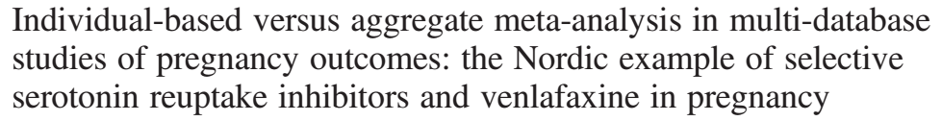
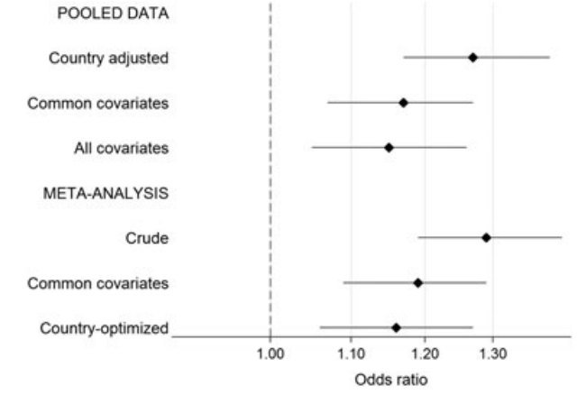
5. Recruiting data partners and Aggregating their results
Selmer et al., Pharmacoepidemiology and Drug Safety (2016)
Notes:
Selmer, Randi, Bengt Haglund, Kari Furu, Morten Andersen, Mette Nørgaard, Helga Zoëga, and Helle Kieler. “Individual-Based versus Aggregate Meta-Analysis in Multi-Database Studies of Pregnancy Outcomes: The Nordic Example of Selective Serotonin Reuptake Inhibitors and Venlafaxine in Pregnancy.” Pharmacoepidemiology and Drug Safety 25, no. 10 (October 1, 2016): 1160–69. doi:10.1002/pds.4033.

Slide 35
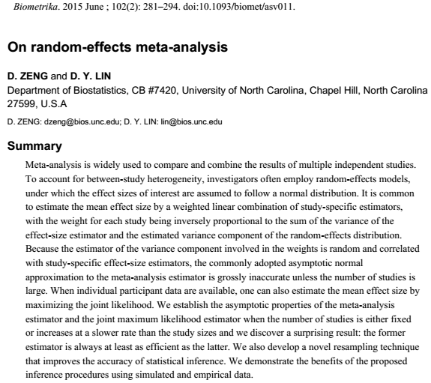
5. Recruiting data partners and Aggregating their results
Zeng and Lin. Biometrika (2015)
Notes:
Zeng and Lin. Biometrika (2015)

Slide 36
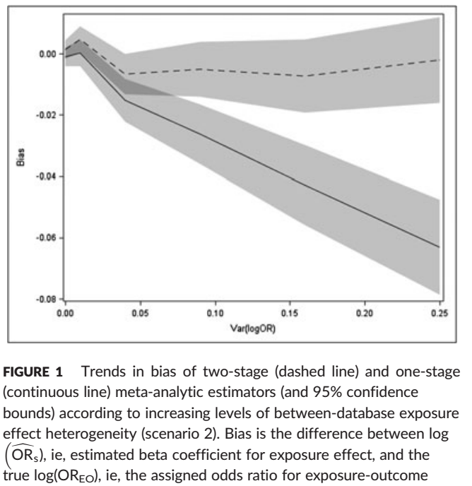
5. Recruiting data partners and Aggregating their results
When the effect of interest is heterogeneous, a one‐stage meta‐analysis ignoring clustering gives biased estimates.
Two‐stage meta‐analysis generates estimates at least as accurate and precise as one‐stage meta‐analysis.
La Gamba et al., Pharmacoepidemiology and Drug Safety (2017)
Notes:
La Gamba et al., Pharmacoepidemiology and Drug Safety (2017)
When the effect of interest is heterogeneous, a one‐stage meta‐analysis ignoring clustering gives biased estimates. Two‐stage meta‐analysis generates estimates at least as accurate and precise as one‐stage meta‐analysis. However, in a study using small databases and rare exposures and/or outcomes, a correct one‐stage meta‐analysis becomes essential

Slide 37
6. Writing: Writing the study was very efficient
Reuse of R code in CohortMethod, DatabaseConnector, SqlRender, EmpiricalCalibration, etc.
Implementation took days instead of months
Next study will be faster

Slide 38
Complexity is not a problem
Use software engineering approaches to deal with complexity:
Abstraction
Encapsulation
Writing clear code
Re-use

Slide 39
Viewing a study as a pipeline has many advantages
Full traceability
Ability to check for correctness
Ability to evaluate using controls
More efficient
Ability to deal with complexity
Ability to work with several people on one analysis
Easy to rerun on different data

Slide 40








What should OHDSI studies look like?
Database
Paper
A study should be like a pipeline
A fully automated process from database to paper
‘Performing a study’ = building the pipeline

Slide 41
Please, Join the Journey
Main homepage
www.ohdsi.org
OHDSI-KOREA Homepage
www.ohdsi-korea.org
OHDSI Community meeting: 1AM (Korean time), Wed
http://www.ohdsi.org/web/wiki/doku.php?id=projects:ohdsi_community
Workgroup meeting
Eastern hemisphere meeting: 4PM (Korean time), Wed,
Population-Level estimating workgroup: http://www.ohdsi.org/web/wiki/doku.php?id=projects:workgroups:est-methods

Slide 42
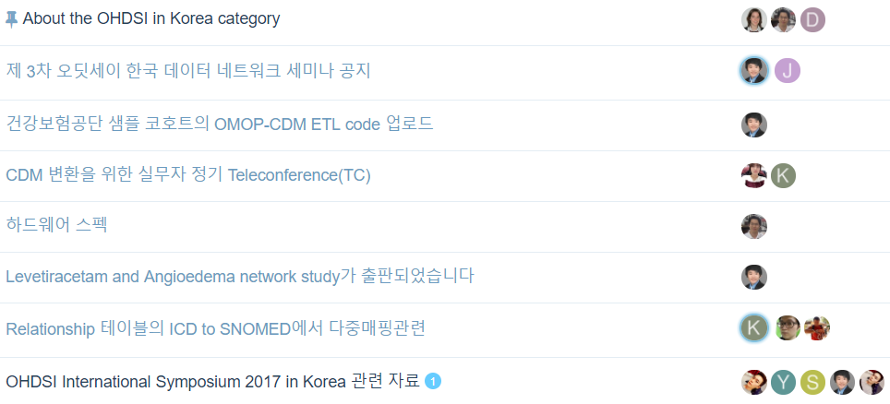
Please, Join the Journey
Forum
http://forums.ohdsi.org/
OHDSI in Korea Forum
http://forums.ohdsi.org/c/For-collaborators-wishing-to-communicate-in-Korean

Slide 43
Goal of the DataThon
행복한 가정은 모두 비슷한 이유로 행복하지만 불행한 가정은 저마다의 이유로 불행하다 (Все счастливые семьи похожи друг на друга, каждая несчастливая семья несчастлива по-своему)
구동이 되는 패키지는 모두 비슷한 이유로 작동하지만, 에러가 나는 패키지는 모두 저마다의 문제가 있다.
➔구동이 되는 PLE or PLP package를 완성하고, 결과를 발표, GitHub Upload
https://github.com/ohdsi-korea/OhdsiDataThonKorea2019

Slide 44
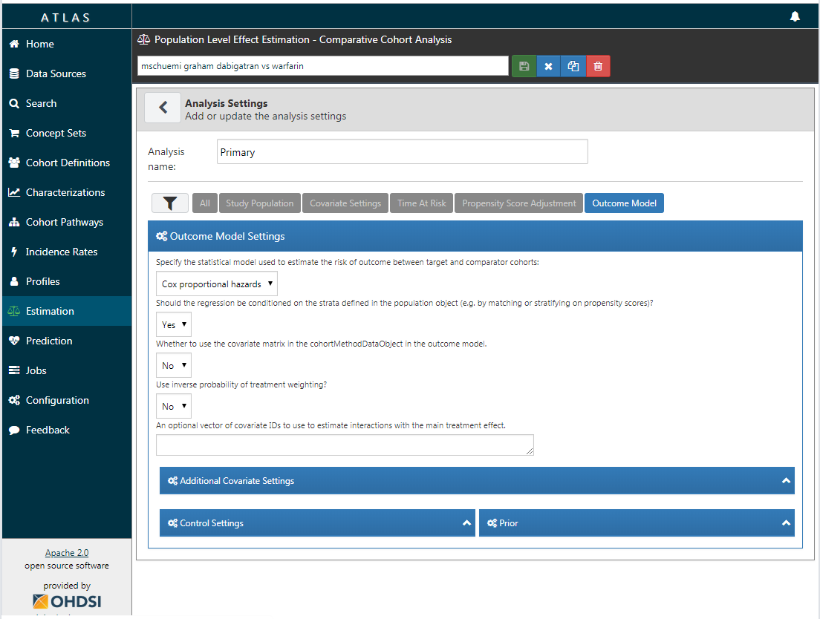
Graham et al. replication: specifying the outcome model

Slide 45
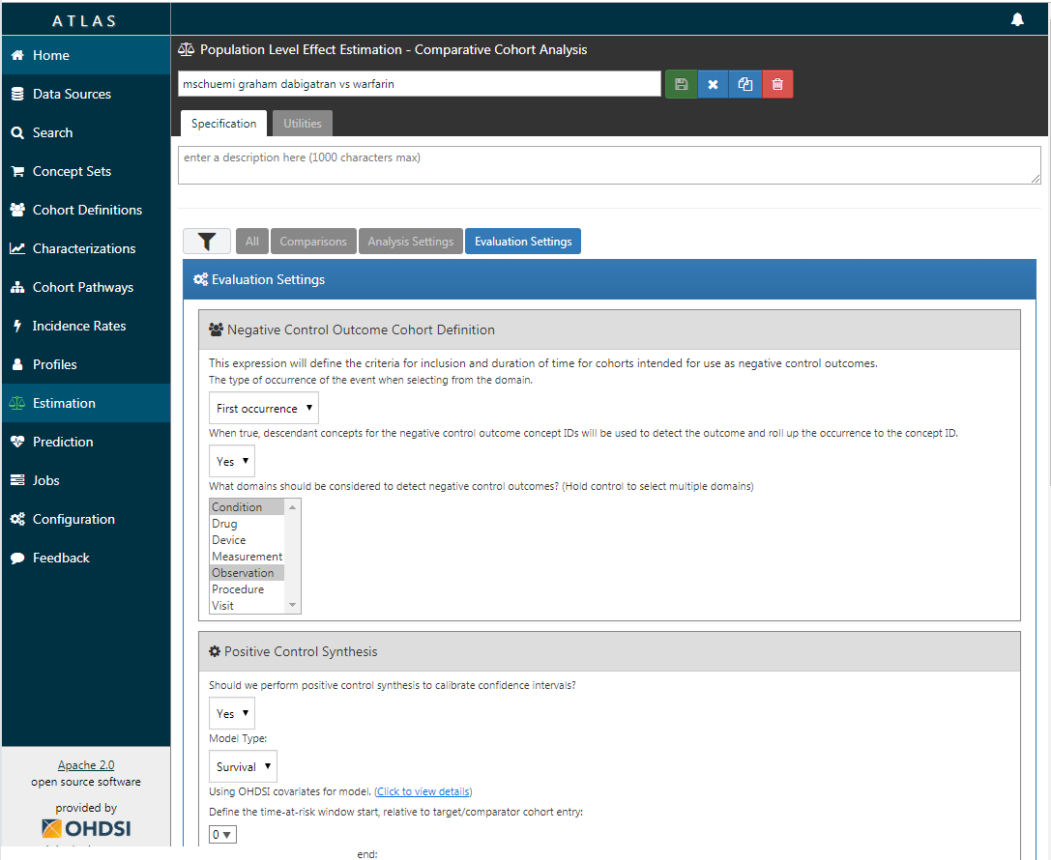
Graham et al. replication: specifying the evaluation settings

Slide 46
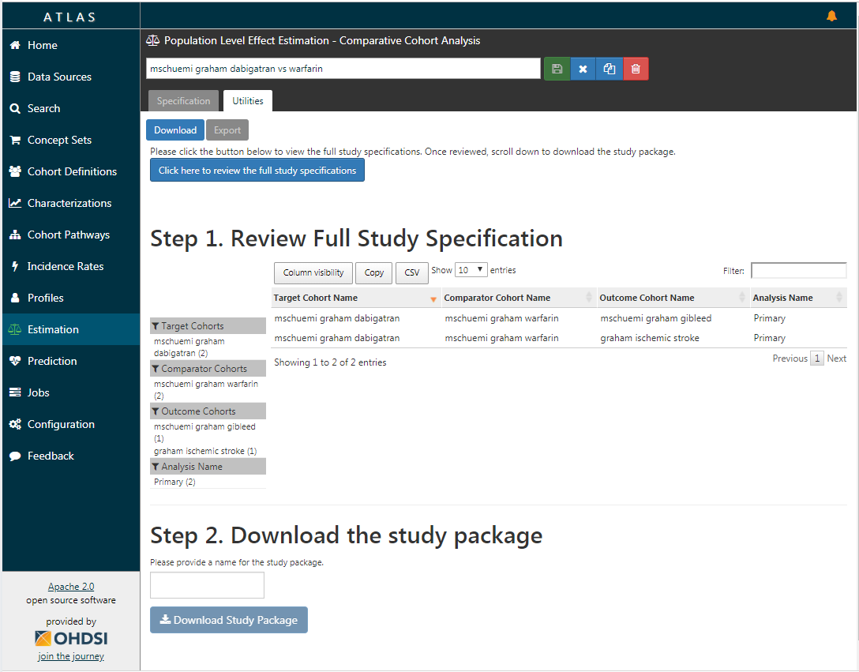
Graham et al. replication: exporting the study package for execution

Slide 47
Anatomy of the study package
Execution code
Cohorts
Main execution code
JSON definitions
SQL definitions
Negative controls
Negative control concepts
SQL template
Positive controls
Shiny app to view results
Positive control settings
Analysis settings
Target-comparator-outcomes
Analysis definitions

Slide 48
Anatomy of the study package
Execution code
Cohorts
inst/cohorts
inst/sql
R
Main execution code
JSON definitions
SQL definitions
Negative controls
inst/settings
inst/sql
Negative control concepts
SQL template
Positive controls
inst/shiny
inst/settings
Shiny app to view results
Positive control settings
Analysis settings
inst/settings
inst/settings
Target-comparator-outcomes
Analysis definitions

Slide 49
How to install?
Build and run in R-Studio
Open package
Own machine: unzip, double-click .Rproj file
R-Studio Server: upload zip, click .Rproj file
Install dependencies (see readme)
‘Build’ → ‘Install and Restart’
Build from GitHub
Unzip and put in GitHub repo
Install dependencies (see readme)
Install with devtools::install_github

Slide 50
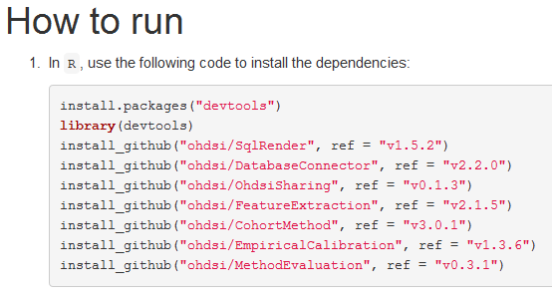
Installing dependencies
Source: readme.md

Slide 51
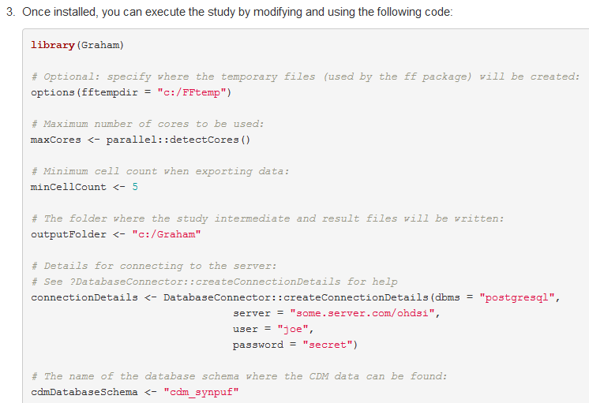
Running package
Source: readme.md

Slide 52
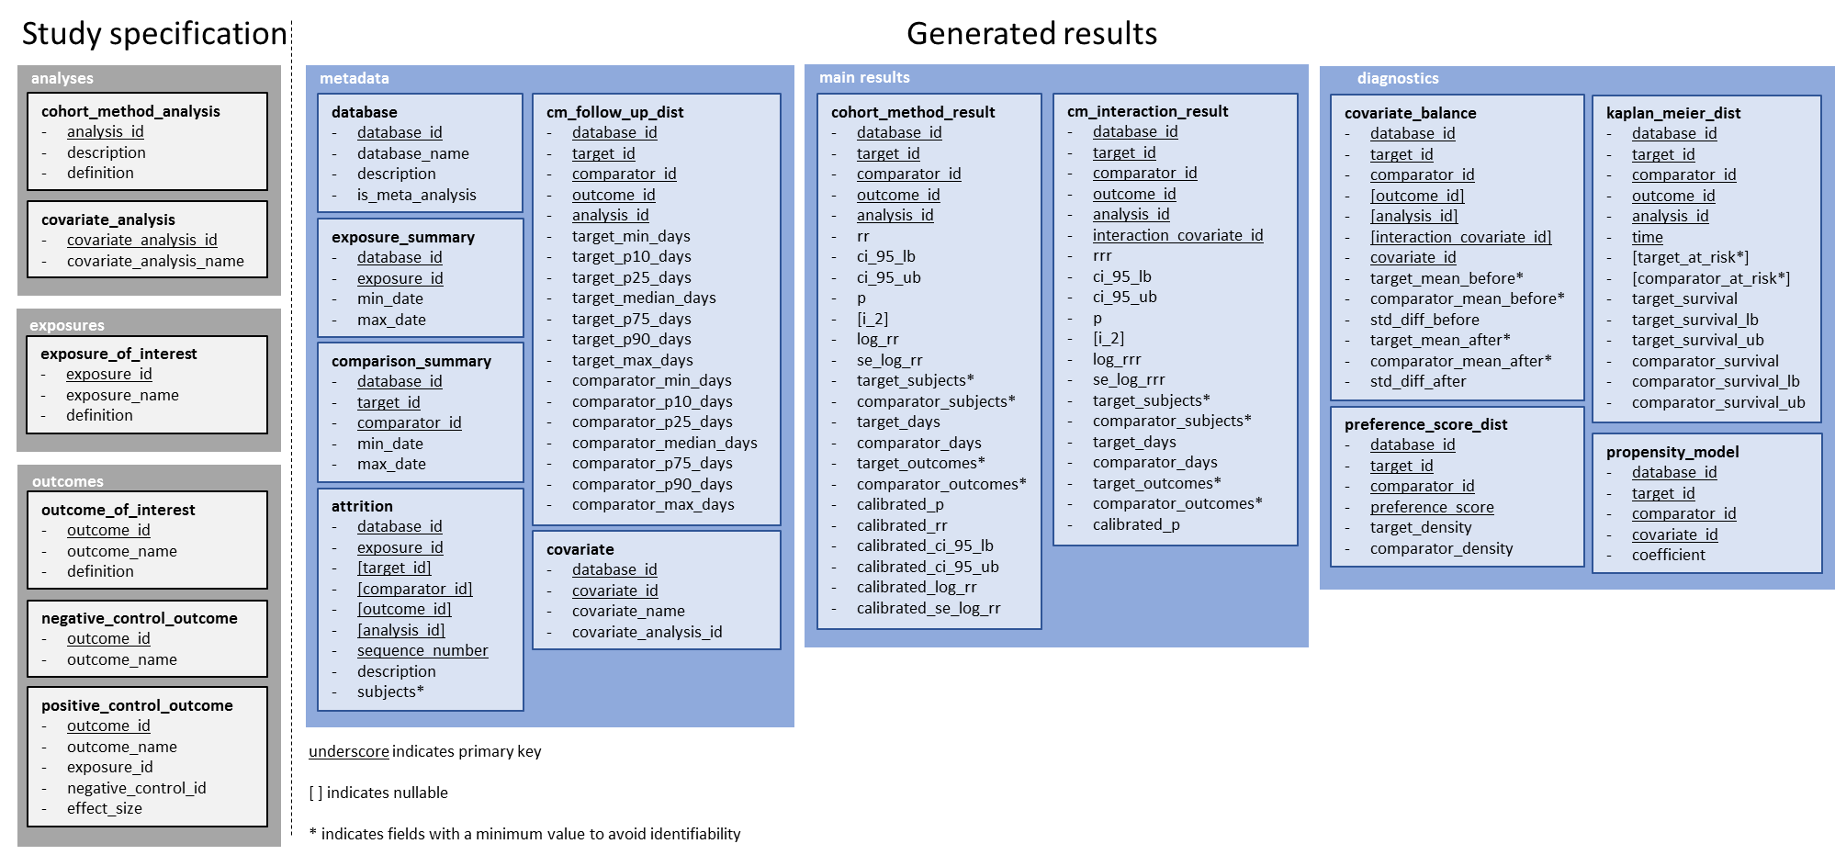
Export data model
Can be shared:
Aggregated, so no patient-level data
Minimum cell count enforced
Saved as CSV, so easily reviewable
Zipped for convenience
See vignette at https://github.com/ohdsi/SkeletonComparativeEffectStudy for details

Slide 53
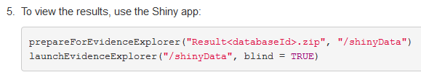
Launching the Shiny app
Source: readme.md

Slide 54
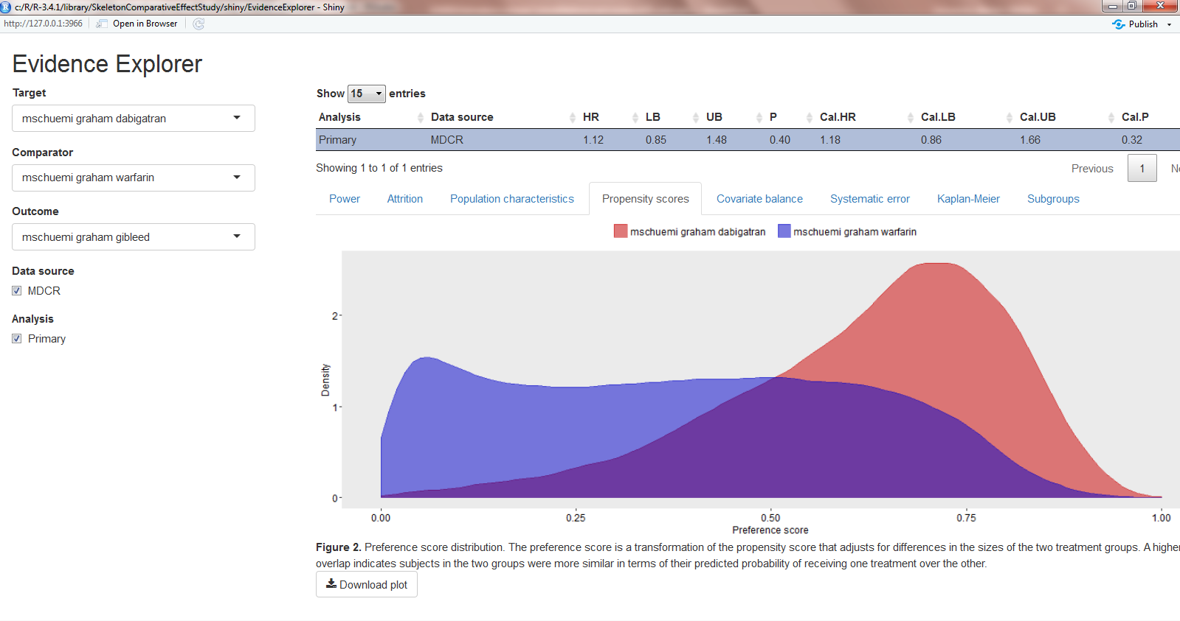
Evidence Explorer

Slide 55
Concluding remarks
CohortMethod package + R offer large flexibility
80% of studies are ‘cookie-cutter’ design, supported by ATLAS
For remaining 20%, will need to modify code generated by ATLAS

Slide 56


