Slide 1
Threats to the validity of study results and best practice
14 December 2019
Korea
Martijn Schumie PhD
Janssen Research and Development

Slide 2
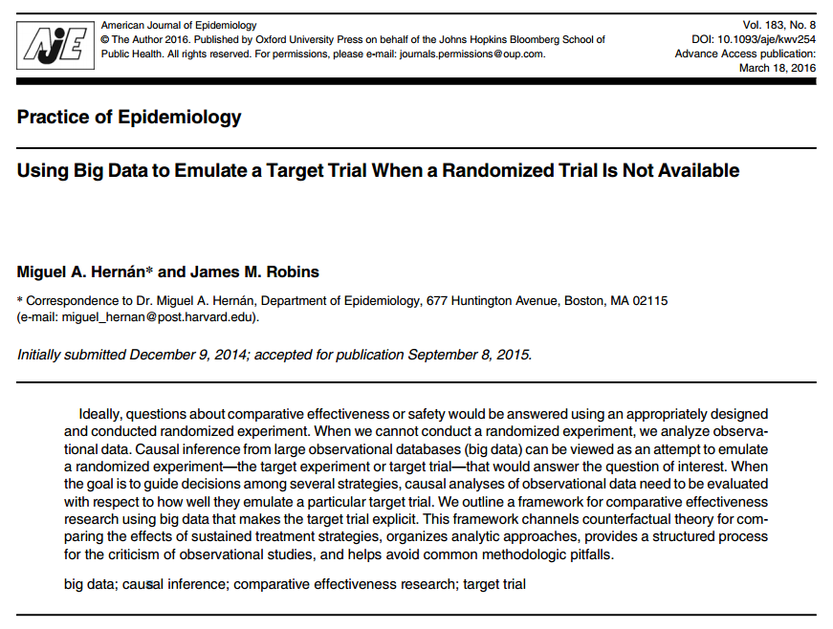
Design an observational study like you would a randomized trial
Protocol components to emulate:
Eligibility criteria
Treatment strategies
Assignment procedures
Follow-up period
Outcome
Causal contrasts of interest
Analysis plan

Slide 3
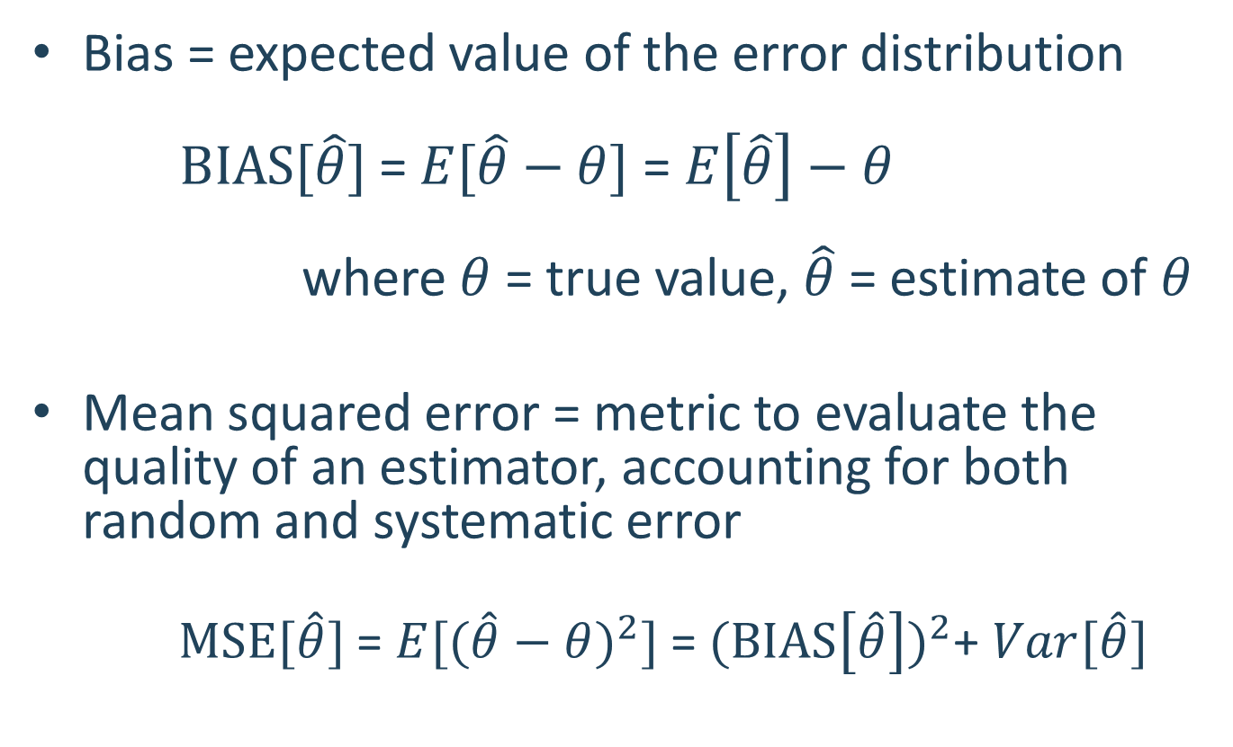
Bias = expected value of the error distribution $BIAS[\hat{θ}]$= $E[\hat{θ}−θ]$ = $E\left[\hat{θ}\right]−θ$ where $θ$ = true value, $\hat{θ}$ = estimate of $θ$
Mean squared error = metric to evaluate the quality of an estimator, accounting for both random and systematic error
$MSE[\hat{θ}]$= $E[{(\hat{θ}−θ)}^{2}]$ = ${(BIAS\left[\hat{θ}\right])}^{2}$+ $Var[\hat{θ}]$
As studies increase in sample size, random error converges to 0 but systematic error still persists!

Slide 4
Types of systematic error
Confounding
Misclassification (Measurement error)
Selection bias (generalizability)

Slide 5
Confounding
C
A
Effect of interest
RR=???
Y
U
Challenge:
Producing an ‘unconfounded’ estimate relies on (empirically untestable) assumption that 1) all confounders were observable, and properly modeled in the design or analysis, and
2) no unobserved factors are associated with both exposure and outcome
A=exposure
Y=outcome
C = observed and modeled confounder
U = unobserved or mismodeled confounder

Slide 6
How do you assess confounding?
PS distribution
Covariate balance

Slide 7
Misclassification (measurement error)
C
A
Effect of interest
RR=???
Y
U
A*
Estimate we observe
Y*
A*=proxy for exposure
Y*=proxy for outcome
C*
C* = proxy for observed confounder
Challenge:
All observations are imperfect proxies for true patient status. Misclassification error can exist for all exposures, outcomes and covariates, but is generally unknown or not properly estimated (via sensitivity and specificity), and is rarely formally integrated into effect estimation.
A=exposure
Y=outcome
C = observed and modeled confounder
U = unobserved or mismodeled confounder

Slide 8
How do you assess measurement error?
Covariate summary for exposures
Operating characteristics for outcome phenotype
Sensitivity
Specificity
Positive predictive value

Slide 9
Selection bias and generalizability
C
A
Effect of interest
RR=???
Y
U
A#
Estimate we observe
Challenge:
A database is a non-random sample of an underlying population. A cohort is a non-random sample of the database. Study design and analysis decisions may further restrict the cohort composition. Selection bias is rarely evaluated and often empirically untestable.
A#=non-random sample of exposure
A=exposure
Y=outcome
C = observed and modeled confounder
U = unobserved or mismodeled confounder

Slide 10
How do you assess selection bias?
Attrition table
Covariate summary (compare before to after)

Slide 11
What can we do to address these challenges?
Think really hard during study design and hope we get it right
Equivocate in our summary of findings with a paragraph in the Discussion that reads:
“This study has several limitations. First, since this study relied on claims data, we had no data on <unobserved confounders>. Second, while we adjusted for <observed confounders>, residual confounding cannot be ruled out. Third, there is a potential for outcome misclassification… Fourth, there is a potential for duplicate person-years between <databases>. Lastly, as the mean follow-up was <short>, long-term effects may need to be further examined.” (Kim et al., Arthritis & Rheumatology, 2017)

Slide 12
What can we do to address these challenges?
Think really hard during study design and hope we get it right
Equivocate in our summary of findings with a paragraph in the Discussion that reads:
“This study has several limitations. First, since this study relied on claims data, we had no data on <unobserved confounders>. Second, while we adjusted for <observed confounders>, residual confounding cannot be ruled out. Third, there is a potential for outcome misclassification… Fourth, there is a potential for duplicate person-years between <databases>. Lastly, as the mean follow-up was <short>, long-term effects may need to be further examined.” (Kim et al., Arthritis & Rheumatology, 2017)
Perform diagnostic analyses that attempt to detect if residual error may still be present
Quantify magnitude of residual error and calibrate statistics

Slide 13
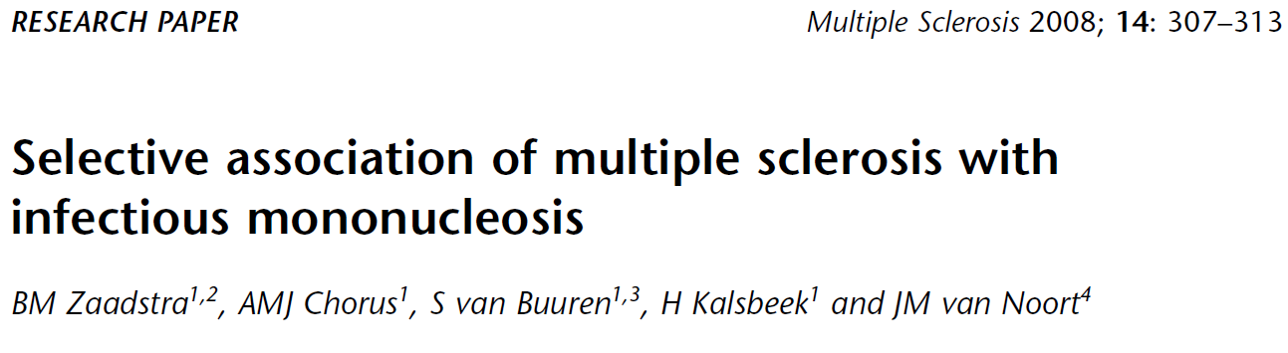
Examples of negative controls
Infectious
mononucleosis
?
Multiple sclerosis
Rubella
?
Measles
?

Slide 14
Example of a negative control
Odds ratio:
Infectious
mononucleosis
2.22 *
Multiple sclerosis
Rubella
1.31 *
Measles
1.42 *
* P < .05

Slide 15
Example of a negative control
Odds ratio:
Infectious
mononucleosis
2.22 *
Multiple sclerosis
Rubella
1.31 *
Measles
1.42 *
Negative controls:
A broken arm
1.10
Concussion
1.23 *
Tonsillectomy
1.25 *
* P < .05

Slide 16
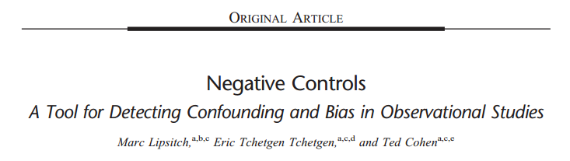
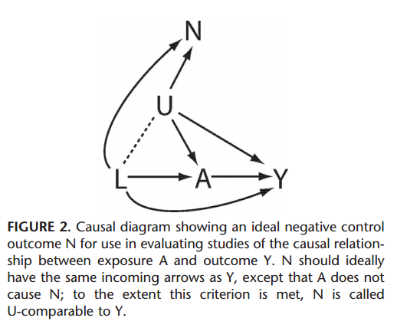
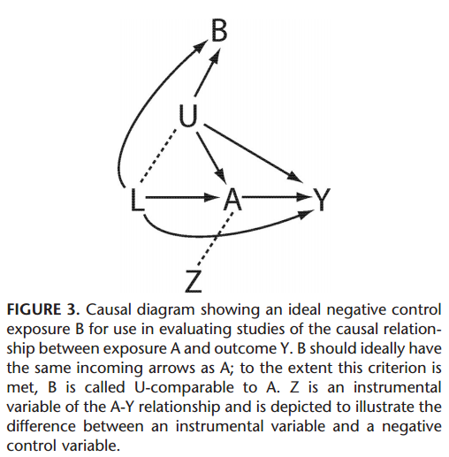
Key points:
2 types of negative controls:
Exposure controls
Outcome controls
“In principle, the measured confounders L of the A-Y relationship need not be causes of N as well, because a properly specified model that accounted for the confounding by L of A-Y would not be misled if such confounding were absent for A-N.”
“In practice, the ideal negative control outcome should be one with incoming arrows as similar as possible to those of Y, including arrows from L”
“In observational settings, the comparability between exposure A and negative control exposure B will be only approximate”
“Subject matter knowledge is required for the choice of negative controls”

Slide 17
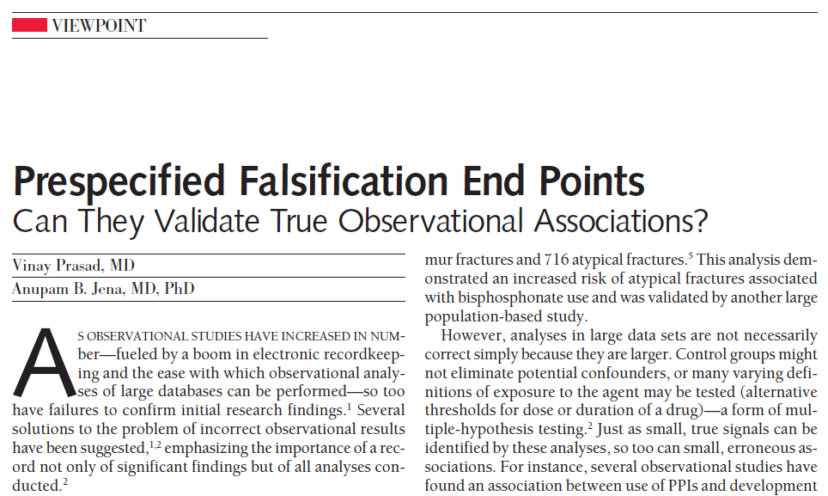


Key points:
“A falsification hypothesis is a claim, distinct from the one being tested, that researchers believe is highly unlikely to be causally related to the intervention in question.”
“Falsification analysis can be operationalized by asking investigators to specify implausible hypotheses up front and then testing those claims using statistical methods similar to those used in the primary analysis.”
“Although no published recommendations exist, standardized falsification analyses with 3 or 4 prespecified or highly prevalent disease outcomes may help strengthen the validity of observational studies”

Slide 18
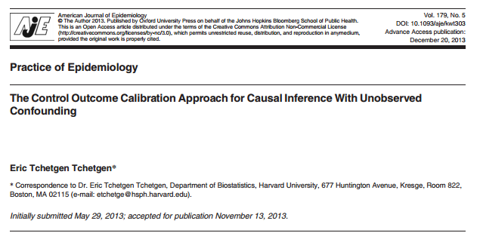
Key points:
“The extent to which an analysis may reveal unobserved confounding bias relies on the non-empirically verifiable assumption that the negative control outcome is carefully chosen so that it is solely influenced by observed and unobserved confounders of the exposure-outcome relationship in view”
“We propose to use a negative control outcome not only to detect, but also to correct for unmeasured confounding bias”

Slide 19
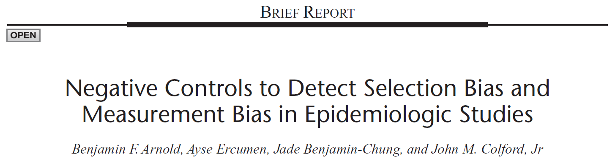

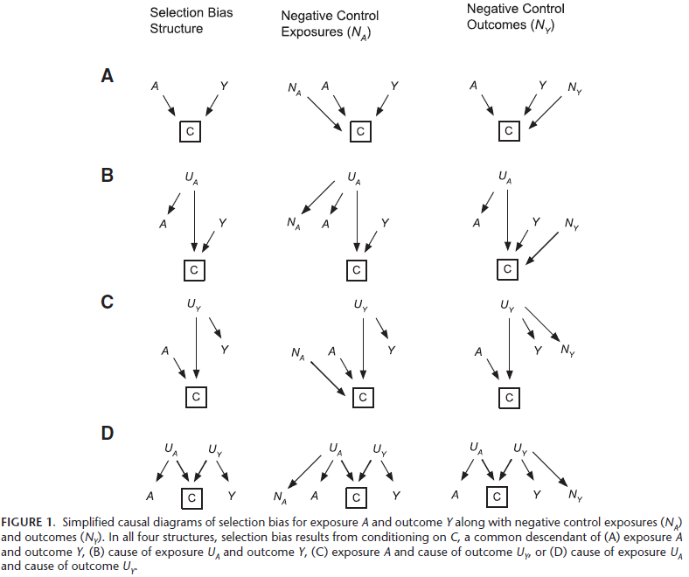
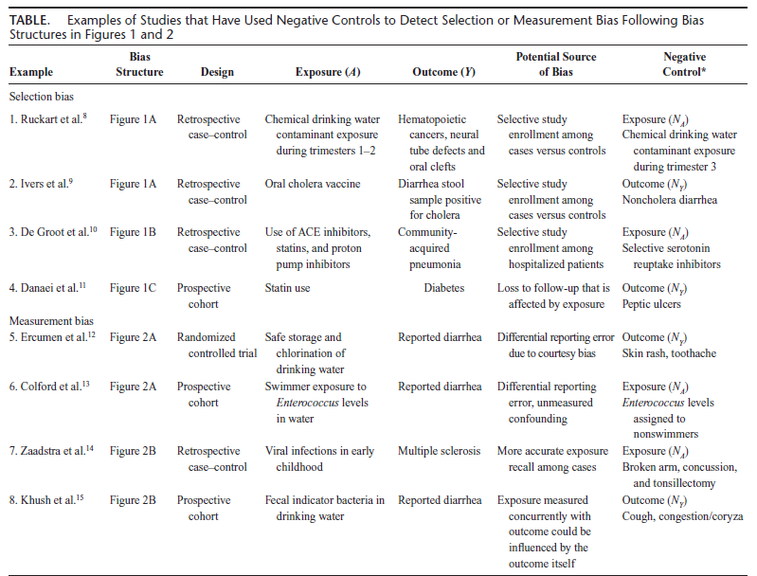
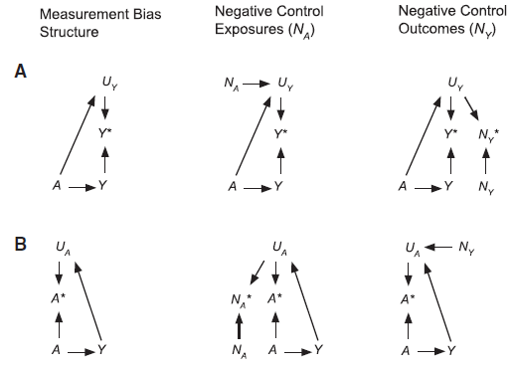
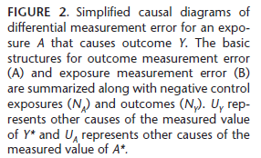
Key points:
Negative controls demonstrated to detect 3 primary sources of systematic error:
Confounding
Selection bias
Measurement bias
Negative controls shown to have utility across many different study types: observational vs. RCT; prospective vs. retrospective; case control vs. cohort
“The ability of a negative control to adequately detect bias ultimately relies on the plausibility of (often untestable) assumptions encoded in its causal diagram”

Slide 20
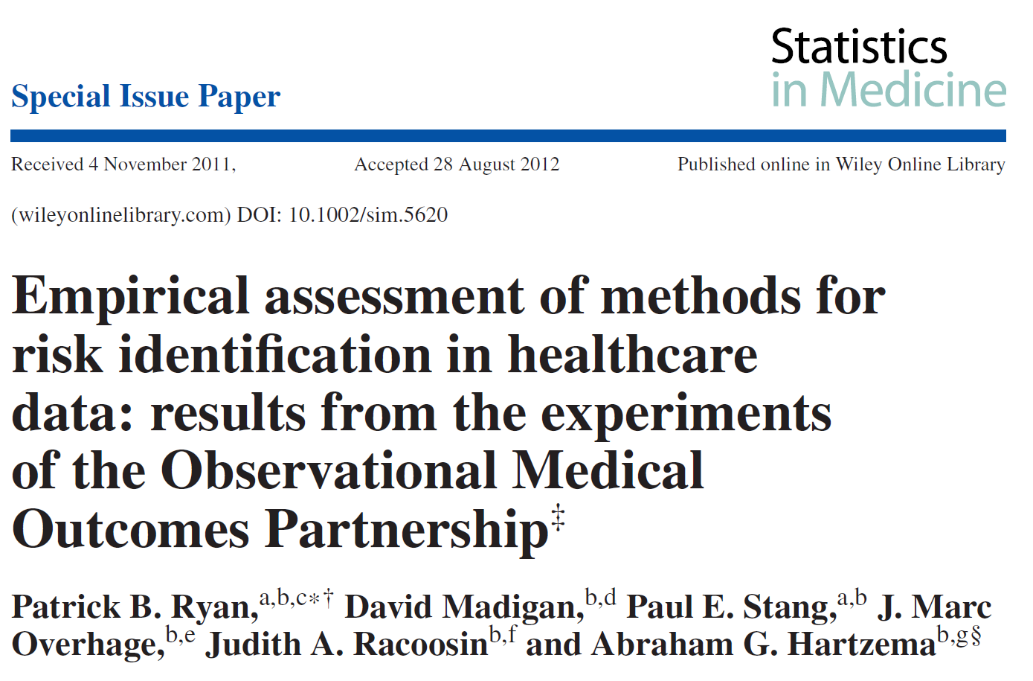
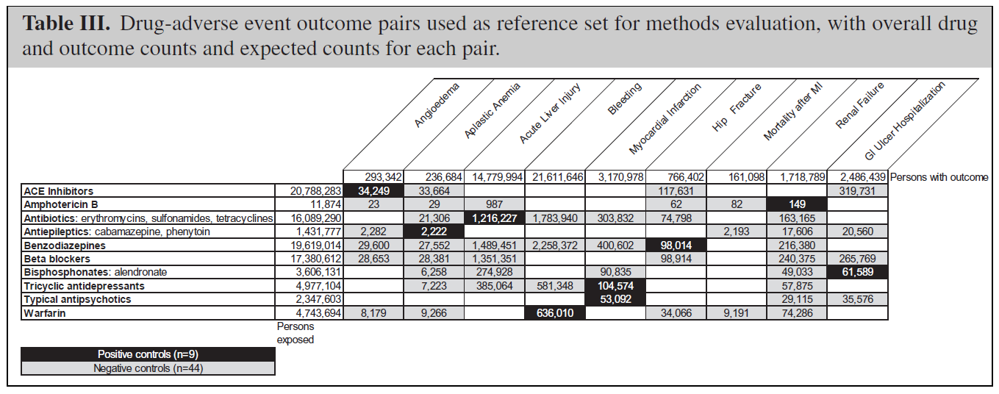

Slide 21
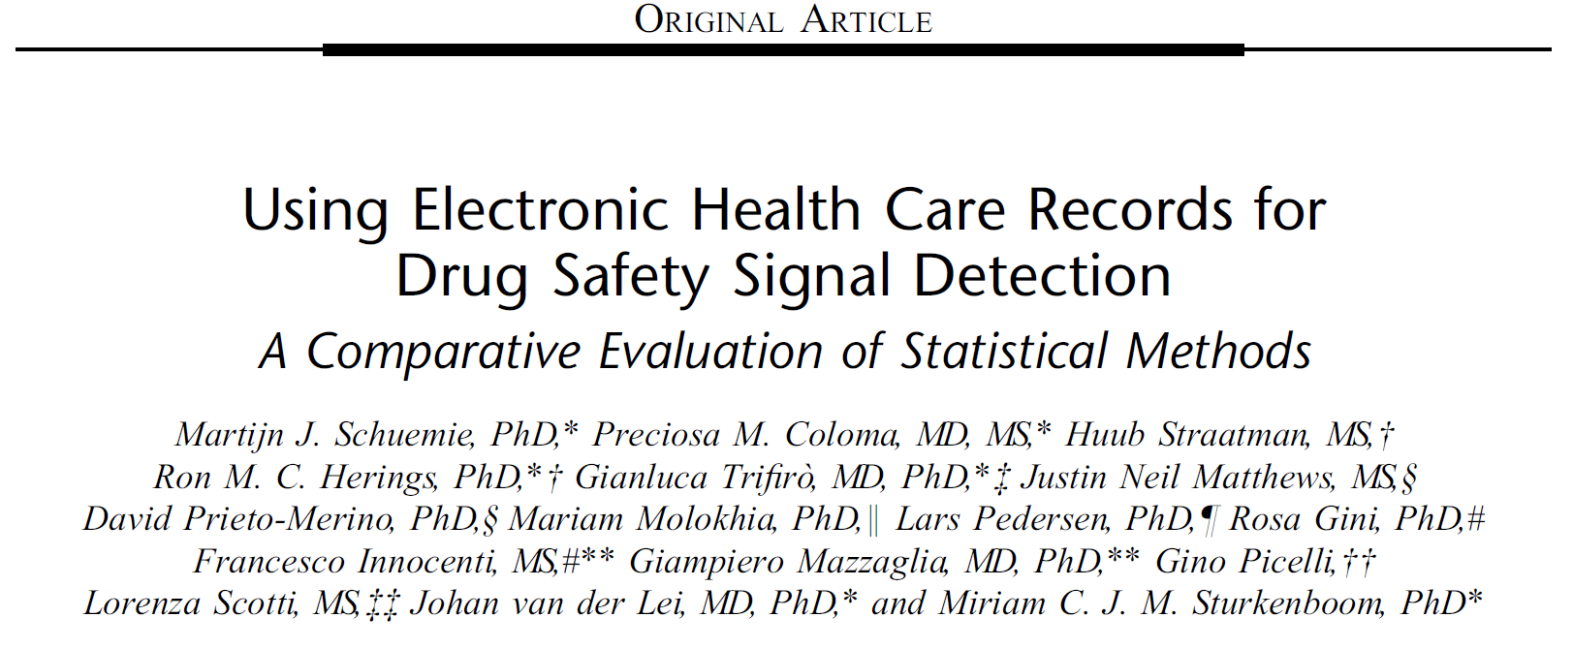

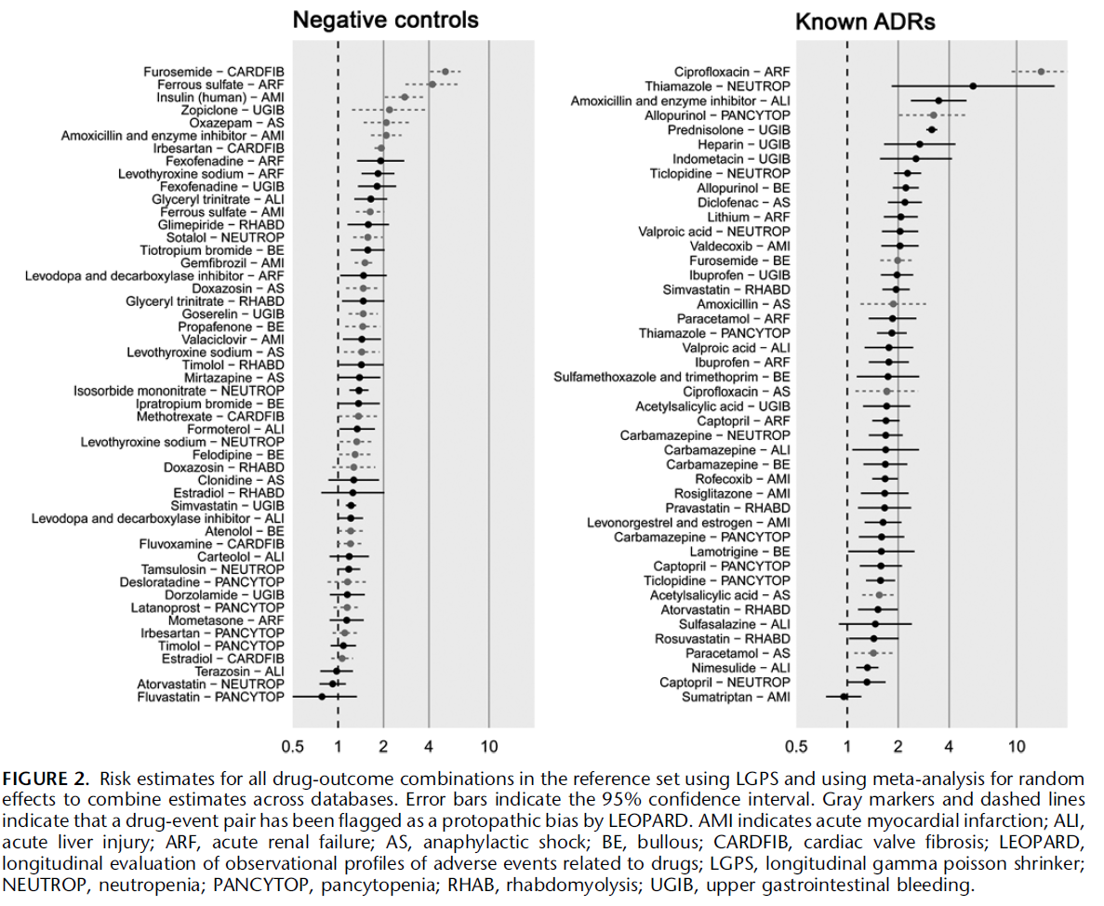

Slide 22
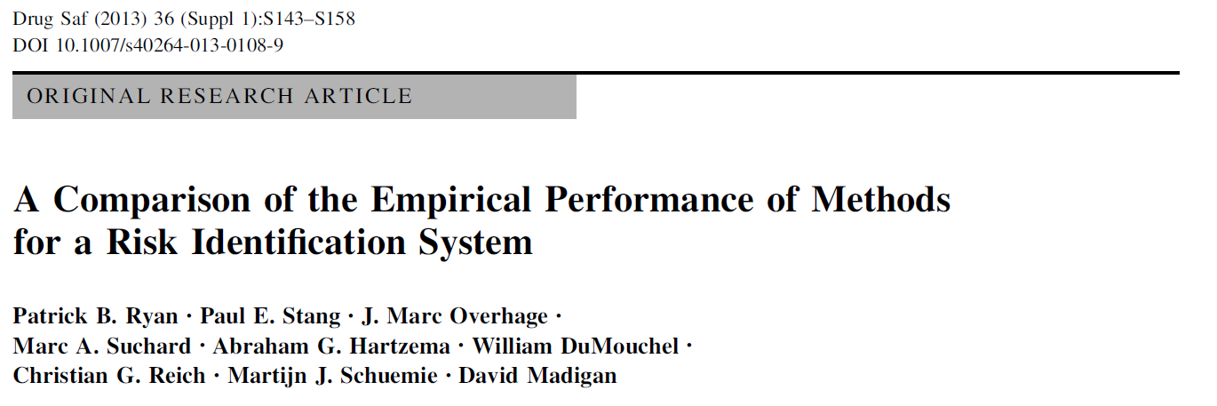
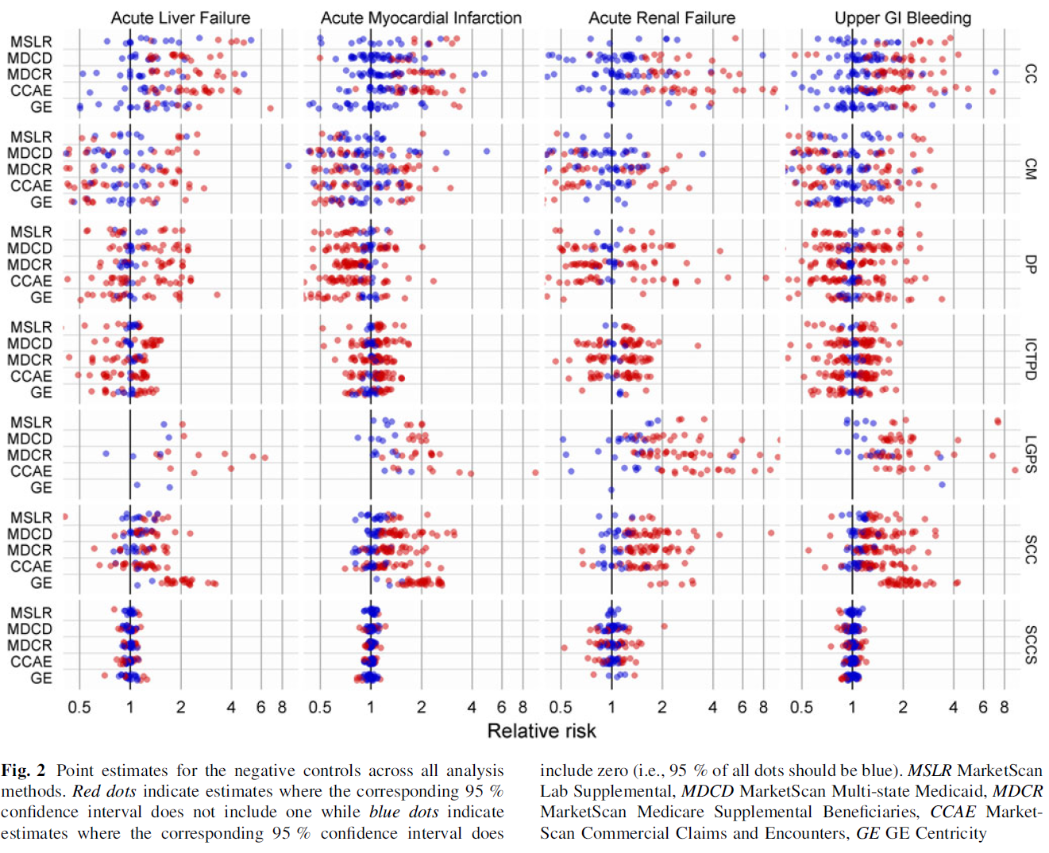

Slide 23
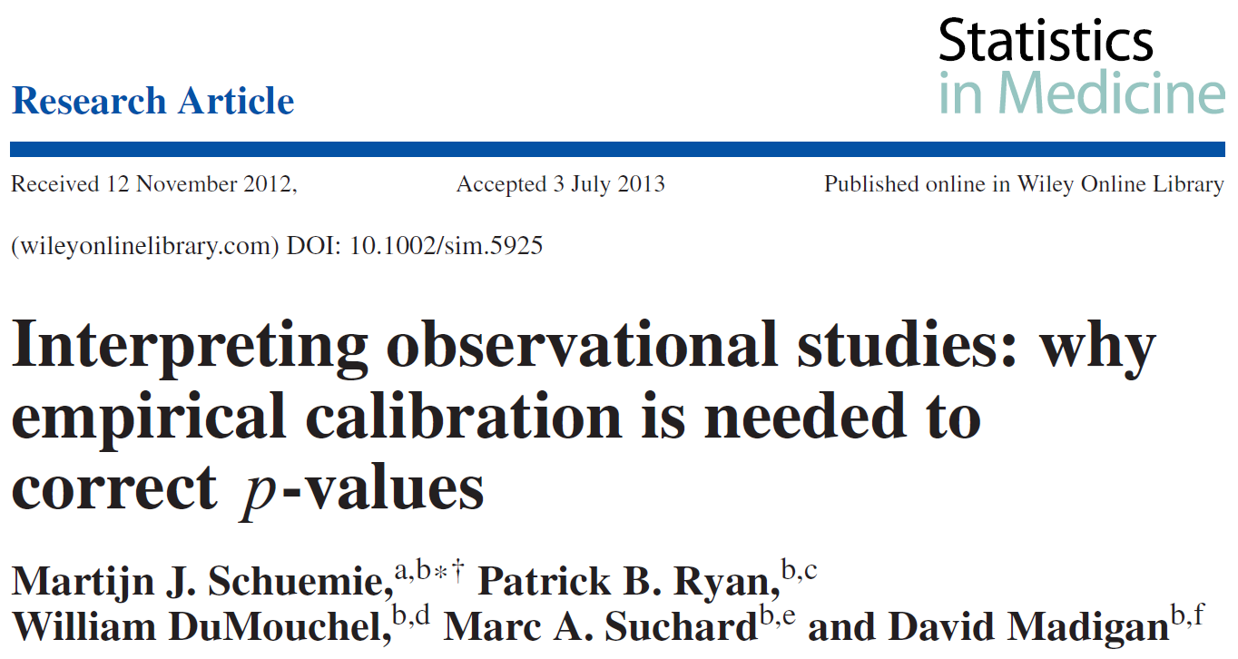
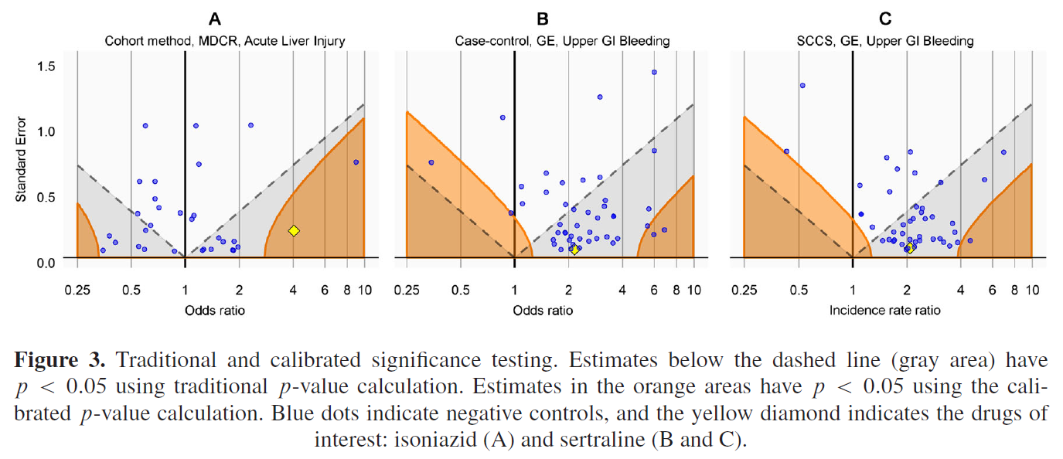

Slide 24

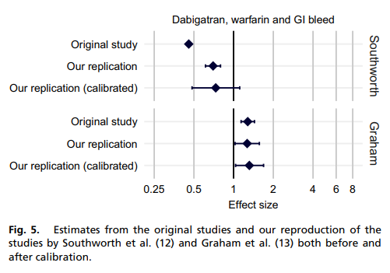

Slide 25
OHDSI’s mission
To improve health, by empowering a community to collaboratively generate the evidence that promotes better health decisions and better care.
To generate reliable evidence for the benefit of patients, providers, researchers, health care systems, industry, and government agencies

Slide 26

OHDSI activities on display at the symposium
Open source analytics development
Methodological research
Clinical evidence generation
Clinical characterization
Population-level effect estimation
Patient-level prediction

