Slide 1
Agenda
Time
8:30am-9:00am | Welcome, get settled, get laptops ready
9:00am-9:30am | Presentation: Overview of the new-user cohort method design | Patrick Ryan
9:30am-10:15am | Threats to the validity of study results and best practice | Martijn Schuemie
10:15am-10:30am | Coffee break
10:30am-11:45am | Presentation: Overall process of Population-Level Estimation Walkthrough of implementing a cohort study using ATLAS, and running the study package in R | Seng Chan You
11:45am-12:15am | Bring your own research question | Seng Chan You
12:15am-1:15pm | Lunch
1:15pm-5:00pm | Exercise: Collaborate on the design of a study | Seng Chan You
Patrick Ryan Janssen R&D, Columbia University Martijn Schuemie Janssen R&D, UCLA Seng Chan You Ajou University
조교: 신서정, 전호균, 이선경, 박철형 (아주대학교)

Slide 2
Overview of the new-user cohort method design
14 December 2019
Korea
Patrick Ryan PhD
Janssen Research and Development

Slide 3
OHDSI’s mission
To improve health, by empowering a community to collaboratively generate the evidence that promotes better health decisions and better care.
To generate reliable evidence for the benefit of patients, providers, researchers, health care systems, industry, and government agencies

Slide 4

OHDSI activities on display at the symposium
Open source analytics development
Methodological research
Clinical evidence generation
Clinical characterization
Population-level effect estimation
Patient-level prediction

Slide 5
A little exercise: choose your own adventure!

Slide 6





A pop culture mash-up to explain counterfactual reasoning…

Slide 7




Counterfactual reasoning for one person
Decision
Baseline:
Period to satisfy inclusion criteria
0
Follow-up:
Period to observe outcomes
Person Time

Slide 8



Counterfactual reasoning for a population
Cohort summary
Outcome summary

Slide 9
Alas, we don’t have a Delorean…
What is our next best approximation?
Instead of studying the same population under both decision options, let’s define a larger population and randomly assign one treatment to each person, then compare outcomes between the two cohorts…

Slide 10




Randomized treatment assignment to approximate counterfactual outcomes
Assigned
Unobserved
Unobserved
Assigned
Assigned
Unobserved
Unobserved
Assigned
Assigned
Unobserved
Unobserved
Assigned

Slide 11
Cohort summary
Outcome summary
Randomization allows for assumption that persons assigned to target cohort are exchangeable at baseline with persons assigned to comparator cohort

Slide 12
Alas, we can’t randomize…
What is our next, next best approximation?
Define a larger population, observe the treatment choices that were made, then compare outcomes:
Between persons who made different choices (comparative cohort design)
OR
Within persons during time periods with different exposure status (self-controlled designs)

Slide 13
How does Epidemiology define a comparative cohort study?
…it depends on what Epidemiology textbook you read…
“In a retrospective cohort study…the investigator identified the cohort of individuals based on their characteristics in the past and then reconstructs their subsequent disease experience up to some defined point in the most recent past or up to the present time” --Kelsey et al, Methods in Observational Epidemiology, 1996
“Cohort studies are studies that identify subsets of a defined population and follow them over time, looking for differences in their outcome. Cohort studies generally compare exposed patients to unexposed patients, although they can also be used to compare one exposure to another.” --Strom, Pharmacoepidemiology, 2005
“In a cohort study, a group of people (a cohort) is assembled, none of whom has experienced the outcome of interest, but all of whom could experience it…On entry to the study, people in the cohort are classified according to those characteristics (possible risk factors) that might be related to outcome. These people are then observed over time to see which of them experience the outcome.” --Fletcher, Fletcher and Wagner, Clincal Epidemiology – The Essentials, 1996
“In the paradigmatic cohort study, the investigator defines two or more groups of people that are free of disease and that differ according to the extent of their exposure to a potential cause of disease. These groups are referred to as the study cohorts. When two groups are studies, one is usually though of as the exposed or index cohort – those individuals who have experienced the putative causal event or condition – and the other is then thought of as the unexposed or reference cohort.” --Rothman, Modern Epidemiology, 2008
“In the cohort study’s most representative format, a defined population is identified. Its subjects are classified according to exposure status, and the incidence of the disease (or any other health outcome of interest) is ascertained and compared across exposure categories.” --Szklo and Nieto, Epidemiology: Beyond the Basics, 2007

Slide 14
OHDSI’s definition of ‘cohort’
Cohort = a set of persons who satisfy one or more inclusion criteria for a duration of time
Objective consequences based on this cohort definition:
One person may belong to multiple cohorts
One person may belong to the same cohort at multiple different time periods
One person may not belong to the same cohort multiple times during the same period of time
One cohort may have zero or more members
A codeset is NOT a cohort…
…logic for how to use the codeset in a criteria is required

Slide 15
Process flow for formally defining a cohort in ATLAS
Cohort entry criteria
Initial events
Events are recorded time-stamped observations for the persons, such as drug exposures, conditions, procedures, measurements and visits.
All events have a start date and end date, though some events may have a start date and end date with the same value (such as procedures or measurements).
Initial event inclusion criteria
Additional qualifying inclusion criteria
The qualifying cohort will be defined as all persons who have an initial event, satisfy the initial event inclusion criteria, and fulfill all additional qualifying inclusion criteria.
Each qualifying inclusion criteria will be evaluated to determine the impact of the criteria on the attrition of persons from the initial cohort.
Cohort exit criteria
Initial cohort
Qualifying cohort

Slide 16
A database is full of cohorts, some of which may represent valid comparisons
Database cohort
Diagnosed with condition 2
New users of Drug A
New users of Drug B
Incident event of condition 1
New users of Device D
New users of Drug C
Had Outcome 3
New users of Drug F
Users of C+F
Persons with surgery E

Slide 17




An observational comparative cohort design to approximate counterfactual outcomes
Observed
Unobserved
Unobserved
Observed
Observed
Unobserved
Unobserved
Observed
Observed
Unobserved
Unobserved
Observed
Observed
Unobserved
Unobserved
Observed
Observed
Unobserved
Unobserved
Observed

Slide 18
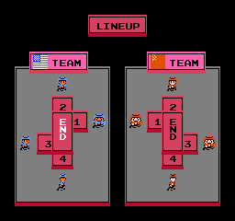
Cohort summary
Outcome summary
Exchangeability assumption may be violated if there is reason for treatment choice...and there often is

Slide 19
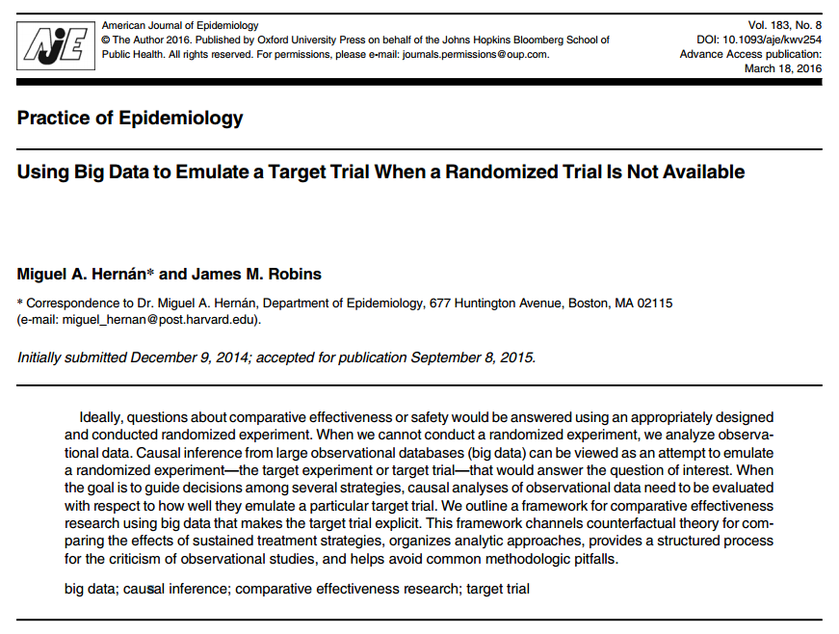
Design an observational study like you would a randomized trial
Protocol components to emulate:
Eligibility criteria
Treatment strategies
Assignment procedures
Follow-up period
Outcome
Causal contrasts of interest
Analysis plan

Slide 20
Propensity score introduction
Propensity score = probability of belonging to the target cohort vs. the comparator cohort, given the baseline covariates
e(x) = Pr(Z=1|x)
Z is treatment assignment
x is a set of all covariates at the time of treatment assignment
Propensity score can be used as a ‘balancing score’: if the two cohorts have similar propensity score distribution, then the distribution of covariates should be the similar (need to perform diagnostic to check)
Rubin Biometrika 1983

Slide 21
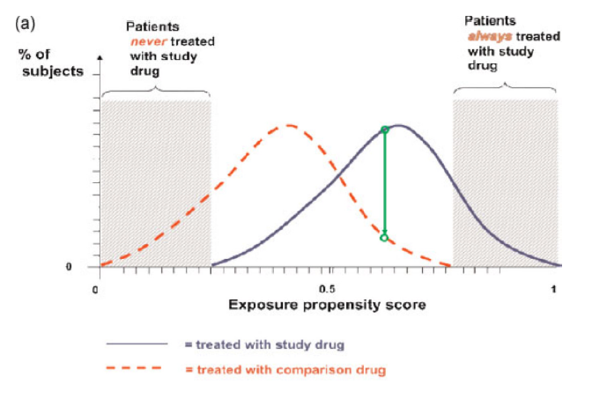
Intuition around propensity score balance
Schneeweiss. PDS 2011

Slide 22
“Five reasons to use propensity score in pharmacoepidemiology”
Theoretical advantages
Confounding by indication is the primary threat to validity, PS focuses directly on indications for use and non-use of drug under study
Value of propensity scores for matching or trimming the population
Eliminate ‘uncomparable’ controls without assumptions of linear relationship between PS and outcome
Improved estimation with few outcomes
PS allows matching on one scalar value rather than needing degrees of freedom for all covariates
Propensity score by treatment interactions
PS enables exploration of patient-level heterogeneity in response
Propensity score calibration to correct for measurement error
Glynn et al, BCPT 2006

Slide 23
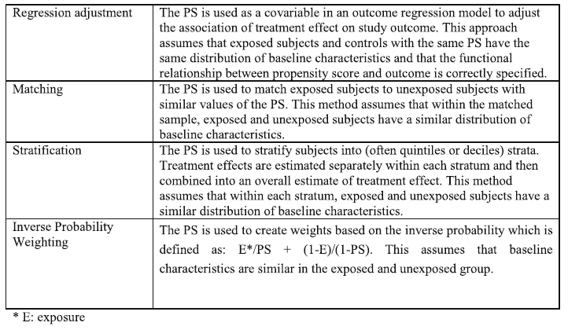
Methods for confounding adjustment using a propensity score
Not generally recommended
Fully implemented in OHDSI CohortMethod R package
Garbe et al, Eur J Clin Pharmacol 2013, http://www.ncbi.nlm.nih.gov/pubmed/22763756

Slide 24
Matching as a strategy to adjust for baseline covariate imbalance
Observed
Unobserved
Unobserved
Observed
Observed
Unobserved
Unobserved
Observed
Observed
Unobserved
Unobserved
Observed
Observed
Unobserved
Unobserved
Observed
Cohort summary
Observed
Unobserved
Unobserved
Observed

Slide 25
Stratification as a strategy to adjust for baseline covariate imbalance
Unobserved
Unobserved
Strata 1:
Large
Cohort summary
Observed
Observed
Observed
Unobserved
Unobserved
Observed
Strata 2: Medium
Observed
Unobserved
Unobserved
Observed
Observed
Observed
Strata 3: Small
Cohort summary
Unobserved
Unobserved
Observed
Unobserved
Unobserved
Observed

Slide 26
Cohort restriction in comparative cohort analyses
Initial target cohort T
Initial comparator cohort C
Qualifying
target cohort
Qualifying
comparator cohort
Analytic
target
Cohort (T’)
Analytic comparator cohort (C’)
Outcome cohort
Analytic outcome cohort: O in T’, C’ during time-at-risk

Slide 27
The choice of the outcome model defines your research question
 | Logistic regression | Poisson regression | Cox proportional hazards
How the outcome cohort is used | Binary classifier of presence/ absence of outcome during the fixed time-at-risk period | Count the number of occurrences of outcomes during time-at-risk | Compute time-to-event from time-at-risk start until earliest of first occurrence of outcome or time-at-risk end, and track the censoring event (outcome or no outcome)
‘Risk’ metric | Odds ratio | Rate ratio | Hazard ratio
Key model assumptions | Constant probability in fixed window | Outcomes follow Poisson distribution with constant risk | Proportionality – constant relative hazard

Slide 28
When designing or reviewing a study, ask yourself:
Input parameter | Design choice
Target cohort (T)
Comparator cohort (C)
Outcome cohort (O)
Time-at-risk
Model specification

