Slide 1


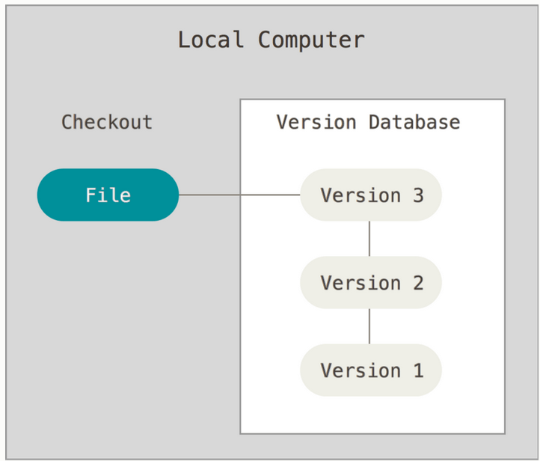


Local Version Control
Module 2
these are the files you are working with
corresponds to one (usually the last) version of the project
Working copy/ tree
stores info about which files are part of the next commit
contained in a file in the .git folder
Index/ Staging area
compressed database with full commit history in .git folder
this is copied when you clone a repository
Local repository

Slide 2

Local Version Control
Module 2
files in the modified state
A
B
A
Working copy/ tree
A
B
updated working tree
edit
untracked change
files in the staged state
Index/ Staging area
add to index
checkout to working tree
tracked change
files in the commited state
commit to repo
Local repository
change added to commit history

Slide 3




Local Version Control
Module 2
What happens when you initialize a new repository?
init
.git
some folder
folder tracked by git

Slide 4

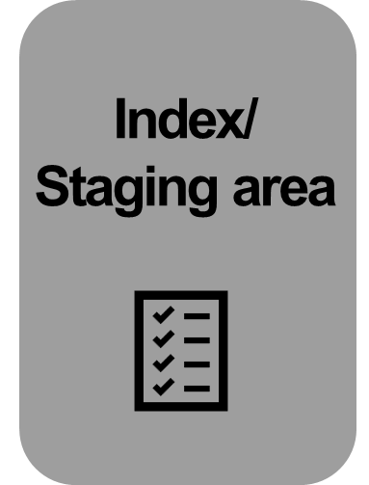


Let‘s go
Module 2
Follow the instructions in module_2.txt!
git add
git commit
git checkout

Slide 5
Commit messages
Module 2
What do you think makes a good commit message?
a „log of work done“
what has been done (& why); maybe also what needs to be done
direct and concise (no filler words)
consistent syntax and wording as far as possible
subject: about 50 characters, capitalize only first word, don‘t end in punctuation, imperative mood
(optionally) body: should be separated by blank line form subject
here is even a paper about it…https://arxiv.org/pdf/2202.02974
Notes:
References:
https://ericmjl.github.io/essays-on-data-science/workflow/effective-commit-messages/
https://gist.github.com/robertpainsi/b632364184e70900af4ab688decf6f53
https://cbea.ms/git-commit/
https://datasciencecampus.github.io/coding-standards/version-control.html

Slide 6

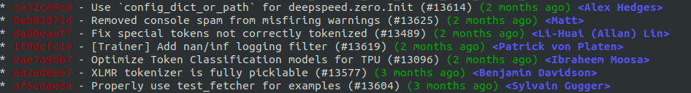
Commit messages
Module 2
What do you think makes a good commit message?
https://valohai.com/blog/git-for-data-science/

Slide 7
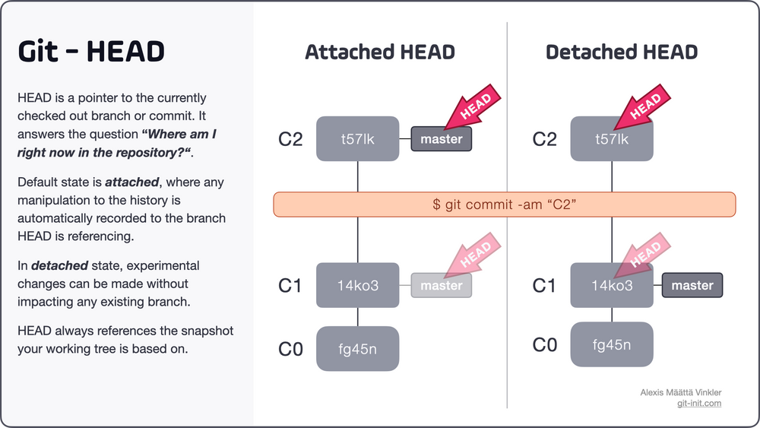
git HEAD
Module 2
Where am I in the repository (which commit is checked out)?
The HEAD usually contains a reference to a branch (branch = a series of commits)
https://blog.git-init.com/what-is-head-in-git/
Notes:
References:
https://git-scm.com/book/en/v2/Git-Internals-Git-References
https://jvns.ca/blog/2024/03/08/how-head-works-in-git/

Slide 8
git revert, reset, restore
Module 2
git revert „undo“ type command → inverts changes leading to specified commit → adds a new commit with inverted changes
revert commit 2
commit 1
commit 2
commit 3
commit 4
Notes:
References:
https://www.atlassian.com/git/tutorials/undoing-changes/git-revert

Slide 9
git revert, reset, restore
Module 2
git reset moves the HEAD and main branch reference to specified commit → it changes the commit history!
git restore alternative (newer) command to git reset
Note: To only add something to the last commit or change its commit message, you can use: git commit --amend
Notes:
References:
https://www.atlassian.com/git/tutorials/undoing-changes/git-reset
https://git-scm.com/book/en/v2/Git-Basics-Undoing-Things

