Slide 1

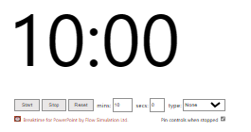
Initial Steps
Module 1
Login to your Github account
Visit: https://github.com/IEECR/Git-Github-Workshop/tree/main
In the repository move to the folder sessions_1 > instructions and click on module_1.md
Follow the instructions…

Slide 2
Wrap-up
Module 1
What is the difference between cloning the repository and downloading it as .zip folder?
Any further questions?

