Slide 1

Git & Github Workshop
10.07.2024 – Bence Mitlasoczki & Lena J. Gschossmann

Slide 2
Motivation & Goal
NOT using version control (and writing clean code) = extremely time and ressource inefficient for yourself and others.
The goal of the workshop is to enable everybody to go back and use version control right away.
Notes:
examples:
- You want to clean up your code by deleting things you’re not using and be able to find the old code
- You want to share your code with someone and the other person wants to make changes to it
- You want to try out a change to your code in different files and if it doesn’t work undo it
- You want to use a publicly available version of code used in a paper and adapt it

Slide 3
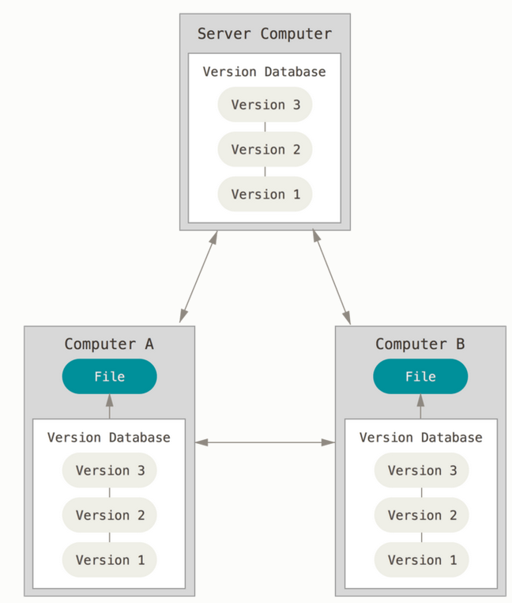
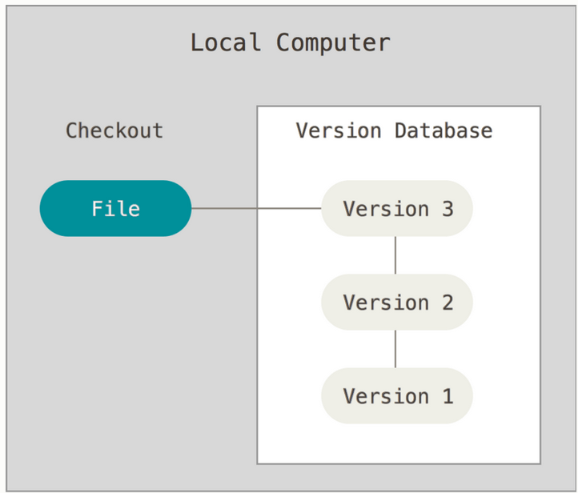
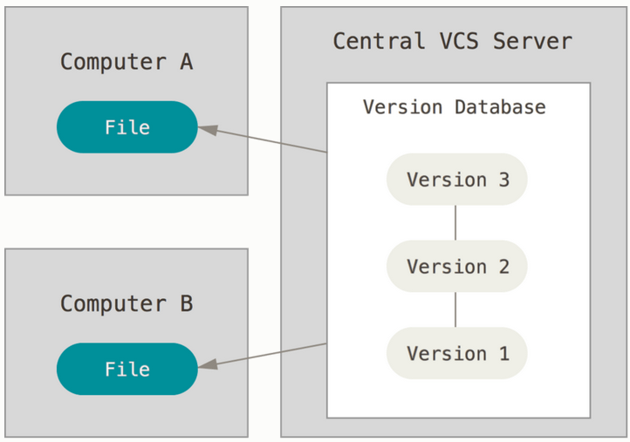
About Version Control Systems (VCS)
VC as you may do it: Copy files and rename them before changing something.
Local VCS: Local database to keep changes to local files under revision control.
Centralized VCS: Server with version database and multiple clients that make changes to files.
Distributed VCS: Server with version database and multiple clients which mirror this database.
Notes:
Source: https://git-scm.com/book/en/v2/Getting-Started-About-Version-Control

Slide 4

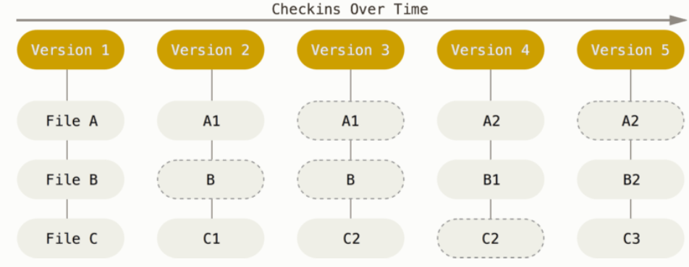
– the most popular VCS (but not the only one)
„a stream of snapshots“
„ makes Git more like a mini filesystem […] rather than simply a VCS”
„impossible to change the contents of any file or directory without Git knowing about it” (by checksumming files)
Notes:
Source: https://git-scm.com/book/en/v2/Getting-Started-About-Version-Control

Slide 5

x Github
Developer platform
Provides Git‘s distributed version control
Many other features: …allows easy sharing of code …allows bug reports and discussions
If ever needed, it will be your programming portfolio

Slide 6
Let‘s get started
Module 1 Setting it up (10 min)
Module 2 Local version control with Git (30 min)
Module 3 Remote version control with Git & Github (30 min)
Module 4 Basics of Visual Studio Code Git integration (5-10 min)
Module 5 What makes a good repository (20-30 min)

