Slide 1

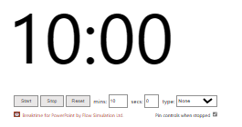
Module 1
Login to your Github account
Visit: https://github.com/IEECR/Github-Workshop
In the repository move to the folder „instructions“ and click on „module_1.txt“
Follow the instructions…

