Slide 1

Blazingly Fast LLM Inference Framework
on Arm Devices
Zhaode Wang, Hui Ni, Xiao Zhang, Song Lin, Jin Yao
Taobao Alibaba,Tencent,Cambricon,Kunlun-inc,TsingMicro
2024 IEEE International Conference on Artificial Intelligence Circuits and Systems

Slide 2
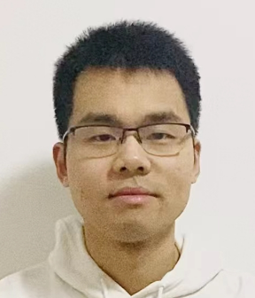
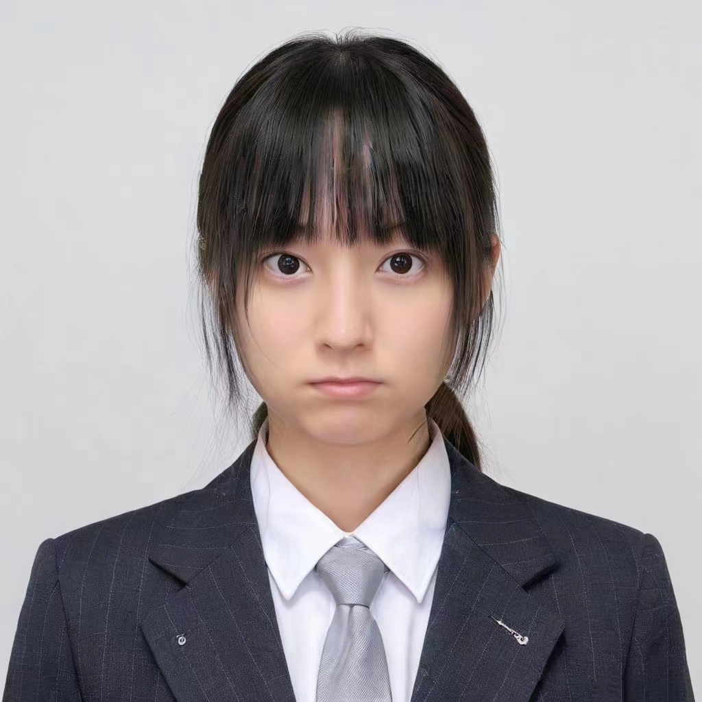
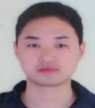
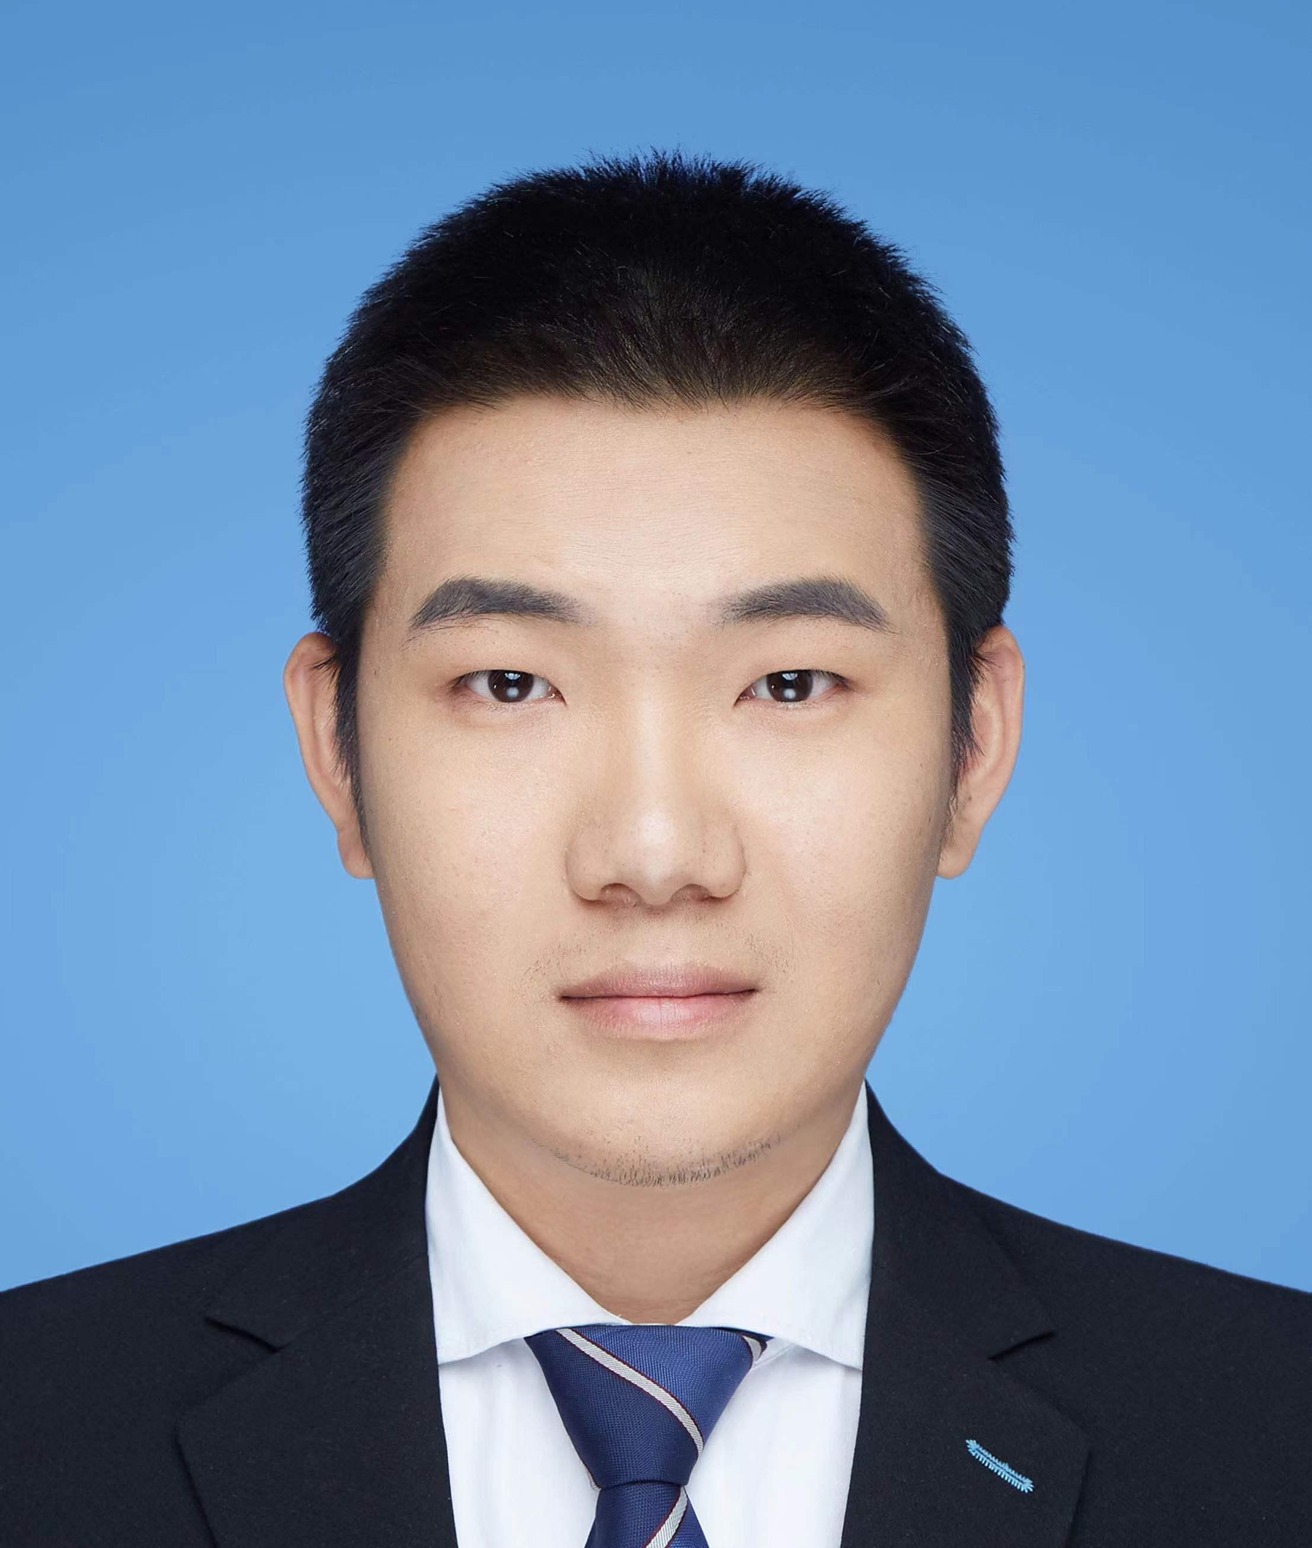
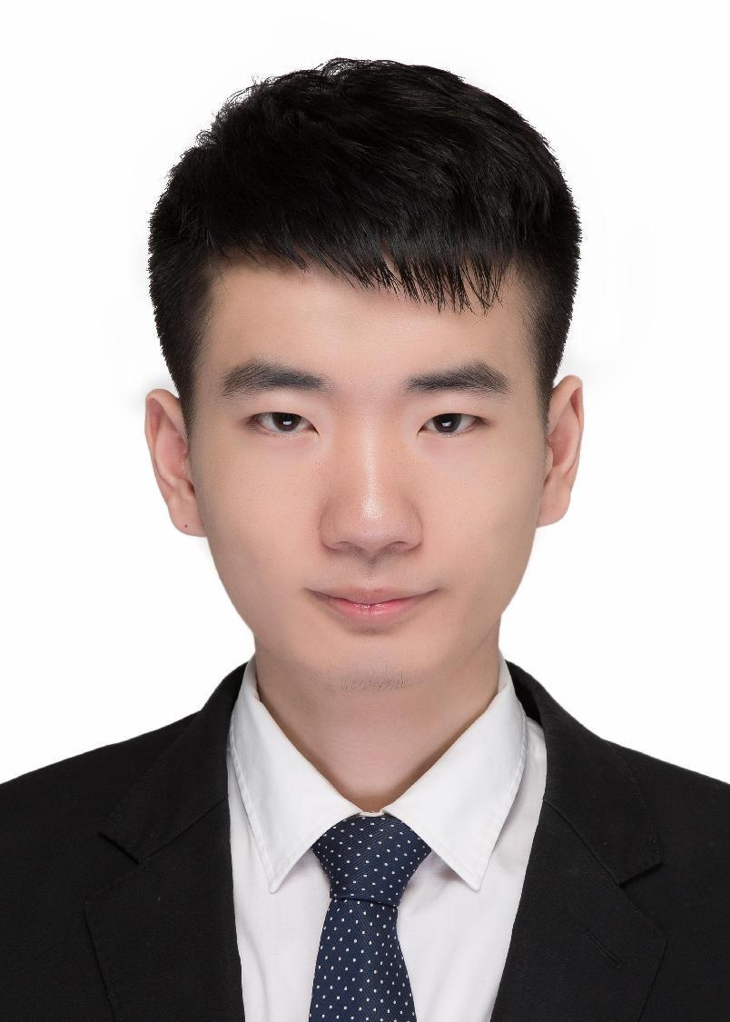
Team Introduction
Zhaode Wang
Hui Ni
Xiao Zhang
Song Lin
Jin Yao
Taobao Alibaba
Working on neural nwtork inference optimization
Tencent
Working on edge computing optimization
Cambricon
Working on training solutions and performance analysis & optimization
Kunlun-inc
Working on AI Infra for llm training and deploying
TsingMicro
Working on neural
network quantization and graph optimization

Slide 3
Pipeline
huggingface
model
finetune
and
4bit qat
llm-export
onnxslim
mnn-llm
GitHub Repositories:
https://github.com/DD-DuDa/BitDistiller
https://github.com/tsingmicro-toolchain/OnnxSlim
https://github.com/wangzhaode/llm-export
https://github.com/wangzhaode/mnn-llm
https://github.com/alibaba/MNN

Slide 4
Finetune and 4bit Quant Aware Training
Why finetune?
W4A8 quantization will induce accuracy loss.
Why Quant Aware Training?
special quantization schemes has to be applied to restore accuracy
Method | DataSet
Finetune | 57137 entries generated from training set
QAT | wikitext 3000 alpaca 5000
Model | DataSet
 | piqa | arc_challenge | hellaswag
QWen 1.8B | 0.7280 | 0.3200 | 0.4543
FineTuned | 0.7514 | 0.3413 | 0.5046
Pseudo Quantization | 0.7242 | 0.3234 | 0.4779
QAT+ Pseudo Quantization | 0.7432 | 0.3294 | 0.4700

Slide 5
Onnxslim
Why onnx?
Pros: Community standard; Graph based
Cons: Extremely redundant
OnnxSlim
Featuring: Shape inference, constant folding, operator fusion, common subexpression elimation and more;
Qwen 1.8B | Before onnxslim | After onnxslim
Operators number | 3726 | 2103 (40% decrease)
Speed (loop 200) | 13.025 s | 12.179 (6.5% decrease)

Slide 6
Memory Optimization
Weight Quantization
Disk-Embedding
Half-Precision and Memory Reuse
Notes:
大语言模型由于参数规模大，内存占用也非常高。因此在部署时内存是一个非常重要的指标，我们针对模型的内存占用情况进行分析，做出了如下的几种优化：1. 权重量化；2. Disk-Embedding; 3.激活值使用半精度与内存服用

Slide 7
Weight Quantization
Qwen1.8B
Memory Analysis
Linear ’s parameter: 1.42 billion
Embedding ’s parameter: 0.29 billion
Activation and past-key-values: depend on the seq length
Weight Quantization
float: 7.2 GB
4bit quantization: 0.9 GB
Notes:
首先占用内存比较大的是模型的参数，Qwen1.8B模型的参数主要有3部分：
Linear的权重，参数规模为 1.42 B
Embedding的权重，参数规模为 0.29 B
运行时的激活值和kv cache;
权重部分是常驻内存的，不随运行的情况变化；激活值和kv cache则与用户输入的长度和decode生成的长度有关。
1.8B的模型如果直接以单精度浮点数的精度加载到内存中，其权重大小就有约7.2GB，这个内存占用还是非常高的。为了解决这个问题，我们必须采用量化的方式来降低权重的占用

Slide 8
Disk-Embedding
Disk-Embedding
Low Utilization
Load from Disk Instead of Memory
Bfloat16 Format
Improving Performance Using Cache
int seq_len = static_cast<int>(input_ids.size());
size_t size = hidden_size_ * sizeof(int16_t);
FILE* file = fopen(disk_embedding_file_.c_str(), "rb");
std::unique_ptr<int16_t[]> buffer(new int16_t[hidden_size_]);
for (size_t i = 0; i < seq_len; i++) {
fseek(file, input_ids[i] * size, SEEK_SET);
fread(buffer.get(), 1, size, file);
auto ptr = inputs_embeds_->writeMap<int16_t>() + i * hidden_size_ * 2;
for (int j = 0; j < hidden_size_; j++) {
ptr[j * 2] = 0;
ptr[j * 2 + 1] = buffer[j];
}
}
fclose(file);

Slide 9
Half-Precision and Memory Reuse
Half-Precision: activation and kv cache using float16.
Memory Reuse: Static memory allocator for reuse.
Get all alloc/free info, defer allocate.
Using simple algorithm compute reuse info.
Memory reuse rate improved by 20% Compared to Dynamic Allocator

Slide 10
Performance Optimization
Performance Analysis.
Linear Optimization
Attention Optimization

Slide 11
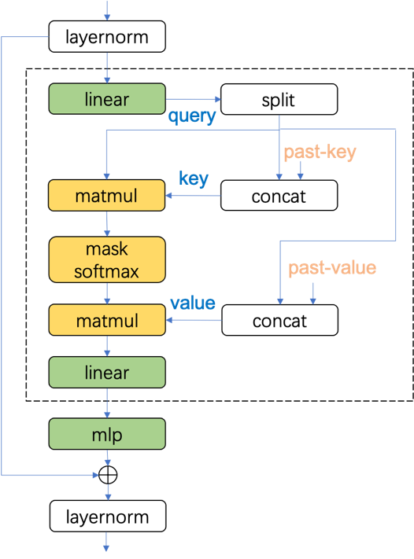
Performance Analysis
LLM are consecutive decode blocks.
prefill + decode stage
three core operations:
Linear
MatMul
Memory (Split, Concat, Transpose)

Slide 12
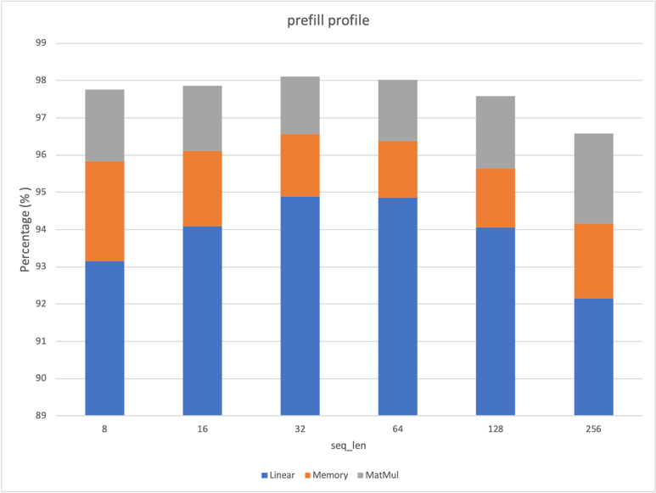
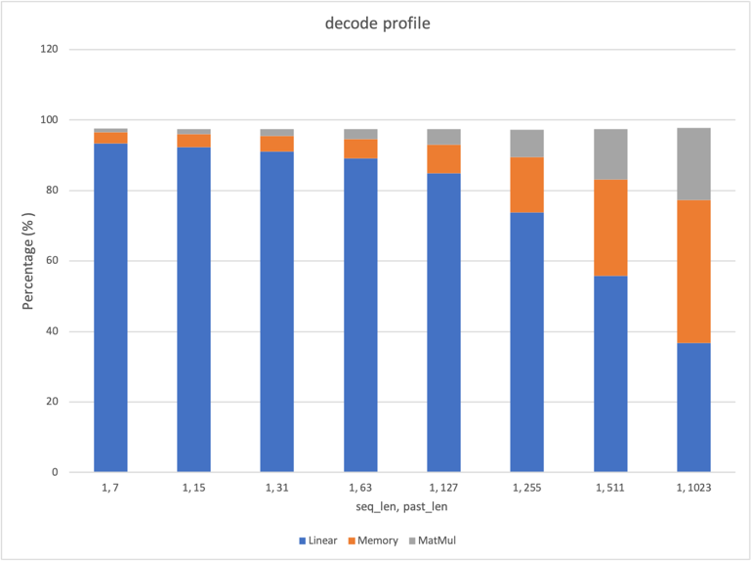
Performance Analysis

Slide 13
Linear and Memory
OP | Linear Computation and Memory
 | FLOP | IO | weight
attn/c_attn | 2 * lh3h | 2 * (lh + 3lh) | 0.5 * h3h
attn/c_proj | 2 * lhh | 2 * (lh + lh) | 0.5 * hh
mlp/w1 | 2 * lhi | 2 * (lh + li) | 0.5 * hi
mlp/w2 | 2 * lhi | 2 * (lh + li) | 0.5 * hi
mlp/c_proj | 2 * lih | 2 * (li + lh) | 0.5 * ih
block total | 6lhi + 8lhh | 18lh + 6li + 2hh + 1.5hi + 10h + 4i
Lm | 2 * lhv | lh + lv + hv + 2v
* l: sequence length; h: hidden size; i: intermediate size; v: vocabulary size
Qwen1.8B (l=560), (h = 2048), (i = 5504) , and (v = 151936)
stage | FLOP | Memory
prefill | 1591.13 G | 1.74 G
decode | 2.84 G | 0.71 G

Slide 14
Attention and Memory
OP | Attention Computation and Memory
 | FLOP | Memory
prefill | 4llh + 22ll | 16lh + 24ll
decode | 4Lh + 22L | 8Lh + 24L + 8h
* l: sequence length; h: hidden size; i: intermediate size; v: vocabulary size
Qwen1.8B (l=560), (h = 2048), and(L=585)
stage | FLOP | Memory
prefill | 57.57 G | 0.58 G
decode | 0.11 G | 0.21 G

Slide 15
Linear Optimization
Quantization W4A8: reduce memory footprint
Instruction Selection: smmla
Loop Tiling: improve memory locality and memory access efficiency

Slide 16


Quantization
W4A8:
weight quant using 4bit asymmetric quant
activations dynamic quant using 8bit symmetric quant
Weight asymmetric quant:
$w_{i}=round(\frac{w_{f}−zeropoint}{scale_{w}}$)
$$w_{f}=w_{i}∗scale_{w}+zeropoint$$
Activations symmetric quant:
$a_{i}=round(\frac{a_{f}}{scale_{a}}$)
$${ a}_{f}=a_{i}∗scale_{a}$$
$$y_{f}=∑{(w}_{f}a_{f})$$
$$=∑\left(\left(w_{i}∗scale_{w}+zeropoint\right)∗\left(a_{i}∗scale_{a}\right)\right)$$
$=∑\left(w_{i}∗a_{i}∗scale_{w}∗scale_{a}+a_{i}∗zeropoint∗scale_{a}\right)$
$=∑{(w}_{i}a_{i}∗scale_{w}∗scale_{a})+∑(a_{i}∗zeropoint∗scale_{a})$
$=scale_{w}∗scale_{a}∗∑w_{i}a_{i}+zeropoint∗scale_{a}∑a_{i}$
Using smmla compute
Pre-compute when dynamic quant.

Slide 17
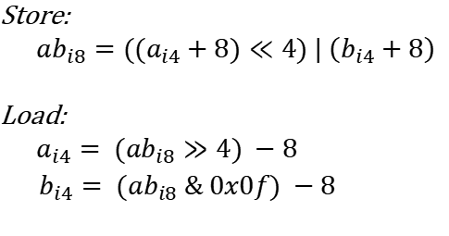
Quantization
W4 store and load
Store: Pack two int4s into an uint8 by offsetting and shifting for space efficiency.
Load: Unpack two int4s from an uint8 by reversing the shift and offset.
Vectorized Implementation
Store:
${ab}_{i8}={((a}_{i4}+8)≪4) | \left(b_{i4}+8\right)$
Load:
${a_{i4}= (ab}_{i8}≫4) −8$
${b_{i4}= (ab}_{i8} \& 0x0f) −8$
ld1 {v0.16b}, [x25], #16
ushr v8.16b, v0.16b, #4
and v9.16b, v0.16b, v10.16b
sub v8.16b, v8.16b, v11.16b
sub v9.16b, v9.16b, v11.16b
zip1 v0.16b, v8.16b, v9.16b
zip2 v1.16b, v8.16b, v9.16b
v0
a | b | c | d | e | f | g | h | i | j | k | l | m | n | o | p | q | …
v0 >> 4 -> v8
a | c | e | g | i | k | m | o | …
v0 & 0xf -> v9
b | d | f | h | j | l | n | p | …

Slide 18
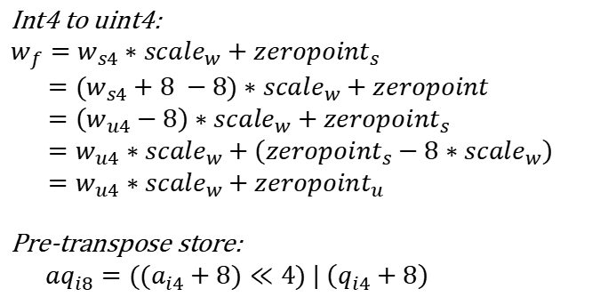
Quantization
int4 to uint4: weight convert to uint4
pre-transpose: 2x16 transpose when store
Int4 to uint4:
$$w_{f}=w_{s4}∗scale_{w}+zeropoint_{s}$$
$={(w}_{s4}+8 −8)∗scale_{w}+zeropoint$
$=\left(w_{u4}−8\right)∗scale_{w}+zeropoint_{s}$
$=w_{u4}∗scale_{w}+\left(zeropoint_{s}−8∗scale_{w}\right)$
$=w_{u4}∗scale_{w}+zeropoint_{u}$
Pre-transpose store:
${aq}_{i8}={((a}_{i4}+8)≪4) | \left(q_{i4}+8\right)$
Vectorized Implementation
ld1 {v8.16b}, [x25], #16
ushr v0.16b, v8.16b, #4
and v1.16b, v8.16b, v10.16b
v0
a | q | b | r | c | s | d | t | e | u | f | v | g | w | h | x | i | …
v0 >> 4 -> v8
a | b | c | d | e | f | g | h | …
v0 & 0xf -> v9
q | r | s | t | u | v | w | x | …

Slide 19
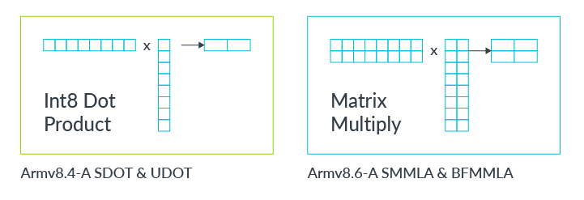
Instruction Selection
smmla: throughput doubles that of sdot
smmla: 32 mul + 32 add = 64 ops
sdot: 16 mul + 16 add = 32 ops
sdot VS smmla
YiTian710 CPU
Peak througput | 1 core | 8 core
smmla | 348 GFlops | 2784 GFlops
sdot | 174 GFlops | 1392 GFlops

Slide 20



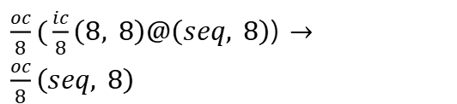
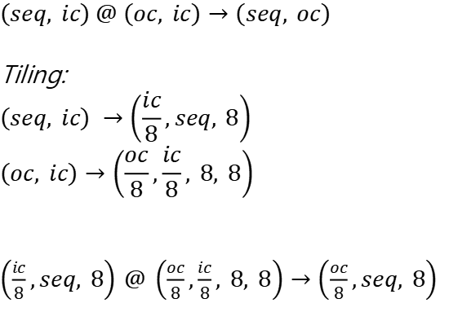
Loop Tiling
Loop Tiling:
Tiling for smmla
Tiling for memory locality
Thread Parallelism
$\frac{oc}{8}(\frac{ic}{8}\left(8, 8\right)@\left(seq, 8\right)$) $→\frac{oc}{8}\left(seq, 8\right)$
Inner Loop
$$\left(seq, ic\right) @ \left(oc, ic\right)→\left(seq, oc\right)$$
Tiling:
$$\left(seq, ic\right) →\left(\frac{ic}{8},seq, 8\right)$$
$$\left(oc, ic\right)→\left(\frac{oc}{8},\frac{ic}{8}, 8, 8\right)$$
$\left(\frac{ic}{8},seq, 8\right)$ $@$ $\left(\frac{oc}{8},\frac{ic}{8}, 8, 8\right)→\left(\frac{oc}{8},seq, 8\right)$
$$\frac{ic}{8}\left(8, 8\right)@\left(seq, 8\right)→seq, 8$$
Implement by seq_size: 8, 4, 2, 1
$$\frac{seq}{2}\left(2, 8\right)@4\left(2, 8\right)→seq, 8$$
Using smmla
$$\left(2, 8\right)@\left(2, 8\right)→4$$

Slide 21
Attention Optimization
Float16 MatMul and Loop Tiling
Fused MHA kernel: reduce memory reordering
Softmax and RMS-Norm: using float32 to ensure the accuracy

Slide 22
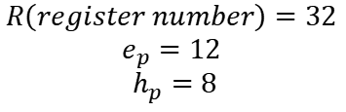
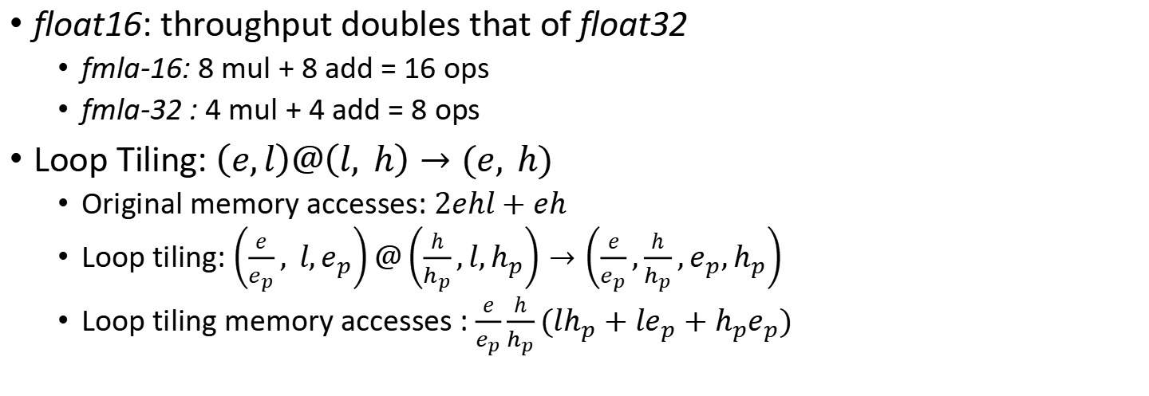
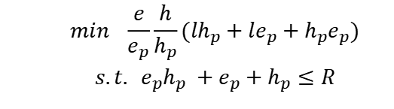
Float16 MatMul and Loop Tiling
float16: throughput doubles that of float32
fmla-16: 8 mul + 8 add = 16 ops
fmla-32 : 4 mul + 4 add = 8 ops
Loop Tiling: $\left(e,l\right)@\left(l, h\right)→(e, h)$
Original memory accesses: $2ehl+eh$
Loop tiling: $\left(\frac{e}{e_{p}}, l,e_{p}\right)@\left(\frac{h}{h_{p}},l,h_{p}\right)→\left(\frac{e}{e_{p}},\frac{h}{h_{p}},e_{p},h_{p}\right)$
Loop tiling memory accesses : $\frac{e}{e_{p}}\frac{h}{h_{p}}(lh_{p}+le_{p}+h_{p}e_{p})$
$$min \frac{e}{e_{p}}\frac{h}{h_{p}}(lh_{p}+le_{p}+h_{p}e_{p})$$
$$s.t. e_{p}h_{p} +e_{p}+h_{p}≤R$$
$$R\left(register number\right)=32$$
$$e_{p}=12$$
$h_{p}=8$

Slide 23


Fuse MHA
Fused MHA kernel: reduce memory reordering
Changing past key/value from input Tensor to operator Internal State
Optimizing multiple reads/writes to a single write
Softmax: using float32 to ensure the accuracy
$$query=transpose\left(query\right);$$
$$key=concat\left(key_{past}, key\right);$$
$$key=tranpose\left(key\right);$$
$$key=tiling\left(key\right);$$
$$value=concat\left(value_{past} , value\right);$$
$$value=transpsoe\left(value\right);$$
$$value=tiling\left(value\right);$$
$$qk=query@key;$$
$$qk=softmax\left(mask(qk)\right);$$
$$qkv=qk@v;$$
$$query=transpose\left(query\right);$$
$$key=write\left(key_{past}, key\right);$$
$$value=write\left(value_{past} , value\right);$$
$$qk=query@key;$$
$$qk=softmax\left(mask(qk)\right);$$
$$qkv=qk@v;$$
Parallelizing across head dim
Using float32
$$IO_{reduce}=2 ∗6∗\left(pastlength+1\right)∗hiddensize −2∗hiddensize$$
$=(12 ∗pastlength+10)∗hiddensize$

Slide 24
Final Performance
Machine peak performance
Linear roofline
Attention roofline
Optimization Gains
Optimized Performance vs. Theoretical Peak

Slide 25
Machine peak performance
Memory bandwidth: using STREAM.
Instruction peak computation: using MegPeak.
 | Peak performance | Computational Intensity
Memory bandwitdh | 99.274 GBps | NA
smmla | 2784 GFlops | 28.04
sdot | 1392 GFlops | 14.02
fmla | 352 GFlops | 3.55
YiTian710 8-core

Slide 26
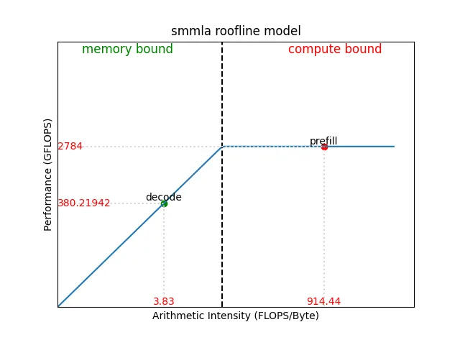
Linear roofline
compute bound on prefill stage.
memory bound on decode stage.
 | Computational Intensity
I_smmla | 2784 / 99.274 = 28.04
I_prefill | 1591.13 / 1.74 = 914.44
I_decode | 2.84 / 0.74 = 3.83

Slide 27
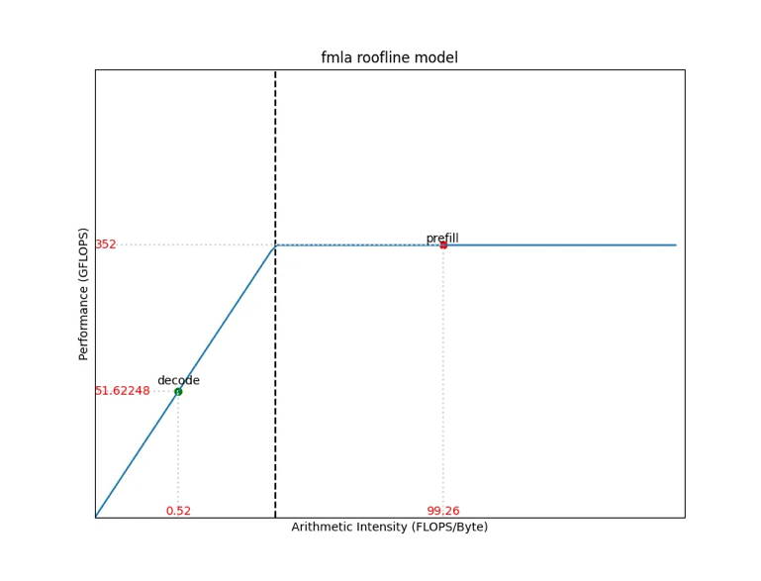
Attention roofline
compute bound on prefill stage.
memory bound on decode stage.
 | Computational Intensity
I_fmla | 352 / 99.274 = 3.55
I_prefill | 57.57 / 0.58 = 99.26
I_decode | 0.11 / 0.21 = 0.52

Slide 28
Optimization Gains
Attention Fuse
Pre-Int4toUint4
Pre-transpose
Optimization | prefill | decode
Attention Fuse | 34.62 % | 300.54 %
Pre-Int4toUint4 | 10.91 % | 13.66 %
Pre-transpose | 12.02 % | 7.5 %

Slide 29
Optimized Performance vs. Theoretical Peak
Prefill: achieved 95% of the theoretical peak
Decode: achieved 94% of the theoretical peak
stage | Theoretical Peak | Our Optimized
prefill | 668.31 tok/s | 638.03 tok/s
decode | 105.26 tok/s | 99.31 tok/s
Notes:
根据前面的内容可以计算出理论峰值吞吐率为：
- prefill
- Linear耗时： 1591.13 / 2784 = 0.57148
- Attention + other耗时： 57.42/352+10.2539/99.274=0.26641
- 总耗时：0.83794
- 吞吐 668.31 tok/s
Decode
Linear耗时: 0.71 / 99.274 = 0.0071519
Attention + other耗时: 0.2332/99.274=0.002349
总耗时：0.0095
吞吐 105.26 tok/s
实际吞吐：
prefill: 638.03 95%
decode: 99.31 94%
我们优化后prefill达到了理论峰值的95%， decode吞吐率达到的了理峰值的94%；这证明我们的优化能够成分利用设备的性能。

Slide 30
Thank you
2024 IEEE International Conference on Artificial Intelligence Circuits and Systems

