Slide 1

Qwen Inference Optimization:
Leveraging Quantization and Weight Rearrangement
Jinwen Liang, Xingyu Luo, Lu Shi, Yuanze Sun
Supervisor : Jie Liu
2024 IEEE International Conference on Artificial Intelligence Circuits and Systems
Notes:
Greetings, we are Team L3S2, we are honored to be invited here and give a speech.
My name is Sun Yuanze.
On behalf of our team members, I will give a brief introduction to our optimization scheme on Qwen Large Language model.

Slide 2

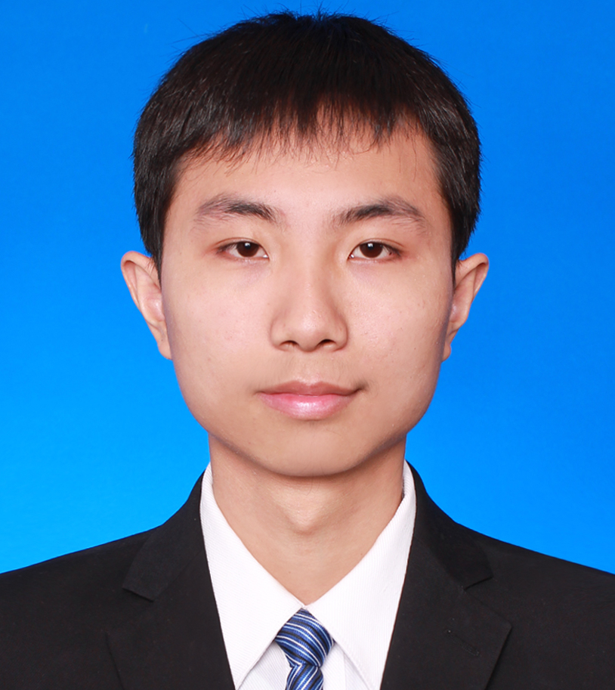
Student members
Supervisor
Jinwen Liang: Undergraduate student, Class of 2021, Department of Computer Science and Technology, Nanjing University.
Xingyu luo: Undergraduate student, Class of 2021, Department of Computer Science and Technology, Nanjing University.
Lu Shi: Undergraduate student, Class of 2021, Department of Computer Science and Technology, Nanjing University.
Yuanze Sun: Undergraduate student, Class of 2021, Department of Computer Science and Technology, Nanjing University.
Jie Liu
- Assistant Researcher
- Mutimedia Computing Group
Nanjing University
(2022.11~now)
- ‪liujie@nju.edu.cn
Jie Liu‬ - ‪Google Scholar：https://scholar.google.com/citations?user=oab9IRYAAAAJ&hl=en‬
Notes:
First, let me introduce our team members. Our team is composed of 4 Grade-3 undergraduates, all studying in Nanjing University, Department of Computer Science of Technology. They are Liang Jinwen, Luo xingyu, Shi lu and me.
And if you are recruiting doctors, welcome to contact us!
We are directed by Liu Jie assistant researcher from MCG Group, Nanjing University.
——————————————————————————————————————————————
The organizer has already introduced the background of challenge, so I just skip this part and step in our optimization scheme.

Slide 3
Our Approach to LLM Inference Optimization
Model Quantization
Adjustment of llama.cpp Backend
Fine-Tuning Practices
Notes:
In the final round,
we mainly used quantization and fine-tuning methods, with the backend of llama.cpp.
It’s worth mentioning that we did a lot of adjustments to the original llama.cpp to better boost the CPU performance.

Slide 4
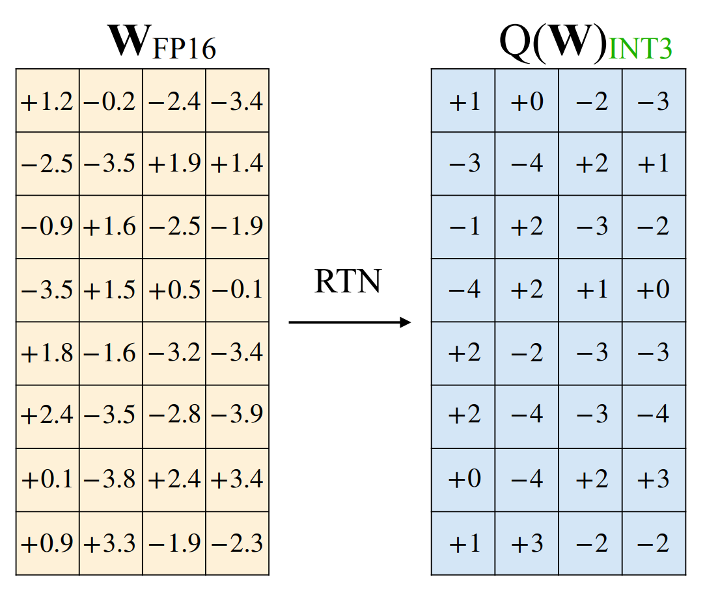
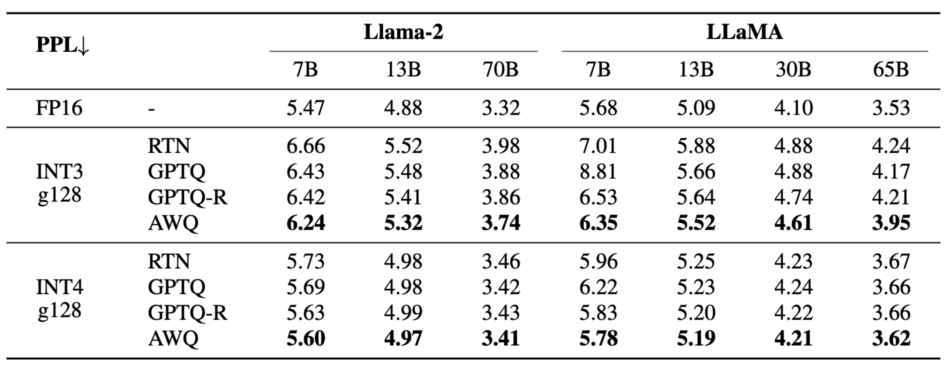
Part 1. Quantization
Quantization maps a floating-point number into lower-bit integers, which is an effective method to reduce the model size and inference costs of LLMs.
We choose AWQ (Activation-aware Weight Quantization) as our quantization strategy.
Notes:
First, I’d like to talk about quantization.
Quantization means converting the original floating-point numbers into low-bit integers. It can effect-ively boost the inference speed and reduce the memory occupation, albeit at the cost of sacrificing a certain level of accuracy. Traditional quantization methods always lead to a large accuracy loss.
Through extensive research（重音在前）, we ultimately chose AWQ (Adaptive Weight Quantization) to quantize the model.
The table shows that AWQ method outperforms RTN and GPTQ across different models and quantization bits.

Slide 5
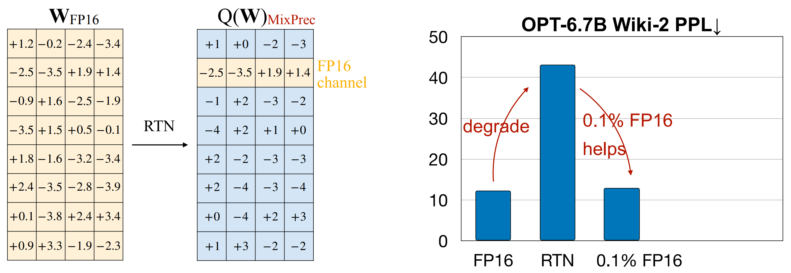
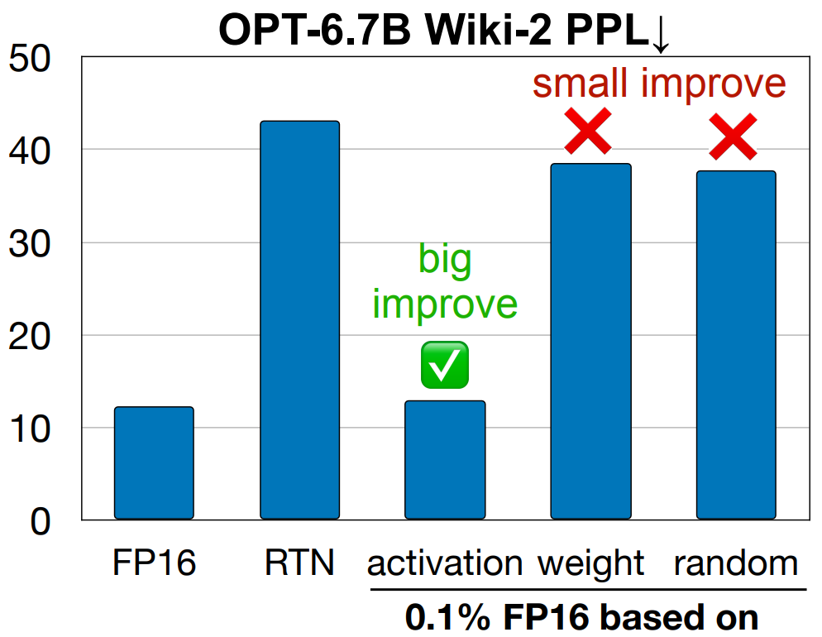
Part 1. Quantization
The authors of AWQ found that weights are not equally important, keeping only 0.1% of salient weight channels in FP16 can greatly improve perplexity.
Salient weights are determined by activation distribution, not weight.
Notes:
They key thought of AWQ is that: weights are not equally important.
By selectively preserving 0.1% of the weights when quantizing, we can achieve barely the same accuracy as the original model.
The criterion（重音在后） to judge the importance of the weights is their activation distribution rather than the weights themselves.

Slide 6
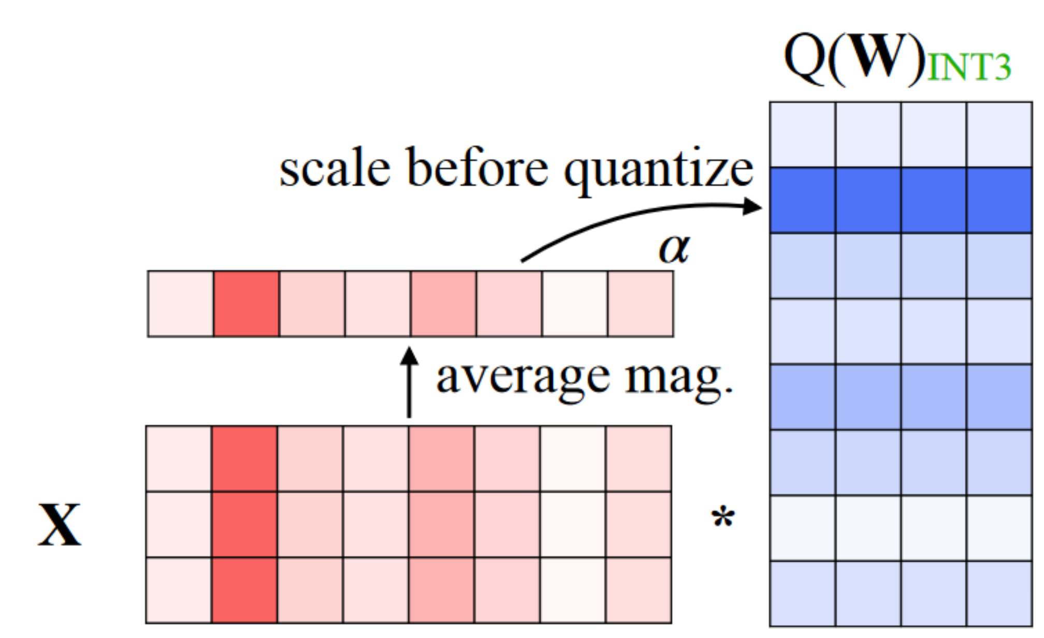
Part 1. Quantization
To avoid the hardware-inefficient mixed-precision implementation, scale up the salient channels can reduce their relative quantization error.
Notes:
However, if we preserve the 0.1% parameters as fp16, the model will be in mixed precision, which will lower computational efficiency.
So, we have to convert these 0.1% parameters also to lower-bit integers. To mitigate（重音在前） the loss in this process, we consider scaling up the 0.1% parameters before quantization.

Slide 7
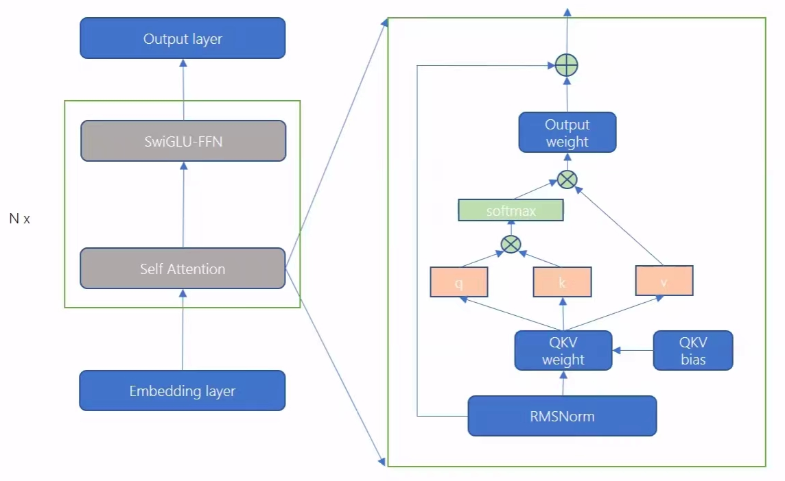
Part 1. Quantization
In order to be compatible with the inference backend llama.cpp, we just apply the scales from AWQ to the model weights and still store them in floating point format.
Scale on Qwen model:
QKV weight: Scale up to reduce the accuracy loss caused by subsequent low-bit quantization.
RMSNorm weight: Scale down to maintain the invariance of the computation. (Won’t be quantized.)
Notes:
This part demonstrates the details of how we implement AWQ on Qwen.
To be specific, we scale up the QKV weights to reduce the expected round loss.
Correspondingly, as compensation（重音在后）, we scale down the RMSNorm weights to maintain computational invariance. Since RMSNorm weights are not quantized, this does not result in accuracy loss.

Slide 8
Part 1. Quantization
Quantization pipeline:
preliminary round
Qwen Model
(safetensors)
Accuracy ↑
Throughput ↓
Latency ↑
Memory ↑
Quantized Model
(Q4_K_M, gguf)
AWQ Scale
Scaled Model
(fp16, safetensors)
Compare
Llama.cpp Convert
final round
Accuracy ↓
Throughput ↑
Latency ↓
Memory ↓
Scaled Model
(fp16, gguf)
Llama.cpp
Quantize
Quantized Model
(Q4_0, gguf)
Notes:
Here, we present the pipeline of our quantization scheme.
First, we apply AWQ to the original Qwen and get the scaled fp16 model in safetensors. Next, we convert safetensors to GGUF. Finally, we apply the built-in quantization methods of llama.cpp to the model.
Here,
In the preliminary round, we use q4km quantization to get better accuracy.
In the final round, we adopted q40 quantization to further boost inference speed, while also ensuring the compatibility（重音在前） with our subsequent adjustment of llama.cpp.

Slide 9

Part 2. llama.cpp
Llama.cpp:
Llama.cpp implements Meta’s LLaMa architecture in an efficient C/C++ manner.
Features:
Llama.cpp is designed as a C++ backend, which features lower complexity and can be seamlessly integrated into other programming environments.
Llama.cpp is operable on numerous platforms, offering support for the AVX, AVX2, and AVX512 instruction sets on x86 architectures.
llama.cpp supports 2-bit, 3-bit, 4-bit, 5-bit, 6-bit, and 8-bit integer quantization.
Code: https://github.com/ggerganov/llama.cpp
Notes:
In both the preliminary and final round, we adopt llama.cpp as the backend, which is based on C++.
llama.cpp enjoys two adorable chraceristics.
First, it uses C++ library to accelerate the inference speed on CPU
Second, it has remarkable flexibility in supporting multiple platforms, models, and strategies.
Particularly, a lot of efforts have been done to optimize its performance on arm platform, which is the reason why we choose it.

Slide 10
Part 2. llama.cpp
Preliminary round
Implementation 1:
Transform the SIMD computation component within the original llama.cpp from NEON instruction set to SVE(Scalable Vector Extensions) instruction set.
Feature | Benefit
Scalable vector length (VL) | Increased parallelism while allowing implementation choice of VL
Gather-load & Scatter-store | Enables vectorization of complex data structures with non-linear access patterns
…… | ……
Notes:
In the preliminary round, our adjustment is relatively simple.
Firstly, we modified SIMD mapping in llama.cpp. We replaced the parts that use ARM Neon instructions（无sets） with ARM SVE instructions, boosting the inference runtime efficiency of the model to some extent.
Compared to NEON, SVE enjoys many benefits.
First, it allows for variable-length vector operations, which support better leverage vector parallelism and enables vectorization of complex data structures with non-linear access patterns, which significantly improves its flexibility.
Besides, it introduces a larger register file that can accommodate more vector data that help enhance parallel computing capabilities by operating on larger datasets at once.

Slide 11
Part 2. llama.cpp
Preliminary round
Qwen-7B optimum-benchmark test result:
NEON Vs SVE
SIMD | Latency(s) | Throughput(samples/s)
NEON | 2.7 | 0.37
SVE | 1.56 | 0.641
Notes:
Here is a comparison of NEON and SVE in the preliminary round.
As you can see, this replacement significantly improves the inference efficiency.

Slide 12
Part 2. llama.cpp
Preliminary round
Implementation 2:
Integrate ‘llama-cpp-python’ into ‘optimum-benchmark’ and ‘lm-eval’.
Benefit:
This Python binding of llama.cpp provides a user-friendly interface, making it simpler for developers to modify and optimize benchmark scripts.
lm-eval
llama-cpp-python
llama.cpp
optimum-benchmark
Llama-cpp-python: https://github.com/abetlen/llama-cpp-python
Notes:
Additionally, another measure we took in the preliminary round is to use llama-cpp-python,
which allows us to use llama.cpp in the form of a Python API when implementing（重音在前） the backends of lm-eval and optimum-benchmark.
However, we decide to abandon this scheme in the final round, the reason will be discussed in the next session.

Slide 13
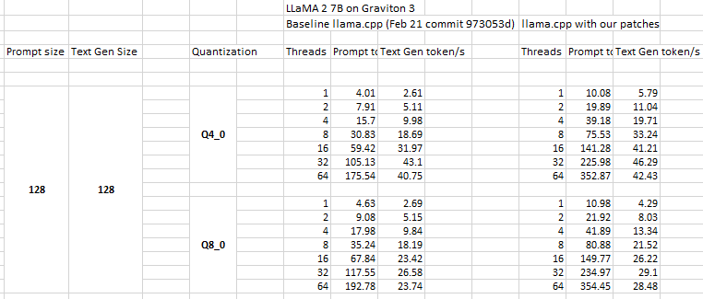
Part 2. llama.cpp
The final round
Implementation 1:
Rearrange tensor weights during the model loading phase.
The newly arranged weights are designed to facilitate the use of SIMD instructions within both the ARM NEON and ARM SVE instruction sets for performing matrix and vector operations. This adjustment has significantly improved inference efficiency.
PR链接：https://github.com/ggerganov/llama.cpp/pull/5780/
Comparison on LLaMa2 7B
Notes:
In the final round, we tried numerous methods to further boost the efficiency, such as Prompt lookup decoding and pruning, but none of them resulted in noticeable improvement in practice.
However, through research, we eventually discovered a weight rearrangement solution that significantly improved our inference performance. This scheme comes from pull request 5780 in llama.cpp.
To be specific, during the model loading phase, the tensors of the model are rearranged into contiguous（重音在后） space to decouple the matrix multiplication and vector multiplication operations of the tensors.
To do this, it is necessary to redesign the corresponding functions for matrix multiplication (which is gemm) and vector multiplication(which is gemv), utilizing ARM Compute Library's SIMD instructions to efficiently operate on the rearranged memory.
To be short, the purpose of rearranging is to make the memory compatible with the computation process.

Slide 14
Part 2. llama.cpp
The final round
Implementation 2:
Align the thread count with the number of physical cores.
threads < physical cores | Not all physical cores are utilized, leading to underutilization of the available processing ability.
threads > physical cores | Threads compete for CPU time, which leads to frequent context switching incurring performance costs.
threads = physical cores | Ensures each core is utilized optimally and each thread runs on a dedicated core, minimizing unnecessary context switches and cache usage inefficiencies.
Notes:
We also tried various runtime options of llama.cpp and found that the inference efficiency only showed significant changes when adjusting the number of threads.
Therefore, we conducted experiments by varying the number of threads from 1 to 12 and ultimately chose 8 which is the same as the number of physical cores.
Below is a explanation why this number is the best.
When the thread number is less than the physical cores, Not all physical cores are used, meaning that we don’t release the full power of CPU.
On the contrary, when it exceeds the number of physical cores, threads will compete for CPU time, leading to frequent context switching, introducing additional costs.

Slide 15
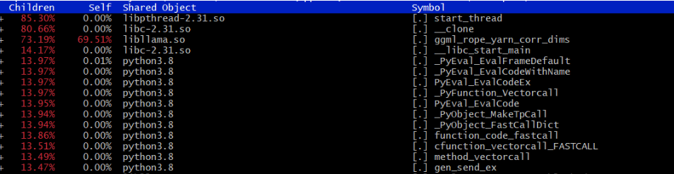
Part 2. llama.cpp
The final round
Implementation 3:
Optimize calculation bottleneck according to the analysis of ‘perf’.
Bottleneck 1: q6_k type exists after Q4_0 quantization
Quantize output tensor weight to Q4_0 rather than Q6_K in original setting.
Bottleneck 2: ‘logf’ operation
Estimating logf using log2, and reduce the number of required logf operations from 4 to 3.
Notes:
What’s mora, we used perf to investigate the time-consuming proportion during the inference process.
We found when we used Q4_0 quantization, there still remained a portion of Q6_k data to ensure model accuracy.
Through experiments, we discovered that replacing all these Q6_k data with Q4_0 only resulted in a slight decrease in accuracy, but it allowed this data to undergo the weight rearrangement and benefit from faster gemm and gemv operations. Therefore, we convert this part of Q6_k data also to Q4_0.
In addition, we also identified another function ‘ggml_rope_yarn_corr_dims’ which involves a lot of logf operation that requires a lot of time. To alleviate（重音在后） this burden, we attempted to reduce the number of logf operations and estimate logf by log2. These optimizations further boosted the efficiency.

Slide 16
Part 2. llama.cpp
The final round
Implementation 4:
Directly invoke the compiled ‘./main’ file from the llama.cpp.
This change enables a more precise measurement of prefill and decode throughput, ensuring that performance assessments were grounded in the actual capabilities of the software.
Avoid the time consumption caused by other irrelevant operations.
Notes:
As mentioned earlier, in the final round, we abandoned the use of llama-cpp-python because we discovered that the way llama-cpp-python generates inference results is by using Python iterators to generate tokens one by one, which will slow down our decoding throughput.
However, if we directly called the main program generated by llama.cpp, the decode throughput can increase from 40 tokens per second to 70 tokens per second as we measured.

Slide 17
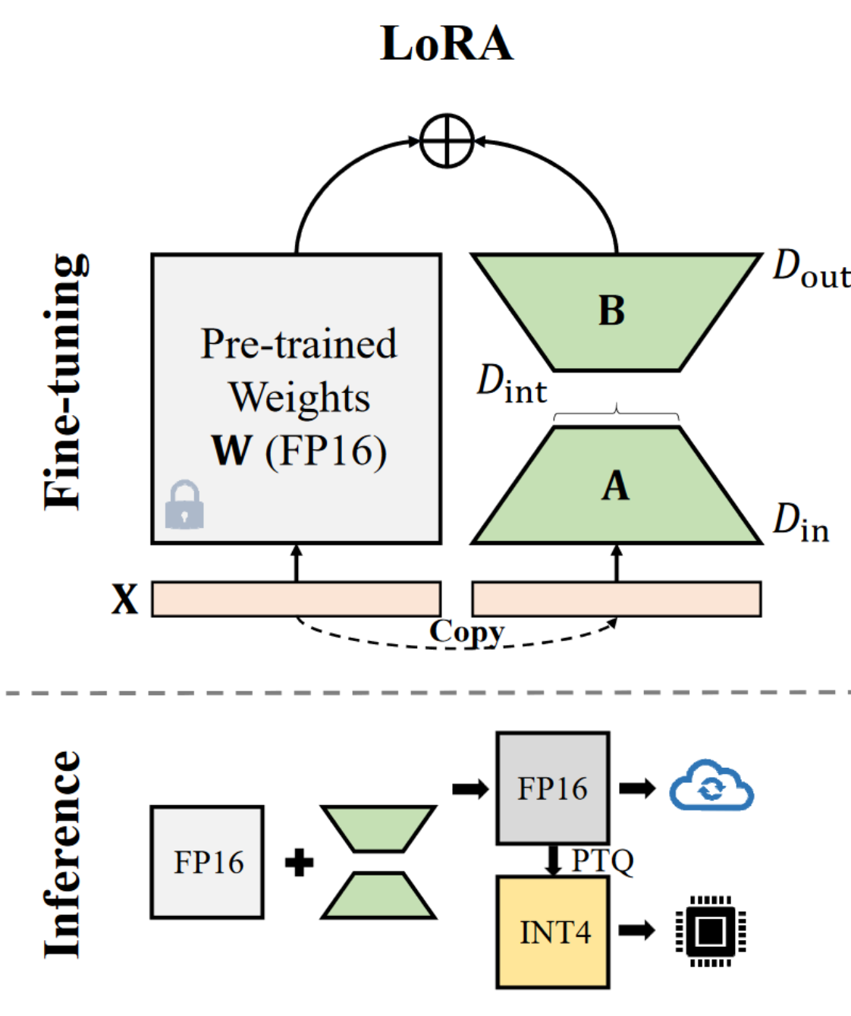
Part 3. Fine-tuning
Fine-tuning can transfer the knowledge from pre-trained models to fit the desired downstream application domain.
Fine-tuning can also be used for recovering the model performance after pruning or quantization(RFT, recovery fine-tuning).
Full Fine Tuning is resource-expensive.
PEFT
Notes:
To further improve the model performance and fit the desired domain, we adopted fine-tuning technique.
We also use fine-tuning to recover the model performance when we try pruning.
We adopt Lora which only trains a low rank adaption rather than the original full rank parameter matrix, which can significantly save memory and training time.

Slide 18
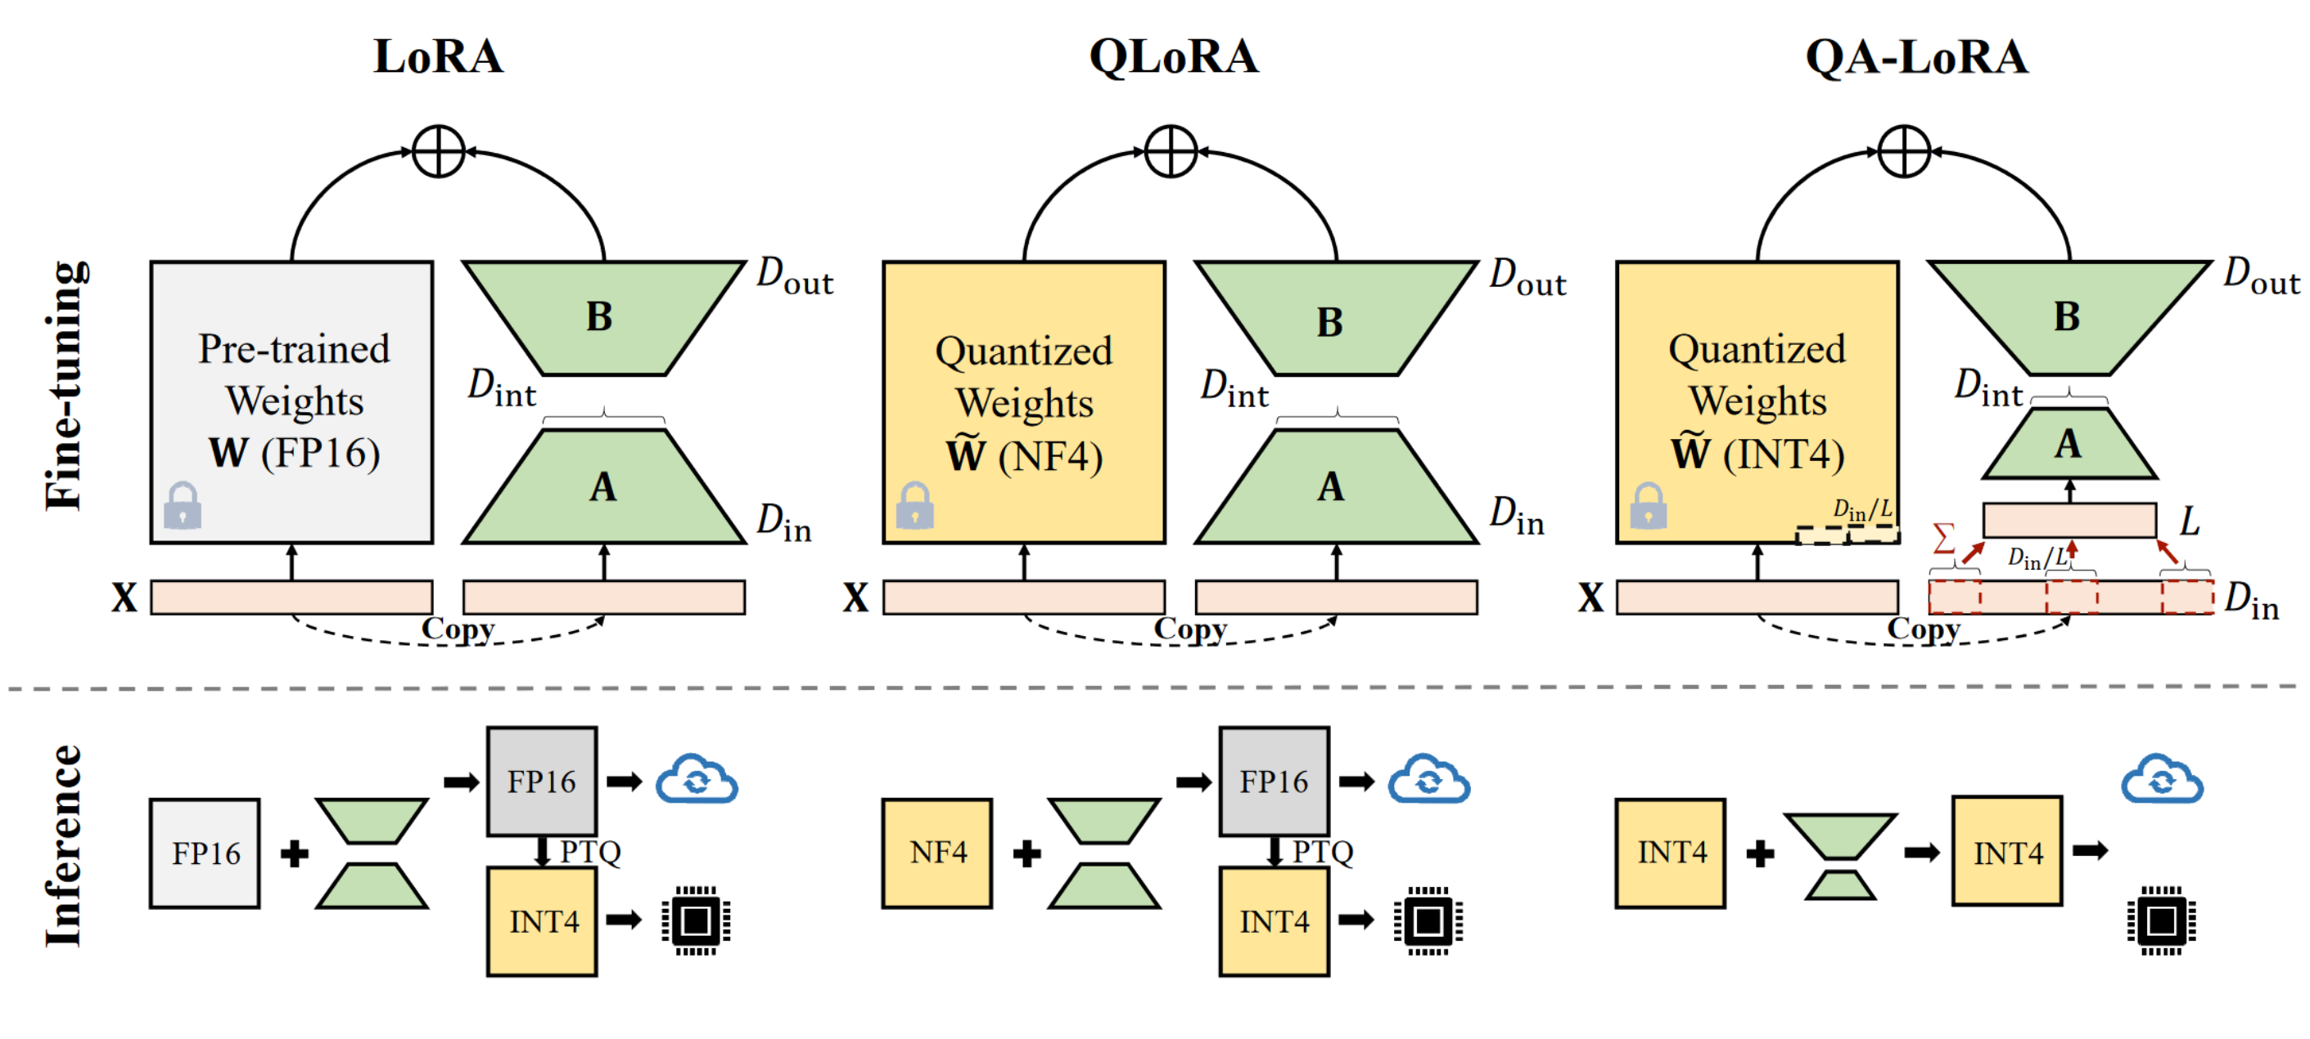
Part 3. Fine-tuning
We adopt ‘llama-factory’ to fine-tune the model with Lora.
LoRA Finetuning on Alpaca-gpt4 and UltraChat can slightly improve the model performance.
LoRA | Acc (Piqa)
Baseline | 73.1
Finetuning | ~73.8
Follow-up Work
Acc without quantization
Notes:
In practice, We adopt llama-factory as the tool to fine-tune the model with Lora.
We tried a lot of fine-tuning datasets and found that Alpaca-gpt4 and UltraChat can slightly improve the model’s accuracy, while other datasets can even cause the accuracy to deteriorate. We attribute this to the dataset scale.
We also tried some follow-up works such as qlora and qalora which further improve the performance.
However, due to the limitation of time, we haven’t yet integrate them into llama.cpp and we leave these adaptions to further works.

Slide 19
Final Round Comparison
The final round
Final test result :
*Baseline: Test Qwen-1.8B on YiTian 710 CPU with pytorch.
 | Acc ( piqa ) | Max_rss | Max_vms | Prifill_ throughput | Decode_ throughput
Baseline | 73.12 | 10627.37 | 12228.18 | 86.79 | 2.07
Our solution | 72.31 | 3230.56 | 3569.94 | 282.65 | 72.14
Notes:
And here is the comparison between the baseline and our implementation in the final round.

Slide 20
failed but promising attempts
Attempts
Replace the NEON instruction set with the SVE instruction in the final stage of
competition
Rearrange the tensor weights during the quantization stage and reduce the memory size that needed to be saved after the rearrangement
Prune the model
···
Notes:
Here are some methods that we tried but ultimately failed.
Replacing NEON with SVE in the preliminary round greatly boosted the inference speed, but in the final round we didn’t observe the same improvement, even though we used the same compiler and identical code as that in the preliminary round. We tried other compilers but still couldn't achieve the desired results. At the moment, we can only attribute this phenomenon to hardware difference.
Currently, the memory rearrangement technique we implemented still requires ‘retaining’ both the original and rearranged memory simultaneously（重音在后）, which brings a certain level of memory pressure. According to the author, the rearrangement can be performed during the quantization phase. But limited by time, we were unable to complete it before the deadline.
We also made numerous attempts at pruning, but unfortunately, unstructured pruning did not reduce memory consumption to a large extent. On the other hand, structured pruning resulted in huge loss even with recovery fine-tuning. Therefore, we ultimately decided not to use the pruned version of the model.

Slide 21
Conclusion
Our quantization strategy successfully minimized model size and computational requirements without degrading accuracy.
Our extensive work on llama.cpp has culminated in substantial improvements in inference efficiency. By integrating advanced instruction sets and optimizing tensor operations, we have maximized the utilization of hardware capabilities.
Our fine-tuning practices refine the models’ accuracy on specific tasks, with strategic adjustments to model parameters and training methods.
Notes:
To conclude,
Our quantization strategy successfully minimized model size and computational requirements without degrading accuracy.
Our adjustment on llama.cpp achieves substantial improvements in inference efficiency. By integrating SVE instruction sets and optimizing tensor operations, we have maximized the utilization of hardware capabilities.
Our fine-tuning practices refine the models’ accuracy on specific domains.

Slide 22
References
[1] Tim Dettmers et al. “QLoRA: Efficient Finetuning of Quantized LLMs”. In: Advances in Neural Information Processing Systems. Ed. by A. Oh et al. Vol. 36. Curran Associates, Inc., 2023, pp. 10088–10115. URL: https : / / proceedings . neurips . cc / paper files / paper / 2023 / file / 1feb87871436031bdc0f2beaa62a049b - Paper Conference.pdf.
[2] Ning Ding et al. Enhancing Chat Language Models by Scaling High-quality Instructional Conversations. 2023. arXiv: 2305.14233 [cs.CL].
[3] Elias Frantar et al. “GPTQ: Accurate Post-training Compression for Generative Pretrained Transformers”. In: arXiv preprint arXiv:2210.17323 (2022).
[4] Edward J. Hu et al. “LoRA: Low-Rank Adaptation of Large Language Models”. In: CoRR abs/2106.09685 (2021). arXiv: 2106.09685. URL: https://arxiv.org/abs/ 2106.09685.
[5] Ji Lin et al. “AWQ: Activation-aware Weight Quantization for LLM Compression and Acceleration”. In: arXiv (2023).
[6] Baolin Peng et al. Instruction Tuning with GPT-4. 2023. arXiv: 2304.03277 [cs.CL].
[7] Yuhui Xu et al. QA-LoRA: Quantization-Aware LowRank Adaptation of Large Language Models. 2023. arXiv: 2309.14717 [cs.LG].
[8] Yaowei Zheng et al. LlamaFactory: Unified Efficient Fine-Tuning of 100+ Language Models. 2024. arXiv: 2403.13372 [cs.CL].

Slide 23
Q&A
Notes:
The last part is Question and Answering.
If you have questions, please feel free to raise them, and I will invite my teammates to answer their part.

