Slide 1

Optimization of Armv9 architecture general large language model inference performance based on Llama.cpp
Longhao Chen
CEATRG, Hangzhou Dianzi University
2024 IEEE International Conference on Artificial Intelligence Circuits and Systems

Slide 2
Outline
Background
Compiler
SIMD (Single Instruction Multiple Data)
Exchanging space for time
Evaluate

Slide 3
Background
The growth rate of model parameters far outpacing the improvement in hardware performance.
The loss of accuracy caused by 8-bit quantization is negligible.
Each processor upgrade will add some instruction sets. New instruction set requires new compiler.

Slide 4
Compiler part
Use the latest compiler
Use more compiler optimizations
Use -Ofast parameter
Enable Link Time Optimization (LTO)
Specify processor architecture

Slide 5
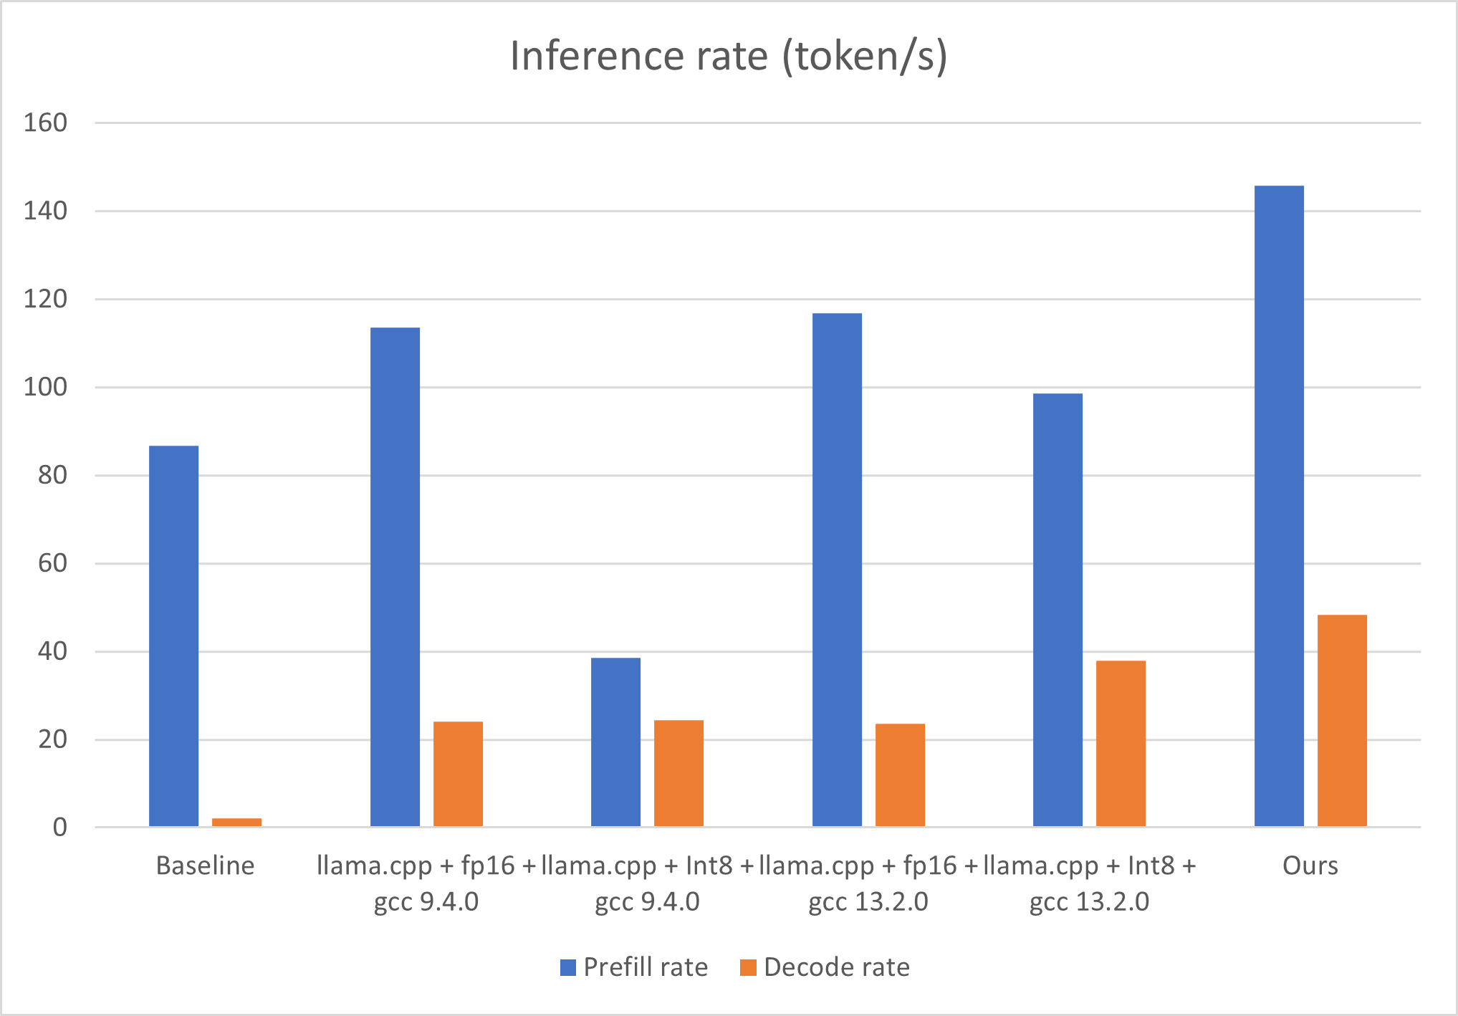
GCC 13.2.0: __ARM_FEATURE_MATMUL_INT8
vmmlaq_s32 instruction

Slide 6
SIMD (Single Instruction Multiple Data)
A single instruction is simultaneously applied to multiple different data streams. Instructions can be executed sequentially, such as by pipelining, or in parallel by multiple functional units.
Neon technology is a packed SIMD architecture.
For simple functions, the compiler's Auto-vectorization can already generate high-performance NEON instructions, but complex functions require manual writing of NEON instructions.

Slide 7
SIMD (Single Instruction Multiple Data)
So we rewrote this functions:
ggml_fp16_to_fp32_row,
ggml_fp32_to_fp16_row,
ggml_compute_forward_norm_f32,
ggml_compute_forward_rms_norm_f32,
ggml_compute_fp16_to_fp32

Slide 8
Exchanging space for time
The 8-bit quantization of llama.cpp treats 32 data as a group by defa-ult, and each group uses the same scaling factor. This scaling factor is saved as a uint16_t type.
In each calculation, the corresponding scaling coefficient needs to be converted into data types, which will take up part of the time.

Slide 9
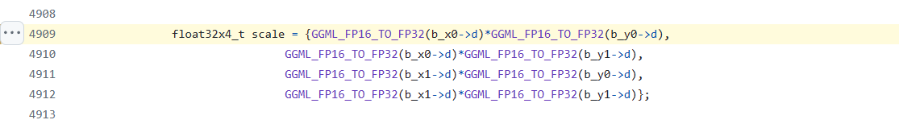
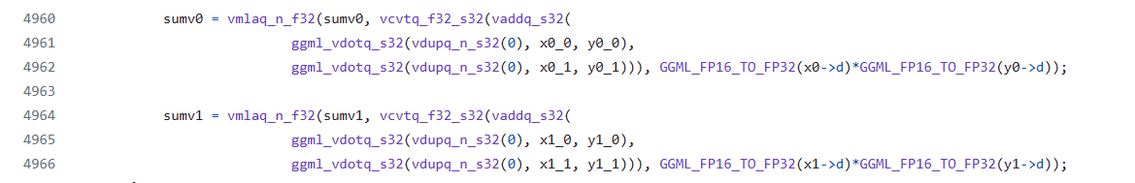
Exchanging space for time
https://github.com/ggerganov/llama.cpp/blob/master/ggml-quants.c#L4909
https://github.com/ggerganov/llama.cpp/blob/master/ggml-quants.c#L4960

Slide 10
Exchanging space for time
use the float32 type to save the scaling factor
From float16_t to float32_t, the memory usage will increase 5.88%
(32+4)/(32+2)=36/34=1.0558

Slide 11
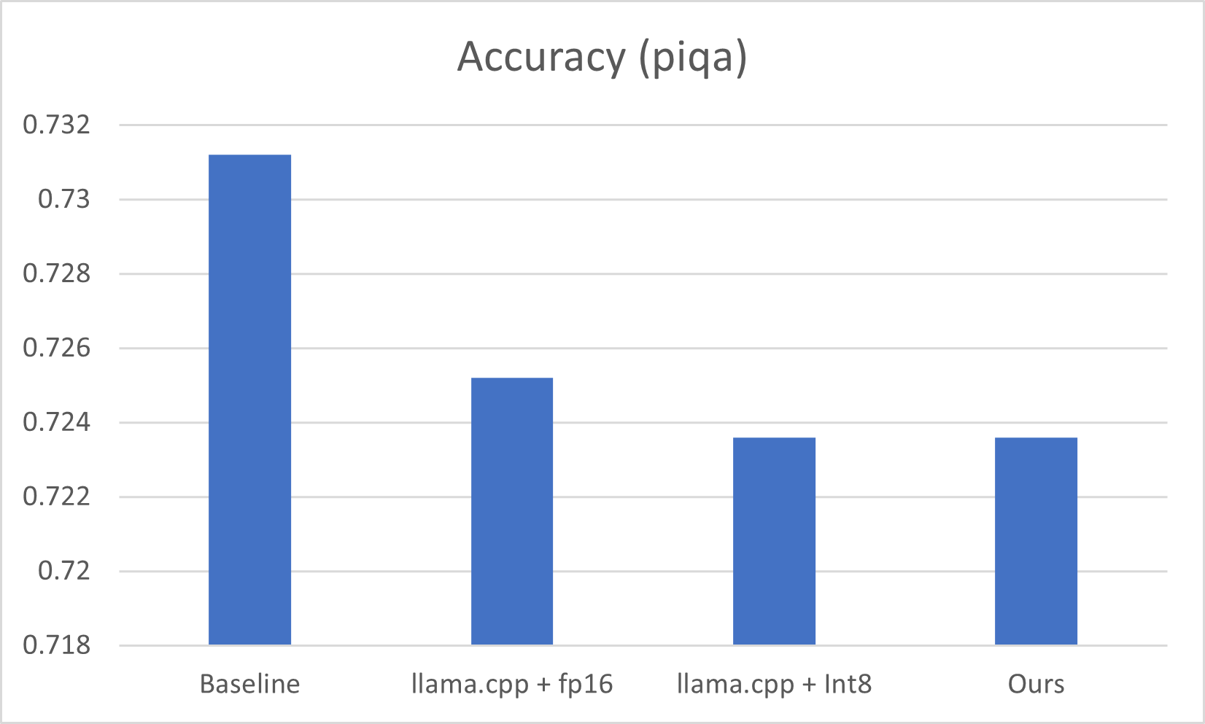
Evaluate: Accuracy
Our accuracy loss is only 1.04% compared to the original model.

Slide 12
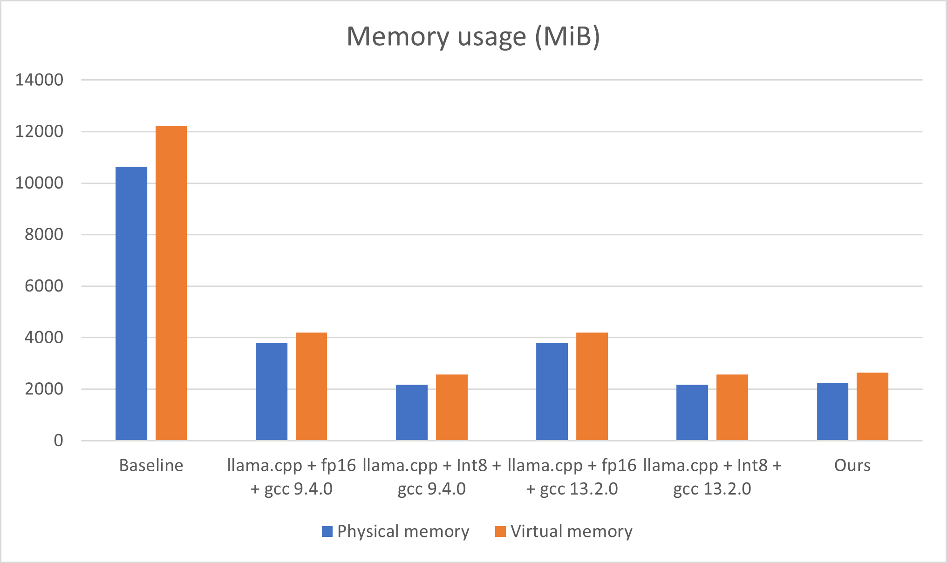
Evaluate: Memory
Compared with Baseline, physical memory usage is reduced by 78.82%.
And compared with the original Int8 type, the physical memory usage only increases by 3.88%.

Slide 13
Evaluate: Inference rate
Compared with Baseline, the prefill performance is increased by 160%
the decoding performance is increased by 2400%.

Slide 14
Thank you for listening

