Slide 1


Software and hardware collaborative optimization of Qwen large language model for ARM CPU
Xingyu Zhu, Pengcheng Yang, Tingjie Yang, Jialong Wang
Xidian University of China
2024 IEEE International Conference on Artificial Intelligence Circuits and Systems
Notes:
Ladies and Gentlemen,
It is an honor to speak at the 2024 IEEE International Conference on Artificial Intelligence Circuits and Systems.My name is Xingyu Zhu, and I am here with my team from Post-Moore Al Chip Team
of Xidian University. Today, I will be presenting our research on 'Software and Hardware Collaborative Optimization of the Qwen Large Language Model for ARM CPU.'
Our presentation will delve into the intricacies of optimizing large language models, specifically the Qwen model, for efficient performance on ARM CPU.

Slide 2
Outline
Background
Model compression
Inference backend
Operator optimization
Result and Evaluation
The End
Notes:
My speech is divided into six parts. Firstly, it introduces the importance of large language model in natural language processing, the problems and solutions of large language model, and then introduces our optimization methods: model compression, inference backend substitution, operator optimization, and finally shows our optimization effect.

Slide 3
Background
Large Language Models
Natural Language Processing has undergone different paradigm changes.
Rule-based Approaches.
Statistical Approaches.
Language model, Word vector
Machine Learning Approaches.
Support Vector Machine (SVM),Decision Tree, Naive Bayes.
Deep Learning Approaches.
Recurrent Neural Network (RNN), Long Term Memory Network (LSTM)
Pre-trained Models.
Large Language Models (LLMs) have demonstrated remarkable performance across a wide domain of Natural Language Processing tasks.
Notes:
Natural Language Processing is a cornerstone of artificial intelligence that focuses on the interaction between computers and humans through natural language. The goal of NLP is to enable computers to understand, interpret, and generate human language in a valuable way.
Natural Language Processing (NLP) has seen a series of paradigmatic shifts over time, evolving from rule-based approaches through statistical methods, machine learning algorithms like Support Vector Machines (SVMs), Decision Trees, and Naive Bayes, to deep learning architectures such as Recurrent Neural Networks (RNNs) and Long Short-Term Memory (LSTM) networks. The advent of pre-trained models, particularly LLMs, has revolutionized NLP performance across a vast array of tasks.

Slide 4
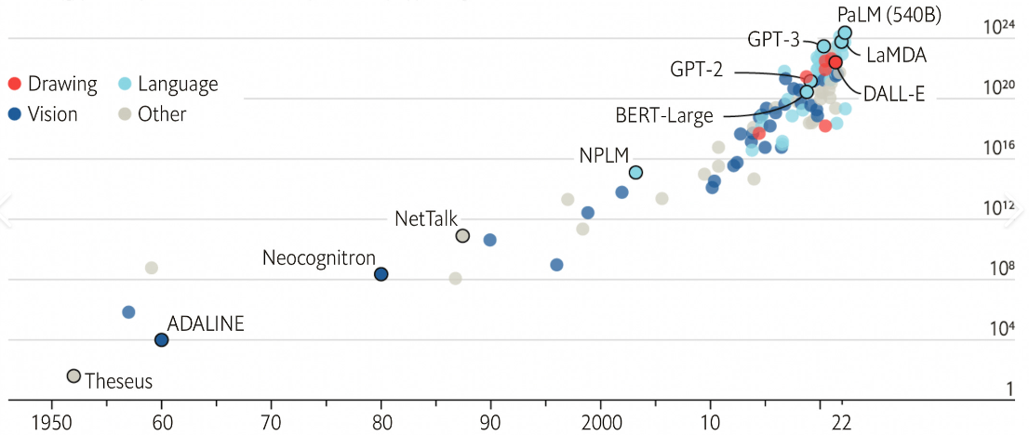
Background
Problems
Problems associated with Large Language Models (LLMs) .
Billions to tens of billions of model parameters.
The corresponding hardware performance evolves slowly. It is challenging to deploy to edge-side inference.
Inference latency is relatively high on CPUs.
Notes:
Large Language Models (LLMs) are at the forefront of the NLP field, driving progress in machine understanding of text with their vast networks capable of billions of parameters. These models leverage deep learning technology to process and generate text in ways that are contextually and grammatically coherent.
However, these models come with their own set of challenges, including billions to tens of billions of parameters, slow hardware advancements, difficulties in deploying them to resource-constrained edge devices and inference latency remains relatively high when executed on CPUs.
Our research aims to tackle these issues head-on, optimizing both the software algorithms and the hardware utilization to make LLMs practical for wide deployment, especially in resource-constrained environments like mobile phones and embedded systems.

Slide 5


Background
Solution
The solution to the problems.
Using quantization to reduce memory usage.
Utilizing CPUs based on the Arm architecture.
Accelerating inference through the optimization of critical operators.
Notes:
Our work proposes a comprehensive solution to these issues by employing quantization techniques to significantly reduce memory usage, accelerating inference through the optimization of crucial operators and Activation-Aware Weight Quantization (AWQ) combined with the innovative GGUF quantization.
These strategies are complemented by significant improvements in matrix operation algorithms, especially General Matrix-Matrix Multiplication (GEMM) and General Matrix-Vector Multiplication (GEMV), which are critical for the performance of Large Language Models.

Slide 6
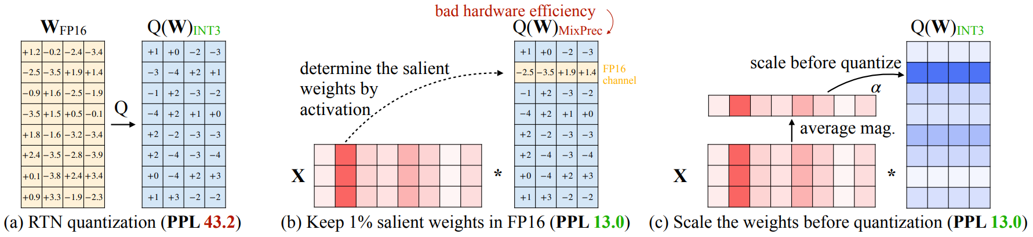
Model compression
Activation-aware Weight Quantization
Improving LLM quantization by retaining only 1% of the most significant weights.
Not all weights are equally important.
Protecting significant weights through activation-aware scaling.
Scaling based on heuristic rules.
Searching for scaling factors.
Notes:
AWQ improves Large Language Model quantization by retaining only the top 1% of the most significant weights, acknowledging that not all weights contribute equally to model performance. We protect these vital weights through activation-aware scaling, which adjusts the scaling factors based on heuristic rules and a meticulous search for optimal values. This approach ensures that the precision of the model is preserved while entirely reducing memory footprint.
By implementing AWQ, we ensure that the optimized model is not only smaller and faster but also retains its effectiveness, making it ideally suited for deployment on ARM CPUs.

Slide 7
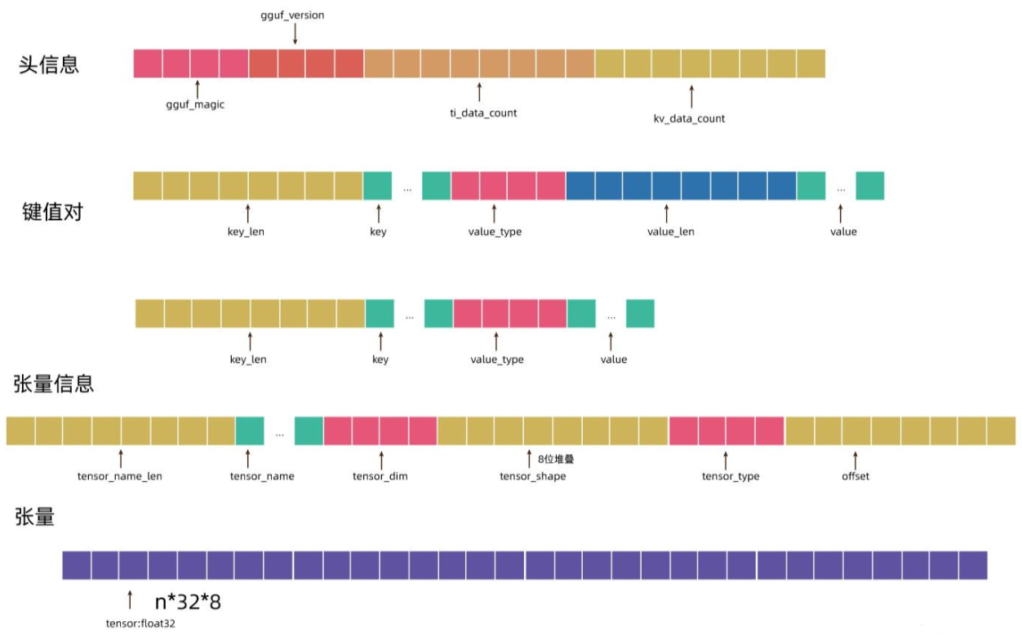
Model compression
GGUF Quantization
The converted GGUF format loads quickly and consumes fewer resources.
GGUF employs multiple techniques to store the training outcomes of large models.
Compact binary encoding format.
Optimized data structures.
Memory mapping.
Notes:
The converted GGUF format offers several advantages. It loads rapidly and consumes fewer resources due to its compact binary encoding, optimized data structures, and memory mapping strategies.

Slide 8
Model compression
Quantization effect
The memory usage of the 4-bit model was reduced by approximately 88%, while that of the 8-bit model decreased by around 82%.
The throughput exhibits no appreciable variations.
The precision shows no discernible decline.
Notes:
As a result, we observe a dramatic reduction in memory usage. For instance, the memory usage of a 4-bit model is diminished by approximately 88%, while that of an 8-bit model drops by around 82%. Impressively, this aggressive quantization does not compromise throughput or precision.

Slide 9

Inference backend
LLama.cpp
Plain C/C++ implementation without any dependencies.
Enable LLM inference with minimal setup and state-of-the-art performance on a wide variety of hardware.
Offers a variety of quantization options.
Notes:
We also introduce the inference backend LLama.cpp, a lightweight and dependency-free C/C++ implementation that facilitates seamless LLM inference across diverse hardware platforms. LLama.cpp not only simplifies setup but also delivers state-of-the-art performance, offering a range of quantization options to cater to varying computational requirements and resource constraints.

Slide 10
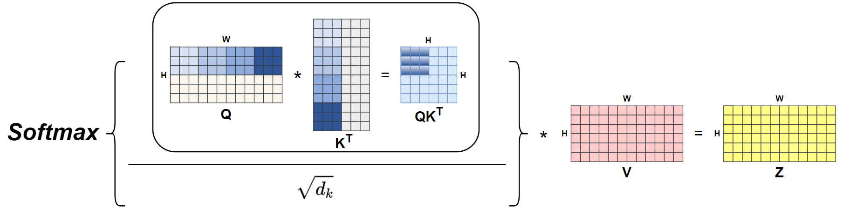
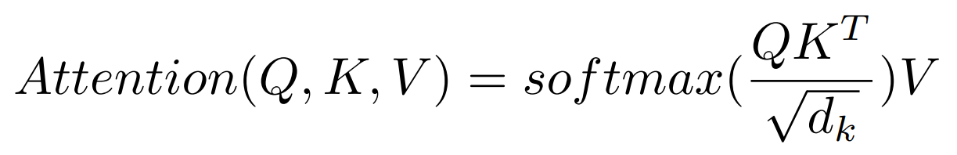
Operator optimization
GEMM Optimization
LLMs contain a substantial amount of matrix operations.
An efficient matrix multiplication kernel has an immeasurable impact.
The following is a diagram illustrating attention matrix multiplication.
Notes:
Focusing on the computational bottlenecks within LLMs, we undertake the optimization of General Matrix-Matrix Multiplication (GEMM) and General Matrix-Vector Multiplication (GEMV) operations. GEMM, being a prevalent operation in LLMs, particularly in the context of attention mechanisms, can greatly influence overall model efficiency. We implement optimized matrix multiplication kernels, as depicted in the accompanying diagram, which have an immense impact on performance.

Slide 11
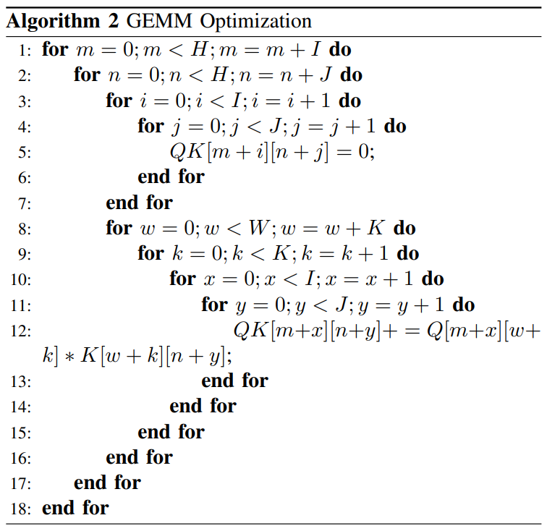
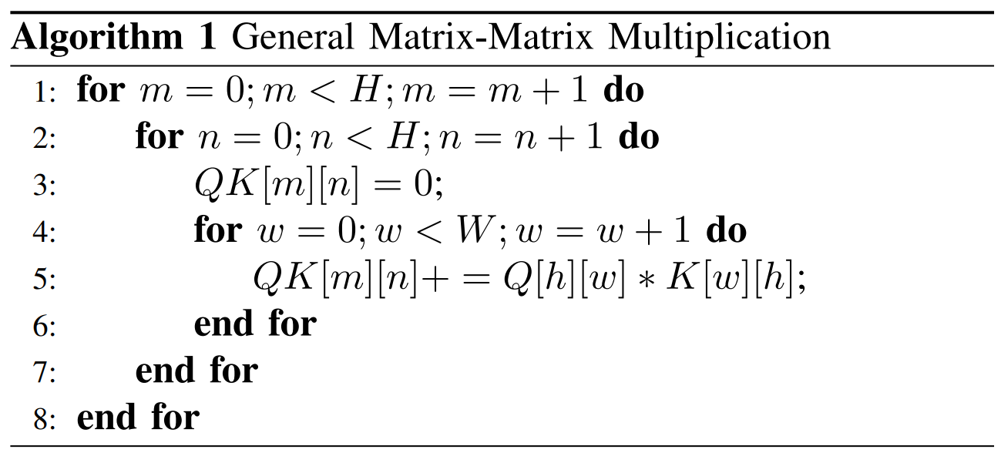
Operator optimization
GEMM Optimization
The following is an example of matrix multiplication optimization code.
Notes:
The following is an example of matrix multiplication optimization code.
When I and J are sufficiently large, the memory access count can be halved compared to the original. If the I times J submatrices within the QKT matrix are themselves stored as temporary variables, the number of memory accesses to the QKT matrix reduces from 2 times H times squared W to H times W, which is negligible relative to H * W. When I = J = Nopt, the resulting speedup factor is 2 times I.

Slide 12
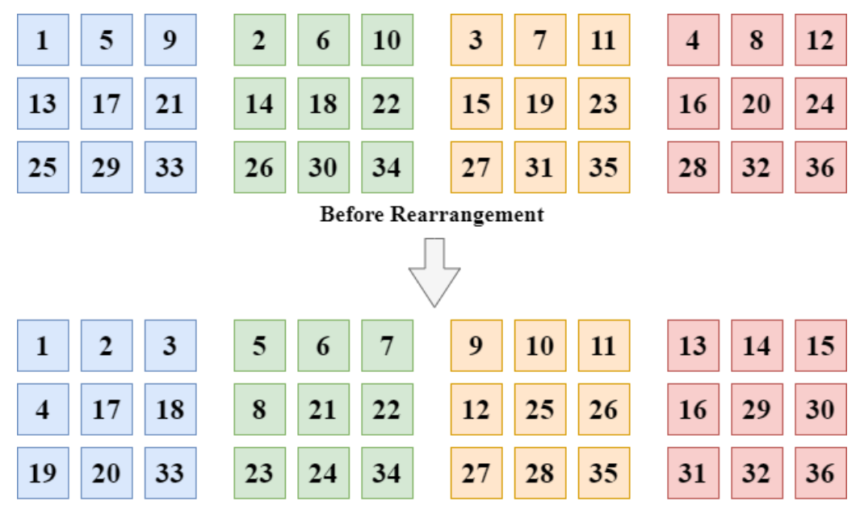
Operator optimization
GEMV Optimization
GEMV significantly influences model inference throughput during decode phase.
Weight rearrangement into contiguous memory is required to enable sdot to accelerate GEMV kernel.
Notes:
GEMV, crucial during the decode phase, necessitates weight rearrangement into contiguous memory to leverage accelerated dot product functions like 'sdot.' By optimizing the GEMV kernel, we unlock substantial speedups in the decode phase, contributing to an overall reduction in inference latency.

Slide 13
Result and Evaluation
Optimization effect
After GEMM kernel optimization, the prefill phase exhibited a 5.4x and 3.5x speedup.
After GEMV kernel optimization, the decode phase demonstrated a 1.5x and 1.1x speedup.
The final results for the INT4 and INT8 exhibited a 3.1x and 3.5x improvement in prefill phase throughput.
The decode phase demonstrated a 15.9x and 13.3x improvement in throughput.
Notes:
Our results demonstrate the efficacy of these optimizations. After optimizing the GEMM kernel, we witness a substantial speedup of 5.4x and 3.51x in the prefill phase. Similarly, following GEMV kernel optimization, the decode phase exhibits a noteworthy speedup of 1.50x and 1.11x. The final results for the INT4 and INT8 exhibited a 3.1x and 3.5x improvement in prefill phase throughput.
The decode phase demonstrated a 15.9x and 13.3x improvement in throughput.

Slide 14
Result and Evaluation
Optimization effect
The figure shows the ratio of memory usage optimization of various methods compared with the original model.
The graph on the right shows the throughput optimization multiples of various optimization methods compared with the original model.
Notes:
The figure on the left shows the ratio of memory usage optimization of various methods compared with the original model.
The graph on the right shows the throughput optimization multiples of various optimization methods compared with the original model.

Slide 15
Result and Evaluation
Optimization effect
The graph on the left shows the memory usage of the original model and various optimization methods.
The graph on the right shows the throughput of the original model and various optimization methods.
Notes:
The graph on the left shows the memory usage of the original model and various optimization methods.
The graph on the right shows the throughput of the original model and various optimization methods.
In conclusion, our research presents a approach to overcoming the challenges associated with large language models, by combining advanced quantization techniques, hardware-aware optimization, and Inference backends optimization. We have successfully demonstrated that the QianWen model, when optimized for ARM CPUs using our methods, can achieve substantial reductions in memory usage without compromising performance. This work paves the way for wider adoption of LLMs on resource-constrained edge devices, closing the gap between domestic and international advancements in large model technology.

Slide 16
The End
Thanks
Notes:
Thank you for your attention, and we look forward to engaging in further discussions about our findings and their implications for the future of AI and NLP.

