Slide 1
BBC micro:bit - Using the REPL
Steve Case

Slide 2
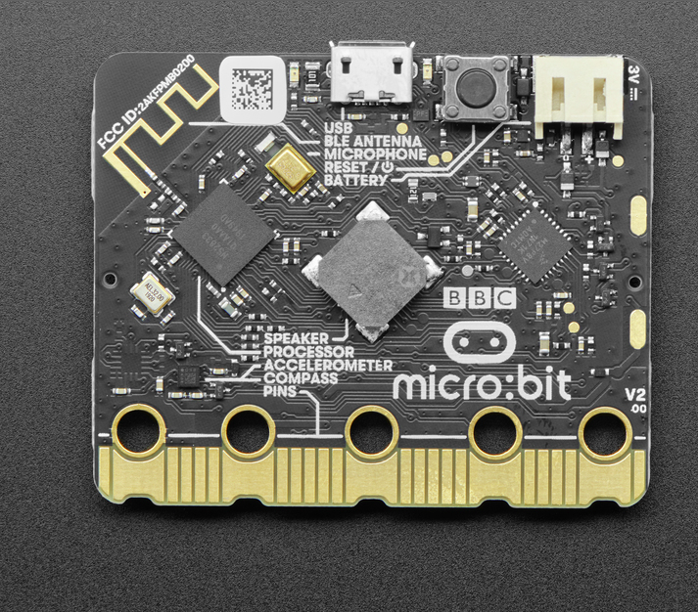
BBC micro:bit v2 Development Board

Slide 3
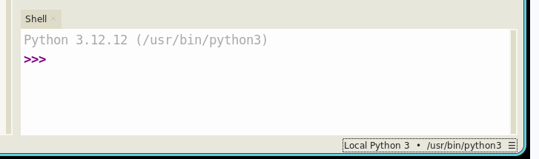
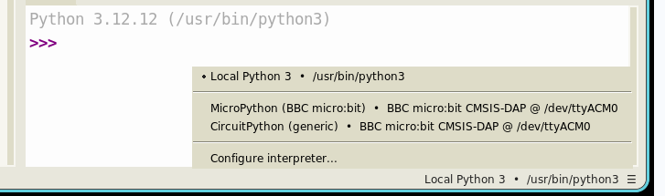
BBC micro:bit Change to connect to micro:bit
Notes:
This is the editor that we suggest students use for editing their work. It has syntax checking and code-completion to make things a bit easier.
For online work in groups, we’ll use the bbc:microbit editor.

Slide 4
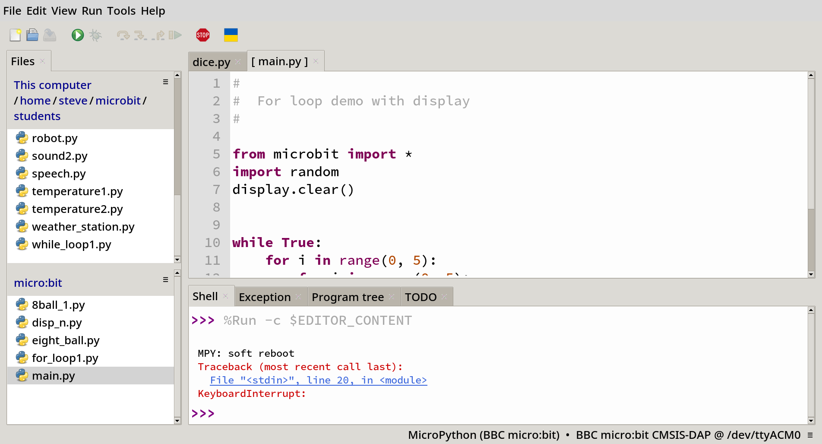
BBC micro:bit REPL is here >>>
Notes:
This is the editor that we suggest students use for editing their work. It has syntax checking and code-completion to make things a bit easier.
For online work in groups, we’ll use the bbc:microbit editor.

Slide 5
BBC micro:bit Thonny Python Editor
Program tabs
REPL
Notes:
This is the editor that we suggest students use for editing their work. It has syntax checking and code-completion to make things a bit easier.
For online work in groups, we’ll use the bbc:microbit editor.

Slide 6
REPL
REPL pronounced “rep-l” stands for
READ
EVALUATE
PRINT
LOOP
The REPL is used to communicate like a command-line to the Python interpreter.
We use it as a short-cut to test code pieces quickly before we start writing a program.

Slide 7
REPL
Explore:
Type 'help(something)' to find out about it. Type 'dir(something)' to see what
it can do. Type 'dir()' to see what stuff is available. For goodness sake,
don't type 'import this'.
Control commands:
CTRL-C -- stop a running program
CTRL-D -- on a blank line, do a soft reset of the micro:bit
CTRL-E -- enter paste mode, turning off auto-indent
For a list of available modules, type help('modules')
For more information about Python, visit: http://python.org/
To find out about MicroPython, visit: http://micropython.org/
Python/micro:bit documentation is here: https://microbit-micropython.readthedocs.io/
>>>

Slide 8
REPL
>>> help()
Welcome to MicroPython on the micro:bit!
Try these commands:
from microbit import *
display.scroll('Hello')
running_time()
sleep(1000)
button_a.is_pressed()
HINT: use the up and down arrow keys to get your command history.
Press the TAB key to auto-complete unfinished words
(so 'di' becomes 'display' after you press TAB).

Slide 9
Python Basics in the REPL- Variables
>>> i = 1
>>> print(i)
1
>>> j = 2.
>>> print(j)
2.0
>>> name = “Coco”
>>> print(name)
Coco
In this case, i is an integer. Think of integers as counting numbers.
In this case, j is an floating point number. Think of it as a number with a fractional part.
In this case, name is a string of collected characters.

Slide 10

Python Basics in the REPL- Libraries
Libraries are collections of programs written by others, that make things easier to duplicate.
A library can hold either one or many routines that we call by name inside them.
When we want to use a library, we need to “check it out” and bring it into our program.
Display
LED’s
Buttons

Slide 11
Python Basics in the REPL- Libraries
>>> from microbit import *
>>> display.scroll(“Hi you!”)
>>> import microbit
>>> microbit.display.scroll(“Hi you!”)
music
speach
microbit
display
>>> from microbit import display
>>> microbit.display.scroll(“Hi you!”)

Slide 12
Images - import microbit, dir(Image)
'HOUSE', 'MEH', 'MUSIC_CROTCHET', 'MUSIC_QUAVER', 'MUSIC_QUAVERS', 'NO', 'PACMAN', 'PITCHFORK', 'RABBIT', 'ROLLERSKATE', 'SAD', 'SCISSORS', 'SILLY', 'SKULL', 'SMILE', 'SNAKE', 'SQUARE',‘SQUARE_SMALL''STICKFIGURE', 'SURPRISED', 'SWORD', 'TARGET', 'TORTOISE', 'TRIANGLE', 'TRIANGLE_LEFT', 'TSHIRT', 'UMBRELLA', 'XMAS', 'YES',
'ALL_ARROWS', 'ALL_CLOCKS', 'ANGRY', 'ARROW_E', 'ARROW_N', 'ARROW_NE', 'ARROW_NW', 'ARROW_S', 'ARROW_SE', 'ARROW_SW', 'ARROW_W', 'ASLEEP', 'BUTTERFLY', 'CHESSBOARD', 'CLOCK1', 'CLOCK10', 'CLOCK11', 'CLOCK12', '
CLOCK2', 'CLOCK3', 'CLOCK4', CLOCK5', 'CLOCK6', CLOCK7', 'CLOCK8', CLOCK9',
'CONFUSED', 'COW', 'DIAMOND', 'DIAMOND_SMALL', 'DUCK', 'FABULOUS', 'GHOST', 'GIRAFFE', 'HAPPY', 'HEART', 'HEART_SMALL',

Slide 13
Music - import music, dir(music)
'BADDY', 'BA_DING', 'BIRTHDAY', 'BLUES', 'CHASE', 'DADADADUM', 'ENTERTAINER', 'FUNERAL', 'FUNK', 'JUMP_DOWN', 'JUMP_UP', 'NYAN', 'ODE', 'POWER_DOWN', 'POWER_UP', 'PRELUDE', 'PUNCHLINE', 'PYTHON', 'RINGTONE', 'WAWAWAWAA', 'WEDDING', 'get_tempo

Slide 14
What’s Happening?
>>> from microbit import *
>>> display.scroll(“Hi you!”)
STORAGE
(random)
(microbit)
(music)
CPU
>>> import microbit
>>> microbit.display.scroll(“Hi you!”)
RAM
Find out what’s inside of a library.
>>> dir()
>>> import music
>>> dir(music)

Slide 15
Anatomy of micro:bit python program
# For-Loop 1
#
# s.case 10/26/20
#
#
# Bring in the libraries that you need
from microbit import *
# Execute loop 5 times
for i in range(5):
display.show(Image.HAPPY)
sleep(500)
display.clear()
sleep(500)
Comments
Libraries
Running program

Slide 16
Thonny Editor for Python
Controls
Programs on tabs
Editing area

Slide 17
Reference Material
BBC micro:bit www.microbit.org
IEEE Course Material & Programs
https://github.com/IEEE-BV/microbit
Thonny-Editor Installation:
https://thonny.org/
Python:
Micro Python documentation for micro:bit
https://microbit-micropython.readthedocs.io/en/v2-docs/#
Other References:
https://www.w3schools.com/python/default.asp
https://www.python.org/ (advanced full reference for Python)
https://wiki.python.org/moin/BeginnersGuide (still pretty advanced)
Adafruit Industries: www.adafruit.com
Sparkfun electronics: www.sparkfun.com

